Slide 1
New resilient cropping systems in Europe
M. G. Sessa¹, F. Zanetti ¹, B. Alberghini¹, A. M. Jeromela², D. Rajković², A. Monti¹
¹DISTAL, Alma Mater Studiorium, Università di Bologna, Bologna, Italy
²Institute of Field and Vegetable Crops, National Institute of the Republic of Serbia, 21000 Novi Sad, Serbia

Slide 2
THE SCENARIO
Europe mostly relies on few primary cropping systems. The lack of crop diversification makes crops more exposed to climate change risks.
The European bioeconomy sector generates an annual turnover of around 2 trillion euros with > 17 M employees
>15% of current biomass feedstock used by the EU bioeconomy sector are imported.
There is an urgent need to develop sound innovative farming systems for the provision of domestic low-iLUC feedstock replacing fallow period of the year or in marginal/degraded soils.
Crop diversification can be an effective strategy to enhance the overall sustainability of farming systems, while restoring soil fertility and agrobiodiversity.

Slide 3
The CARINA project
CARINA will capitalize on an experienced and competent team of 19 partners (+5 affiliates farmers’ cooperatives) located in EU or Associated Countries.
The CARINA consortium includes: research organizations/institutes, universities, SMEs, companies, farmers’ cooperatives, NGO, and farming consultants.
CARINA started in November 2022 and will last 48 months.
CARINA identified two emerging easy-to-grow oilseed crops, camelina (Camelina sativa L. Crantz) and carinata (Brassica carinata L. Brown), as the most feasible options for integrating them in the current farming systems.
Both species proved to be suited to nearly all European pedo-climatic conditions.

Slide 4
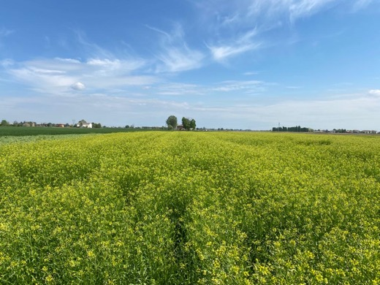
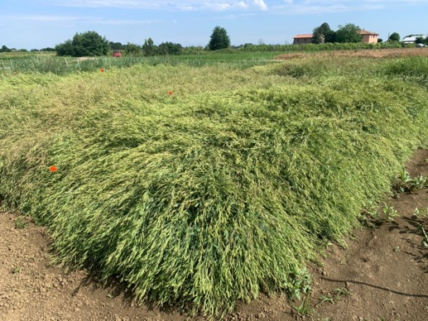
Camelina sativa (L. Crantz)
Brassica carinata (A. Braun)
Annual oilseed crop: Brassicaceae
Seed production: 1.5-3.0 Mg DM ha⁻¹
Oil content: 26-49%
Protein content: 24-32%
Annual oilseed crop: Brassicaceae
Seed production: 1.4-2.4 Mg DM ha⁻¹
Oil content: 35-52%
Protein content: 19-28%

Slide 5
AIM OF THE STUDY
To investigate camelina as a winter cash-cover crop preceding typical food spring/summer crops, such as sunflower and sorghum.
To evaluate carinata included in relay-, inter- cropping systems with typical autumn/winter food crops, such as chickpea and barley.

Slide 6
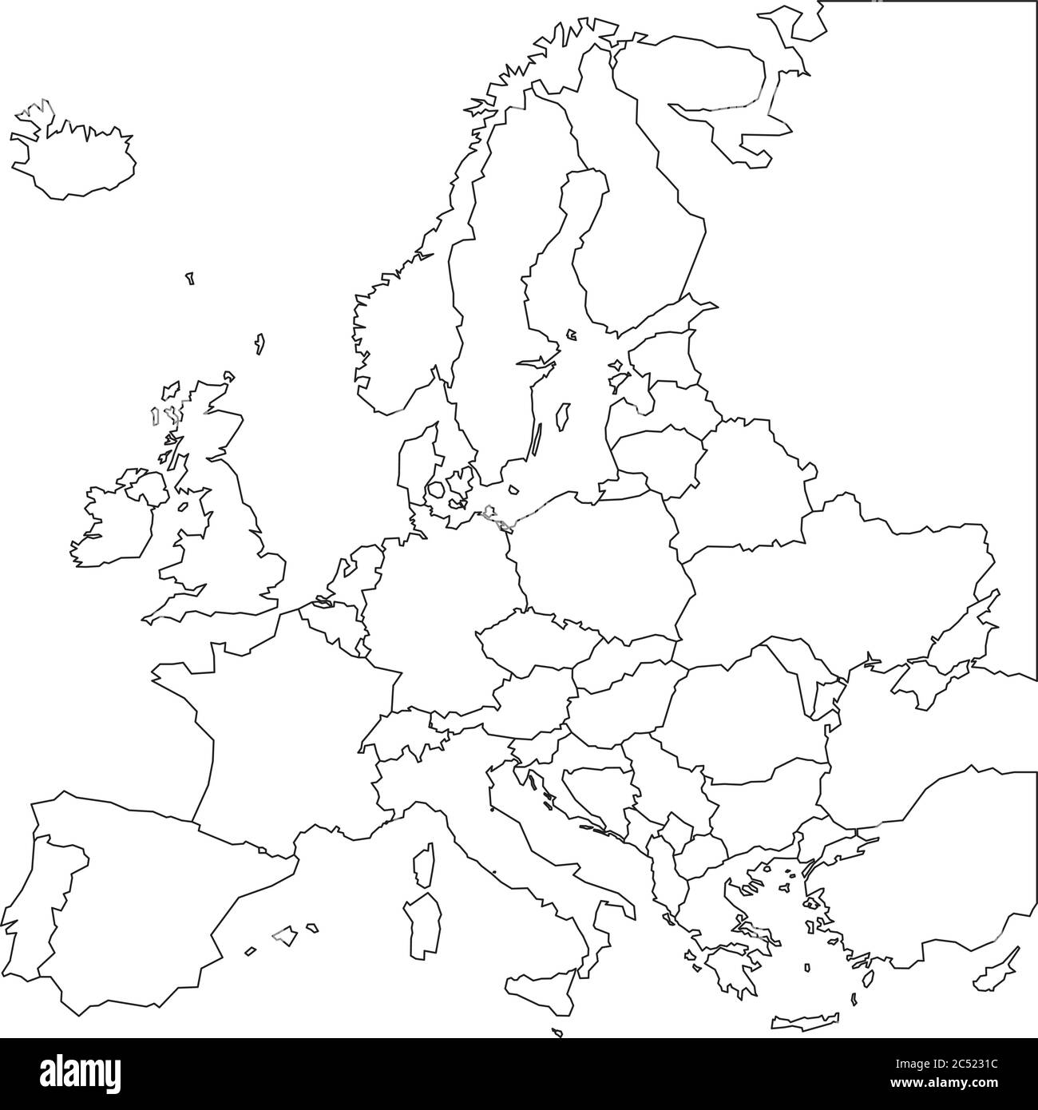
EXPERIMENTAL LAYOUT
3 different cropping systems:
1) DOUBLE CROPPING
2) RELAY-CROPPING
3) INTERCROPPING
Sowing
Date
Growing
Season
{
Camelina
Sorghum
Sunflower
Autumn /Spring
2022-2023
Spring/Summer
{
Carinata
Barley
Spring
2023-2024
Autumn
{
Carinata
Chickpea
Spring
2024
Rimski Šančevi, Novi Sad (Serbia)
45°20′N, 19°51′E
Cadriano, Bologna (Italy)
44°33′N, 11°23′E

Slide 7
DOUBLE CROPPING SYSTEM
Experimental layout
S | O | N | D | J | F | M | A | M | J | J | A
SCENARIO 1
FALLOW
BUSINESS AS USUAL
PELARGONIC ACID APPLICATION
SCENARIO 2
when camelina seed residual moisture ~36%
CASH COVER CROP
FOOD CROPS

Slide 8
RELAY-CROPPING SYSTEM
INTERCROPPING SYSTEM
Experimental layout
SOLE-BARLEY
SOLE-CHICKPEA
BARLEY + CARINATA
CHICKPEA + CARINATA
SOLE-CARINATA
SOLE-CARINATA

Slide 9
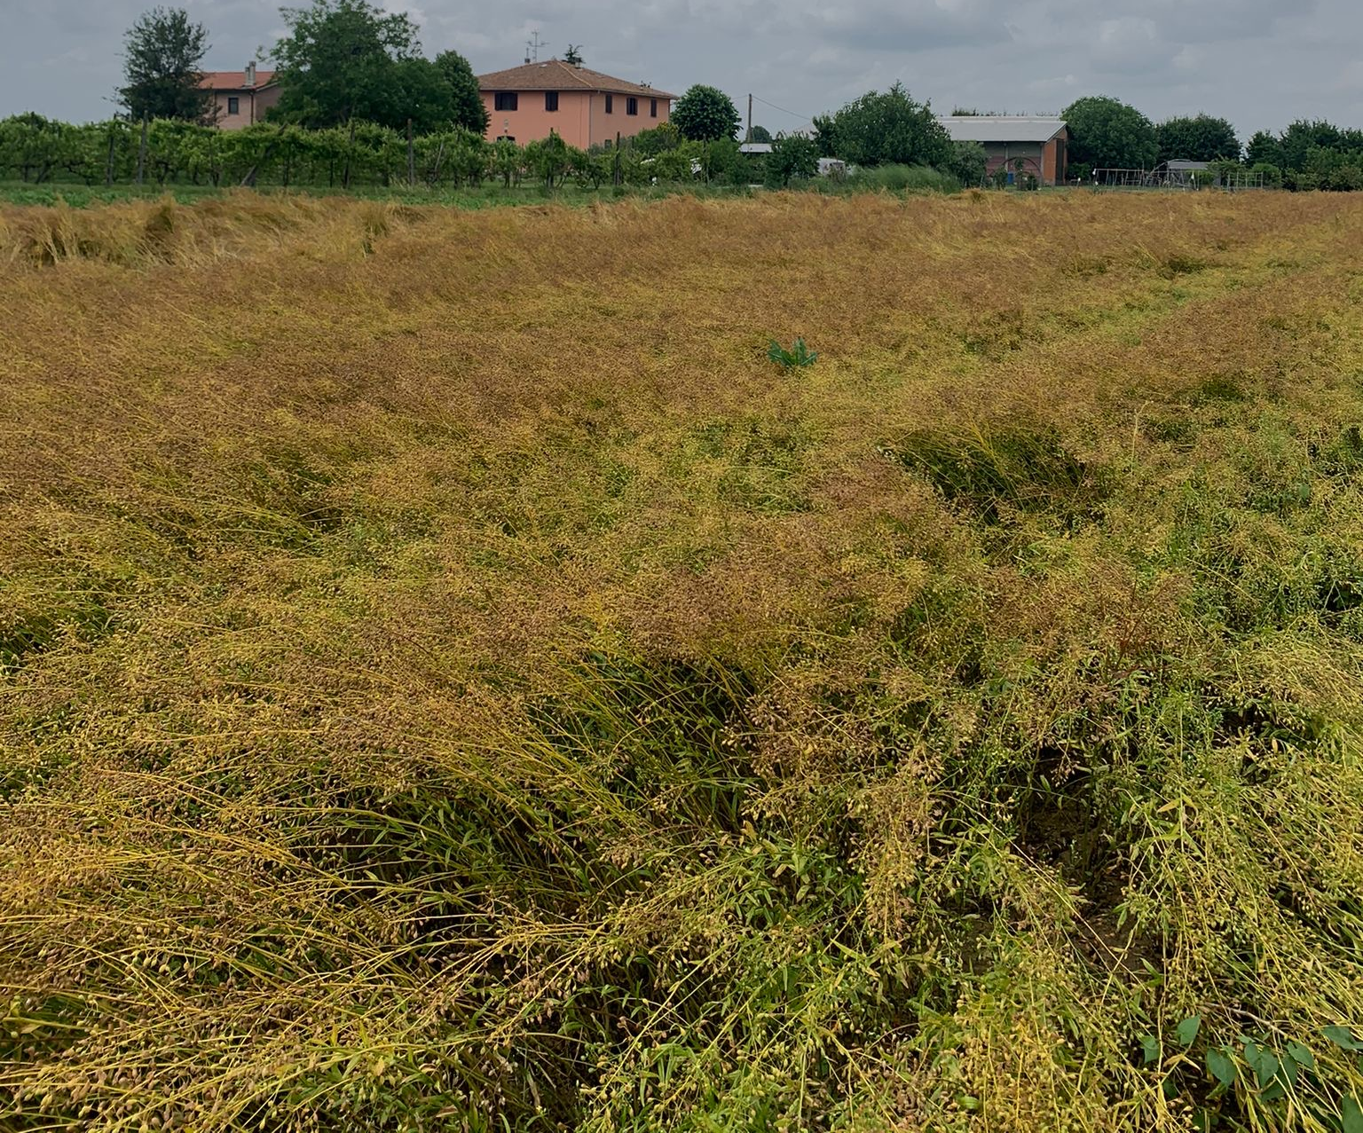
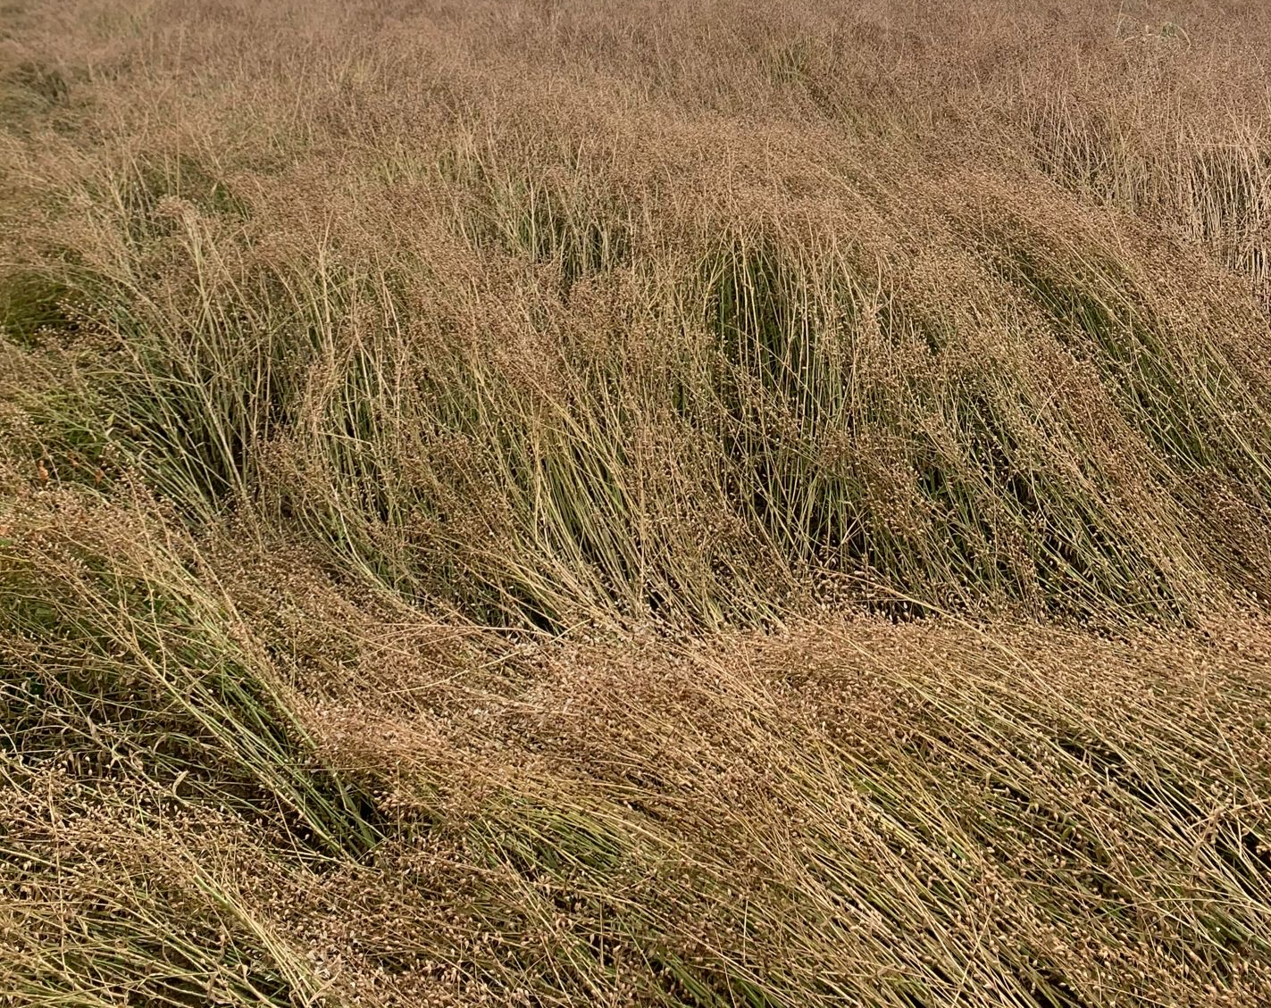
RESULTS – DOUBLE CROPPING (CAMELINA, ITALY)
Camelina sprayed with pelargonic acid was harvested 25 d earlier
Camelina before pelargonic acid application
Camelina after 6h from pelargonic acid application

Slide 10
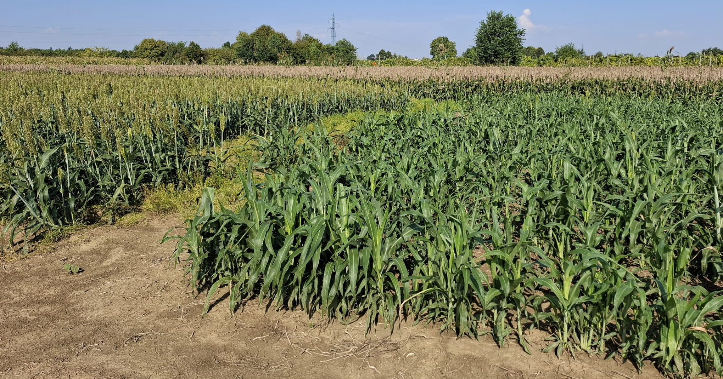
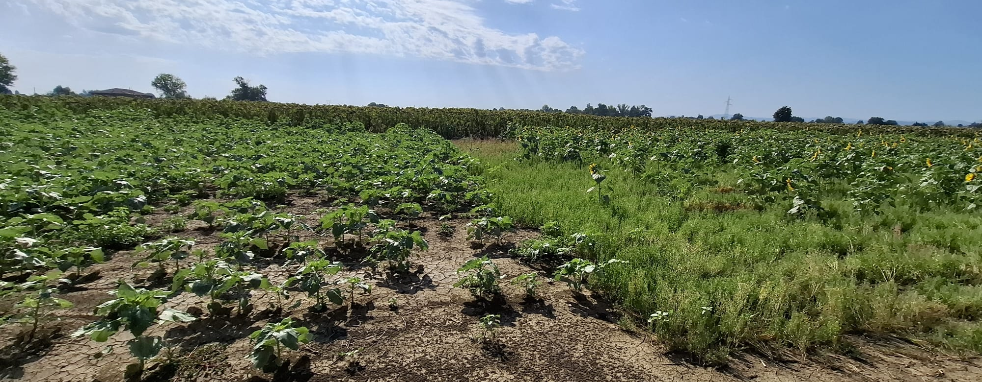
RESULTS - DOUBLE CROPPING (FOOD CROPS – ITALY)
SORGHUM
SUNFLOWER

Slide 11
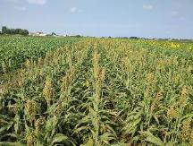
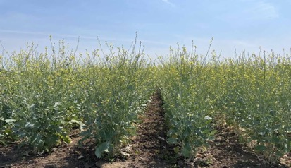
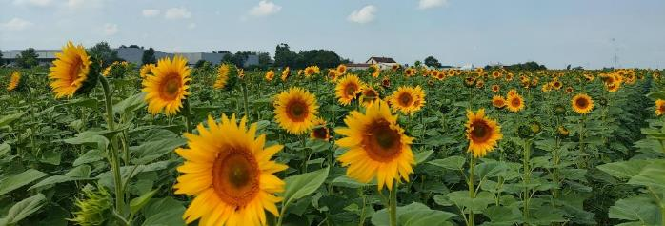
RESULTS - DOUBLE CROPPING (CAMELINA/FOOD CROPS – SERBIA)
CASH COVER CROP
The crops were hit by two high intensity storms
FOOD CROPS

Slide 12
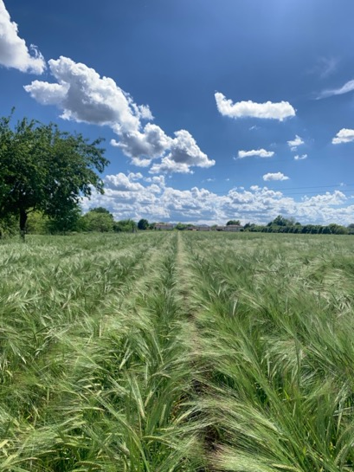
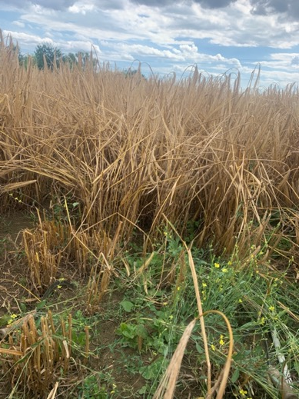
RESULTS – RELAY CROPPING CARINATA (ITALY/SERBIA)
MAIN PROBLEMS
⎡
At both sites, barley plants were too tall and shadowed carinata ones.
Carinata suffered by the lack of precipitation after sowing.
The seeding rate was not adequate to ensure good carinata growth, which was suffocated by barley canopy.
⎦

Slide 13
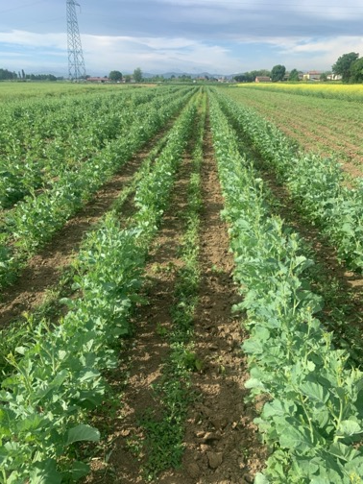
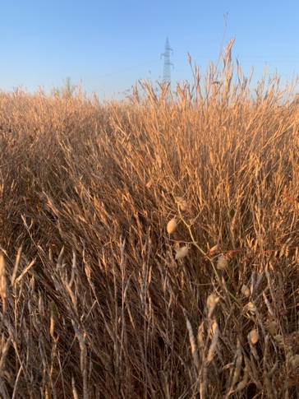
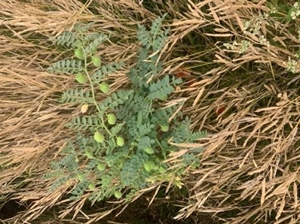
RESULTS – INTERCROPPING CARINATA (ITALY – SERBIA)
MAIN PROBLEMS
⎡
Birds caused severe damages to chickpea. Plant establishment was not optimal.
High weed pressure on intercropping trials; no herbicides selective for both crops.
⎦

Slide 14
CONCLUSIONS
Camelina is a feasible option in double-cropping systems in both Serbia and Italy, preceding the establishment of typical summer crops, e.g. sorghum or sunflower.
In Italy, the application of pelargonic acid permitted to anticipate camelina harvest and, consequently, summer crop establishment. This represent a good example of circularity since pelargonic acid is derived from vegetable oils.
In Italy, carinata is suitable for both autumn and spring sowing and demonstrates its resiliency, despite the attack of some pests in spring time (e.g., flea beetle, pollen beetle, cabbage weevil).
It is necessary to identify the correct neighbouring model for the inter-/relay-cropping systems.
It could be possible to test new inter-, relay-cropping systems with other food crops.

Slide 15
mariagiovanna.sessa2@unibo.it

