Slide 1
The importance of understanding and examining the moral dimensions of farmers‘ economic life for their culture of cooperation
M. Slovenc Grasselli
Research Centre of the Slovenian Academy of Sciences and Arts

Slide 2
Rural co-operation
Political and scientific solutions for the economic, social and ecological sustainability of European agriculture.
A common research question: „Why do farmers not work together despite obvious advantages?“
The focus is on the social (the problem of trust and different values) and above all on the economic dimension of agriculture.

Slide 3
Moral dimensions of rural co-operation
They are under-researched.
The concept of moral economy: does not reject people's economic motivations, but emphasises the importance of moral sentiments and norms for people‘s economic lives (Thompson, 1963, 1993; Scott, 1976; Sayer, 2000, 2011).
Historical contextualisation of emic evaluations of duties, rights and expectations of different groups of people.

Slide 4
Research questions
How do farmers evaluate past and present practises of cooperation in relation to their ideas of a life worth living?
To whom do farmers attribute responsibility for the emergence, continuation and failure of different forms of cooperation?
Do farmers perceive collaborative relationships as legitimate when it comes to assessing the fairness and fulfilment of duty of those involved?

Slide 5
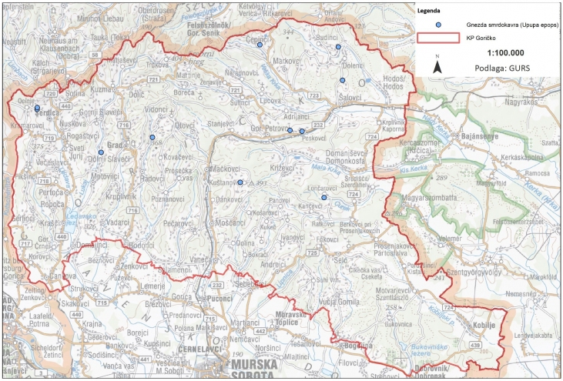
Methodology

Slide 6
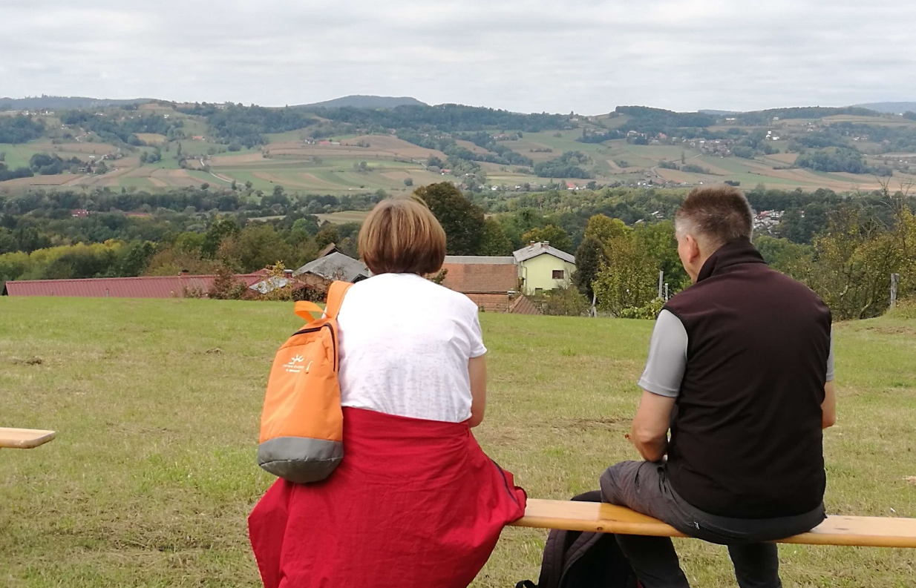
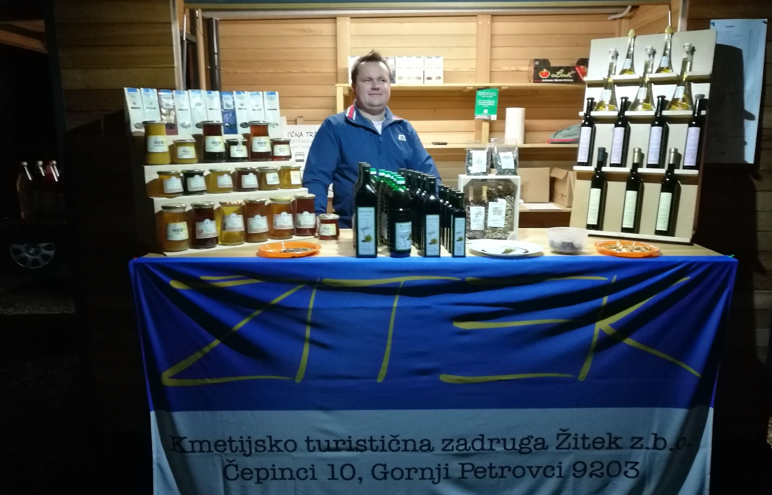
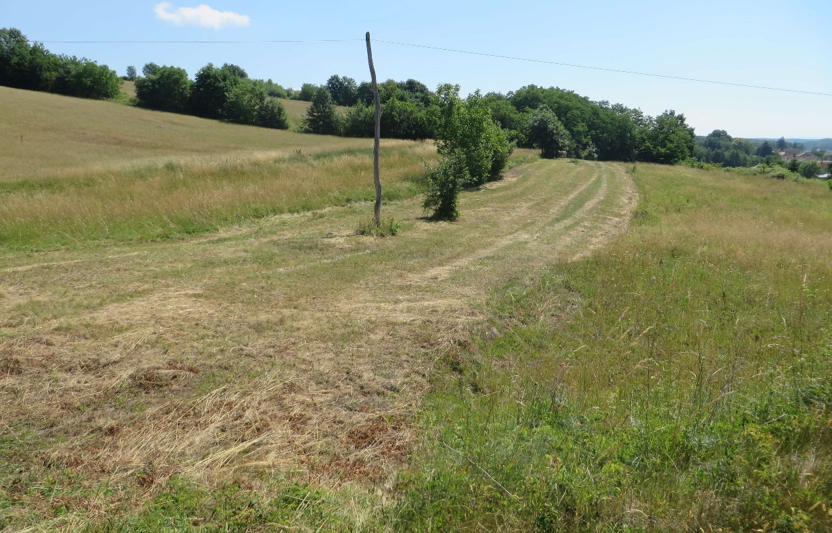
Fieldwork
Motovilci environment in September 2019
Moravske Toplice in November 2019
Fokovci in June 2020

Slide 7
Results
„There were six siblings. Hungarian inheritance law. /.../ This land, which was two hectares, was divided into six parts. /.../ My father bought it back, so it was put together again. I bought some more. Now [the property] has about four hectares“ (L. K., 2021).
„Then came Mura [the factory] and Sobota [the town] and the opportunity, and this is what actually happened: the old parents are still in power, the son and daughter-in-law have to go to work so that everyone can earn money and build a new house. But the young couple liked it and didn't want to go back, so they stayed in Sobota. Then two farms collapsed. /.../ That is the tragedy of Goričko“ (S. S., 2020).

Slide 8
Results
„Now you can no longer make a living from it [agriculture]“ (K. C., 2019).
„Otherwise, it is very difficult to connect in this way. Very difficult. There is no human being who would begin to do so. Then perhaps the problem lies within ourselves. And this envy“ (J. F., 2019).
„The problem is that nobody works with the farmers. They all have specialists at the advisory level - for economics, for taxes, for accounting - there is no one for the co-operative model, not even in the faculties“ (J. V., 2019).

Slide 9
Results
„The dairy got into trouble, went bankrupt, and of course the farmers were left without anything. You see what happened in the past, and now you persuade one of them to pay in a share again somewhere, when they've already lost a thousand, two, five, ten, thirty thousand, stolen from some of the bigger farmers. One of them said to me: ‚You know, I have 30,000 euros and I don't have them. It's like buying a car and breaking it, I don't have it anymore, but I'm still alive.‘ That's exactly what they did to them“ (D. O., 2018).
„The co-operative lived for about ten years. But after five or six years it began to die out because the harvest was sold in passing. Back then, the farmers didn't know what it meant to have their own cold store. Now everyone knows, we know, but it's too late. Unfortunately“ (B. P., 2019).

Slide 10
Conclusions
Moral boundaries of what is good and acceptable play an important role in rural co-operation and have a strong influence on people's ability to act and make decisions for co-operation.
Formal co-operation is not perceived as something that enables farmers to live a good life, but on the contrary is associated with sentiments of fear and insecurity.
Future rural co-operation: cross-regional and with the help of researchers and agricultural advisors.
Future studies: archival research, good examples of cooperation, comparative post-socialist study, new contexts (Covid-19, war in Ukraine).

Slide 11
References
Sayer A. 2000. Moral economy and political economy. Studies in Political Economy, 61, 1: 79–103
Sayer A. 2011. Why things matter to people: Social science, values and ethical life. 1st ed. Cambridge, Cambridge University Press
Scott J. C. 1976. The moral economy of the peasant. 1st ed. New Haven and London, Yale University Press
Thompson E. P. 1963. The making of the English working class. 1st ed. New York, Pantheon Books
Thompson E. P. 1993. Customs in common. 2nd ed. London, Penguin Books
Source for image 1: https://sl.m.wikipedia.org/wiki/Slika:Slovenia_map.png [accessed 21 August 2024]
Source for image 2: https://www.park-goricko.org/vsebina/2053 [accessed 21 August 2024]
Source for photos: M. Slovenc Grasselli

Slide 12
Thank you for your attention!
Mateja Slovenc Grasselli, research assistant
Research Centre of the Slovenian Academy of Sciences and Arts
mateja.slovenc@zrc-sazu.si

