Slide 1
Provision of ecosystem services by biodiversity-based cropping systems in the context of climate change: a 50-year simulation in western France
Arnaud Delbaere, Matthieu Carof, Olivier Godinot, Edith Le Cadre
Institut Agro Rennes Angers

Slide 2
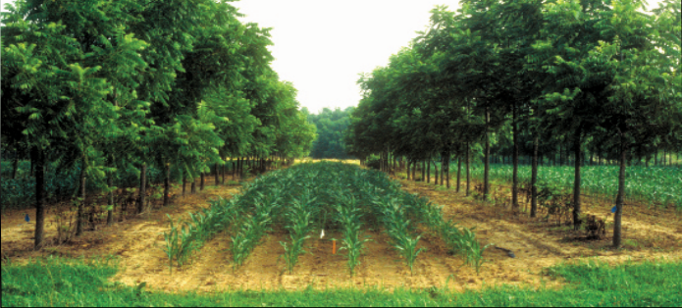
Crop diversification
Crop diversification: a potential lever for greater sustainability and resilience in cropping systems
Crop diversification → action of increasing the level of plant diversity within an agroecosystem (Tibi and Therond, 2018)
There are several ways and scales of crop diversification:
IN TIME
IN SPACE
ROTATION
INTERCROPPING/AGROFORESTRY
For this study
Only herbaceous crop at the plot scale
Successive plant species on the same plot of land
Grow at least 2 species, on the same plot, during the same period

Slide 3
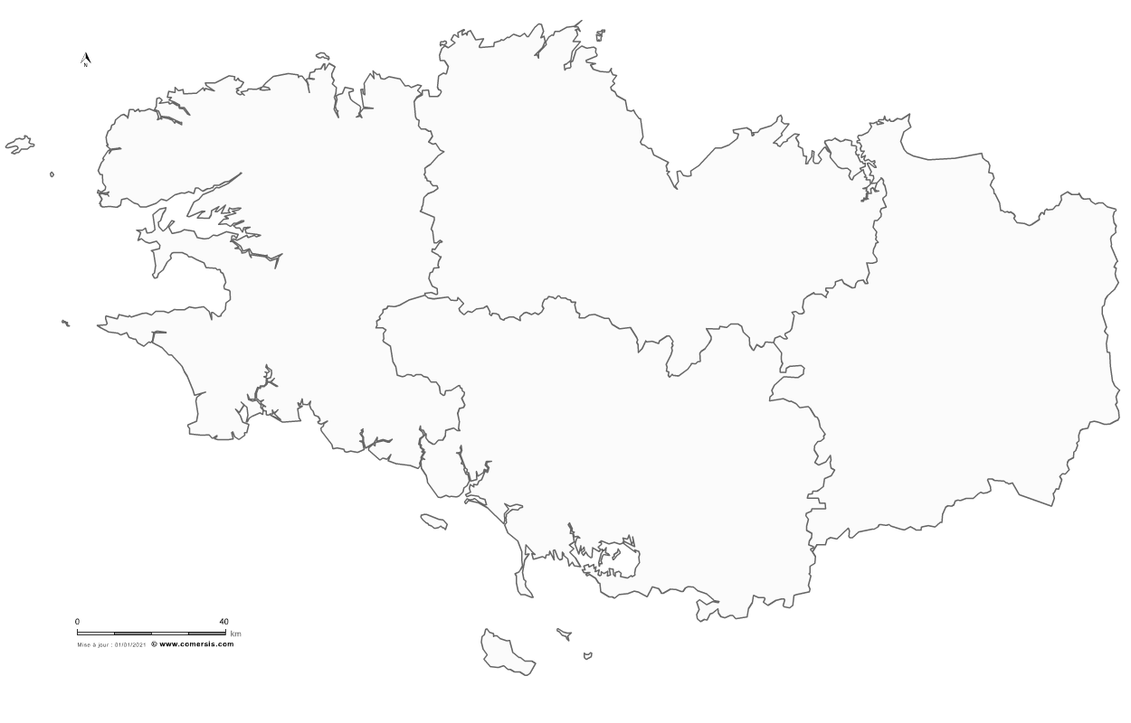
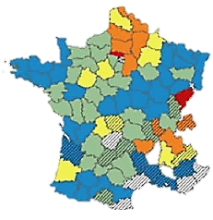
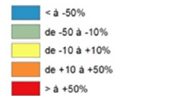
In Brittany, what level of diversity in crop rotation?
Crop diversification
20-30% of cropland (Agreste, 2020)
Maize-Wheat
Variation in the number of crop triplets between 1981-1985 and 2006-2010 (Terrutti-Lucas, 2010)
Diversity/2 in 30 years
Uniformisation
Prevailing trend towards simpler cropping system
Need to design more diversified cropping systems
Notes:
Grossir la seconde figure. Tendance à l’inverse de ça

Slide 4
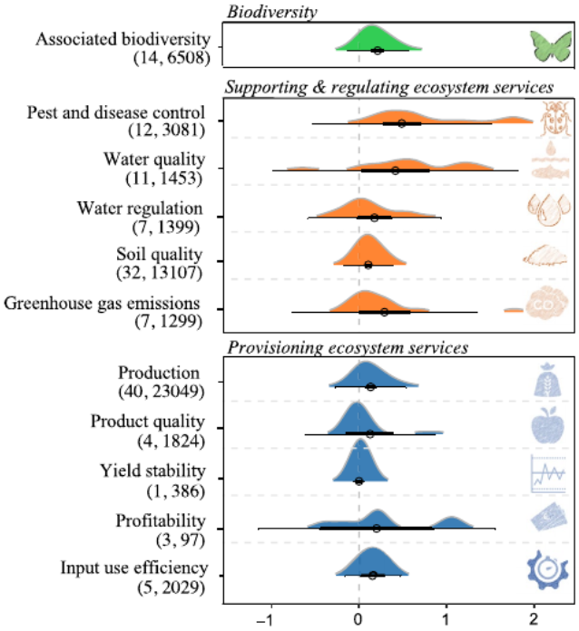
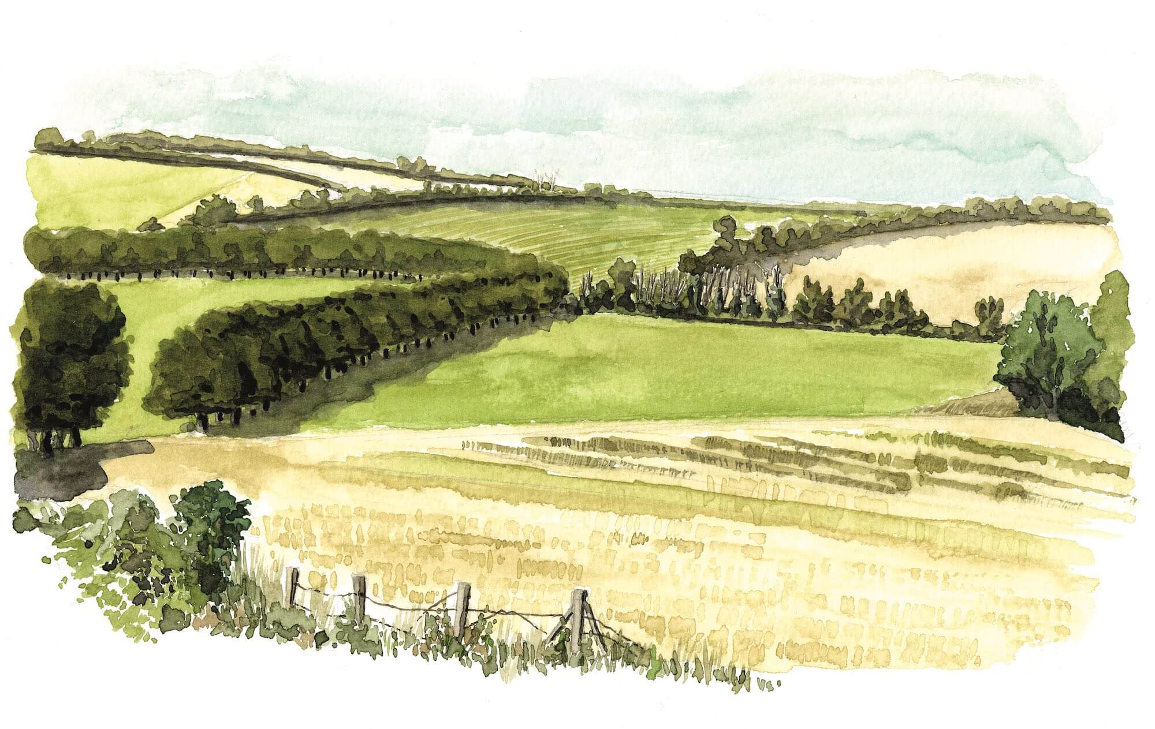
Hypothesis
Which benefits from diversified cropping system?
Positive effect of crop diversification on the provision of ecosystem services (Beillouin et al., 2021)
Celine Lecoq (CPIE du Cotentin) – 2016
Diversified cropping system
YET
The effect of diversification on ecosystem services provision varies (Carof and al., 2022):
Diversification strategy
The service provided
Pedoclimatic context
Time horizon → long term (50 years)
Beillouin, 2021
Co-designed diversified cropping system enable the improvement of agroecosystem functions over the long term, in the perspective of multiple ecosystem services provision

Slide 5
Approach
An interdisciplinary approach: the benefits of a participatory approach to design and improvement
Participatory approach
Local agronomic expertise
Elicitation
Mecanist modeling
Multicriteria assessment
Co-design
System description using different parameters
Simplified system operation using a set of equations
Simulation of dynamic system behavior over time
Assess system performance in terms of the level of ecosystem services provided
Obtain profiles of ecosystem service evolution over time
Design of diversified cropping systems adapted to given soil and climate constraints, with the aim of providing a range of ecosystem services on long term
(Brisson et al., 2003)
Validation/Reject
Notes:
Insister sur le modèle : sur pourquoi on utilise le modèle. En surbrillance la partie modèle. Changement clmatique, LT manque de projection

Slide 6
Methods
Simulate, for the co-designed diversified cropping system and reference cropping systems, the evolution of functions involved in the development of different ecosystem services
Consider different climate scenarios over the long term (50 years)
Obtaining data sets for carbon and nitrogen for each site (here 1 site): Diversification modality x Climate scenario
Comparison of simulation results for active carbon and mineralised nitrogen between diversified co-designed rotation and both reference systems
Scientific contribution: impact over time of increased plant diversity on the ecosystem functions of the cropping system
Notes:
Mettre les variables de sorties : C et N

Slide 7
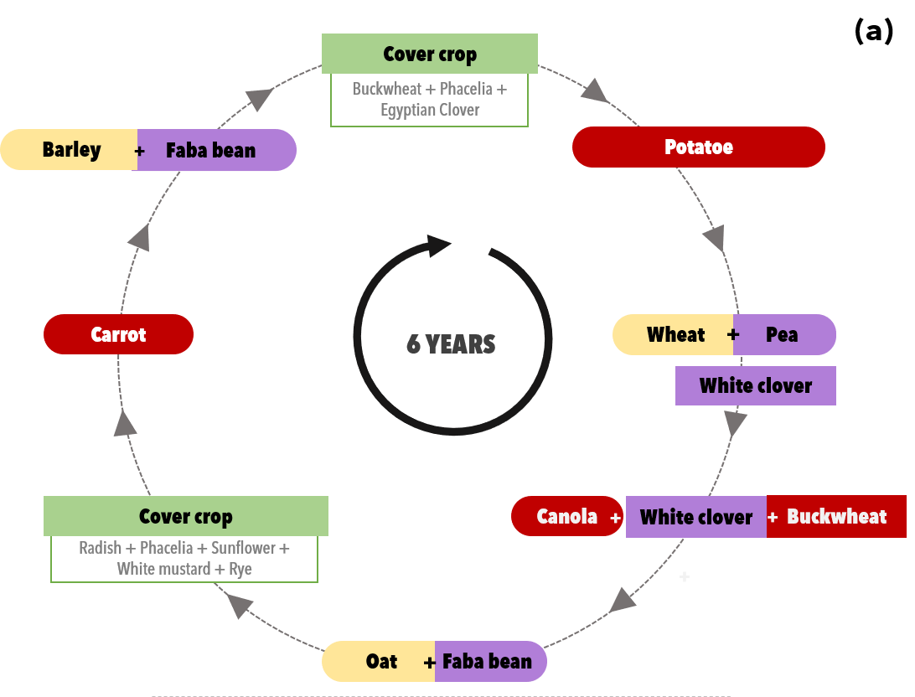
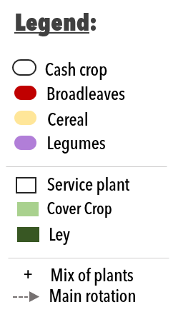
Methods
The simulated system: a co-designed cropping system
Notes:
Legend. Repondondre en diapo une les infos différentes famille qui se succède espace et temps. Elnever rotation nmber one et mettre nombre espèce diffrentes

Slide 8
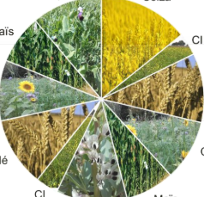
The two simulated reference cropping systems
Methods
« Business as usual » system
Kerguéhennec Synophyt agroecological system (Pourias and al., 2024)
Wheat
Corn
WHEAT – CORN – CC
WHEAT – CC – CORN – FABA BEAN – CC – WHEAT – CC – CORN – TRICTICALE/PEA - RAPESEED
Prevailing system designed guided by sole economic perspective and compliance with legal framework
A 6 year agroecological system that is co-designed, for pesticide reduction and adapted to Brittany conditions.
Organic inputs are equivalent in the 3 crops rotations modalities but neither soil tillage nor crop residues
Notes:
Poster référence

Slide 9
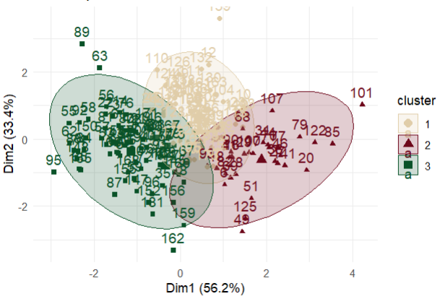
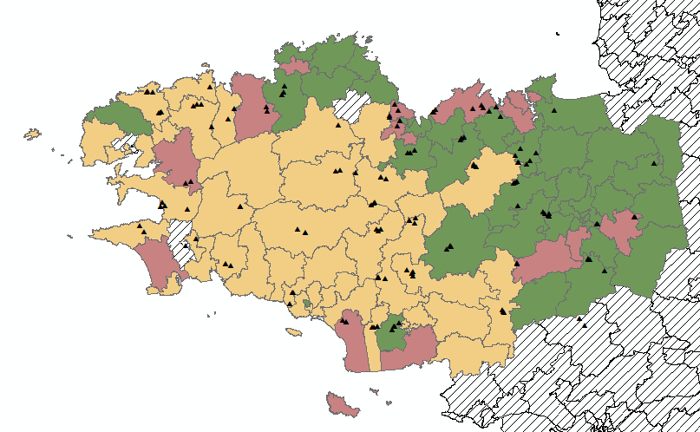
Definition of soil and climate inputs
Methods
Geographical distribution of clusters and plot data usable in STICS (Mh plot network, Morvan 2023)
Several climate models considered
CNRM-ALADIN63
CRNM-RACMO22
EARTH-RACMO22
Multi-modelling gives greater validity to predictions
Several climate scenarios considered
REFERENCE
RCP 4.5
RCP 8.5
Three sufficiently contrasting scenarios for the study
SOL 1 x RCP 8.5
3 Cropping system modalities
Business As Usual
Synophyt’
Co-desgined
Cluster “OM+”: highest OM, lowest pH, clay < 17%.
Cluster “Clay+”: lower OM, median pH, clay > 17%.
Cluster « pH+” : lower OM, higher pH, clay <15%.
SolMh network measurement points
Notes:
1 sol 1 climat, ne se concentrer que sur un seul jeu de données.

Slide 10
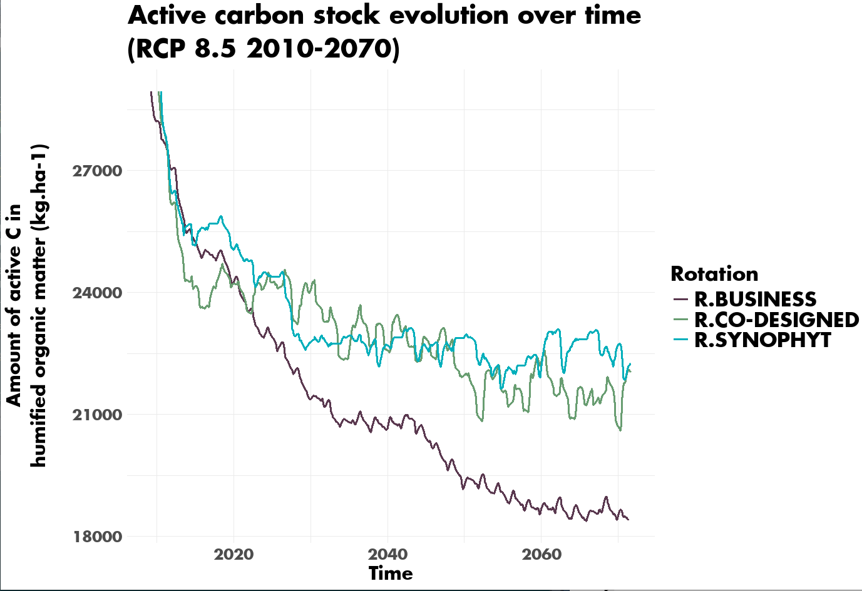
Active soil organic carbon evolution over time (RCP 8.5 2010-2070)
Results : Carbon
Drop in organic carbon in all rotations
Significantly faster rate of C destocking in the “business as usual” rotation
Stabilization of active carbon for more diversified rotations, particularly the “Synophyt” rotation
Questions the ability of the more diversified rotations studied to efficiently store carbon in the soil
Notes:
Mettre les codes couleurs respectant. Mettre en Mat et Meth que les effluents sont équivalents mais pas le travail du sol et les résidus. On perd pas mal de carbone pas de prise en compte de la stabilisation en profondeur. Discussion stockage de carbone. Take home message, sous fome de bullet point

Slide 11
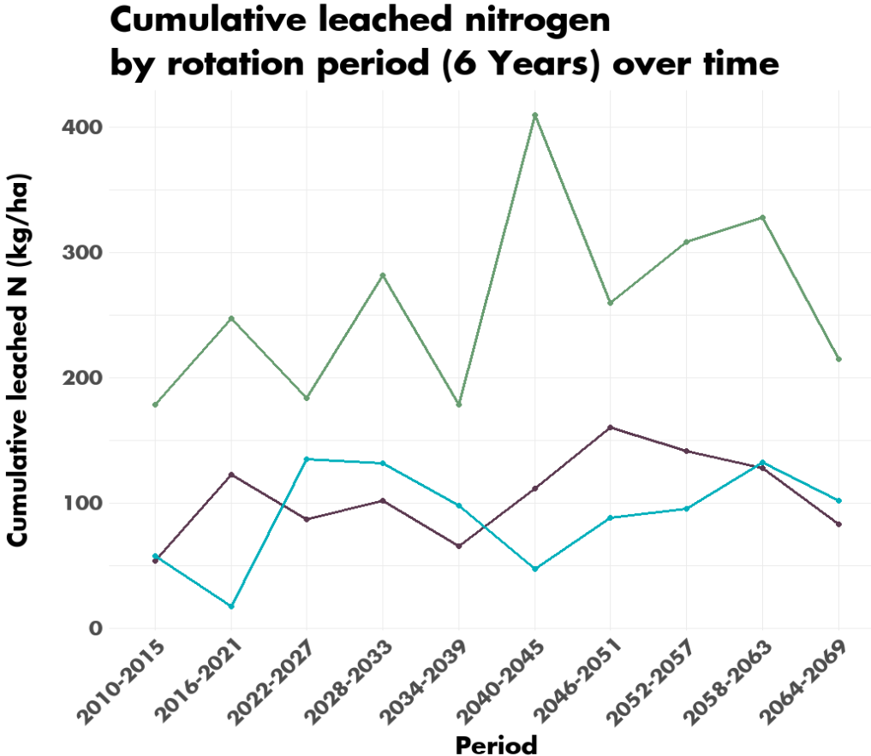
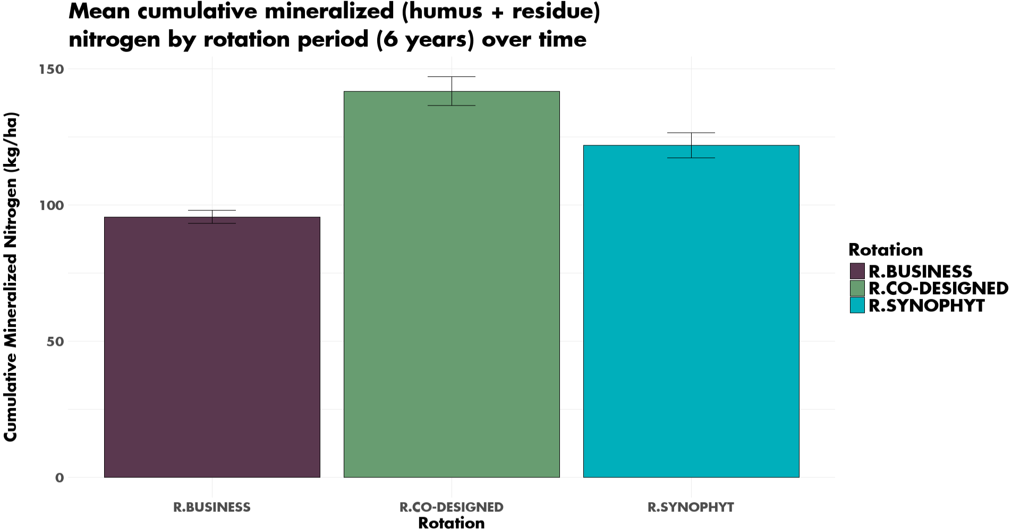
Total mineralized soil nitrogen trends
Results : Nitrogen
**
**
**
Higher mineralization on average over the 6year period for the co-designed rotation. Could be due to the greater inclusion of legumes in the associations and cover crops (cut clover + return to the soil of all biomass)
Work in progress!
Greater leaching as a result, possibly amplified by lack of soil cover due to crop failure.
Notes:
Début explication, résultats préliminaires, crop failure dans le modèle : présenter en point d’interrogation. Minéralisation totale. Mettre un titre commun. Minéralisation nette

Slide 12
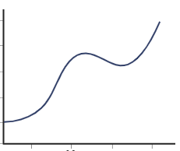
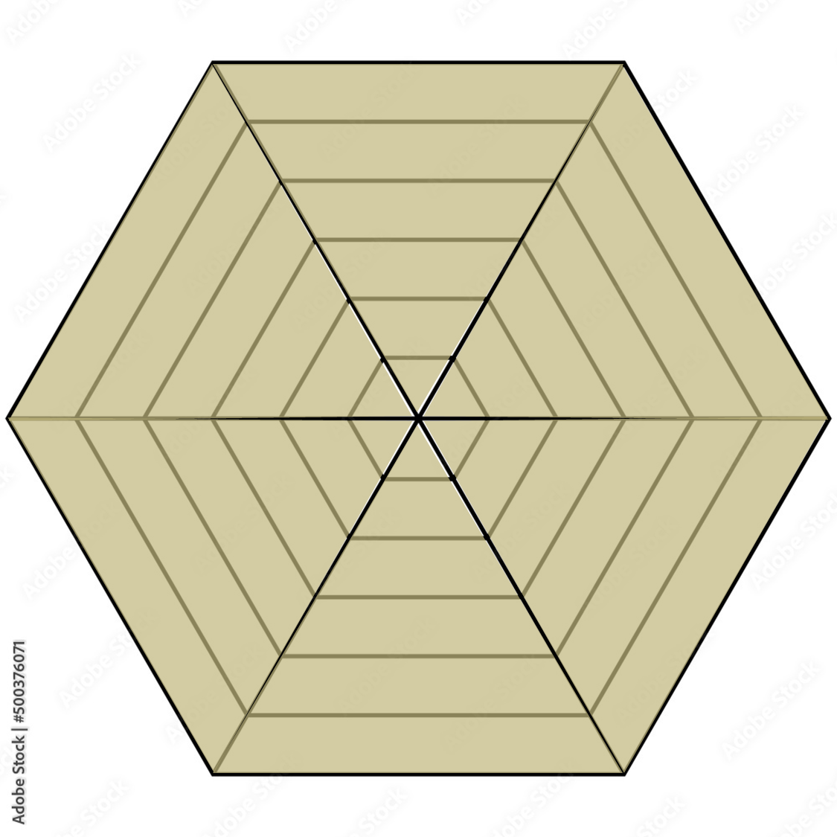
A steps toward the evaluation of ecosytemic services trade-off evolution trends over the long time
Perspectives
Visualization of ecosystem services provision over 50 years
Trade-off score
Trade-off
For the 3 crop rotation over time (50 years)
Provisioning
Maintenance
Time
B
Eco.service A
Eco.service B
Eco.service C
A
C
(Bohanec, 2008)
1 score by 6 years rotation cycle
-
-
Active Carbon stock
Mineralized N
Outpus not from Stics
-
Visualisation of ecosystem services provision for one crop rotation cycle
Adapted from Lebas 2024
Notes:
Using DEXI = description de DEXI
Ecrire carbone azote + autre service

Slide 13
Main ideas
To conclude…
The active carbon stock decreases for all rotations, but at a faster rate in the least diversified rotation. The most diversified rotations seem to maintain a more stable stock over the long term under the given conditions.
Mineralization appears to be greater in the co-designed rotation, with a subsequent increase in leaching, which might have an impact on the maintenance of water quality.
Modelling still needs to be improved (e.g. for minor crops and cover crops) to take better account of the plant diversity and its impact on ecosystem services

Slide 14
Thanks for you attention!
Bocage à maille ouverte, Celine Lecoq (CPIE du Cotentin) – 2016
UMR 1069 SAS, Sol Agro et Hydrosystème Spatialisation, 35042 RENNES
contact : arnaud.delbaere@agrocampus-ouest.fr

