Slide 1
Breeding progress in terms of carbon footprint reduction for five cereal crops in Germany
Donghui, Ma¹; Riedesel, Ludwig¹; Laidig, Friedrich²; Rentel, Dirk³; Lichthardt, Carolin³; Piepho, Hans-Peter²; Feike, Til¹
¹Julius Kühn Institute, Coordination Unit Climate, Institute for Strategies and Technology Assessment, Kleinmachnow
²University of Hohenheim, Institute of Crop Sciences, Biostatistics Unit, Stuttgart
³Federal Plant Variety Office, Hannover

Slide 2
Background and motivation
The global food systems are estimated to be responsible for more than one third of global anthropogenic greenhouse gas (GHG) emissions (Crippa et al., 2021)
Agricultural production accounts for approximately 80% of total food system emissions (Vermeulen et al., 2012)
Optimizing agricultural management practices and reducing agricultural emissions are crucial for climate change mitigation (Lynch et al., 2021)
What is the role of plant breeding besides its achievement of food security? Can plant breeding as a tool also contribute to the climate change mitigation?

Slide 3
Aims and scope
Evaluation of GHG of cereal crops production and carbon footprint (CFP) of grain products in Germany using Life Cycle Assessment (LCA)
Disentangling genetic and non-genetic trends
Year of variety approval as a factor representing the genetic progress
Year of harvest as a factor representing the environmental effects confunded with management effects
Assessment and evaluation of breeding’s contribution to climate mitigation
Using winter wheat and winter rye to illustrate the main pattern in this presentation
3

Slide 4
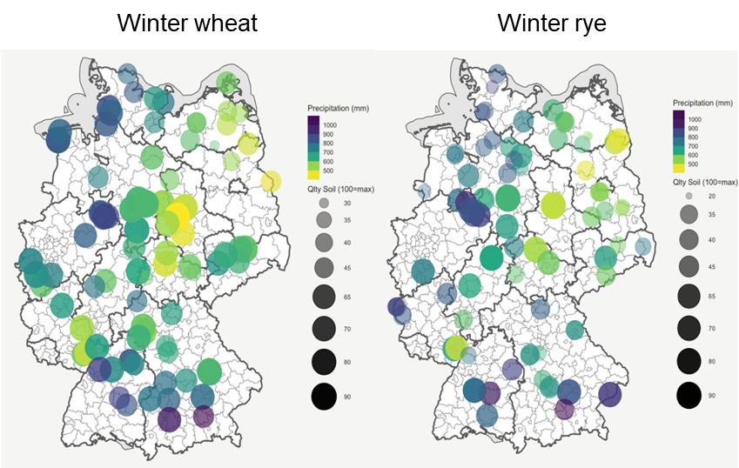
Materials & Methods - Data
Data from Value for Cultivation and Use trials (VCU)
Conducted by Bundessortenamt
Candidates tested for 3 years before approval
Good local agricultural practice (GLAP)
Crop specific growing regions
4

Slide 5
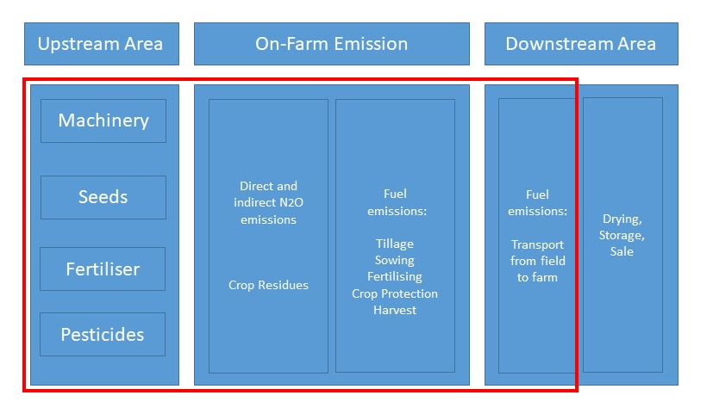
Materials & Methods - LCA
Functional units:
5

Slide 6
Materials & Methods – Mixed Model
Basic model (Laidig et al. 2008)
y_{ijk}=μ+G_{i}+L_{j}+Y_{k}+(LY)_{jk}+(GL)_{ij}+(GY)_{ik}+(GLY)_{ijk}, (1)
G: Genotype; L: Location; Y: Year
Regression term for genetic-trend
G_{i}=β_{ri}+H_{i}, (2)
Genotypic effect is modelled with β as the year of release effect
Regression term for non-genetic-trend
Y_{k}=γ_{tk}+Z_{k}, (3)
Year effect is modelled with γ as the year of harvest effect
→ Disentangling genetic and non-genetic trends
6

Slide 7
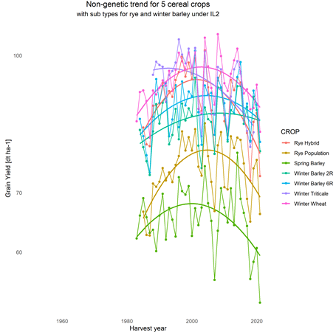
Results - Yield development under intensive management (IL2)
Disentangling genetic and non-genetic trends
G x E x M
Genetic trend no plateau
Non-genetic trend negative in recent years for all cereals
Winter barley least neg.
7
Ma et al. (2024) (in preparation)

Slide 8
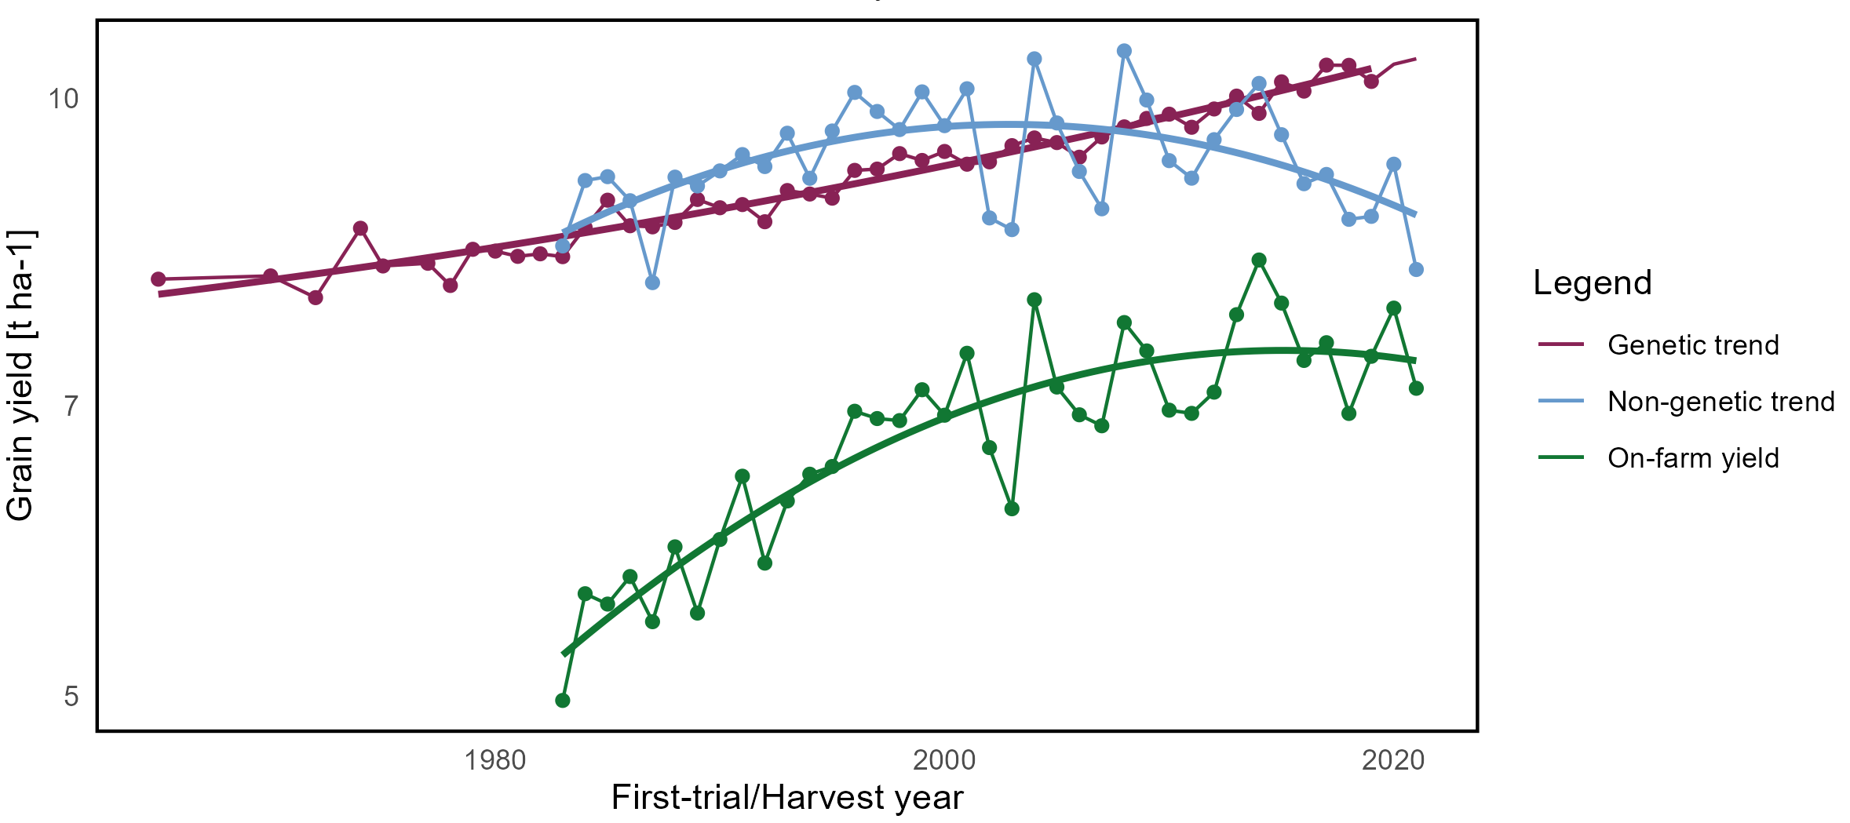
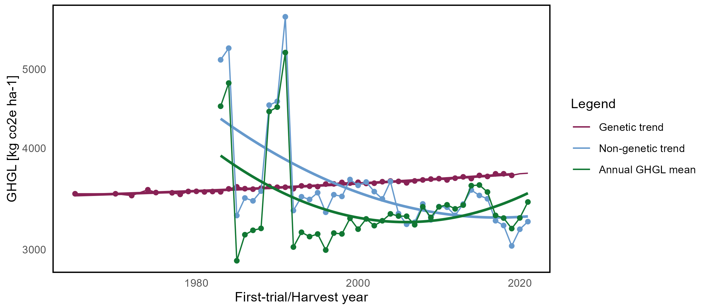
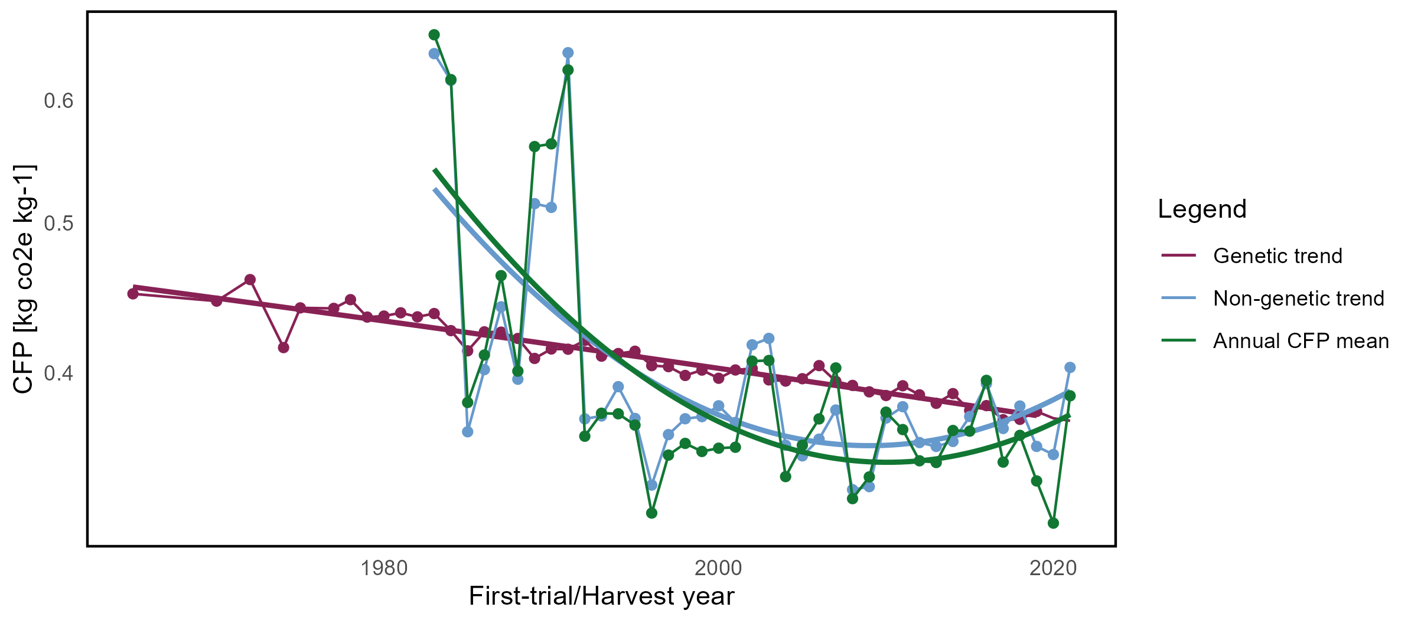
Results – Trends of Yield, GHGL and CFP
Winter Wheat
Yield
GHGL
CFP
Yield reached a pleatu for on-farm and experimental cond.
Genetic trend for yield is positive → newer cultivars with
latest release year have higher yield
Genetic trend for CFP is negative → newer cultivars with
latest release year have lowest carbon footprint
Similar pattern observed for spring barley

Slide 9
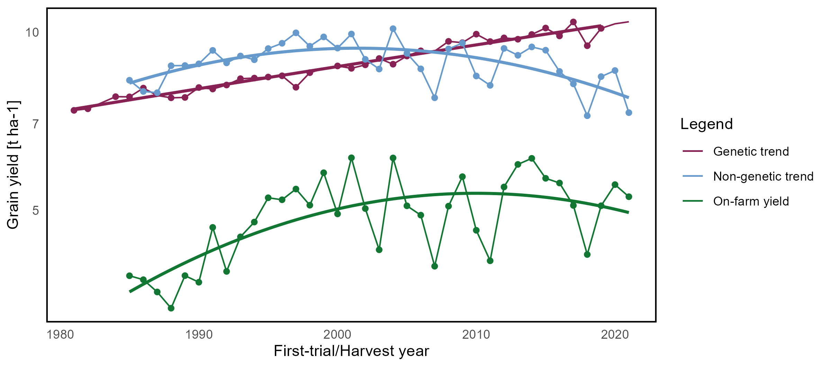
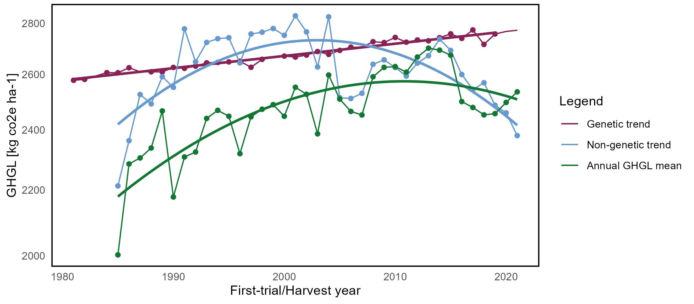
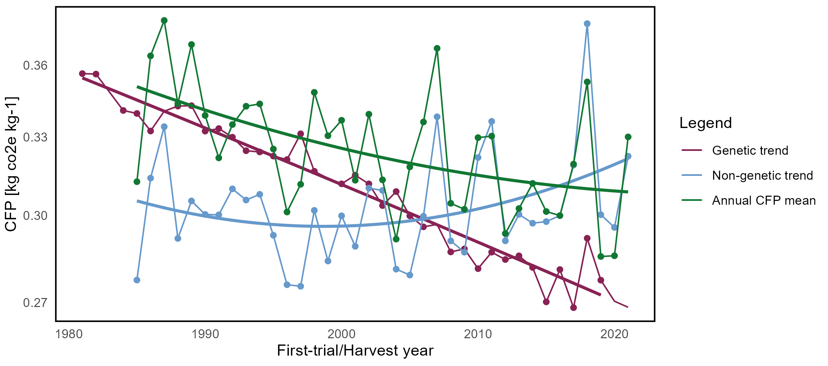
Results – Trends of Yield, GHGL and CFP
Winter Rye (hybrid)
Yield
GHGL
CFP
Yield reached a pleatu for on-farm and experimental cond.
Genetic trend for yield is positive → newer cultivars with
latest release year have higher yield
Genetic trend for CFP is negative → newer cultivars with
latest release year have lowest carbon footprint
Similar pattern observed for winter triticale and winter barley

Slide 10
Discussion
Overestimation of genetic trend due to aging effect (Piepho et al., 2014)
Future work to add correction from independent vintage trial data
Bias with data reduction (Hartung et al., 2023)
Bias in estimation of genetic gains (Raymond et al., 2023)
Overestimation of GHGL and CFP with IPCC Tier 1 method
Tier 1 use 1% as emission factor for Nitrogen
Tier 2 use 0.62% as emission factor for Nitrogen
Trends will be similar to the current findings

Slide 11
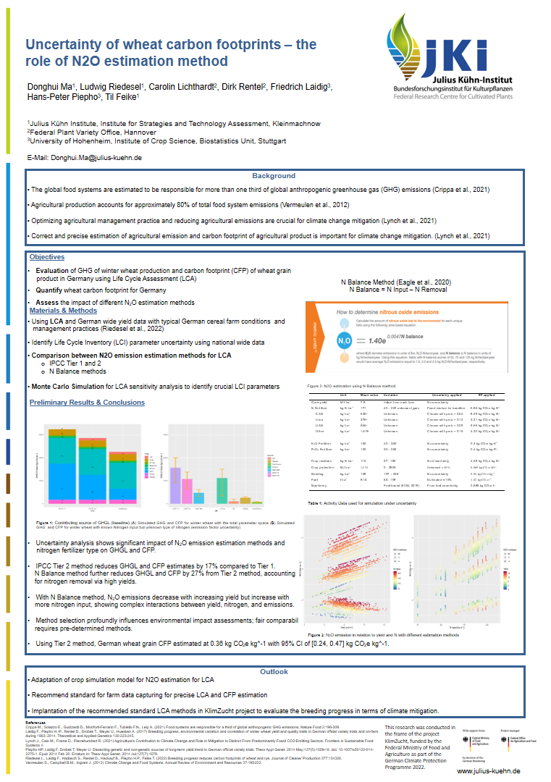
Discussion
Biased estimation of N2O emission for high yielding genetics due to the IPCC methods.
IPCC methods calculate direct and indirect N2O emission from crop residues modelled with grain yield
N Balace method take the removal of N from grain into account
(Ma et al., 2024, in our poster at ESA)

Slide 12
Conclusions
Cereals may have yield plateaus but the genetic improvement in yield persists
Non-genetic (E x M) effects are mostly negative for yield in recent years
Genetic improvement obviously helped to buffer negative trends in E and M to maintain high yields
In terms of CFP, the genetic effect is downward and could compensate the upward non-genetic effect for some cereals
Breeding does not only contribute to yield improvement, it could also be a tool for climate change mitigation to reduce cereal grain carbon footprint
12

Slide 13
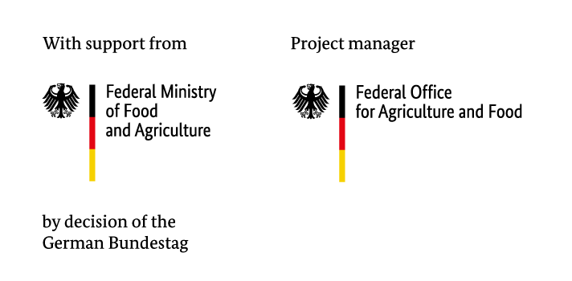
Thank you for your attention! Questions?
This research was conducted in the frame of the project KlimZucht, funded by the Federal Ministry of Food and Agriculture as part of the German Climate Protection Programme 2022.

