Slide 1
Adaptive Crop Management Strategies for Lentil Production in Italy under Future Climate Scenarios: Insights Using a Modelling Approach
Authors : A. Triacca; J. S. Ahmed; F. Leoni; S. Carlesi; A. C. Moonen; M. Reckling; C. Nendel
Sant’Anna School of Advanced Studies & Leibniz Centre for Agricultural Landscape Research

Slide 2
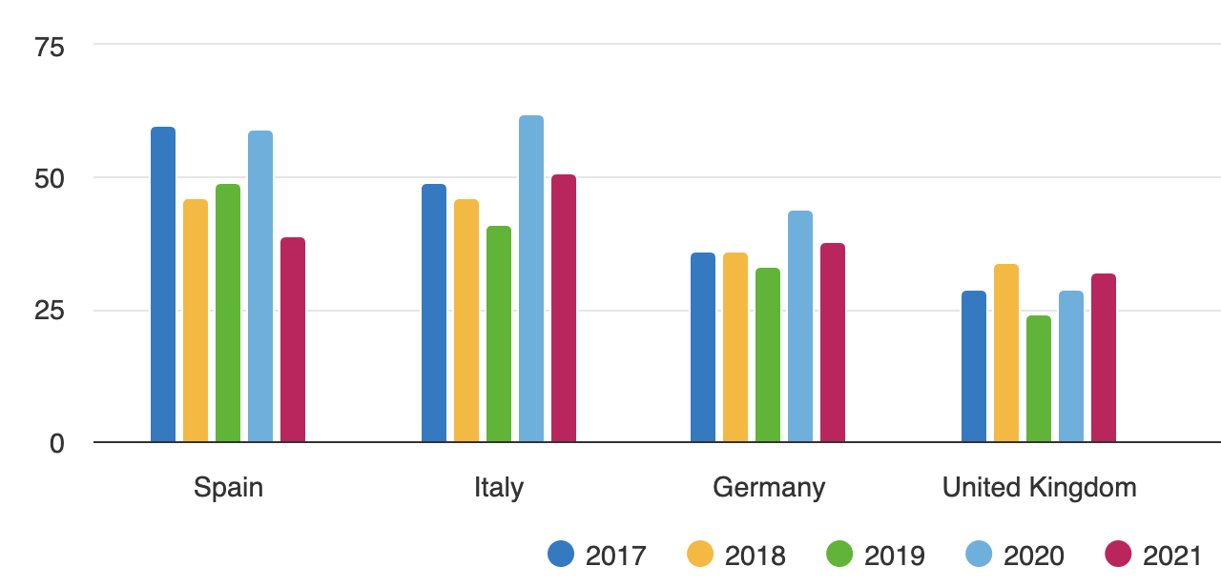
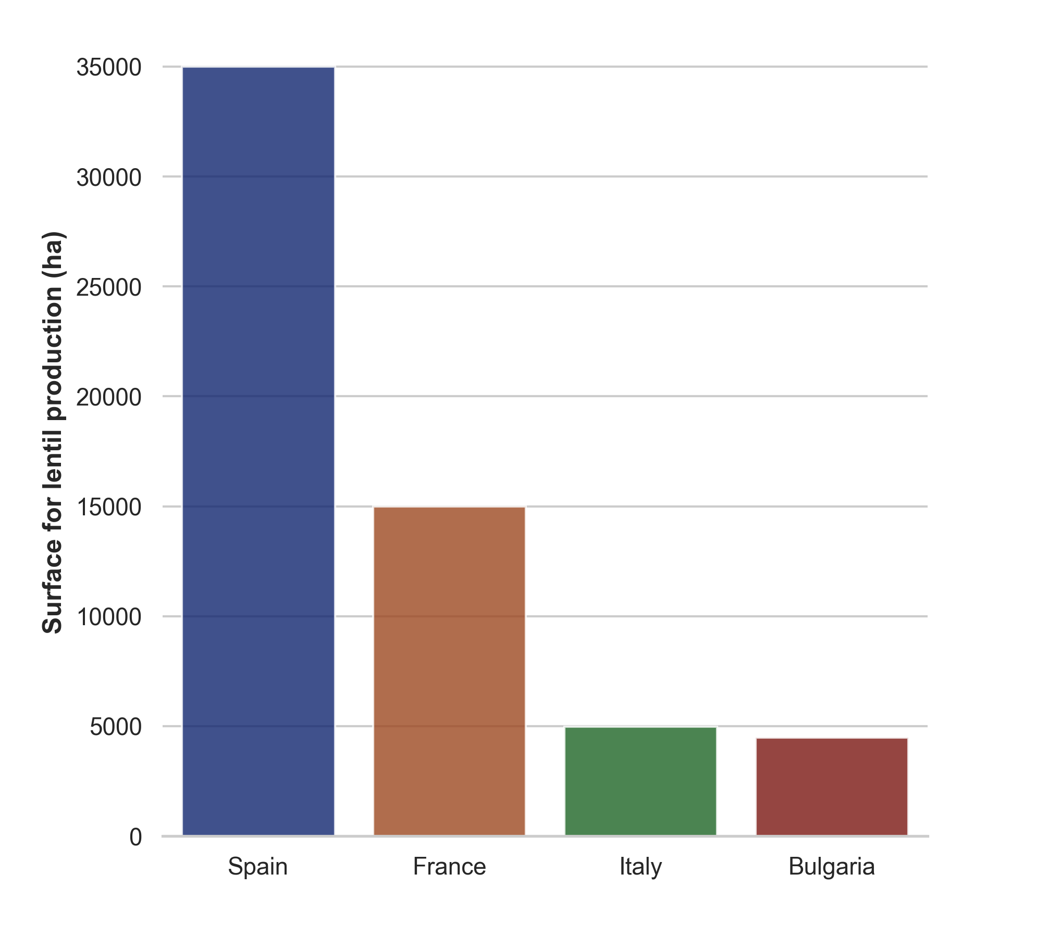
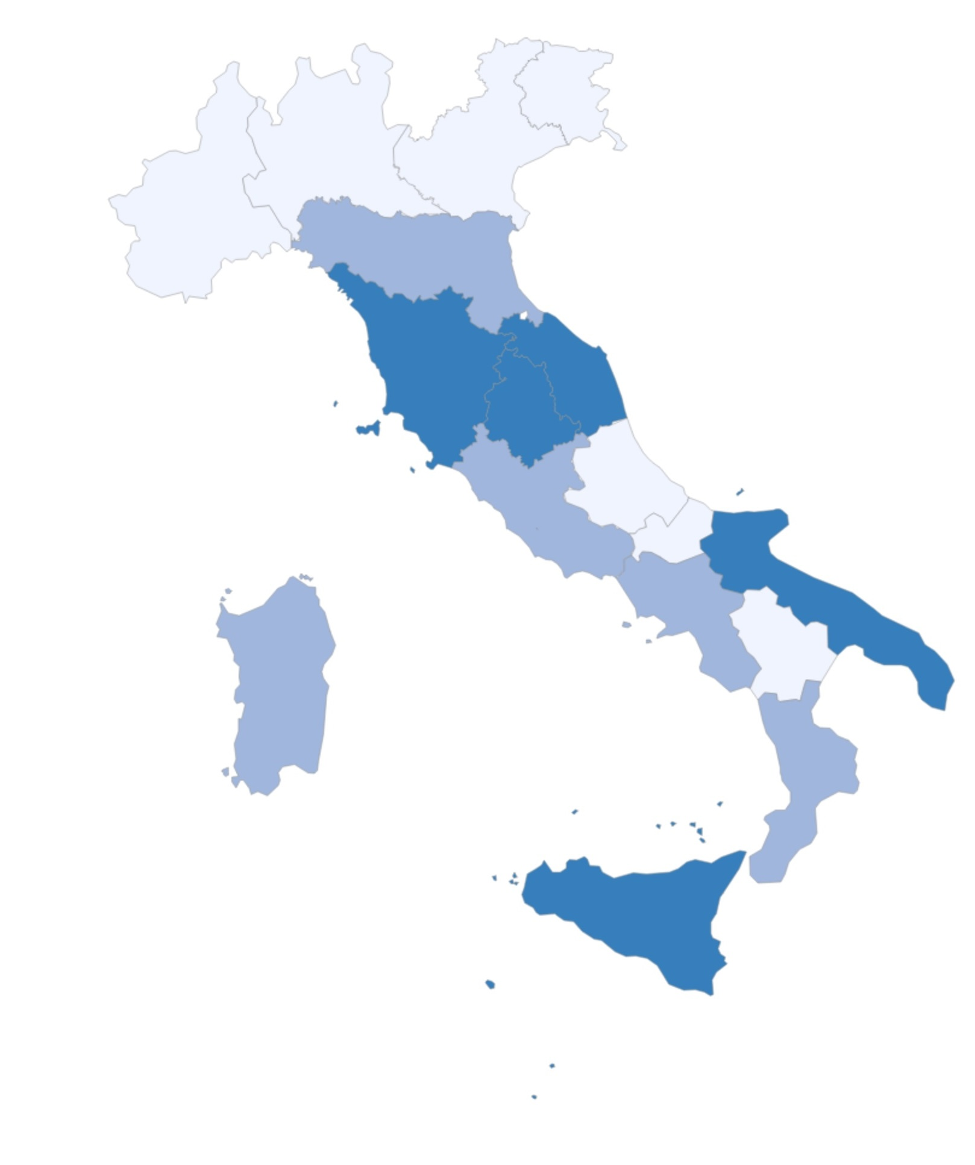
Introduction
Top European importers of dried lentils.
www.cbi.eu/market-information/grains-pulses-oilseeds/dried-lentils/market-potential
Lentil demand, import and production in Italy
Thousand of tonnes
Italy is a major lentil consumer in Europe, consuming 50,000 tons in 2021, but it imports 98% of its supply.
Lentil production in Italy is currently limited (5,000 tonnes in 2021).
Lentil cultivation is mainly concentrated in central and southern regions.
Regions of major lentil
cultivation in Italy by 2023
(dark blue).
www.istat.it/
Lentil cultivation area by 2019.
www.cbi.eu/market-information/grains-pulses-oilseeds/dried-lentils/market-potential
Introduction 1/10

Slide 3
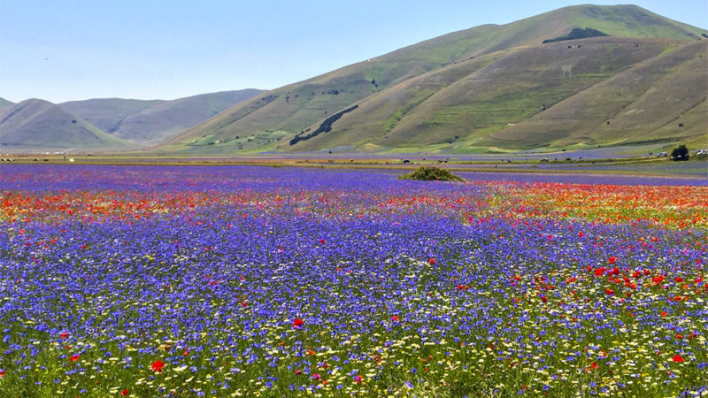
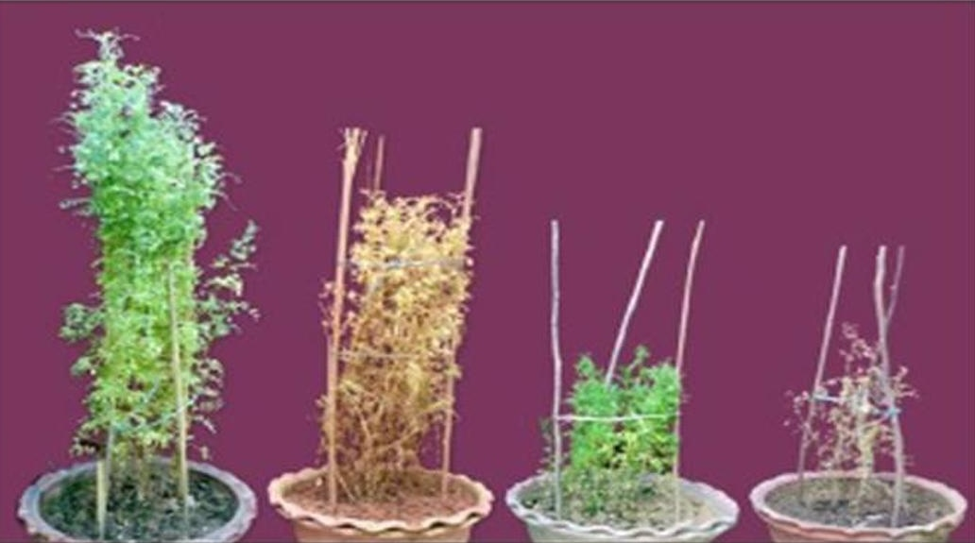
Climate change and challenges in lentil cultivation
Lentil flowering in Castelluccio, Italy - drought sensitive lentil cultivar.
https://doi.org/10.3389/fpls.2017.01776.
Lentil cultivation
Lentil prefers warm, dry climates, grown in plains and higher altitudes, often rotated with cereals.
Sowing time: November - January in warmer areas and March - April in colder regions.
Harvest time: July - August.
Challenges in lentil cultivation
Water scarcity (especially at flowering) is the primary limitation to lentil production globally.
Climate change is expected to anticipate the flowering and alter the suitability of areas for lentil cultivation in Italy.
Effect of drought and heat stress on a drought sensitive lentil cultivar.
https://doi.org/10.3389/fpls.2017.01776.
Well-watered
Drought-stressed
Heat-stressed
Heat + drought
Introduction 2/10

Slide 4
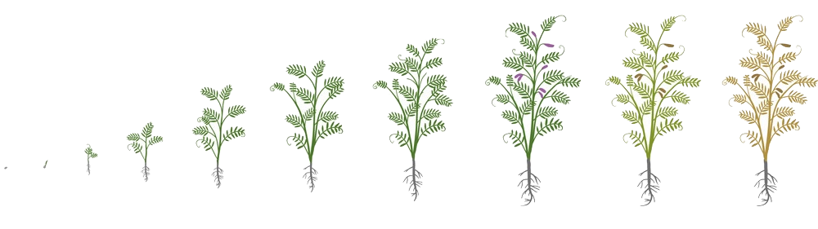
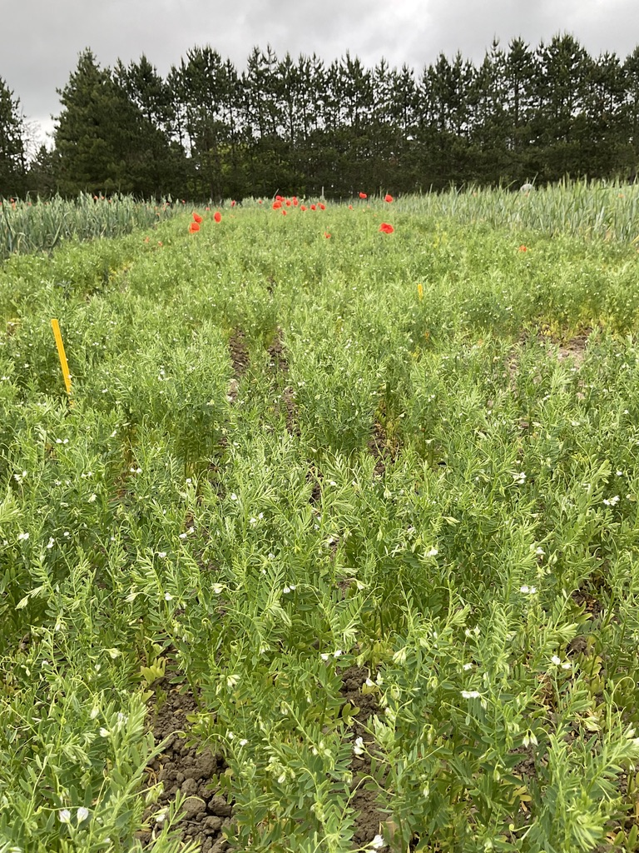
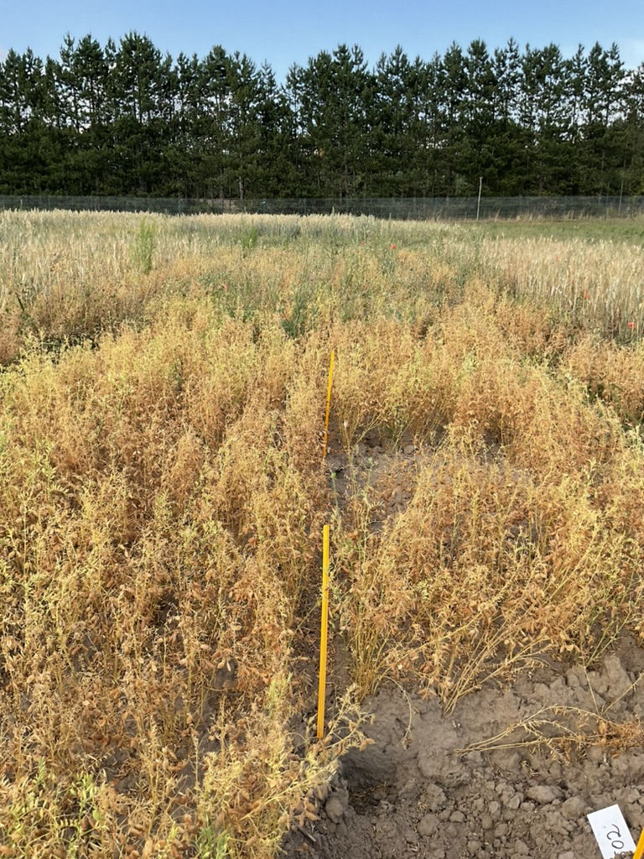
Objectives
Lentil phenology.
www.shutterstock.com
Provide valuable insights to adapt agricultural practices to climate changes effects
Predict the plant growth and yield formation using a crop model.
Simulate the expected changes in lentil phenology under future climate scenarios in Italy, focusing on key stages.
Simulate productivity and potential area expansion, considering adaptation strategies that Italian farmers can use, such as earlier sowing.
Flowering
Maturity
Lentil key stages. 2023.
own collection
Objectives 3/10

Slide 5

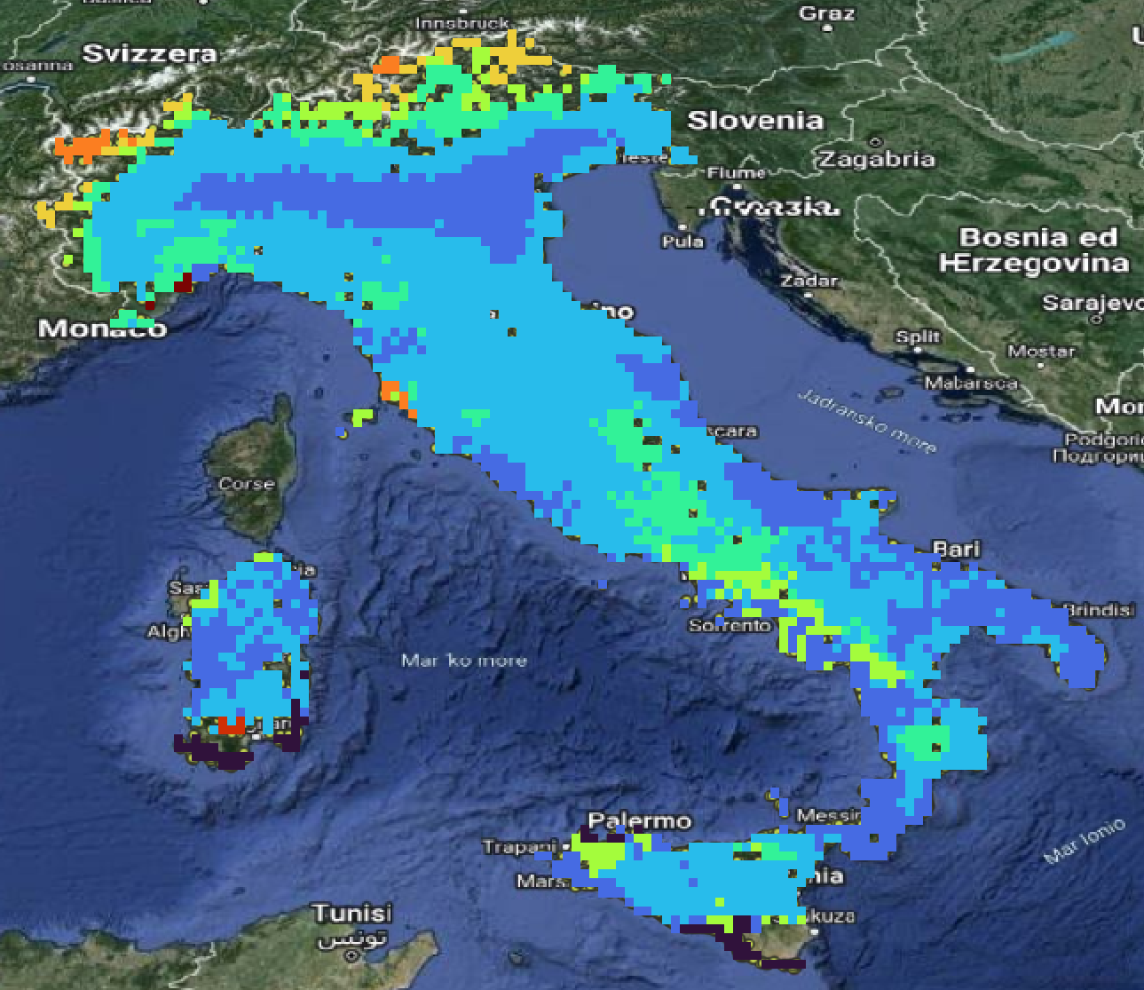
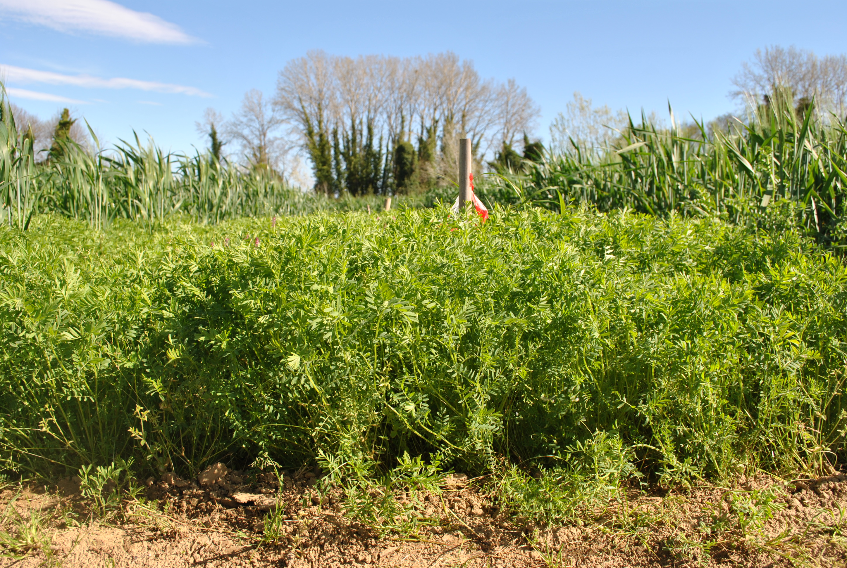
Methodology
General setting
https://github.com/zalf-rpm/monica
Climate data
Historical baseline
Future scenarios
Soil data
European soil database
Management
Land cover dataset
2. Crop model
1 km² gridded data. Own collection.
4. Output
1. Input data
3. Model calibration
Methods 4/10

Slide 6
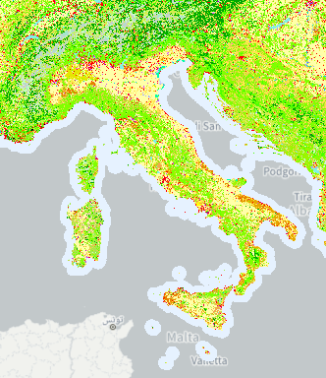
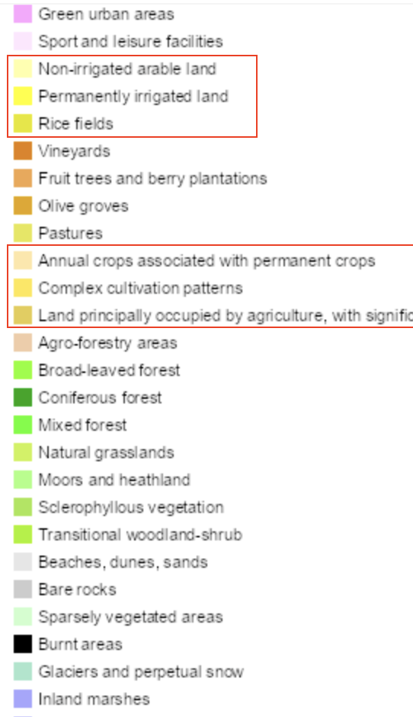
1. Input data
Climate data
Daily gridded data (25 km²): temperature, humidity, precipitation, wind speed and solar radiation on a daily basis.
Historical baseline (1980-2010): Joint Research Center Meteorological Database.
Future scenarios (2040-2070): Ensemble of 5 Global Circulation Models under SSP2-4.5 (CMIP6).
Soil data
European Soil Data Centre (1 km²): Texture, pH, organic carbon content, bulk density, depth available to roots.
  - Top soil and sub soil profiles.
Management data
CORINE Land Cover 2006 raster for Europe (100 m²) masking agricultural areas.
CORINE 2006 Land Cover map and classes considered. https://land.copernicus.eu/en/map-viewe
Methods 5/10

Slide 7
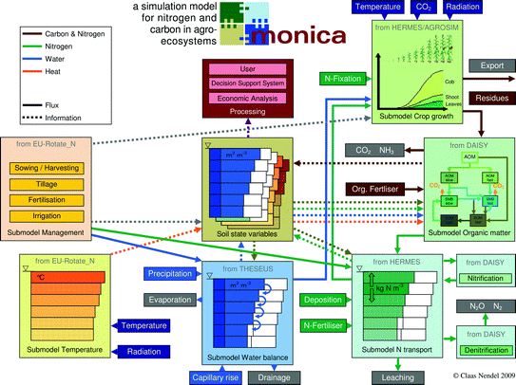
2. Crop model
MOdel of NItrogen and CArbon dynamics in
Agro-ecosystems (MONICA), one-dimensional.
Simulation settings (30 years):
Continuous mode, rain-fed, in rotation with durum wheat.
Two different triggered sowing times:
- 10 January - 30 April (spring)
- 01 October – 01 December (autumn).
Harvest at maturity, latest on 30 August.
Response to water-logging, heat, drought and N stress.
Fixed CO₂ concentration (historical at 360 ppm and future at 499 ppm).
MONICA flow.
https://github.com/zalf-rpm/monica
Methods 6/10

Slide 8
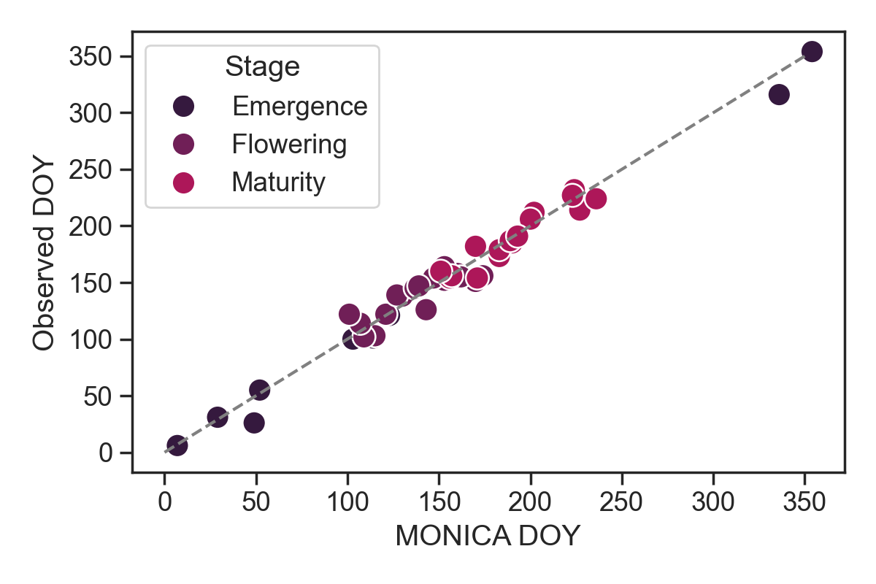
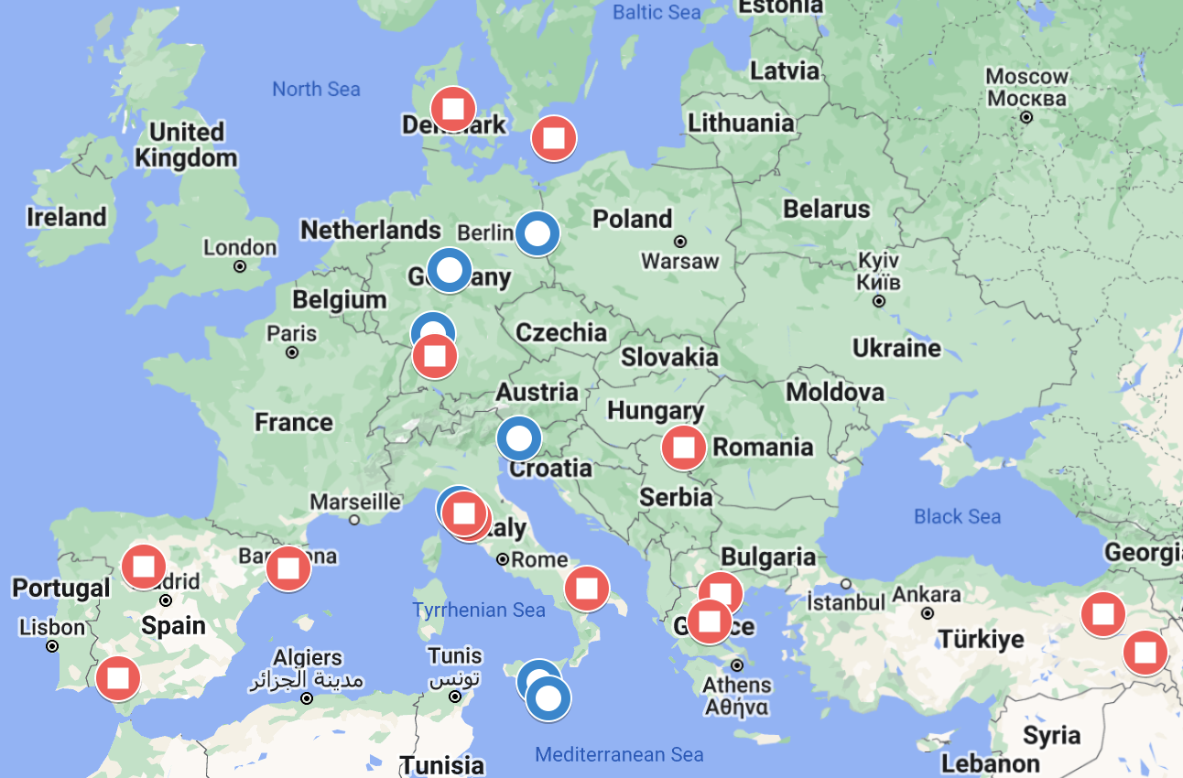
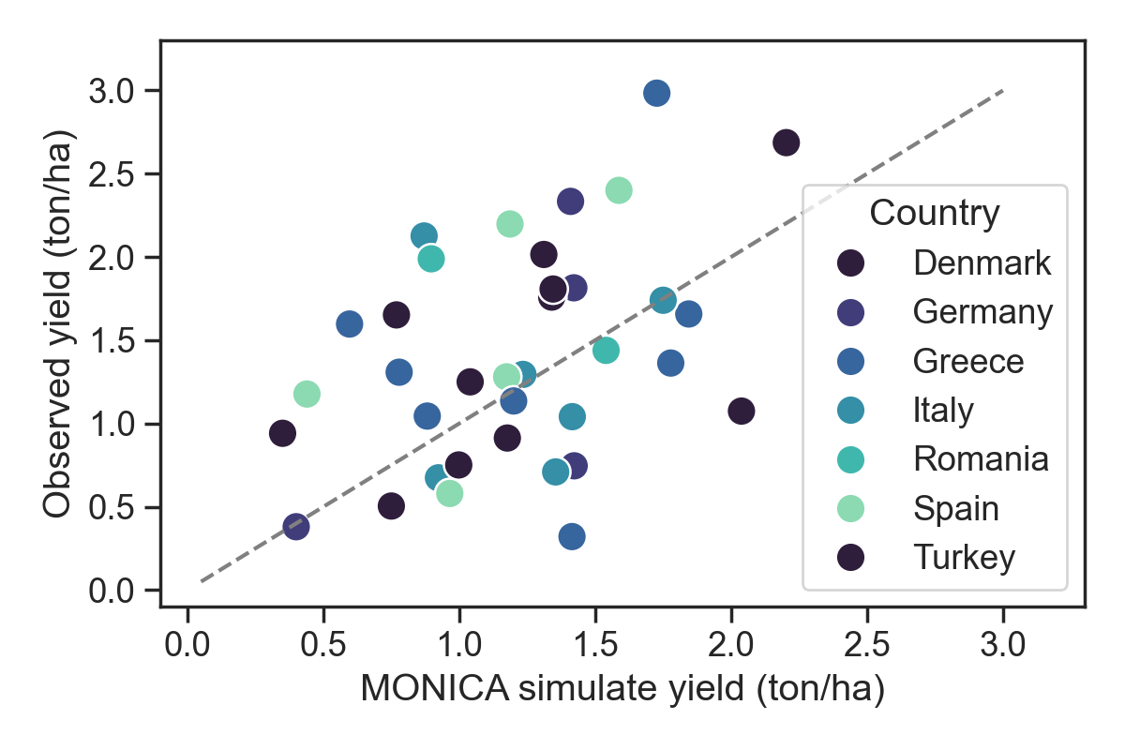
3. Model calibration and testing
Lentil field experimental data:
(calibration set) Phenology, productivity and other dynamical variables (e.g. LAI, plant N,…) across 6 sites in Italy and Germany and 8 years.
(test set) Lentil grain yield across 14 sites in Europe.
RMSE = 8 days
nRMSE = 5.2 %
Observed vs predicted day of the year (DOY) for key stages in calibration set.
RMSE = 0.64 ton/ha
nRMSE = 45 %
Maps of the experimental sites in the calibration (blue) and test set (red). https://www.google.com/maps
Observed vs predicted grain yield in test set.
Methods 7/10

Slide 9
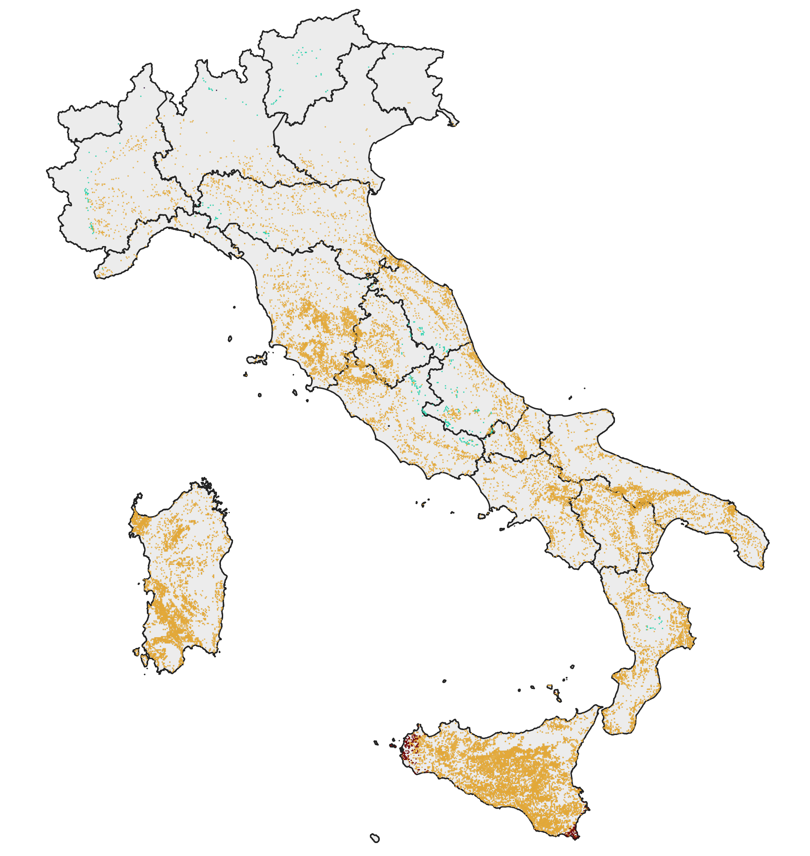
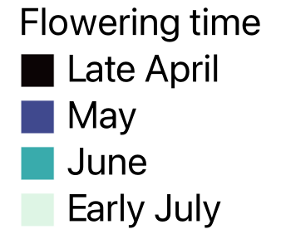

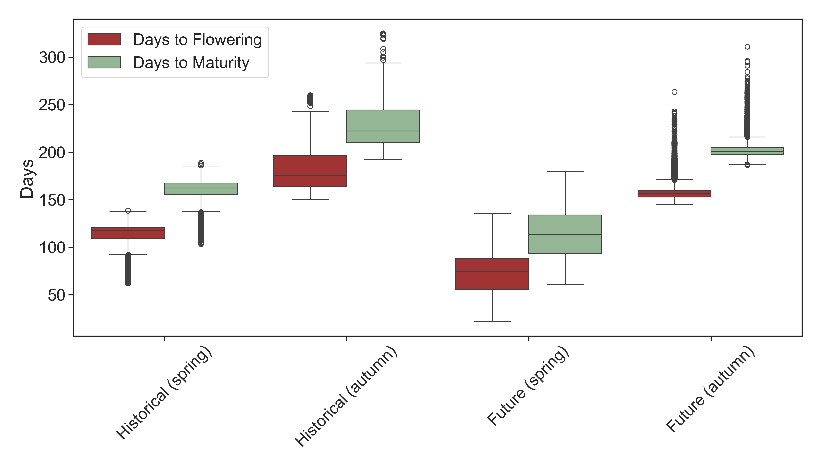
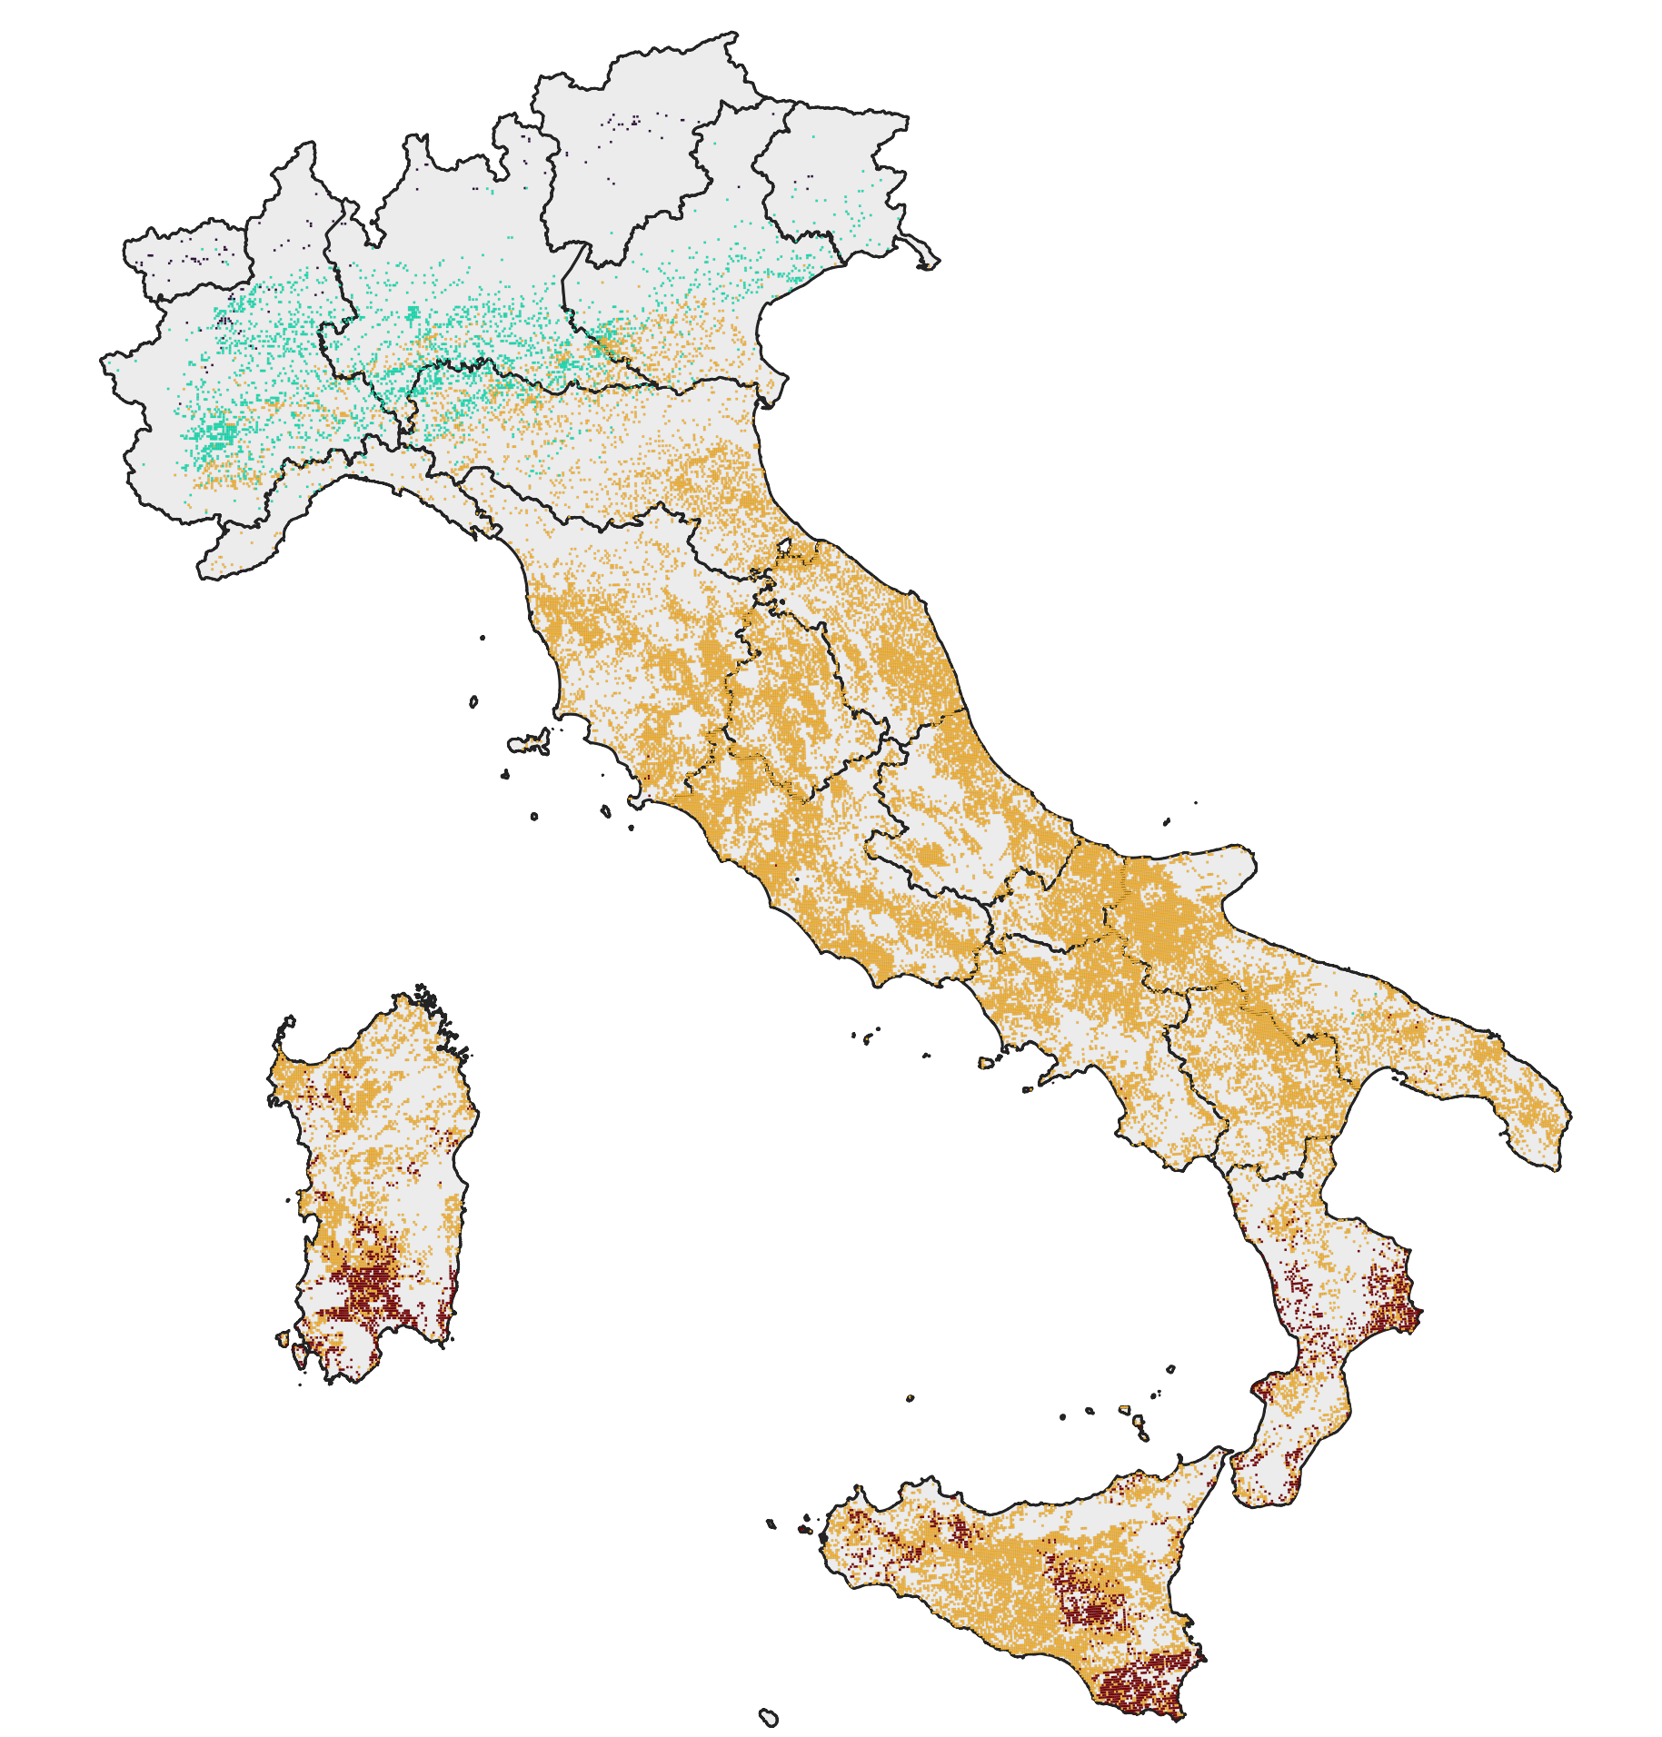
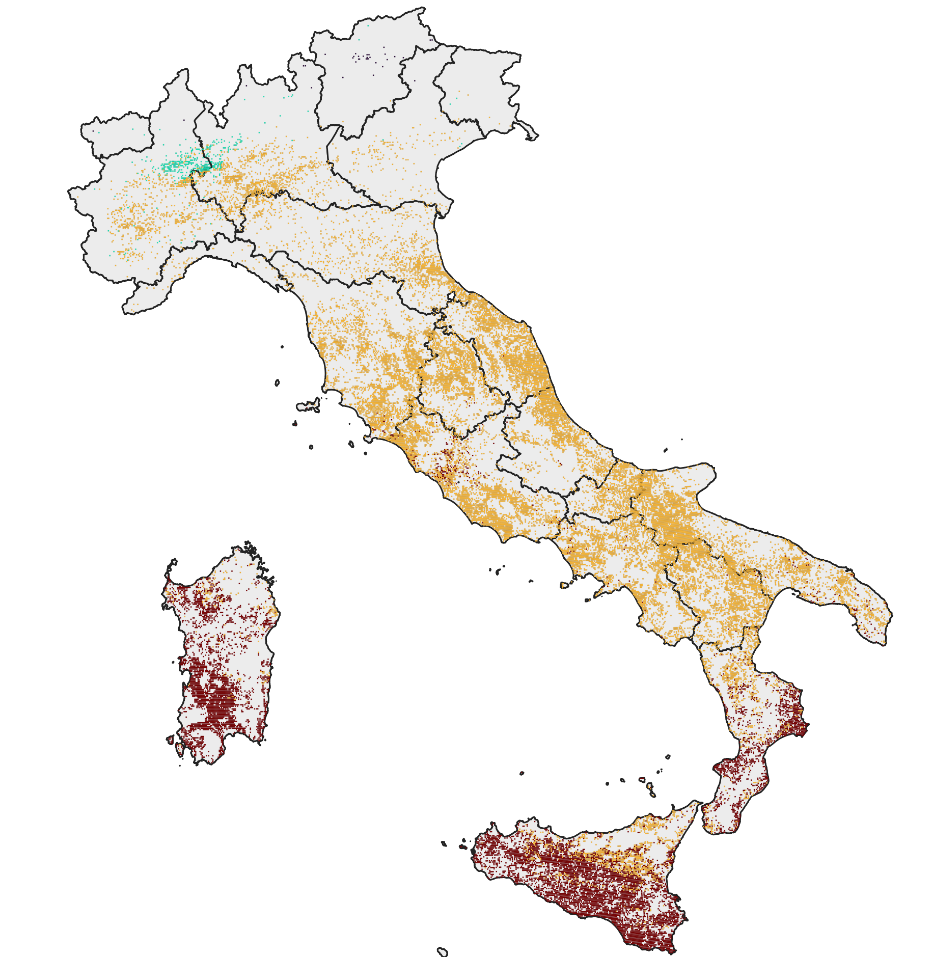
Results
Phenology
Plausible flowering time (May) from historical baseline (1).
Earlier flowering time in future scenarios (2 - 3).
Short seasons varieties (avoiding drought) will be favoured (4).
1. 1980 – 2010 hindcast
4
Predicted days from sowing to flowering and to maturity.
2. 2040 – 2070 scenario (spring)
3. 2040 – 2070 scenario (autumn)
Results 8/10

Slide 10
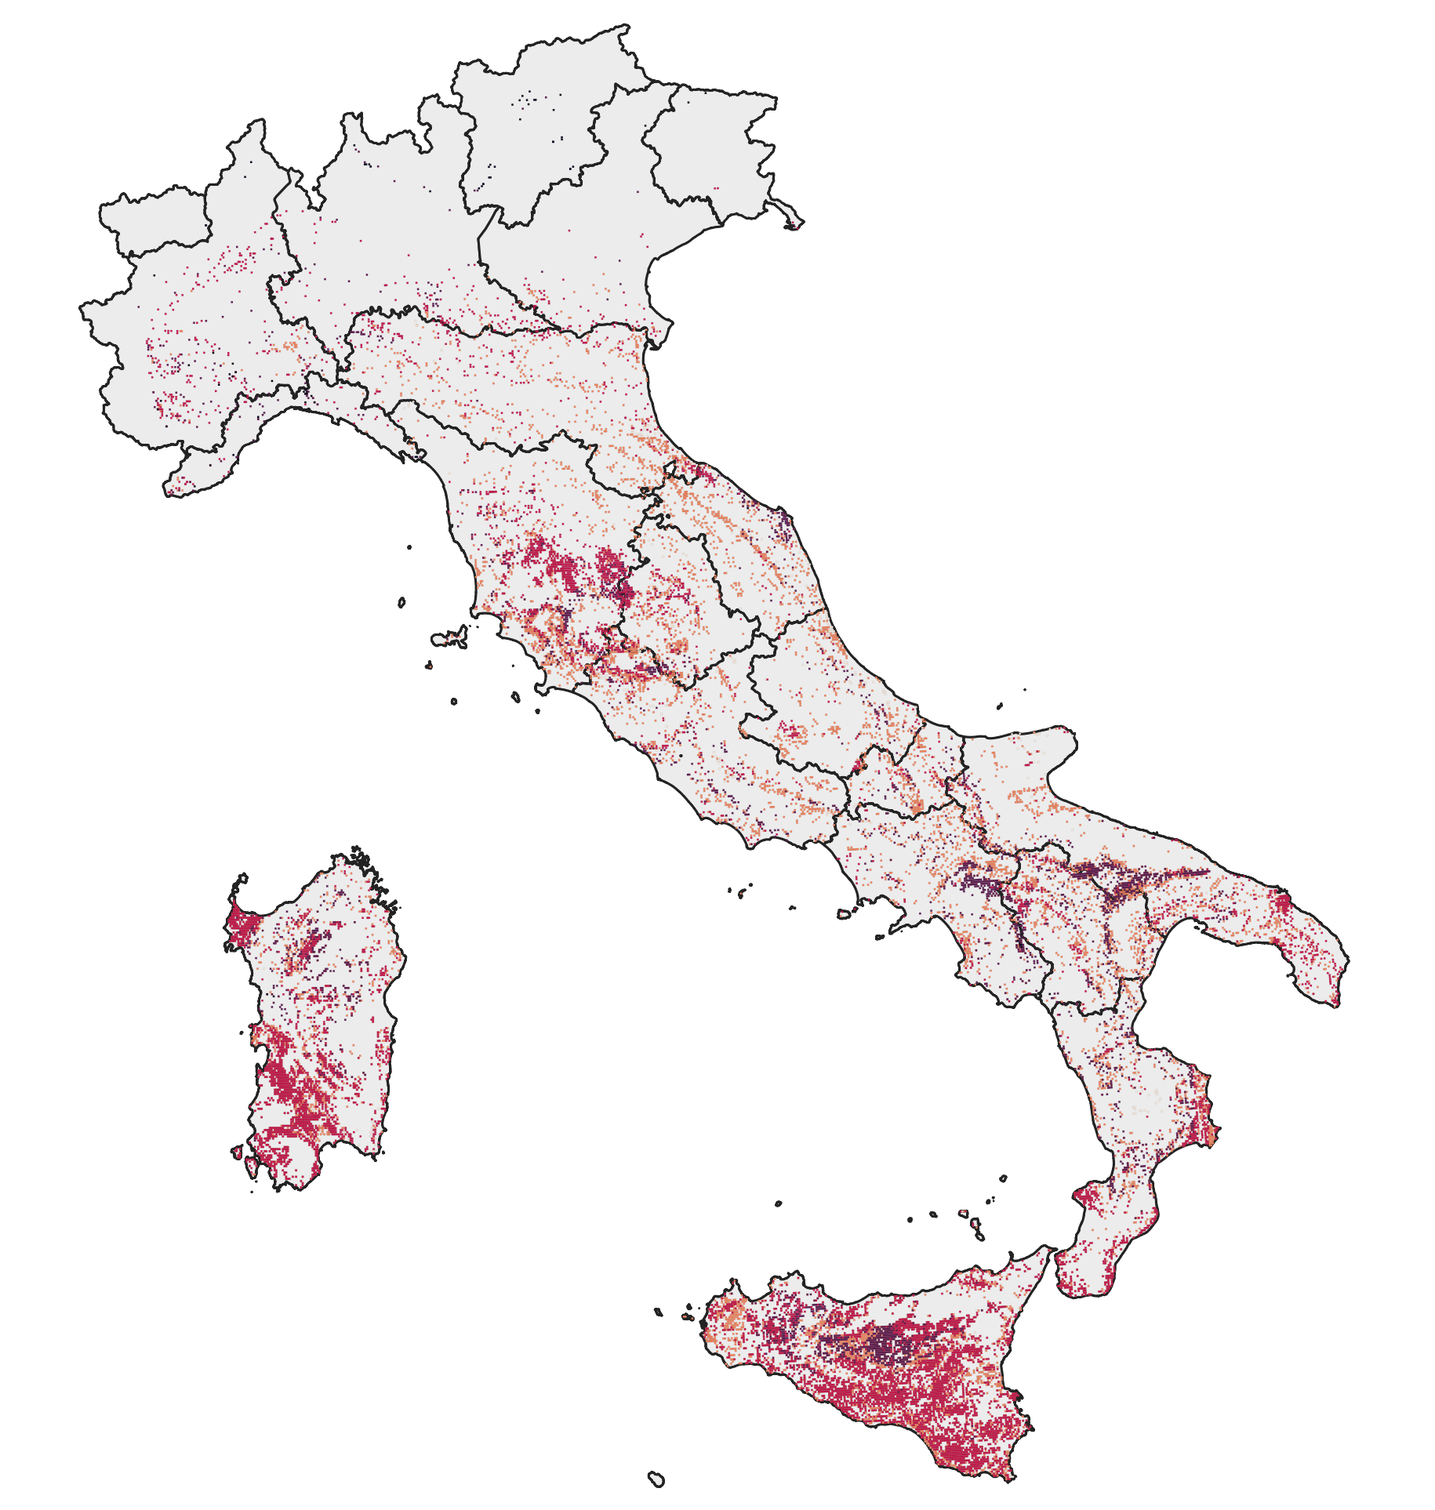
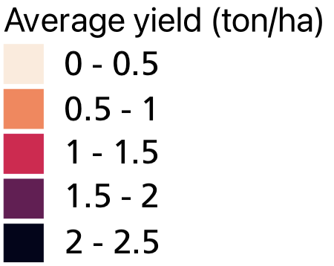
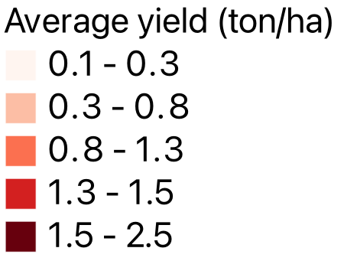
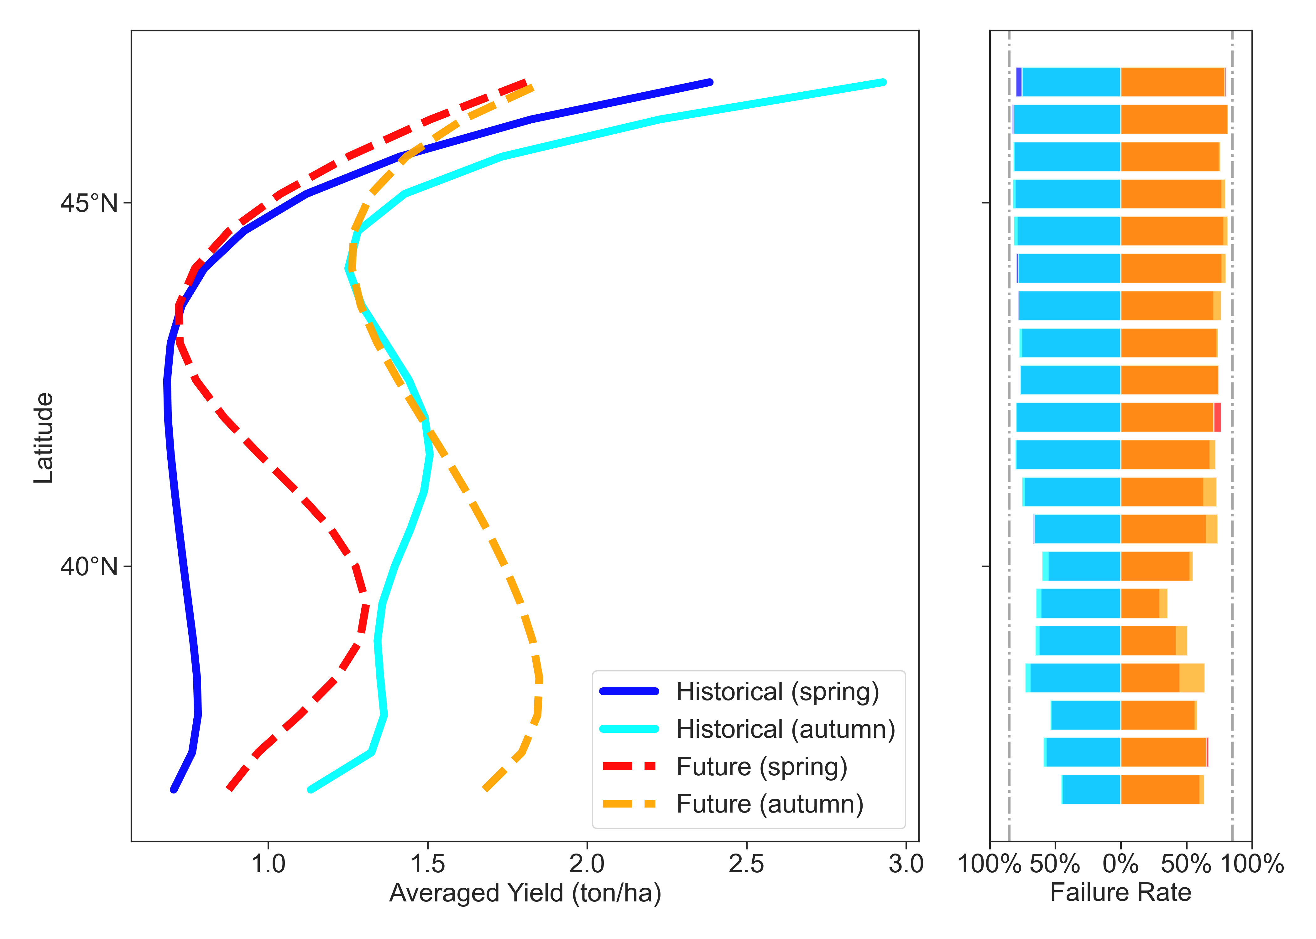
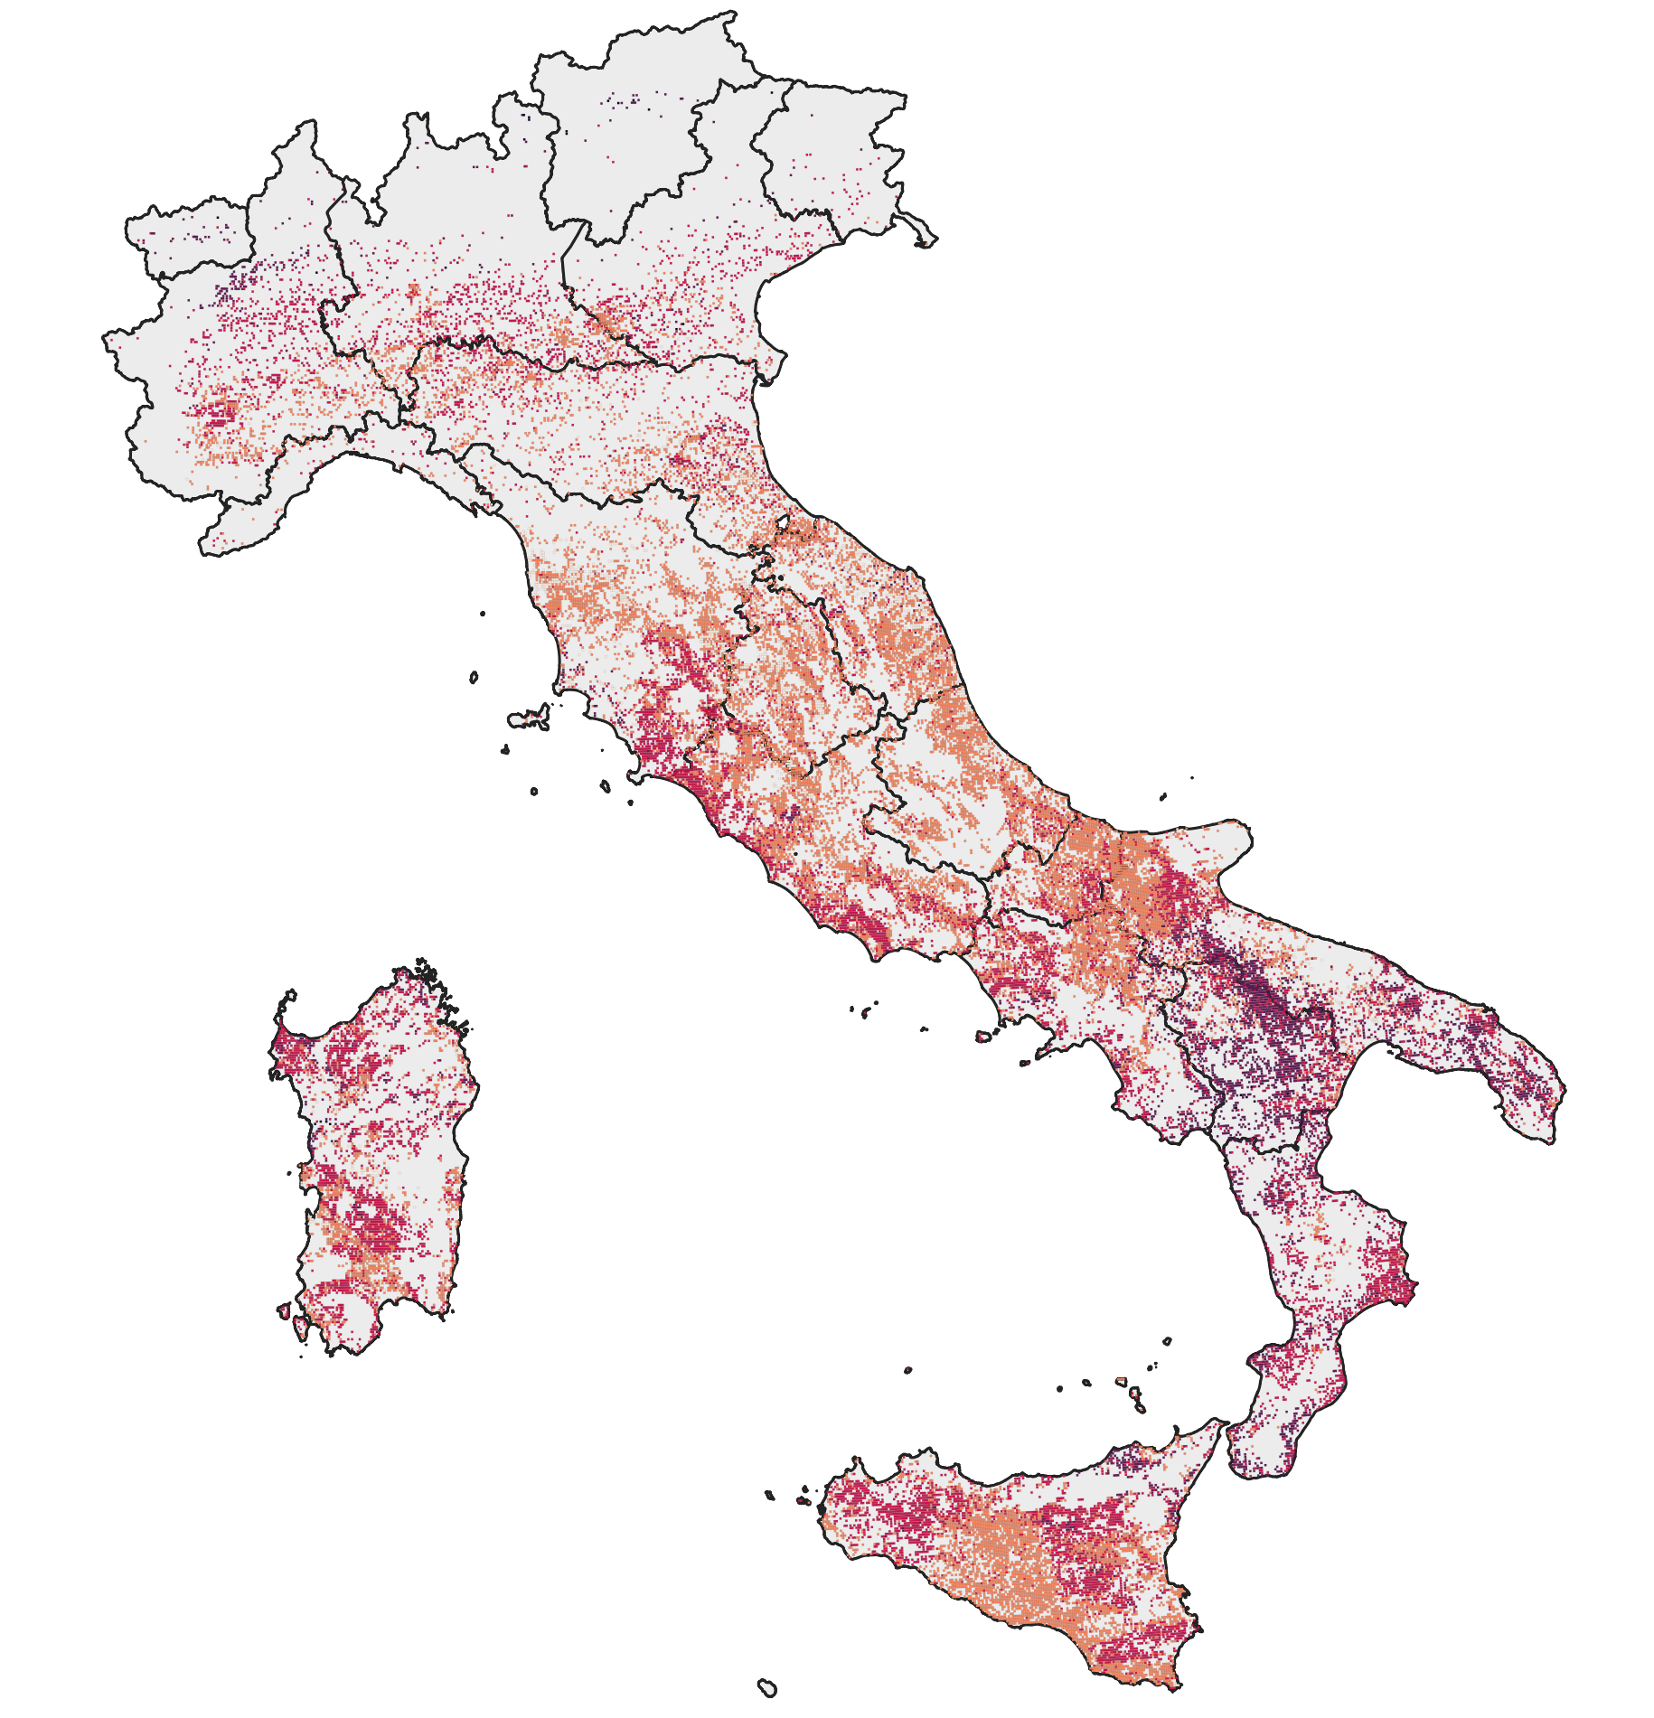
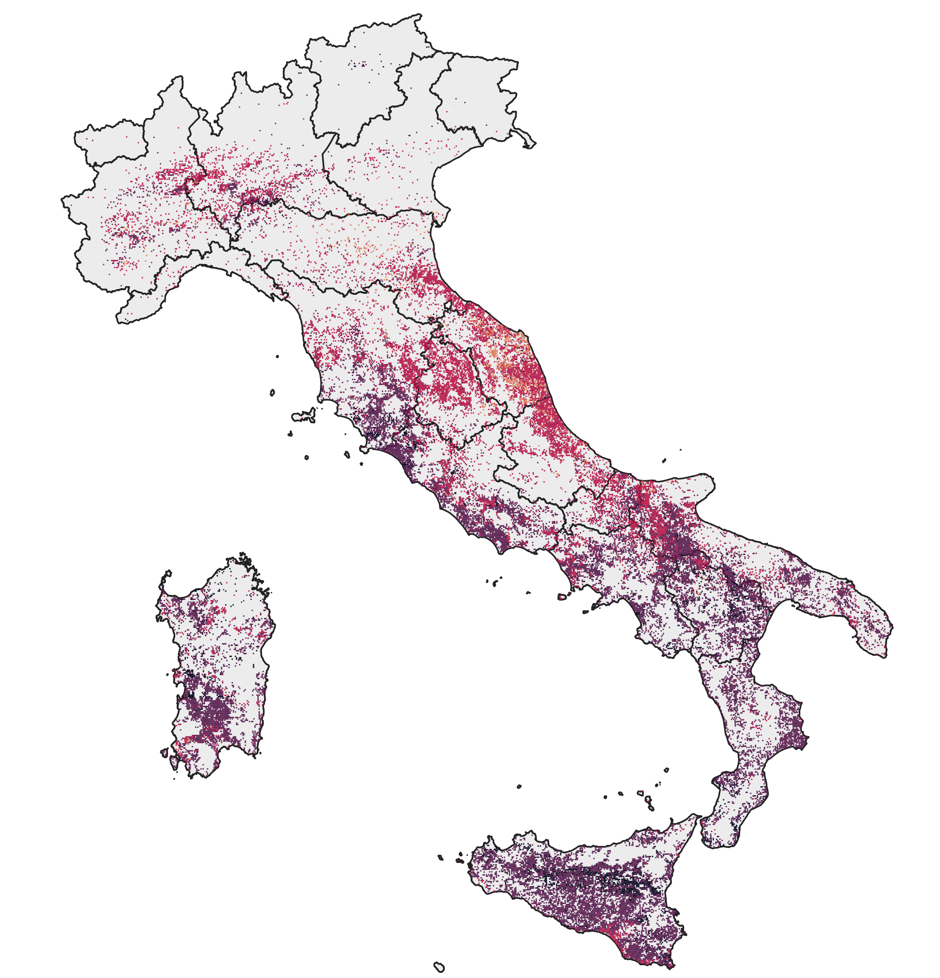
Productivity
Plausible distribution and average yield (0.8 - 1 ton/ha) (1).
Higher economically viable yields and northwards shift of the distribution (2 – 3).
Lower chance of failure at northern latitudes in future scenarios (4).
1. 1980 – 2010 hindcast
4
Average distribution for lentil yields along latitudes gradient.
2. 2040 – 2070 scenario (spring)
3. 2040 – 2070 scenario (autumn)
Results 9/10

Slide 11
Conclusion
Climate change may expand lentil cultivation, boosting protein self-sufficiency and diversifying production systems in Italy.
Shifting sowing anticipates flowering time and increases yield.
Positive effects of increased CO₂ and temperature could offset abiotic stress-related yield reductions, but the impact of these stresses on yield is still unknown.
Unexplored management adaptation strategies may conserve and promote the cultivation of lentil in Italy:
- new crop rotations and managements (e.g.intercropping).
Conclusion 10/10

Slide 12





Thank you for your attention
https://www.researchgate.net/profile/Alessandro-Triacca
https://linktr.ee/goagroecology
alessandro.triacca@santannapisa.it

