Slide 1
Influence of organic farming on microorganisms associated to crop plants – from landscape to local scale
C. Mony¹; C. Ricono¹; A. Alignier²; S. Aviron²; C. Bertrand³; P-A. Precigout³; C. Robert³; P. Vandenkoornhuyse¹
¹UMR ECOBIO, Université de Rennes, France
²UMR BAGAP, INRAE Rennes, France
³UMR ECOSYS, INRAE Paris, France

Slide 2
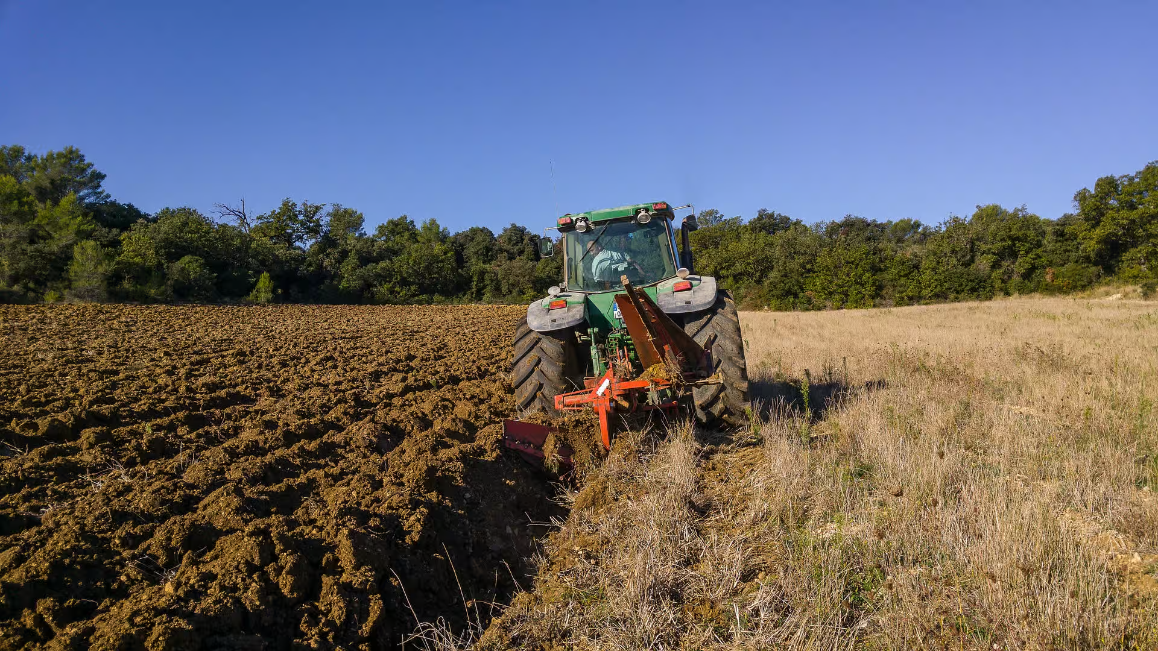
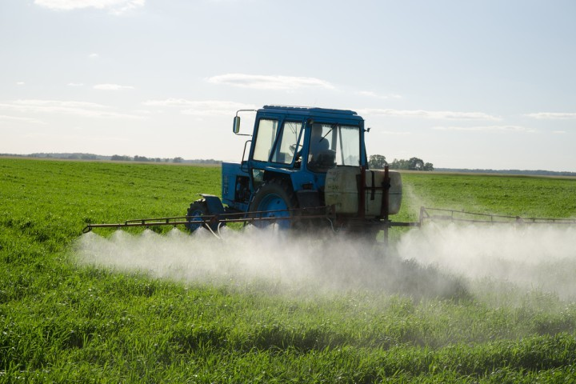
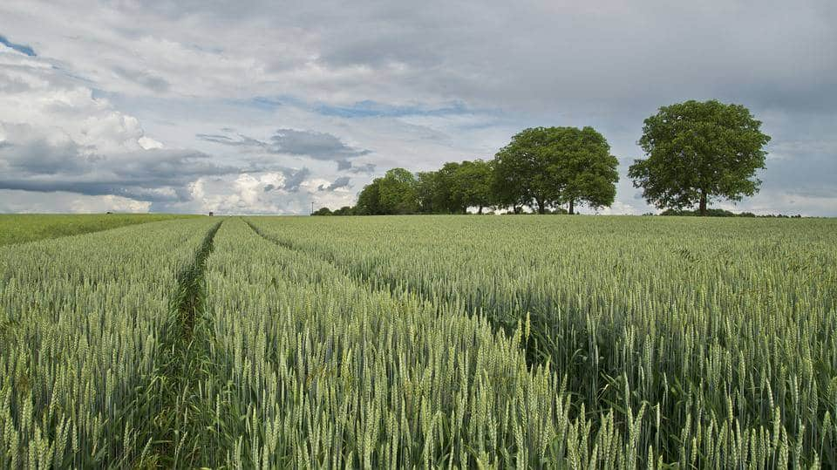


Introduction
Intensification of agricultural practices
Field scale
Field management (mineral input, pesticides,…)
Soil management (ploughing, …)
Crop rotation and type (monocultures,…)
Biodiversity and related ecosystem services

Slide 3
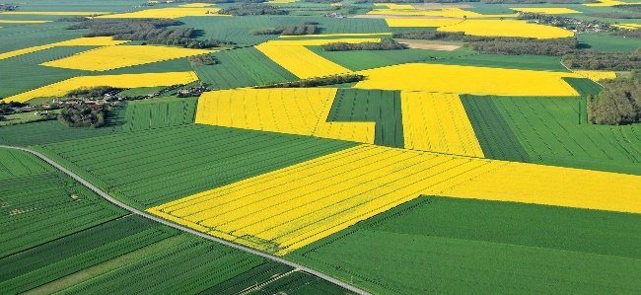
Introduction
Intensification of agricultural practices
Landscape scale
Field scale
Landscape homogeneization
Removal of semi-natural habitats
Field management (mineral input, pesticides,…)
Soil management (ploughing, …)
Crop rotation and type (monocultures,…)
Biodiversity and related ecosystem services

Slide 4
Introduction
Intensification of agricultural practices
Landscape scale
Field scale
Landscape homogeneization
Removal of semi-natural habitats
Field management (mineral input, pesticides,…)
Soil management (ploughing, …)
Crop rotation and type (monocultures,…)
Biodiversity and related ecosystem services
Organic farming as a solution ?

Slide 5
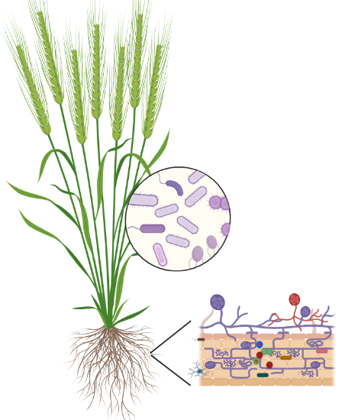
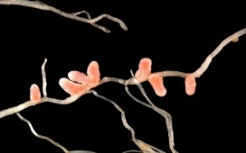
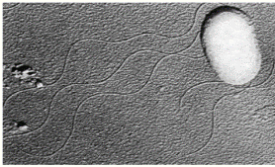
Introduction
Microbes as a pilar of soil fertility
One plant =several hundreds of microbes
Phyllosphere
Endosphere
Rhizosphere
Recruitment
Bacteria
Fungi (AMF)
Archae
Soil reservoir

Slide 6
Introduction
Microbes as a pilar of soil fertility
One plant =several hundreds of microbes
Phyllosphere
Key ecological functions
>Nutrition and biomass production
>Resistance to environmental stresses
>Defense mechanisms against pathogens
Endosphere
Rhizosphere
Recruitment
Bacteria
Fungi (AMF)
Archae
Soil reservoir
Bulgarelli et al., 2013; Berg et al., 2016

Slide 7

Introduction
Organic farming as an alternative sustainable way of practising agriculture
No pesticides (higher soil management)
Organic instead of mineral amendment
Mixed culture of cultivars/ species instead of monocultures
Selection of old cultivars
Main assumptions:
Increase in soil microbial biodiversity
Increase in microorganisms associated with plants
Increase in Crop health

Slide 8

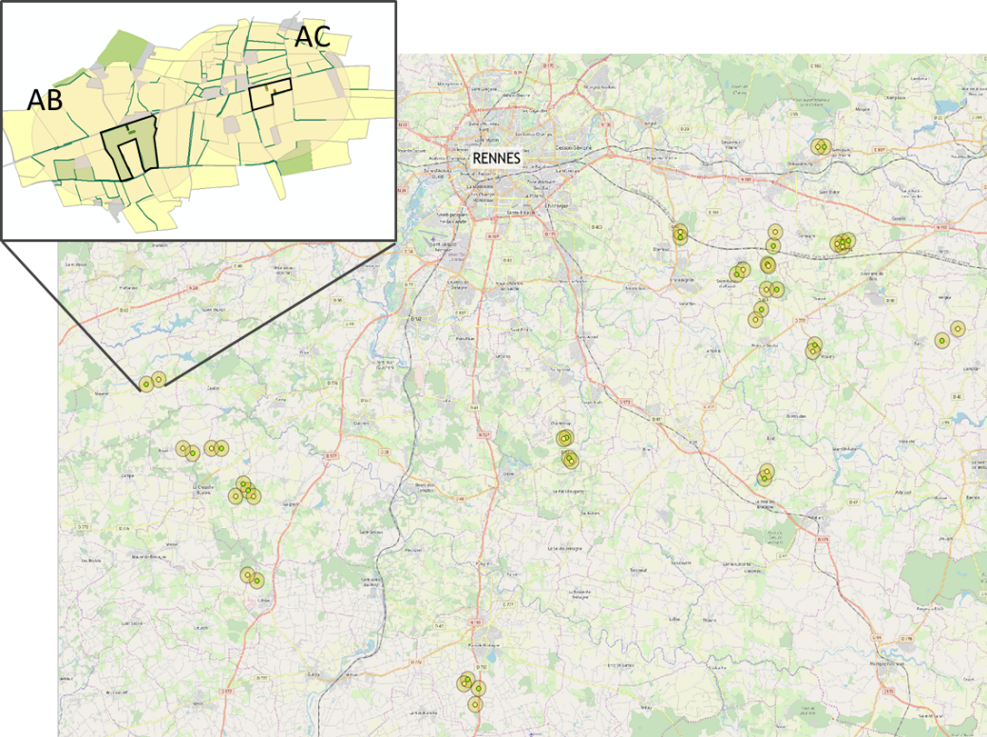
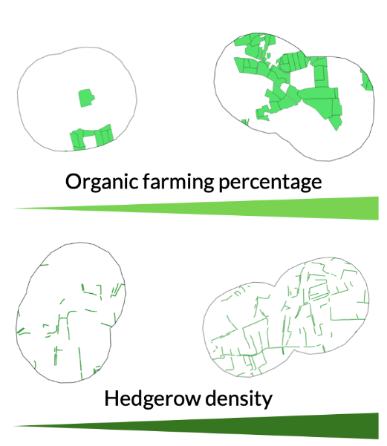




Experimental design
Pairs of OF versus CF fields
Landscape scale
20 landscapes
(500m-buffer around fields)
0
40%
0
5%
Field scale
40 farmers involved

Slide 9

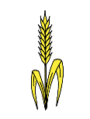
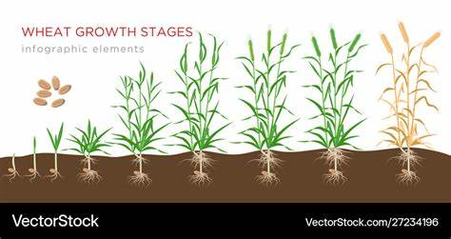
Experimental design
Wheat microbiota composition
4 sampling point along 2 transects per edge type
2 time-points (March & May)
Bacteria and Fungi (16S & 18S rRNA)

Slide 10

Experimental design
Wheat microbiota composition
Environmental conditions
Agricultural practices
Inputs
Nb of cultivars
Soil management
Pesticides treatments…
Soil parameters
Physical structure (% silt, sand,…)
Soil chemistry (pH, MO, N, P…)
Floristic composition
Center & field edges
4 sampling point along 2 transects per edge type
2 time-points (March & May)
Bacteria and Fungi (16S & 18S rRNA)

Slide 11
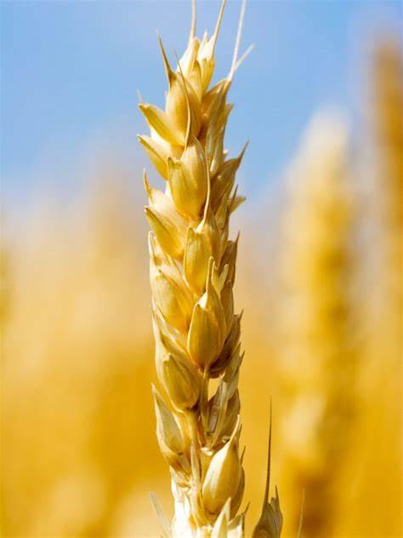
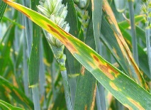
Experimental design
Wheat microbiota composition
Environmental conditions
Agricultural practices
Inputs
Nb of cultivars
Soil management
Pesticides treatments…
Soil parameters
Physical structure (% silt, sand,…)
Soil chemistry (pH, MO, N, P…)
Floristic composition
Center & field edges
4 sampling point along 2 transects per edge type
Crop performance indicators
2 time-points (March & May)
Grain production
% of pathogen attack on leaves
(septoriose)
Bacteria and Fungi (16S & 18S rRNA)

Slide 12
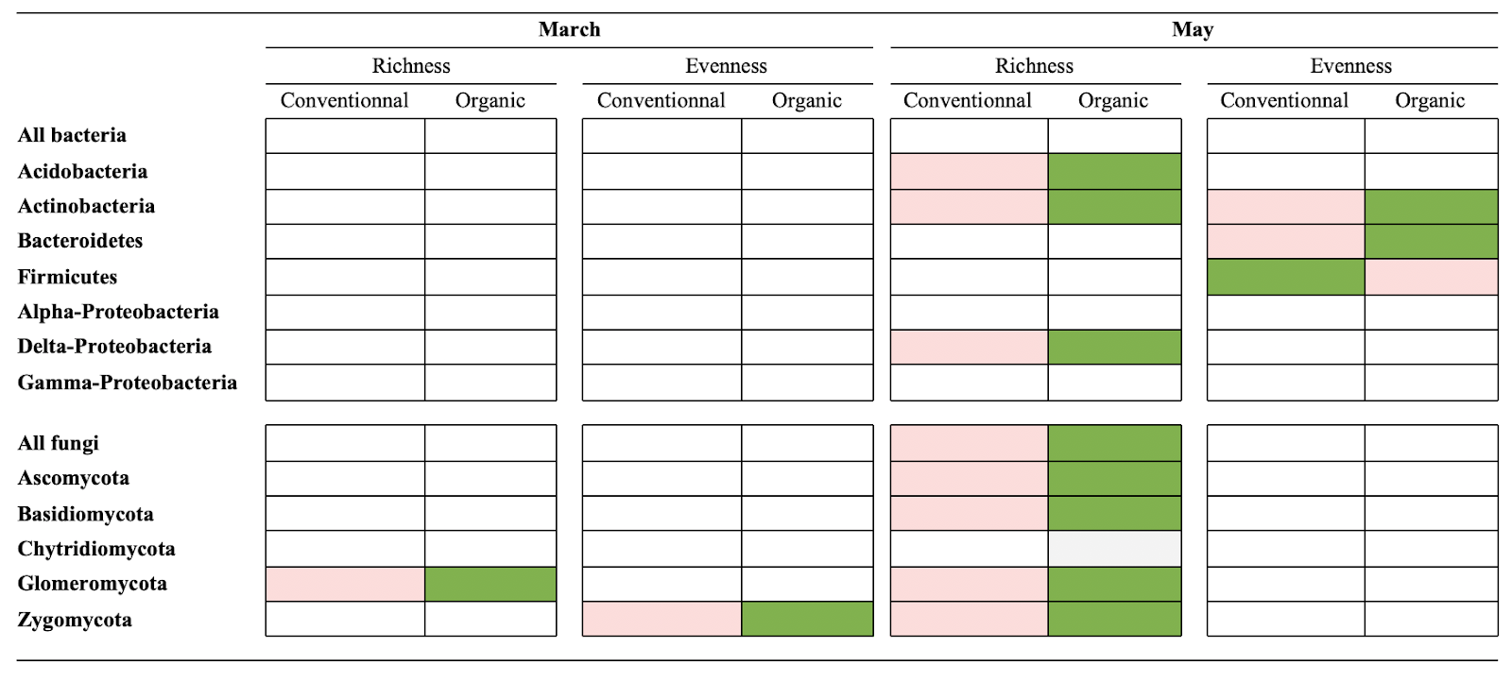
Results and discussion
↗ in diversity in most phyla, especially for late developmental stage (cumulative of management actions along the crop development)
lower
higher
Ricono et al., in revision, AGEE

Slide 13
Results and discussion
Different scales of effect of organic farming, hedgerow occurrence depending on phyla (cumulative of management actions along the crop development)
Landscale scale
Field scale
All Bacteria
+
-
Acidobacteria
Actinobacteria
+
-
+
Bacterioides
Firmicutes
+
Proteobacteria
+
+
All fungi
+
-
-
Ascomycota
-
Basidiomycota
-
-
Chytridiomycota
+
-
+
Glomeromycota
+
Zygomycota
+
-
Ricono et al., 2022, FEMS

Slide 14
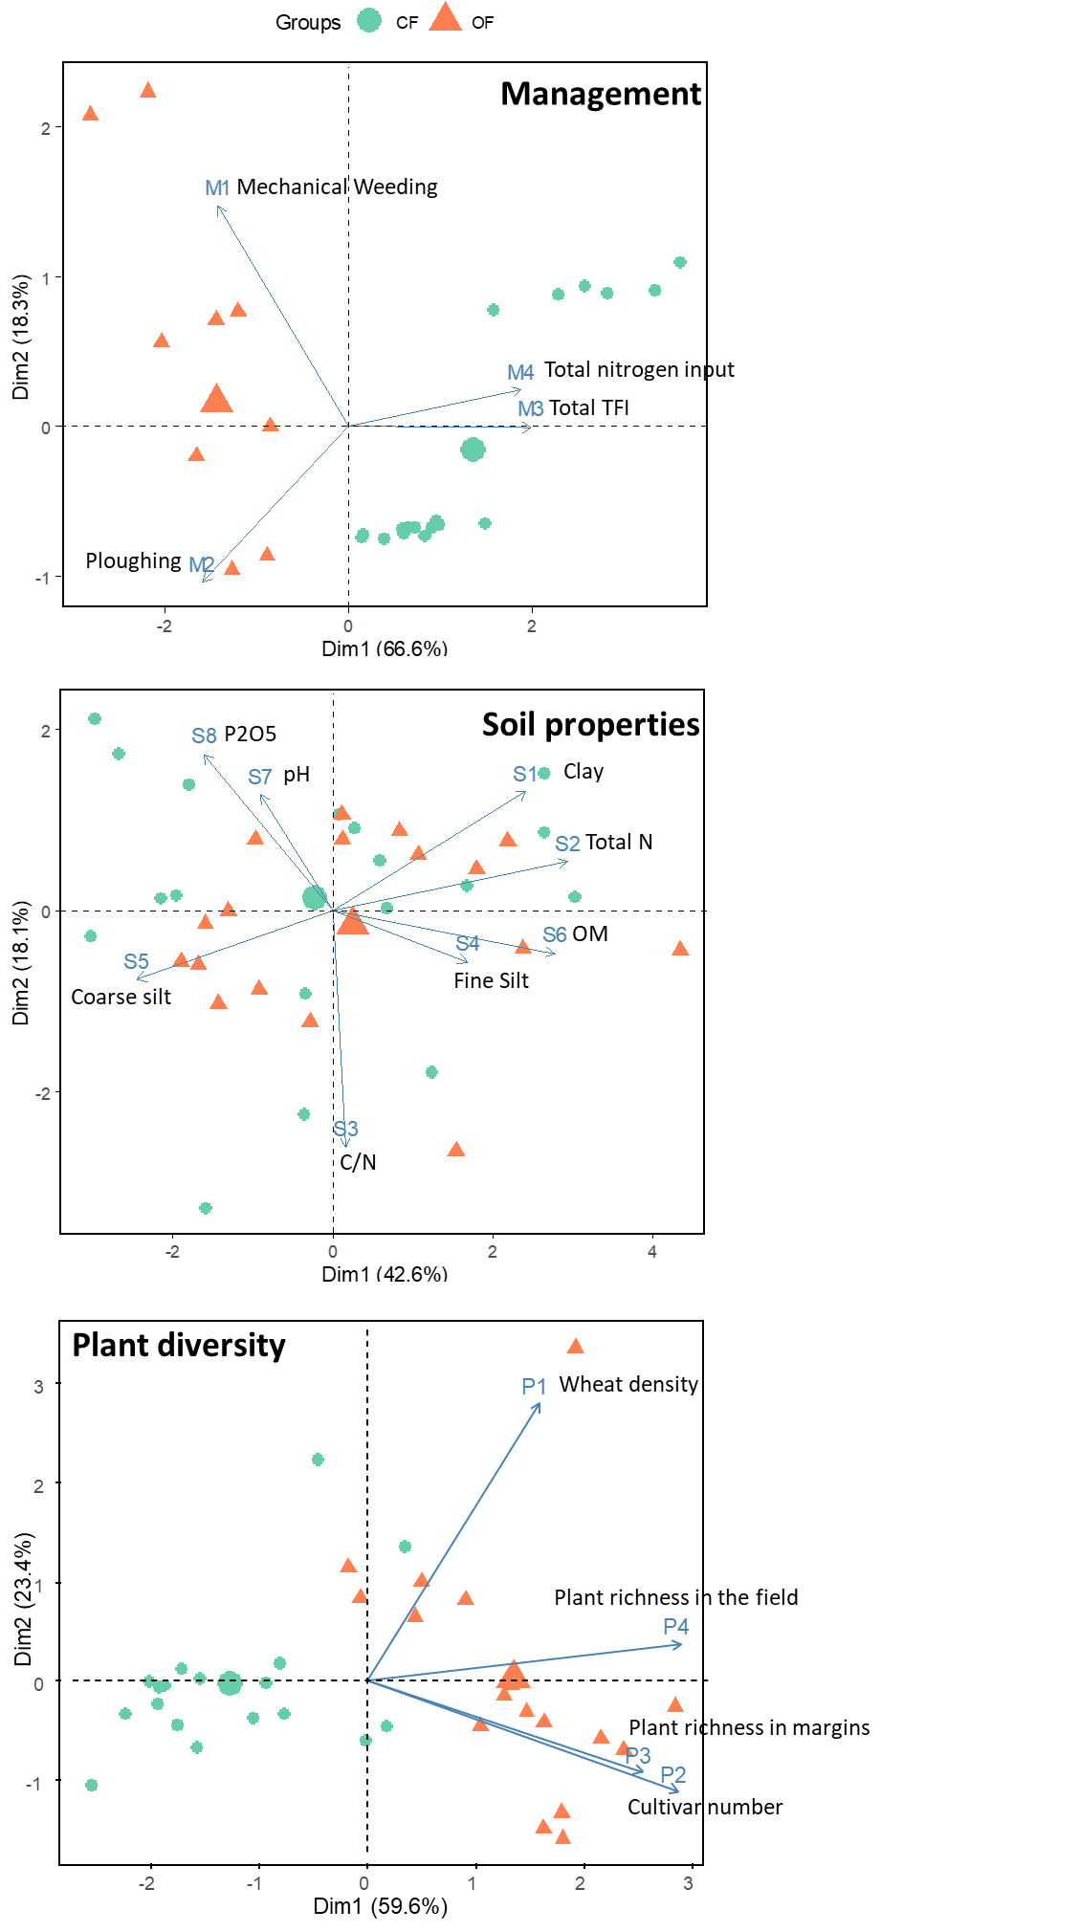
Results and discussion
Environmental conditions
Agricultural practices
Soil parameters
Floristic composition
Variable aggregation

Slide 15
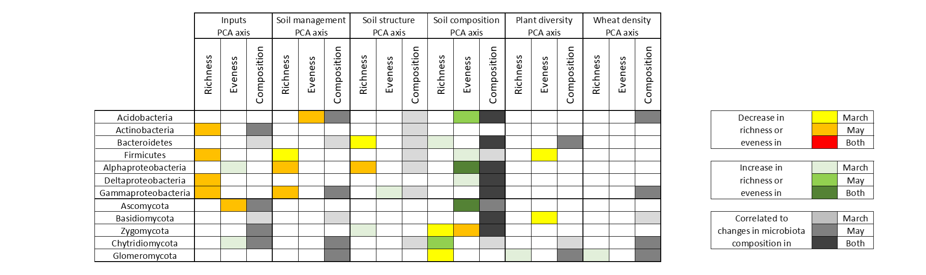
Results and discussion
Behind organic farming, field management and soil characteristics on bacteria and fungi diversity and/or composition
Field management
Soil characteristics
Plant density & diversity
Mostly field management and soil characteristics
+ Early effect of soil characteristics but late effect of field management

Slide 16
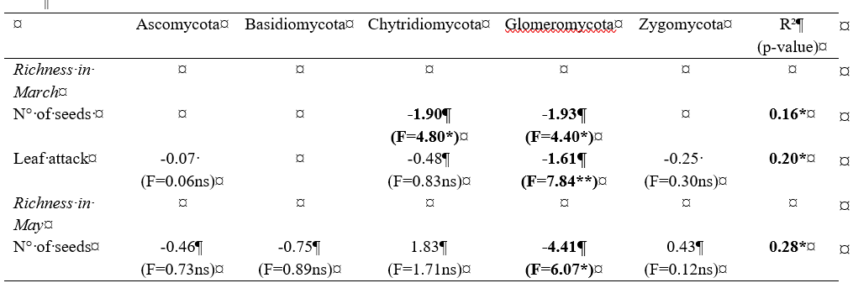
Results and discussion
Change in fungi diversity related with grain production and pathogen attack on leaves, especially in early developmental stage

Slide 17
Conclusion
Organic farming for plant microbial enrichment
>Environmental-friendly practices influencing plant microbiota
Structure (diversity and composition)
Soil characteristics
+ Field management

Slide 18

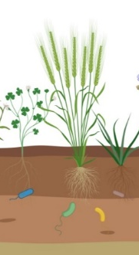

Conclusion
Organic farming for plant microbial enrichment
>Environmental-friendly practices influencing plant microbiota
Structure (diversity and composition)
Soil characteristics
+ Field management
>Muti-scale targets for application
Crop performance
(production, resistance to pathogens)
Crop microbiota
Landscape scale
Field scale
Within field scale

Slide 19


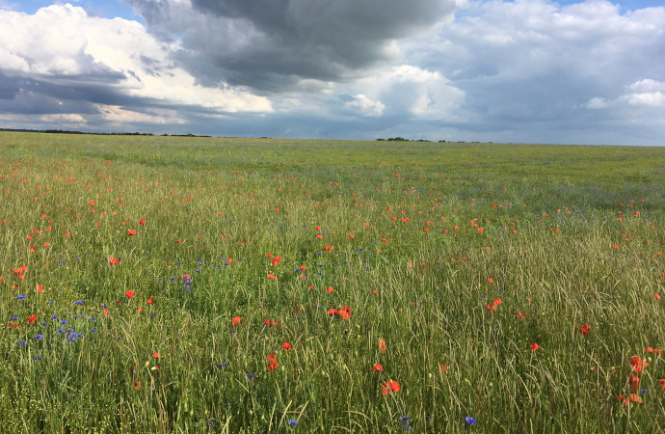


Acknowledgements
Collaborators
Romain Causse-Védrines
Sophie Coudouel
Thierry Fontaine
Olivier Jambon
Ting-Ting Wang

