Slide 1
Tracking-down inter-farm collaborations to promote crop diversity
A. Pépin; M. Mosset
INRAE UMR SAS

Slide 2
Context
Specialisation of farms vs. agroecology
Specialisation of farms and territories
Mixed farms in EU28 : 30% in 2005, 24% in 2016 (Eurostat)
Mixed farms in Brittany : 12 % in 2020 (Eurostat)
Crop-livestock integration and crop diversification are major levers for the development of agroecology
Improves farming system resilience by e.g. limiting disease pressure, optimizing the use of nutrients and regulating the water cycle (Lin, 2011; Martin et al., 2016).
A challenge for farmers
Increased workload (Ryschawy et al., 2017)
Labour organization and mental workload (Navarrete et al., 2015)
Knowledge intensive (Toffolini et al., 2017)
Specific machinery (Meynard et al., 2018)
Inter-farm collaborations for crop-livestock integration and crop diversification at the inter-farm level ?
Notes:
However, their implementation on the long term by farmers is a challenge, as they require an increased workload and more knowledge.

Slide 3
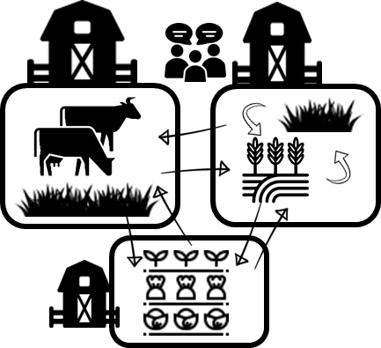
Context
Inter-farm collaborations ?
Inter-farm collaborations
Specialized farms
Sharing crops, fields or a common crop planning
Poorly documented in the North-West of France
Which type of farms ?
What are they sharing ?
With which organisation ?
What are their interests ?
What are the constraints ?
→ Tracking-down « innovations »

Slide 4
Context
Partners
First stage of a broader project
Co-designing inter-farm collaborations with a group of farmers next to Rennes
Produce transferable knowledge to provide advice to farmers
Funded by
Notes:
This study is part of a larger project conducted with Agrobio 35, i.e. the local organic farming syndicate, and a group of farmers that raised the topic of inter-farm collaboration to enhance crop diversification. This project aims at co-designing inter-farm collaborations with the group of farmers and produce transferable knowledge to provide advice to producers.

Slide 5
Method
Tracking farmers’ innovations (Salembier et al., 2021)
1. Defining a tracking project
2. Unearthing on farm innovations
3. Getting to know innovations
4. Analysing learnings from the innovations
5. Generating agronomic content
Farms that cooperate with other farms in order to diversify or maintain a diversity of crops and/or livestock
Identify farms by snowball sampling : asking targeted stakeholders if they knew either farmers who were innovating or people who might know them
Conducting individual interviews with 16 farmers (10 collaborations)
Qualitative multi-theme coding (Ayache and Dumez, 2011)
Cross-sectional analysis
Master student report
More to come

Slide 6
Results
Four types of collaborations
Complementarity
Synergy
Planned sales between 2 farms
Exchange of raw materials
Shared crop rotation
Joint selling
Coordination between farmers to offer a complete range of products for direct selling
A farmer produces a crop on his/her own land and sells it to his/her neighbour on a regular basis. The neighbour commits to buying the crop each year.
The 2 (or more) farmers produce a crop on his/her own land for his/her neighbour on a regular basis. Financial compensation can occur in case of unbalanced value.
Plot exchange or plot sharing. Often formalised by an agreement as the operations are very intertwined and therefore require better guarantees.
N=1
N=4
N=3
N=2

Slide 7
Results
Four types of collaborations
Complementarity
Synergy
Provide wheat seeds
Field operations (weeding, harvesting) + sorting
Buys the wheat (minus the costs of seeds and field operations)
Exchange of raw materials
The 2 (or more) farmers produce a crop on his/her own land for his/her neighbour on a regular basis. Financial compensation can occur in case of unbalanced value.
Oral agreement
Which plot ?
Price (same every year)
Allow 1 to have enough wheat with a 4 year rotation + outlet for the grass
Allow 2 to grow crops between 2 cycles of pasture + outlet for the wheat
Grass
Straw-manure exchange
Farmer-baker
35 ha UAA
Needs 12 ha for wheat : only 8 ha available in a 4 year rotation
Wheat
Cow breeder
60 ha UAA
70 milking cows
Needs to grow cereals between 2 cycles of pasture
Harvest the grass
Buys the grass
N=2

Slide 8
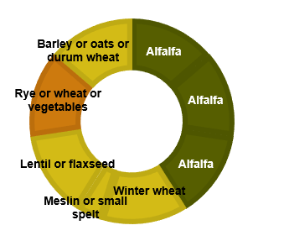
Results
Four types of collaborations
Complementarity
Synergy
Shared crop rotation
Plot exchange or plot sharing. Often formalised by an agreement as the operations are very intertwined and therefore require better guarantees.
Market gardener
3,5 ha
Cow breeder
160 ha including 40 ha in the shared rotation
Written agreement
Management (date of harvest, fertilisation)
Straw-manure exchange
Condition of use of other farm’s machinery
1 meeting per year
Debrief
Plan next year
N=3
Farmer-baker
70 ha

Slide 9
Discussion
Collaboration allows longer crop rotation
Produce crops not directly needed
Forage in farms without livestock
Crops for human consumption in farms with livestock
Control of weeds and diseases
Fertilisation with legumes and manure
Only organic cases
No chemicals and synthetic fertilisers : need long rotations
Possible intensification
Fodder produced out of the farm → more livestock

Slide 10
Discussion
Helps setting-up young farmers
Possible to set up on a small area
Limited investment (land, machinery…)
Focus on a few crops or activities
Farmers without agricultural background : not the same attachment to land
Independence
Towards suppliers of inputs
Towards agricultural contractors
Towards industry : on-farm processing (bread, cheese, beer…) + local outlet
Territorial diversification

Slide 11
Discussion
Social aspects
Social relations with “colleagues”
Require the same vision, a good communication, trust
Not collective farms : each farmer make his/her own decisions
Regulation
Organic certification
CAP subsidies

Slide 12
Thank you !
antonin.pepin@inrae.fr

Slide 13
Results
Four types of collaborations
Complementarity
Synergy
Joint selling
Coordination between farmers to offer a complete range of products for direct selling
Each farm: limited diversity of vegetables (~20 vs. ~5 for specialised and ~40 for direct sellers)
Keep the value of direct selling with not so complex farms (but still diversified)
Outdoor vegetables (potato, cabbage, carrot…)
Joint selling of a complete range of vegetables :
Markets
Box scheme
Common employee, truck, table, boxes…
Sheltered vegetables (tomato, lettuce, radish)
N=1
Complementary vegetables
Market gardeners

Slide 14
Results
Four types of collaborations
Complementarity
Synergy
Planned sales between 2 farms
Pasture (grass)
Shared tractor
A farmer produces a crop on his/her own land and sells it to his/her neighbour on a regular basis. The neighbour commits to buying the crop each year.
Goat breeder
Sells
Oral agreements
Outlet for alfalfa (1)
Outlet for grass surplus (2)
The buyer harvest the crop (no need for specific machinery for 1)
Local source of organic fodder (2 and 3)
Alfalfa
Sells
Sells
Farmer-baker
N=4
Cow breeder

Slide 15
Context
Specialisation of farms

