Slide 1
Contribution of diversification to resilience capacities of agricultural systems
M. Arndt; K. Helming
Leibniz Centre for Agricultural Landscape Research (ZALF)

Slide 2
Contribution of diversification to resilience capacities of agricultural systems
Overview
Why resilience matters?
Contribution of agricultural diversifiction measures to resilience
Resilience capacities and the adaptive cycle
https://tse4.mm.bing.net/th?id=OIP.JmhhobQkxKObkUCdoW579wHaEb&pid=Api

Slide 3
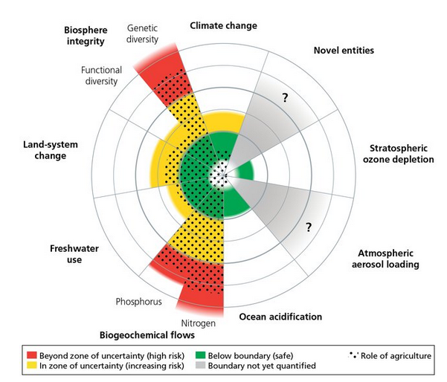
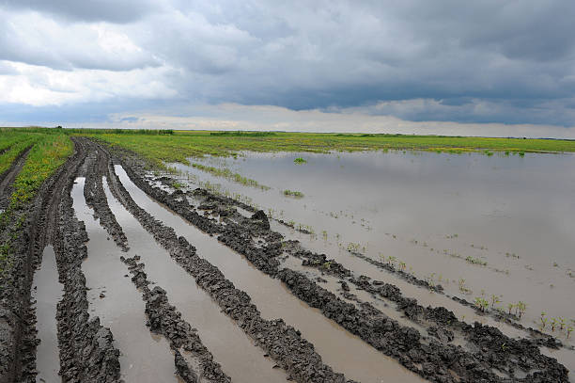
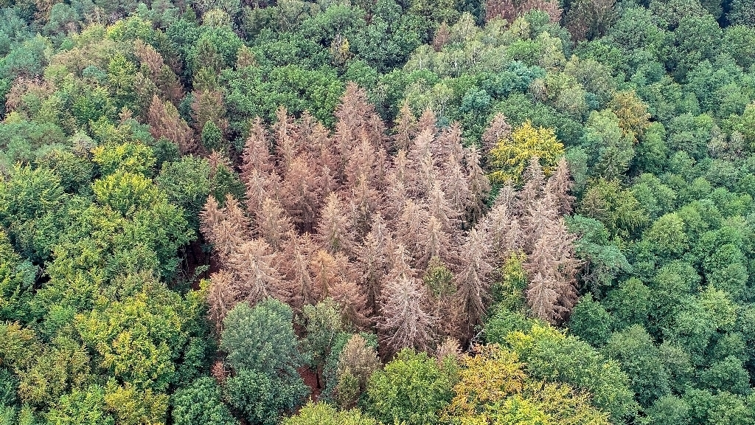
Multiple struggles of agriculture
Longterm risks: threatened planetary boundaries, rural exodus, limited skilled workforce…
Sudden shocks: war, Covid, sudden weather extremes…
https://www.moz.de/imgs/38/7/2/9/2/5/3/3/9/tok_3cc90da9ded5a9edab422bc317d11d1e/w1024_h576_x512_y351_88057942bb648875.jpeg
Campbell et al. 2017
Resilience is needed!
Notes:
Rockström 2009 „A safe operating space for humanity” biophysical thresholds
exceeded! transgressed
The safe spaces/“safe limits” within humanity can operate
Stored!
Contribution of agriculture to it
Shocks: can affect single or multiple farms. War → fertilizer prices, covid→ labour

Slide 4
Resilience (of a farming system)
“its ability to ensure the provision of the system functions in the face of increasingly complex and accumulating economic, social, environmental and institutional shocks and stresses, through capacities of robustness, adaptability and transformability.”
Meuwissen et al. , 2019, p.1
Meuwissen et al. , 2019, p. 5
Notes:
Farm is the ball, conditions/circumstances are the valley.

Slide 5
Equilibrium of the three resilience capacities
ADAPTABILITY
ROBUSTNESS
TRANSFORM-
ABILITY
Notes:
https://www.maths.ox.ac.uk/system/files/media/3ballcascade_2.png
https://www.juggling-for-beginners.com/image-files/3ball.jpg

Slide 6
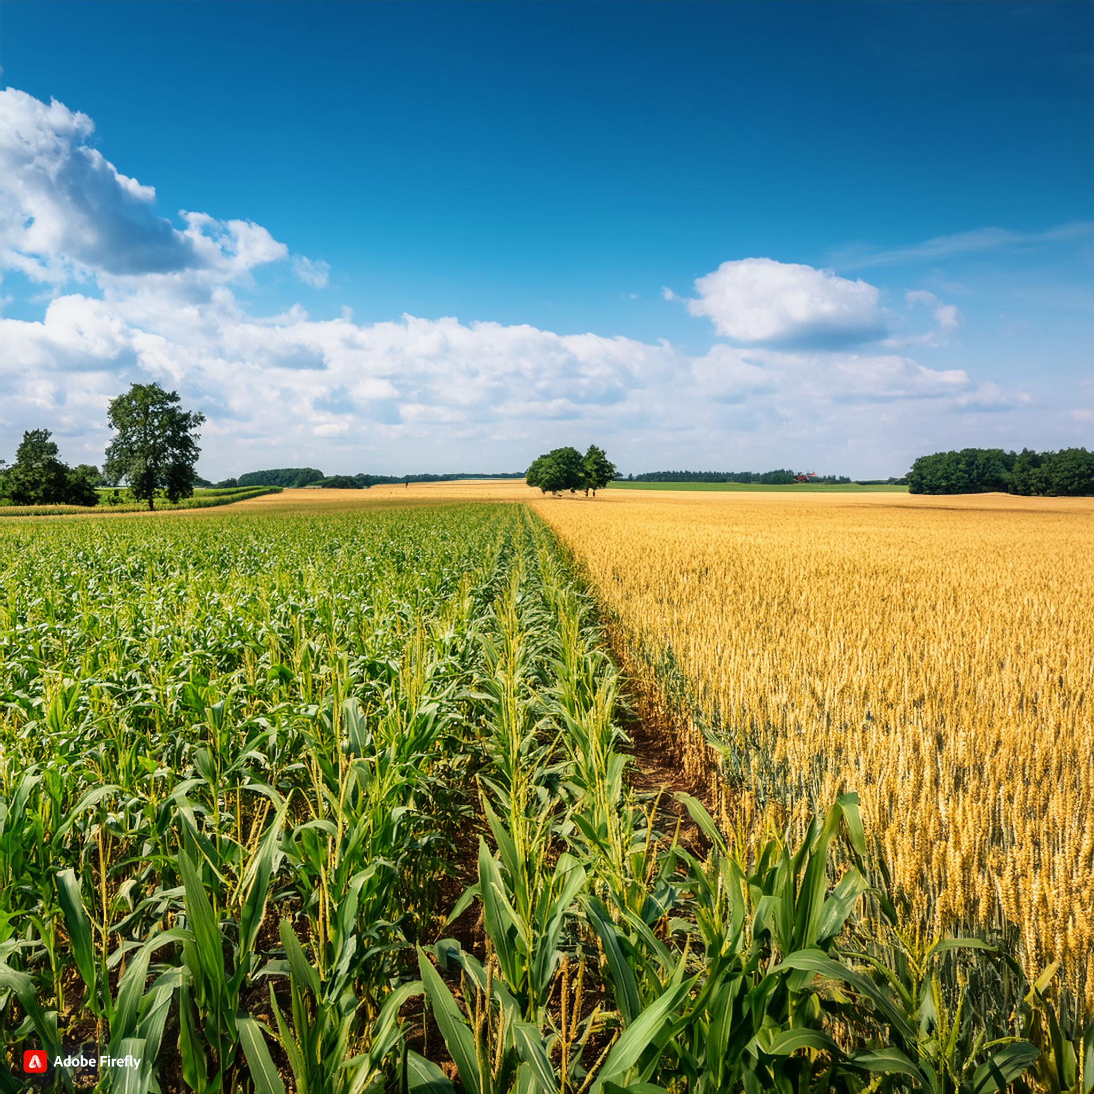
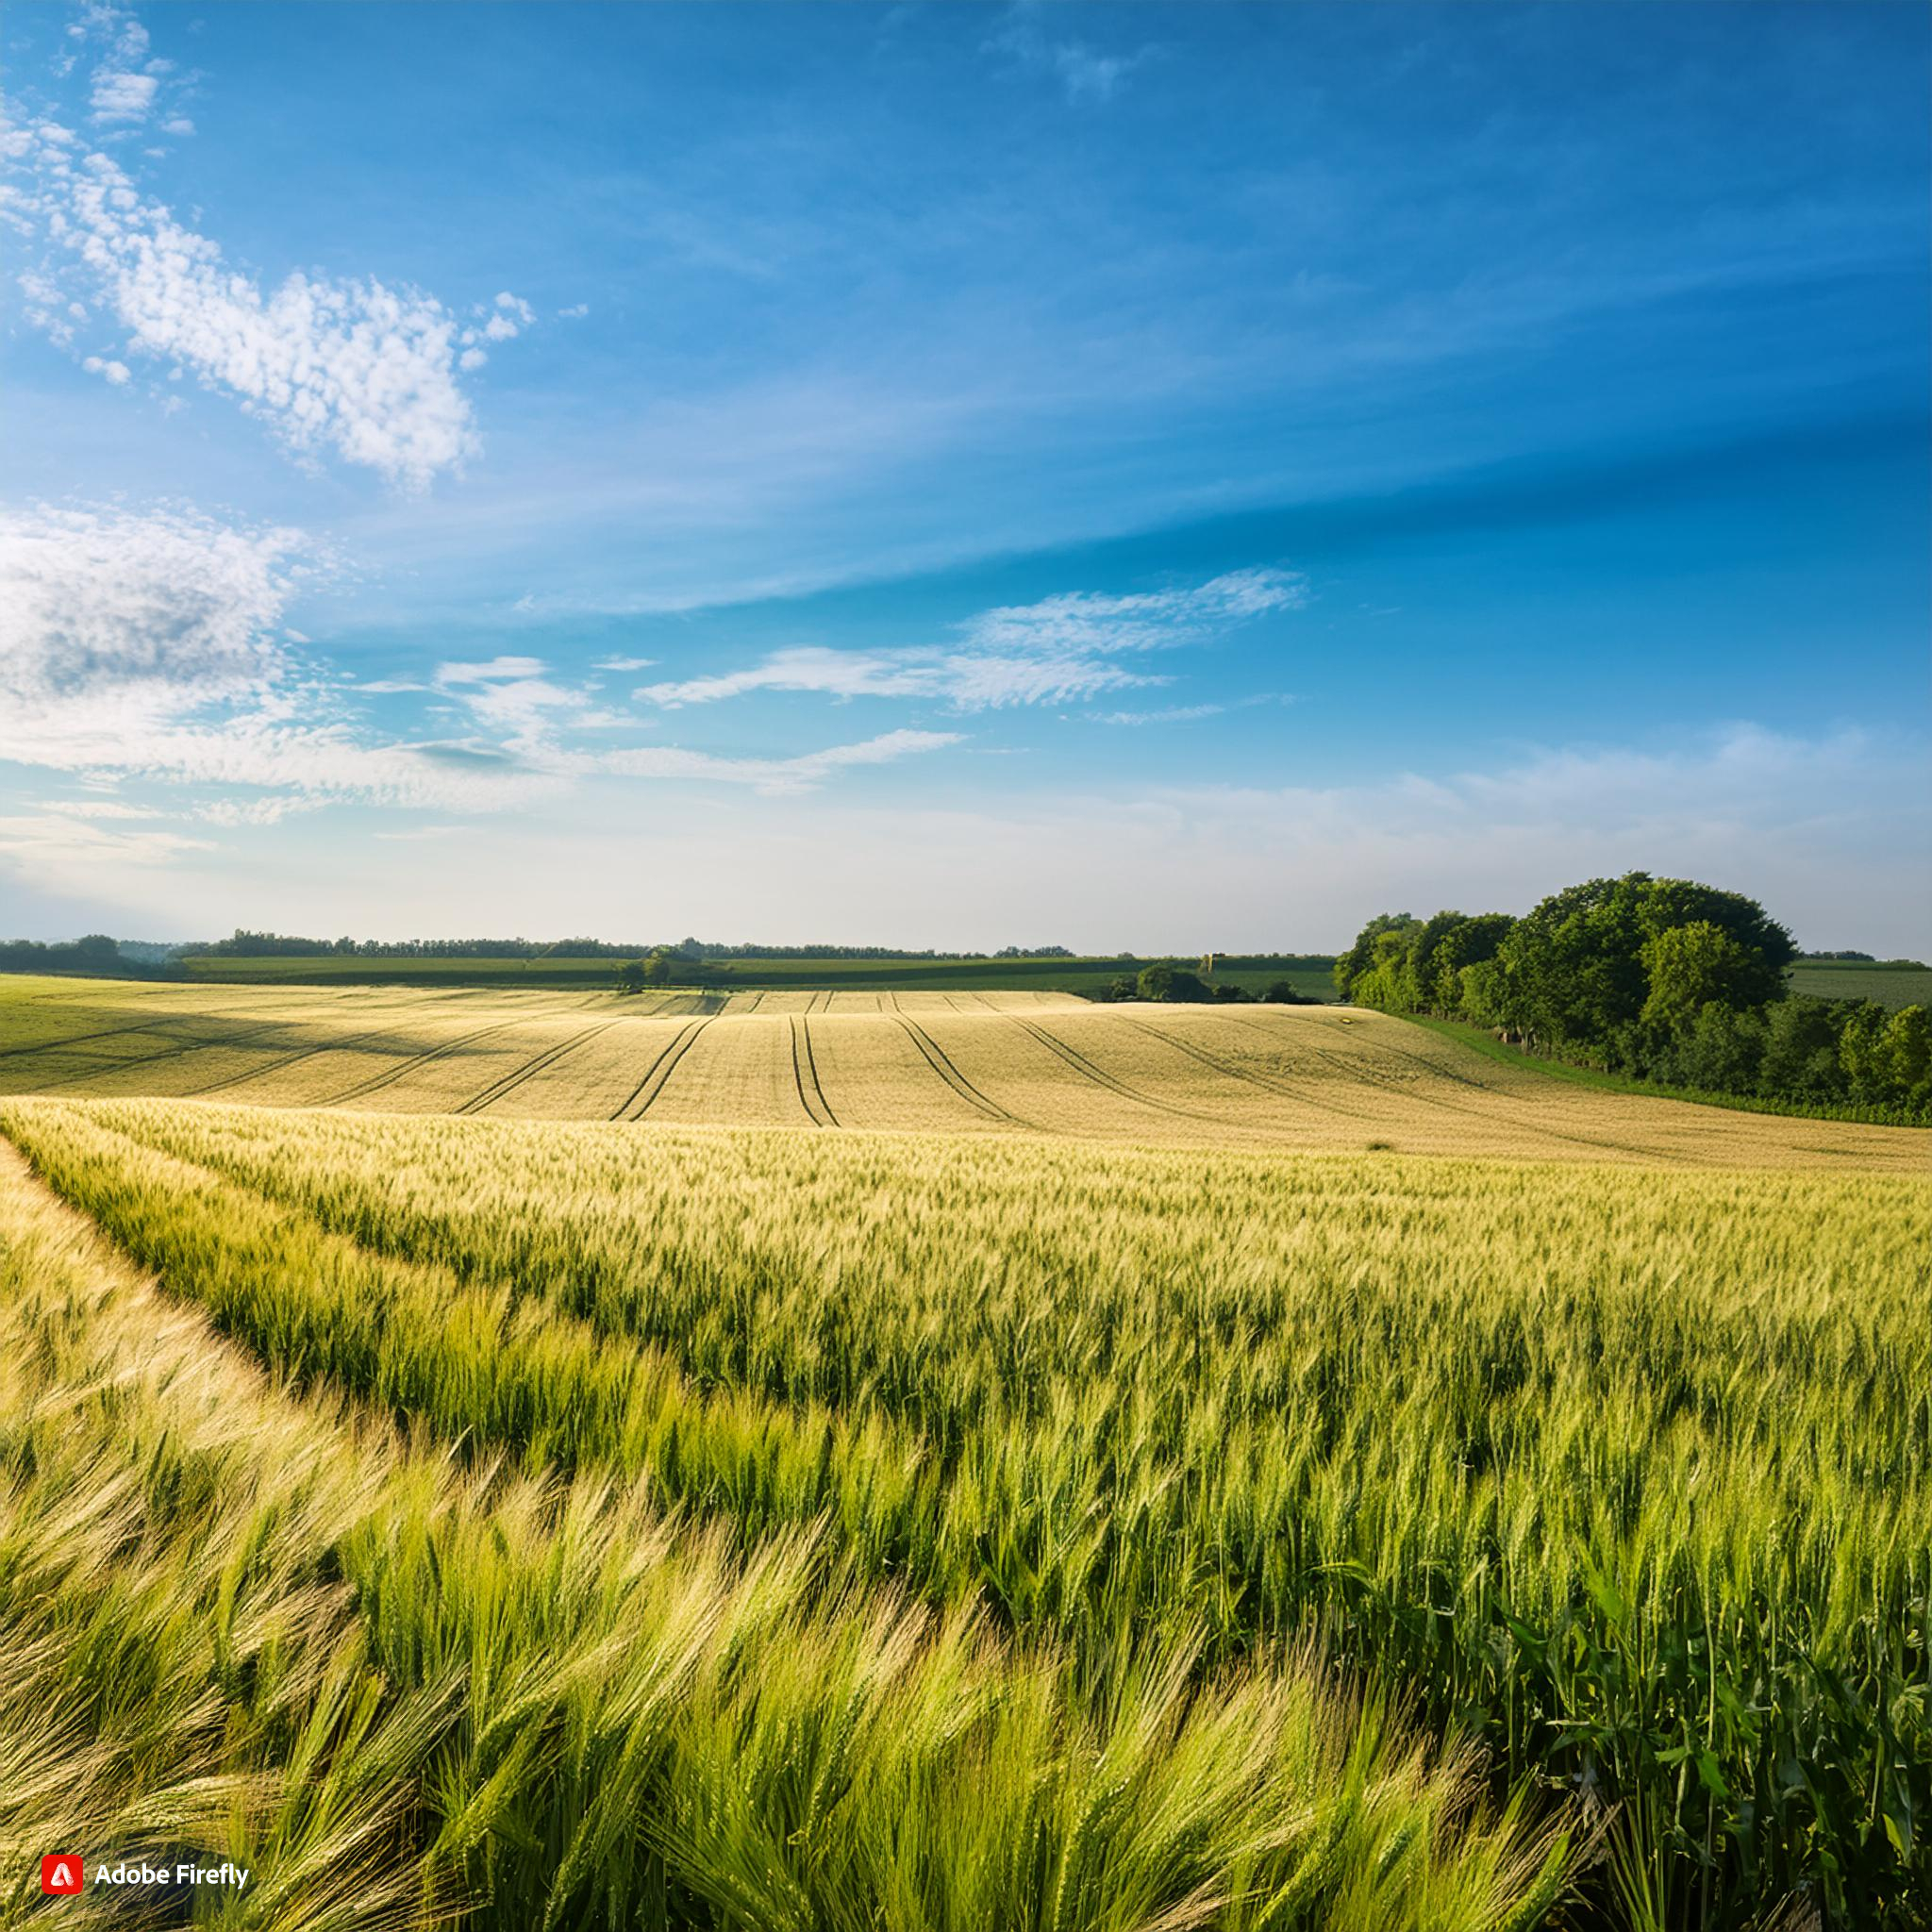
Resilience through diversification?

Slide 7
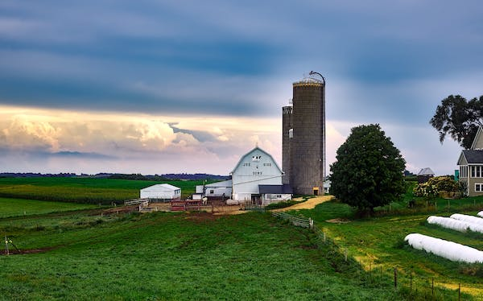
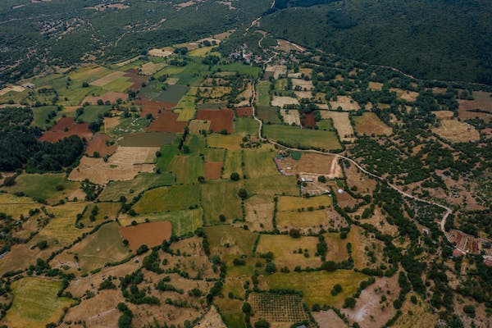
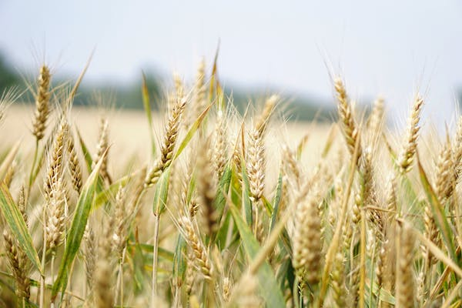
Agricultural diversification across spatial levels
FIELD
FARM
LANDSCAPE
Crop diversification
Spatial diversification
Temporal diversification
Species diversification
Agroforestry
Management diversification
Soil management
Integrated arable and livestock farming
Field edges and flowerstrips
Fertilization techniques
Mowing regimes
Deepening
Product diversification
Marketing diversification
Broadening
Non-agricultural diversification (tourism, social agriculture, energy production)
Nature protection
Wood fiber
(Off-farm diversification)
Landscape management options
Multifunctional landscapes
Structural diversity
Habitat connectivity
Reforestation
Value chain cooperations
Cooperation among farmers
Notes:
“39.5% of all farms surveyed in North-East Brandenburg employ diversification activities. This mostly involved a renting out of sum-
mer cottages or offering horse-boarding facilities and farm holiday activities in general (29%), or offering direct marketing facilities
(40%) on their farms to sell refined farm products to locals and visitors.” (LangeA) → im schlimmsten Falle das als Indikator nutzen?

Slide 8
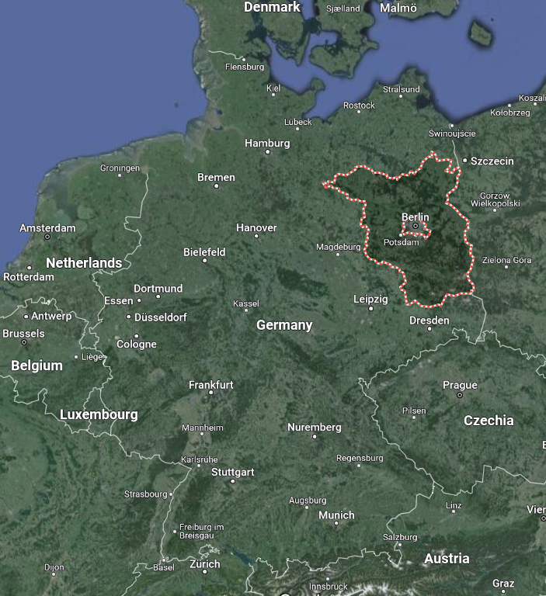
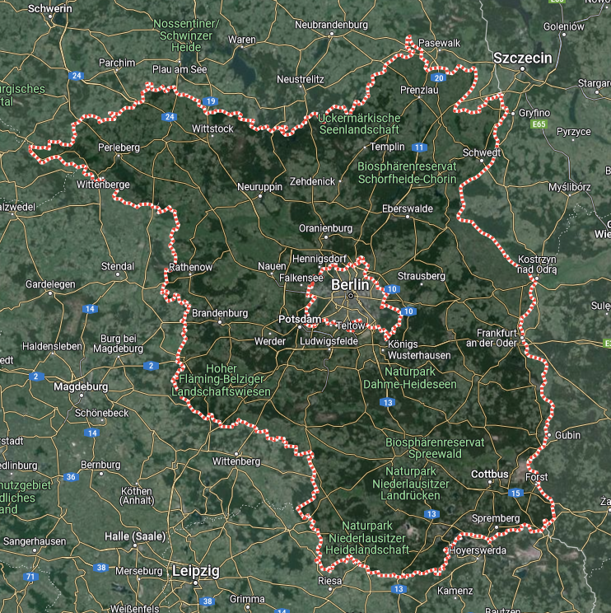
Study area – Brandenburg
Low rainfall (560mm) MLUK 2021b
2/3 of the soils are sandy-(loamy) soils Gutzler et al. 2015; Wolff et al. 2021
45% of the area is used for agriculture (75% arable) Gutzler et al. 2015; Wolff et al. 2021
Large strokes, average farm size = 238ha Gutzler et al. 2015
→ Homogeneous landscapes Wolff et al. 2021
interviews and workshops
Notes:
Many areas of Brandenburg are characterized by a low soil fertility and little rainfall (MLUK 2021b) and climate change accentuates the difficulties existing already without it.
Agriculture of Brandenburg is characterized by large farm enterprises (average size of 238 ha, which is four times the German average) and high mechanization (Gutzler et al. 2015), leading to homogeneous landscapes with intensified production (Wolff et al. 2021).
The physical conditions in Brandenburg are challenging: around 80 percent of Brandenburg's agricultural land has been considered disadvantaged since 2018 (MLUK 2021b). Brandenburg exhibits a high share of low-quality soils, almost two-thirds of Brandenburg’s soils are sandy or sandy-loamy soils with a water holding capacity lower than 140 mm (Wolff et al. 2021; Gutzler et al. 2015). Together with the low rainfall (four-year average 557 mm), agricultural production is difficult (MLUK 2021b)

Slide 9
Diversification measures as an answer to shocks and stresses
Crop rotation
Unstable markets
Uncertain weather conditions
Financial dependency from few crops
Social agriculture
economic
Crop rotation diseases
Conversion to organic
environmental
Low producer prices
Poor soils
Poor biomass quality
Agritourism
Shortage of skilled workers
Energy production through paludiculture
social
Societal demand
Notes:
Größe der Bälle: 4 = 1,4; 2 = 1,2 usw.
AFTER A TRANSFORMATION, THE TRANSFORMATION NEEDS TO GENERATE MONEY BEFORE ANYTHING ELSE CAN HAPPEN!
Anpassung + Transformation sind gut (weniger einmal transformiert ist der Kopf noch im Modus: wenn Lernprozess in Gang ist, fällt es leichter noch mehr dazuzulernen, es gibt viele Möglichkeiten sich anzupassen und zu transformieren)

Slide 10
Resilience capacities and diversification options
 | Robustness | Adaptation | Transformation
Crop rotation (2)
Social agriculture
Conversion to organic (2)
Agritourism
Energy production through paludiculture (2)
4
5
3
2
2
0
4
4
4
5
4
5
3,5
0
0
3
5
4
5
3
5
3
5
0
Notes:
Größe der Bälle: 4 = 1,4; 2 = 1,2 usw.
1=1,2
2=1,4
3=1,6
4=1,8
5=2
AFTER A TRANSFORMATION, THE TRANSFORMATION NEEDS TO GENERATE MONEY BEFORE ANYTHING ELSE CAN HAPPEN!
Anpassung + Transformation sind gut (weniger einmal transformiert ist der Kopf noch im Modus: wenn Lernprozess in Gang ist, fällt es leichter noch mehr dazuzulernen, es gibt viele Möglichkeiten sich anzupassen und zu transformieren)

Slide 11
Resilience capacities – how they‘re seen?
Robustness
Adaptation
Transformation
“Transformation is key. We all have to constantly question whether we're on the right path.”
“It's good to adapt and transform. Once you've transformed, your mind is still in learning mode. When you're learning, it's easier to learn more, and there are many ways to adapt and transform.”
“Permanent adaptation is essential in agriculture! Without adaptation, no stable yields!”
“After a transformation, the transformed systems needs to generate money before anything else can happen!”
“It depends on the size of the company. Some can do it permanently, while others need a break afterwards (capacity are tied up).“

Slide 12
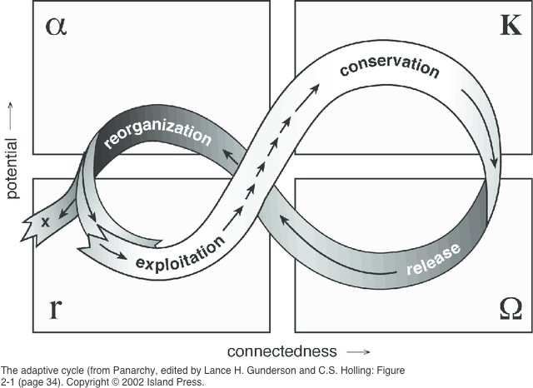
Resilience capacities and the adaptive cycle (Holling)
Adaptation
Robustness
Anticipation
Transformation
https://www.resalliance.org/files/Adaptive-cycle-from-Panarchy-edited-by-Lance-H-Gunderson-and-CS-Holling-Figure_W640.jpg
Notes:
https://www.resalliance.org/files/Adaptive-cycle-from-Panarchy-edited-by-Lance-H-Gunderson-and-CS-Holling-Figure_W640.jpg

Slide 13
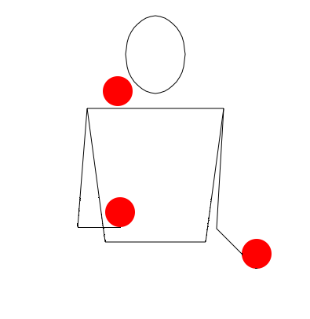
Equilibrium of the three resilience capacities
ADAPTABILITY
ROBUSTNESS
TRANSFORM-
ABILITY
https://upload.wikimedia.org/wikipedia/commons/2/26/3-ball_cascade_movie.gif
Notes:
https://www.maths.ox.ac.uk/system/files/media/3ballcascade_2.png
https://www.juggling-for-beginners.com/image-files/3ball.jpg

Slide 14
Thank you for your attention.
Contact:
Marie Arndt; marie.arndt@zalf.de

Slide 15
References
Campbell, B. M., Beare, D. J., Bennett, E. M., Hall-Spencer, J. M., Ingram, J. S., Jaramillo, F., ... & Shindell, D. (2017). Agriculture production as a major driver of the Earth system exceeding planetary boundaries. Ecology and society, 22(4).
Gutzler, Helming, Balla, Dannowski, Deumlich, Glemnitz, Knierim, Mirschel, Nendel, Paul, Sieber, Stachow, Starick, Wieland, Wurbs, Zander (2015): Agricultural land use changes – a scenario-based sustainability impact assessment for Brandenburg, Germany. Ecological Indicators 48, pp. 505–517. DOI: 10.1016/j.ecolind.2014.09.004.
Holling, C. S., & Gunderson, L. H. (2002). Resilience and adaptive cycles. in: Panarchy: Understanding Transformations in Human and Natural Systems. L.H. Gunderson and C.S. Holling, eds. Island Press, Washington, D.C., 25-62
Meuwissen, M. P., Feindt, P. H., Spiegel, A., Termeer, C. J., Mathijs, E., De Mey, Y., ... & Reidsma, P. (2019). A framework to assess the resilience of farming systems. Agricultural Systems, 176, 102656.
MLUK - Ministerium für Landwirtschaft, Umwelt und Klimaschutz des Landes Brandenburg (2021b): Natürliche Bedingungen. Agrarbericht online. Available online at: https://agrarbericht.brandenburg.de/abo/de/start/agrarstruktur/natuerliche-bedingungen/, updated on 12/10/2021, checked on 2/3/2022
Wolff, Hüttel, Nendel, Lakes (2021): Agricultural Landscapes in Brandenburg, Germany: An Analysis of Characteristics and Spatial Patterns. Int J Environ Res 15 (3), pp. 487–507. DOI: 10.1007/s41742-021-00328-y.

Slide 16
Possible questions to discuss
Are the resilience capacities equally important?
Does the perception of resilience play a role?
Does the research area affect resilience?

Slide 17
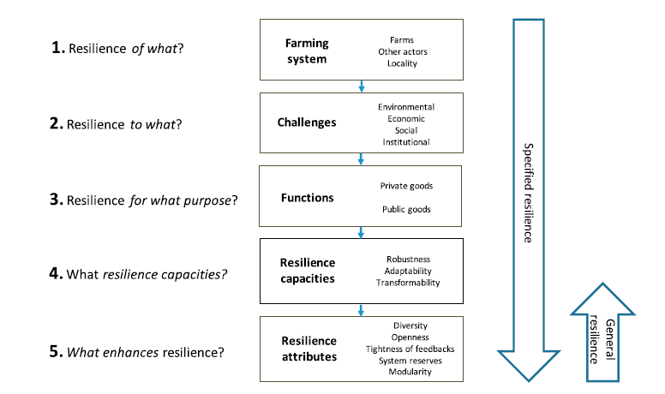
Resilience assessment of agricultural diversified systems
Resilience Assessment (Meuwissen et al., 2019)
Drivers
Push- and Pull- factors
10 interviews
Agricultural actors of Brandenburg and possible diversification options
Pressure
State
Impact areas
3 workshops
Impact of diversification on resilience capacities
Impact
What makes diversification more feasible?
Response
Meuwissen et al, 2019, p. 3
Notes:
Through participatory WS and interviews
The FoPIA employs a qualitative and participatory approach to relate ex-ante impact
assessments with SD. The FoPIA approach was first described by Morris
et al. (2011), who link the expected effects of land use scenarios with the
normative preferences of stakeholders by evaluating those perceived
scenarios’ impacts on LUFs.
DPSIR: shows potential of influencing (that is missing in the Res. Ass.)
is a causal framework used to describe the interactions between society and the environment
A framework that shows causal relations in systems analysis
https://www.eea.europa.eu/publications/TEC25

Slide 18
Resilience to what? Short-term stresses
Economic:
Shortage of skilled workforce
War in Ukraine
Social:
Shortage of seasonal workforces (Covid)
Societal pressure
Environmental:
Extreme weather events
African swine fever
Institutional:
Farm successors
Short notice in the announcement of directives
Digitalisation
Political requirements (applications, updates)

Slide 19
Resilience to what? Long-term challenges
Economic
economic efficiency
competition due to globalization
shortage of skilled workforce
subsidy policy
processing facilities
high prices for land and lack of entry opportunities
yield stability
Social
Societal knowledge and lack of recognition
Changing consumption pattern
Urbanisation & rural exodus
Reliability of food supply
Farm successor
Work-life balance
Environmental
soil quality
precipitation (quantity and distribution)
temperature rise & intermittent frost
increasing water scarcity in Brandenburg
species/insect extinction
Institutional
Political regulations
Land and property ownership
Increasing bureaucracy
institutional
political regulations
"direct payments prevent innovative ideasNO (if, then economic)“(slow down predicatability)
Land and property ownership
competition for land (agric <--> industry)
increasing bureaucracy of existing subsidies
complexity of new subsidy-programs
lack of contact persons at authorities
"digitalisation in medium-term"

Slide 20
Resilience for what purpose? Faming functions – impact areas
Long list (20)→ short list (6)
Environmental:
Soil health
Landscape diversity
NO GHG-emission balance
Social:
Animal welfare
Provision of high-quality food products
Economic:
Income security of the farm
local value chains

