Slide 1
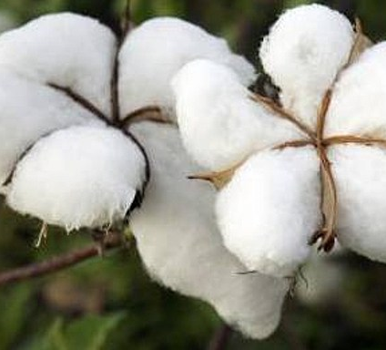




Coupling experimentation and crop modeling to evaluate morpho-physiological traits of cotton cultivars in agroecological cropping systems in Benin
Author(s) [D. C. Aboua; E. Gérardeaux; P. Debaeke; S. Boulakia; E. Sèkloka]
IRC

Slide 2
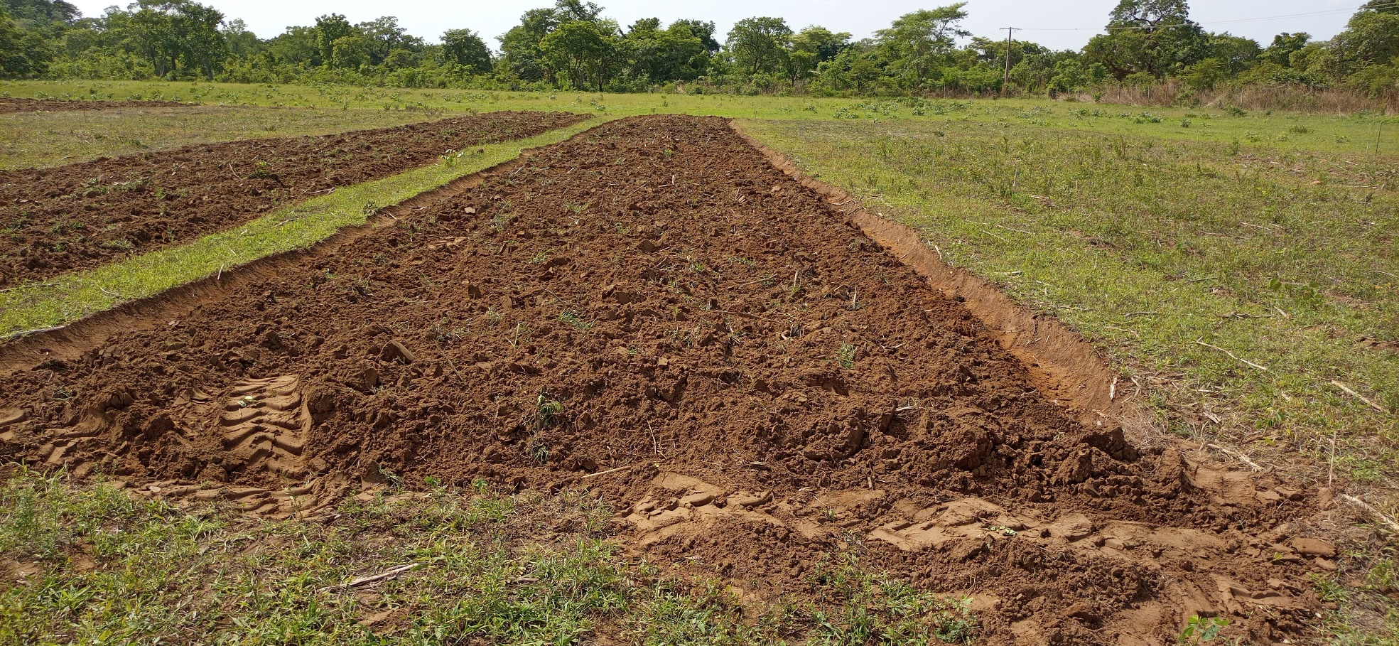
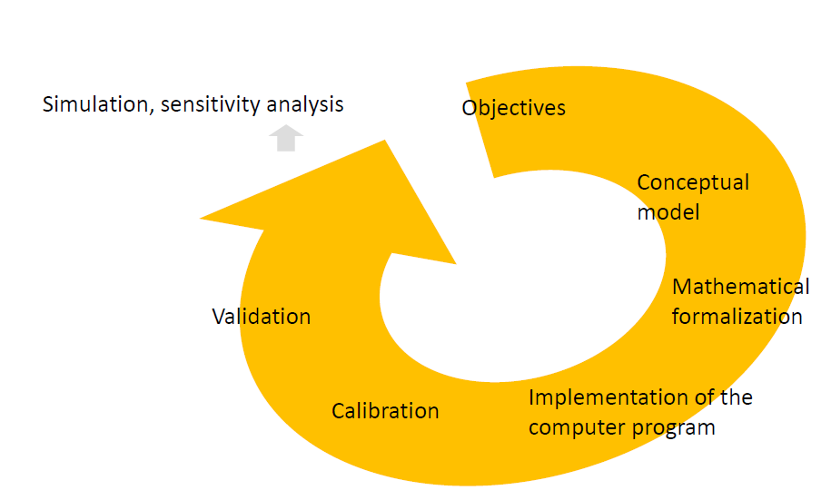

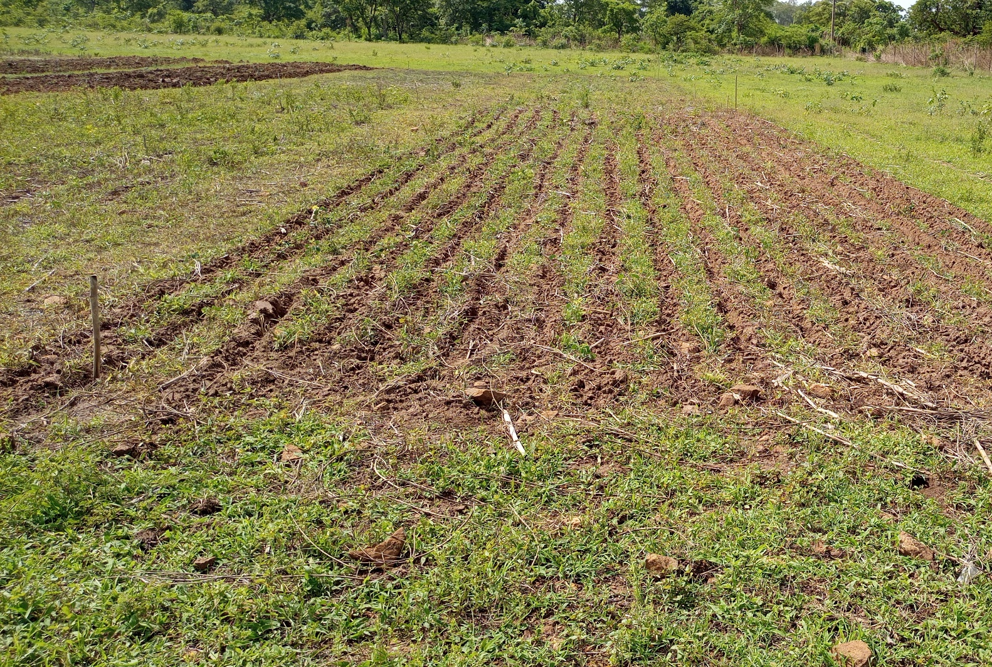
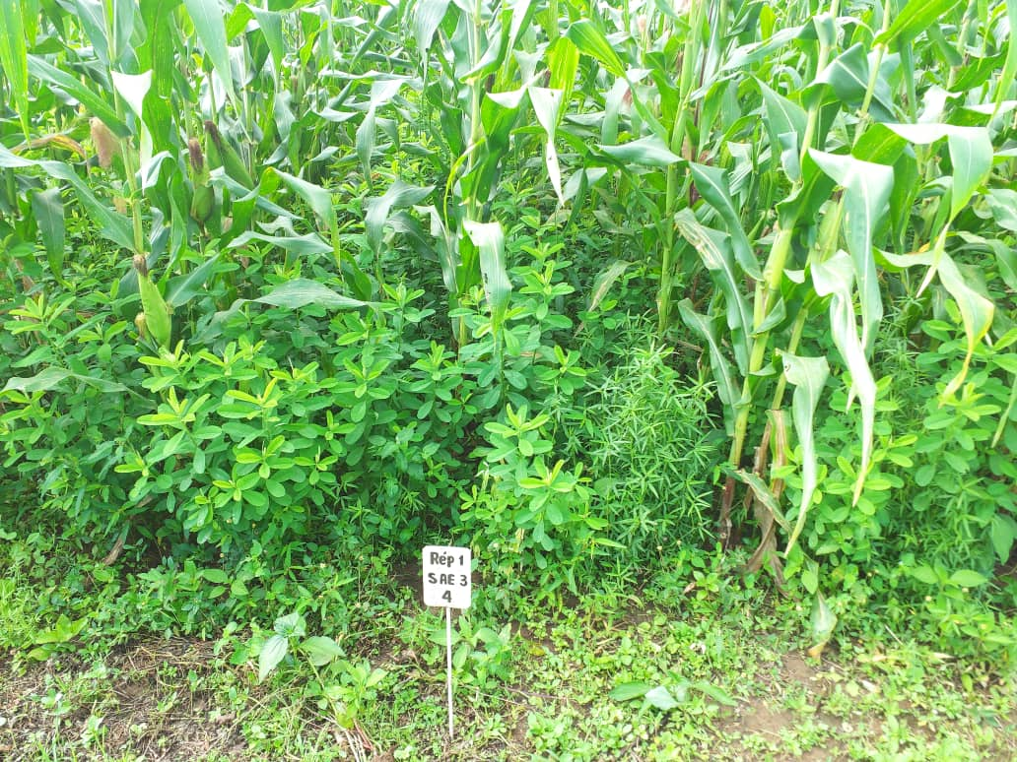
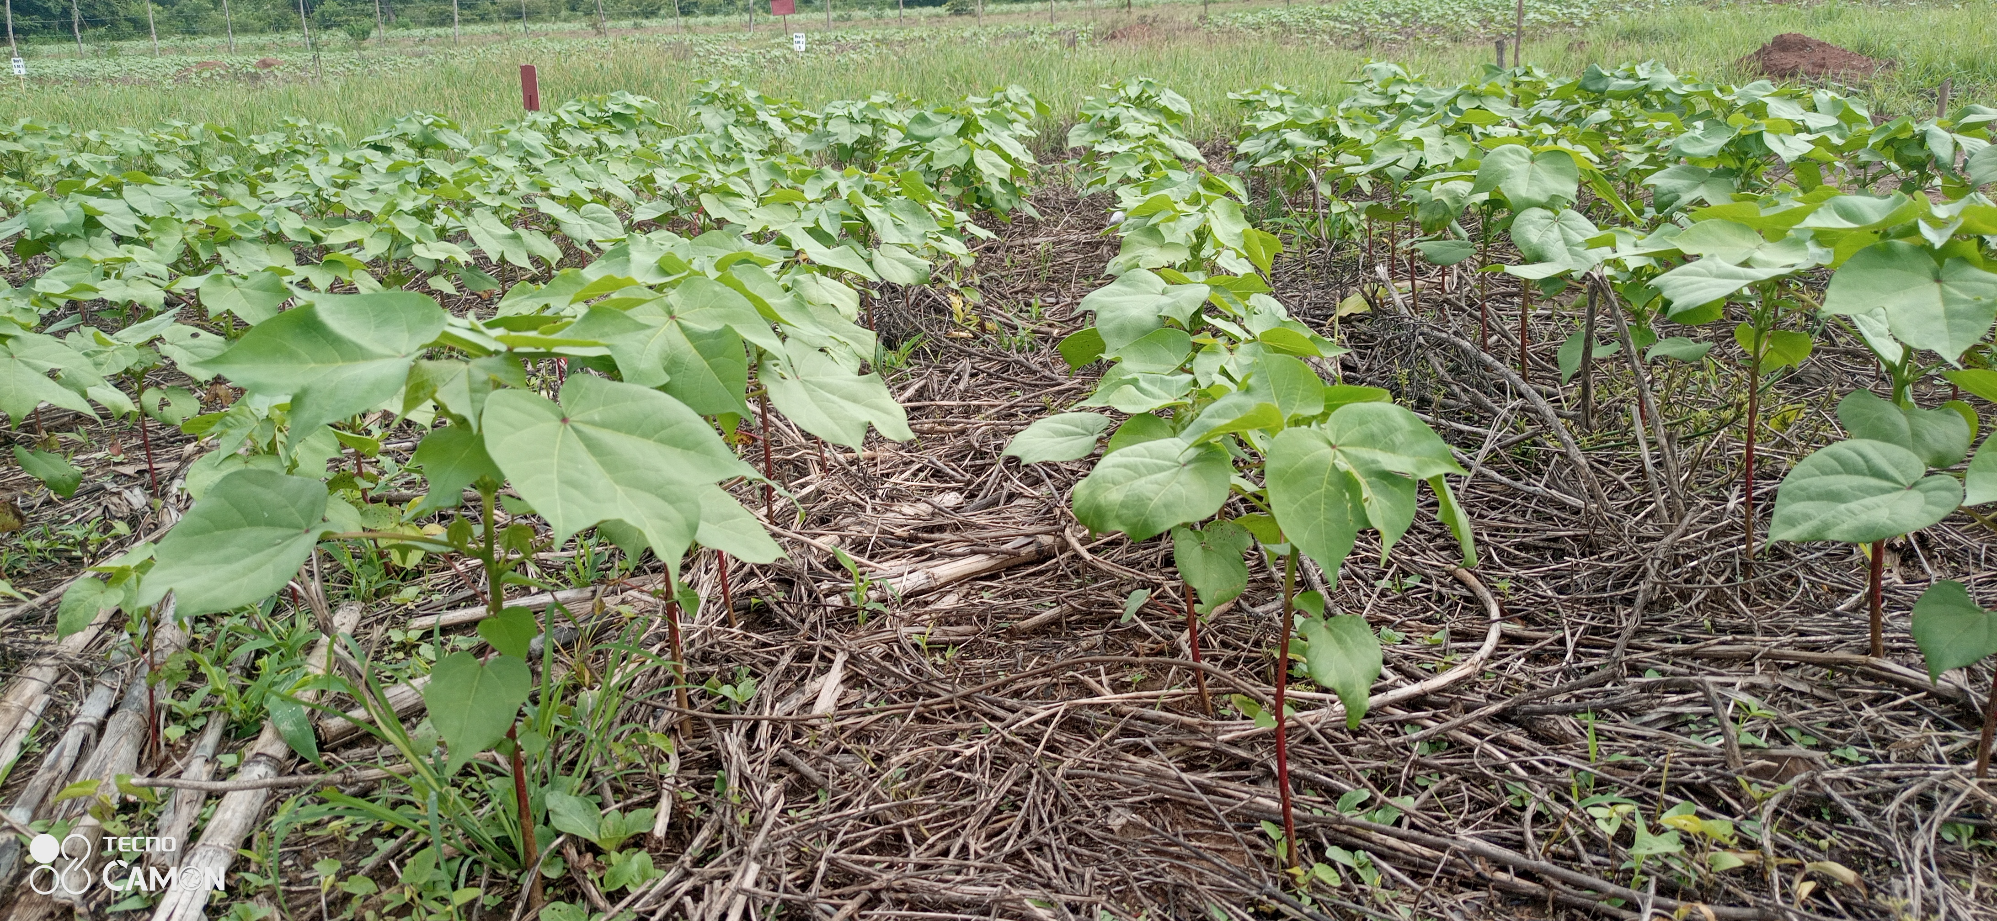
Plan
Introduction
Materials and methods
Results and discussion
Conclusion

Slide 3
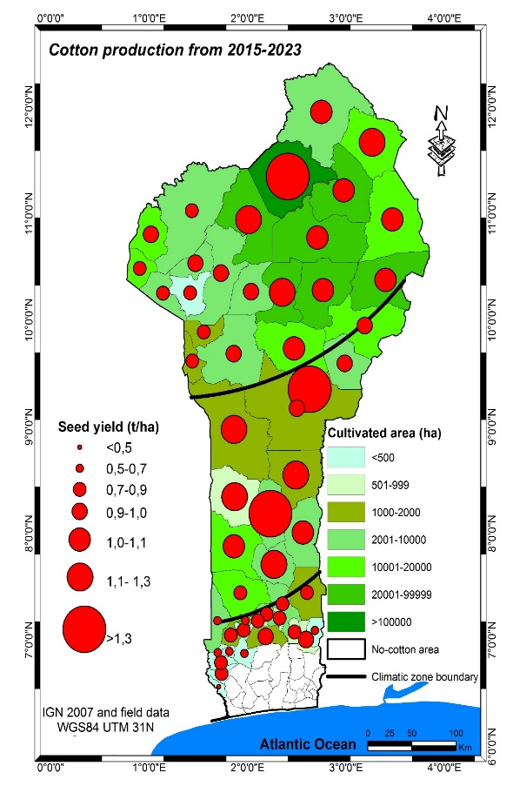
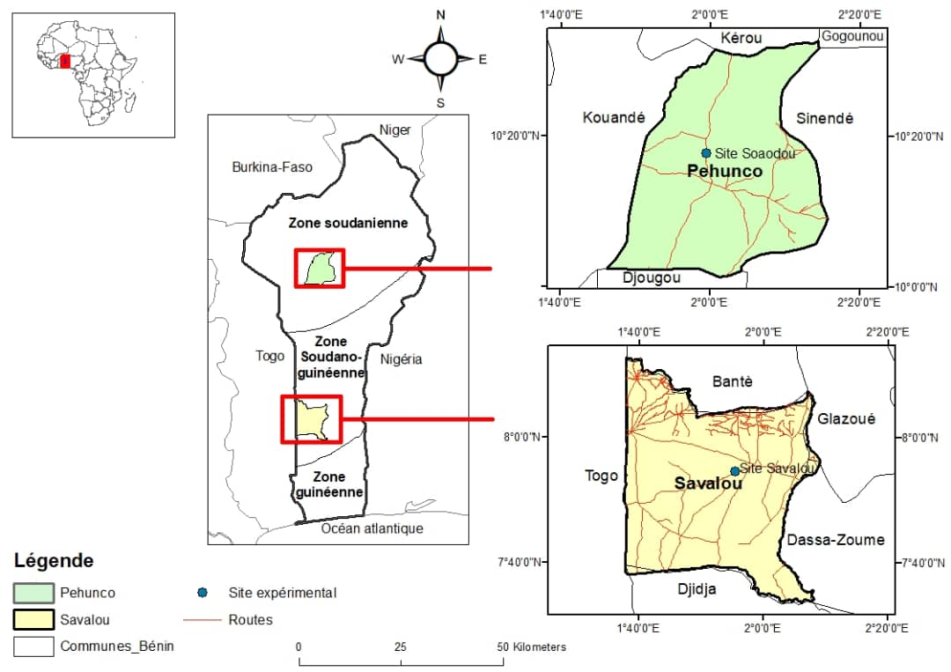
Introduction
Materials and Methods
Results and discussion
Conclusion
and prospects
Cotton is Benin's leading export crop grown in 3 pedoclimatic zones with adapted varieties
As a result of poor farming practices in agroecosystems leading to a decline in soil fertility (Amonmidé et al, 2019) seed cotton yields of cultivated varieties are low and stagnates around 1.2 t ha⁻¹, whereas the theoretical potential yield is 4.5 t ha⁻¹ (Aboua et al., 2021)
Agroecological practices are proposed as an alternative to conventional cropping systems. The emerging challenge for breeders is therefore to select new cultivars adapted to innovative cropping systems (Gouleau et al., 2021).
Crop simulation models can be used to assess growth and yield of crop genotypes (G) in environments (E) by using environment-specific weather, soil, and crop management (M) practices (Boote et al., 2001, Oteng-Darko et al., 2013) and help understanding the direct effect of each plant trait or a combination of traits on the GxE interactions for crop yield and other complex traits

Slide 4
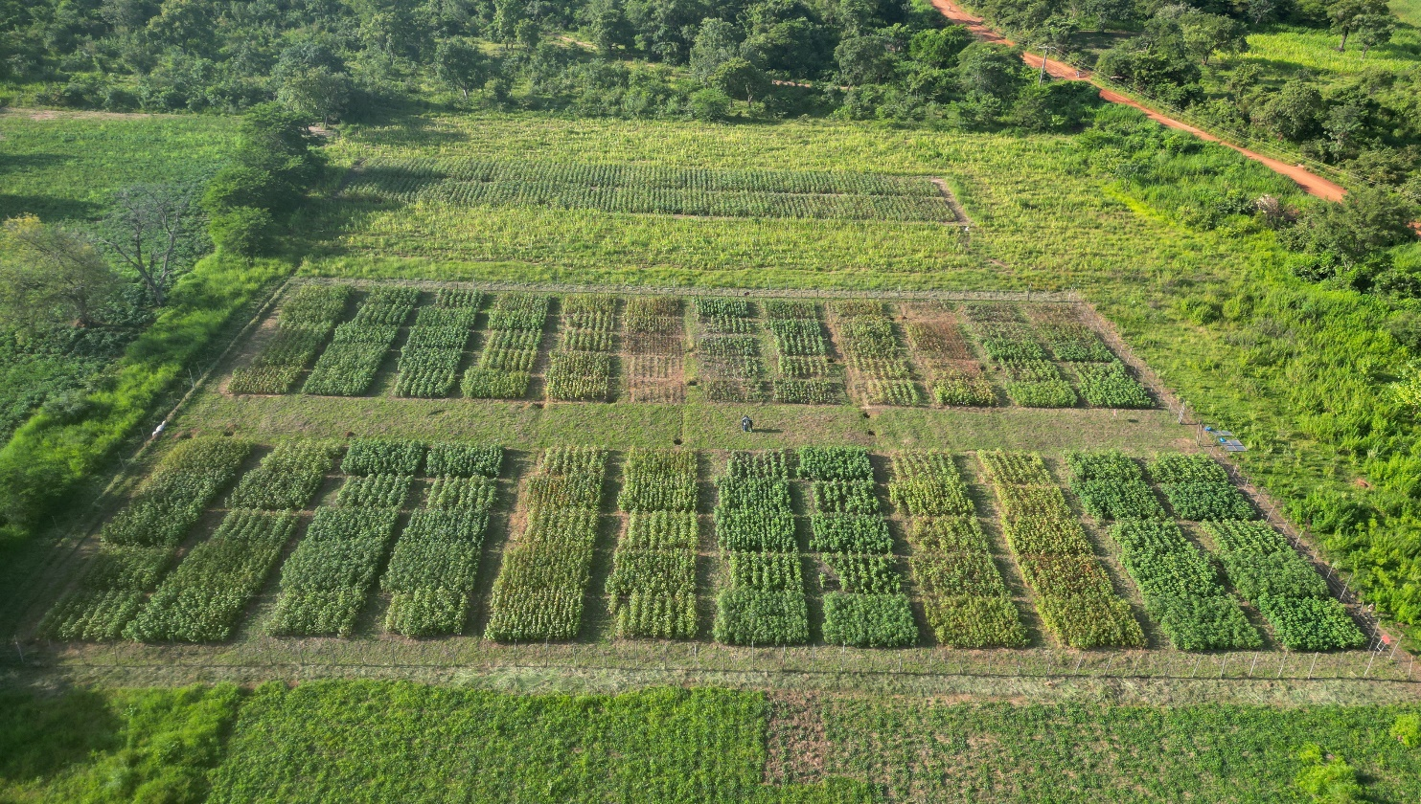

Introduction
Materials and Methods
Results and discussion
Conclusion
and prospects
Objectives
(i) to evaluate the relative contribution of plant traits driving the G by E by M interactions for cotton yield as measured during field experiments and to explain the results using CSM-CROPGRO-cotton model from Decision Support System for Agrotechnology Transfer (DSSAT),
(ii) to identify morpho-physiological traits for yield enhancement in agroecological cropping systems in Benin

Slide 5
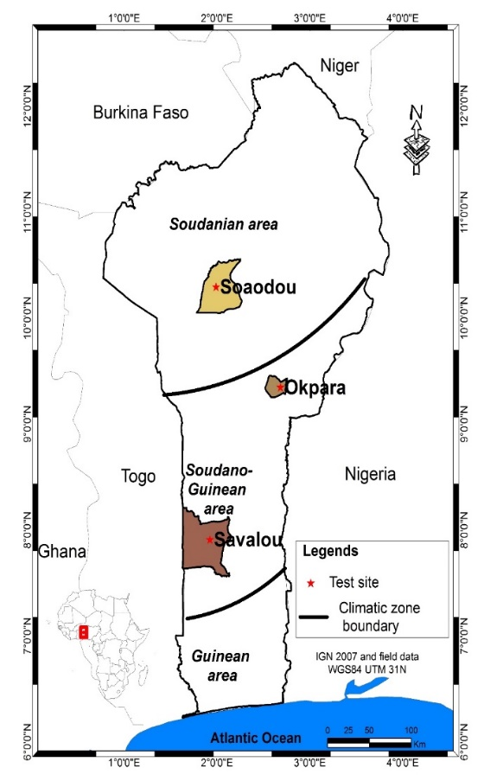
Introduction
Materials and Methods
Results and discussion
Conclusion
and prospects
Field experimentation
maize/cotton 2020 to 2023
Cropping systems | Sites | Tillage | Crop rotation | Crop diversification | Crop residues management
Conventional Tillage (CT) | Savalou | +++ | Cowpea/maïze// cowpea/cotton | ++ | Burying at the time of ploughing
 | Soaodou |  | Maïze//cotton | + | Total export residues
Conventional Tillage with Incorporation biomass (CTI) | Savalou | +++ | Cowpea/maïze+Crotalaria retusa// cowpea/cotton | +++ | Burying at the time of ploughing
 | Soaodou |  | Maïze+Crotalaria retusa//cotton | ++ | Burying at the time of ploughing
Conservation Agriculture_ Strip Tillage (CA_ST) | Savalou | + | Cowpea/maïze+Crotalaria retusa// cowpea/cotton | +++ | Keeping on the soil surface
 | Soaodou |  | Maïze+Crotalaria retusa//cotton | ++ | Half of residues left on the soil surface
Conservation Agriculture_ No Tillage (CA_NT) | Savalou | 0 | Sorghum+Crotalaria juncea/maïze+C.r+Stylosanthes guianensis//S.g/cotton | +++ | Keeping on the soil surface
 |  |  | Maïze+C.r+Stylosanthes guianensis//cotton | +++
 | Soaodou |  | Maïze+C.r+Stylosanthesguianensis//cotton | +++
2020;2022: maize
2021; 2023: cotton

Slide 6
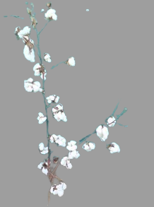
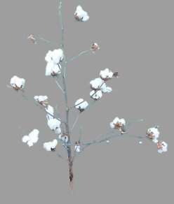
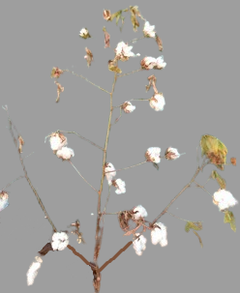
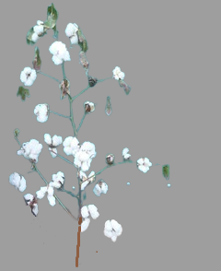
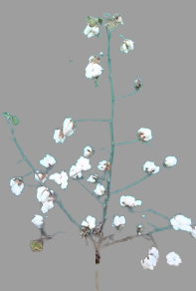
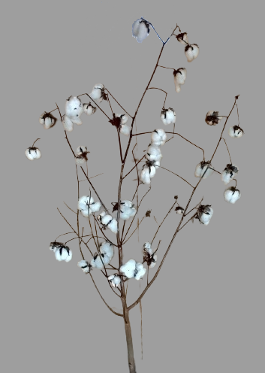
Introduction
Materials and Methods
Results and discussion
Conclusion
and prospects
Traits of cotton cultivars studied
Early
Moderately Early
Late
Thin leaves
Thick leaves
SD= 12.5plts m⁻²
Thick leaves
Large seeds
Large seeds
Large seeds
Clustered
Short branches
Arborescent, okra leaf
OULTAN
TAMCOT-CAMDE
S188
Normal
Normal
Normal
Medium thick leaves
Thick leaves
Medium thick leaves
Small seeds
medium-sized seeds
SD= 4.17 plts m⁻²
Small seeds
Slender arborescent
Compact
Slender arborescent
GUAZUNCHO2
ANG 956
OKP 768

Slide 7
Introduction
Materials and Methods
Results and discussion
Conclusion
and prospects
Model calibration and evaluation steps
Experimentation: Environments x Genotypes x Cropping systems
Granulometry 2020
Water dynamics data 2021
Phenological and agromorphological data on varieties and water dynamic (2021 and 2023)
Water dynamics data 2023
CT, CTI, CA_ST, CA_NT
2021
CT, CTI
2021
CA_ST, CA_NT
2021
CT, CTI, CA_ST, CA_NT
2023
Parameterization soil properties of cropping systems
Calibration genetic parameters of cultivars (Gérardeaux et al, 2013)
Model validation.
Model evaluation.
Phenology
Leaf area index
Biomass
Cotton yield
Experimentation: Varietal precocity (2022)
Experimentation: Varietal characterization (2022)

Slide 8
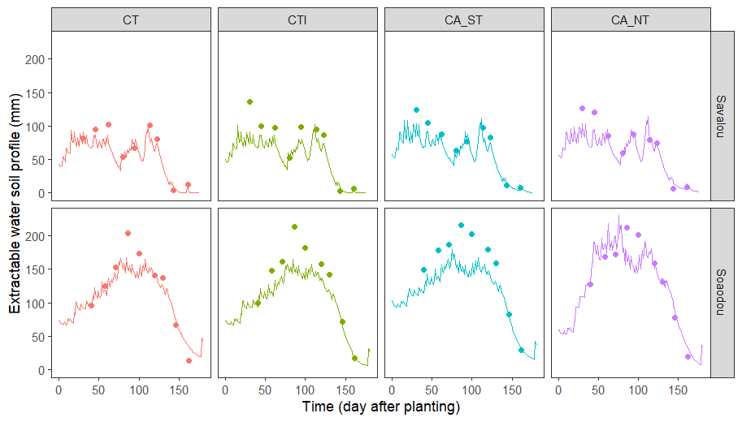
Introduction
Materials and Methods
Results and discussion
Conclusion
and prospects
Measured (symbols) and simulated (lines) extractable water soil in profile under cropping systems (CT, CTI, CA_ST, CA_NT) at sites (Savalou, Soaodou) in 2023 for evaluation
nRMSE=19%
d=0.96
nRMSE=27%
d=0.93
nRMSE=15%
d=0.97
nRMSE=17%
d=0.97
Model evaluation was better in both sites and prediction and could be used to assess soil water dynamics in agroecological cropping systems in both sites.
nRMSE=19%
d=0.94
nRMSE=24%
d=0.90
nRMSE=25%
d=0.86
nRMSE=18%
d=0.94

Slide 9
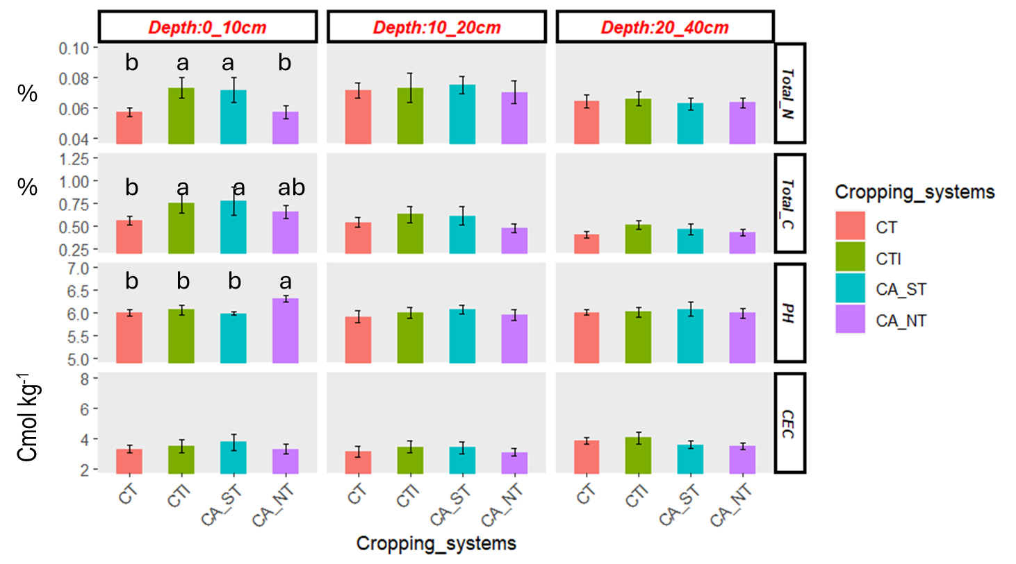
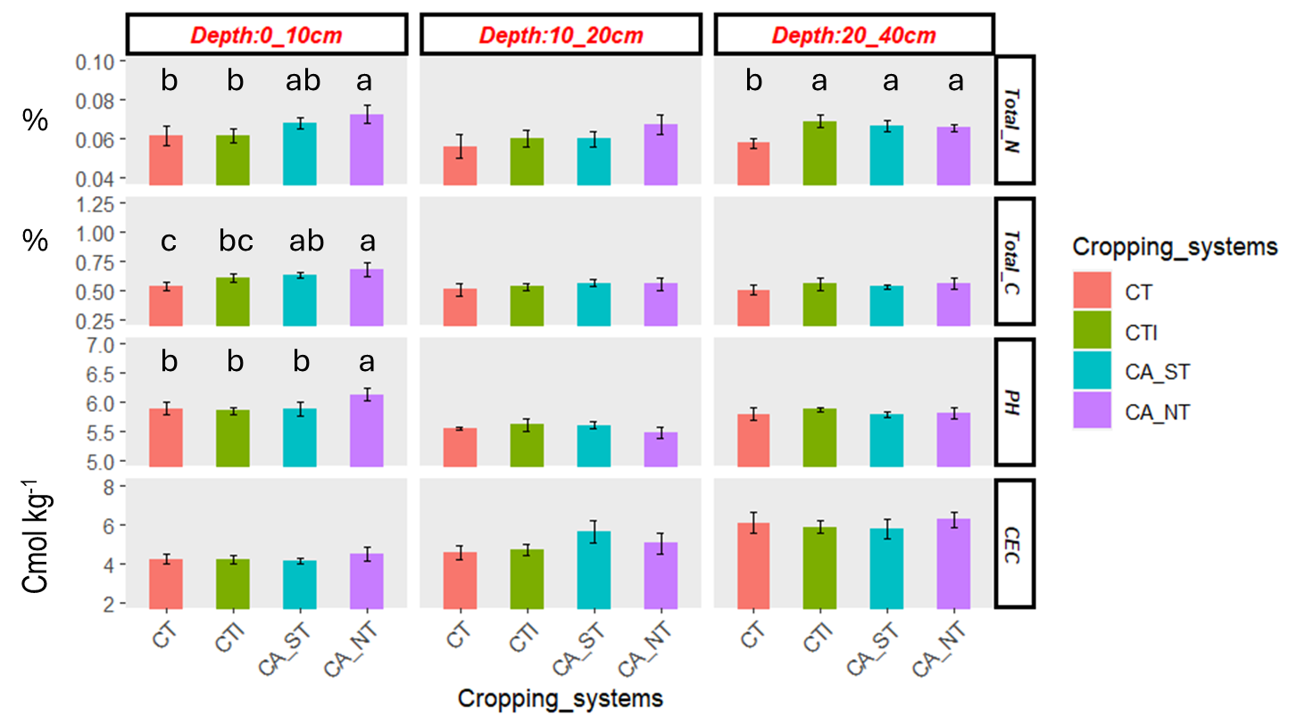
Introduction
Materials and Methods
Results and discussion
Conclusion
and prospects
Physico-chemical soil properties of cropping systems in 2023
Savalou
Soaodou
CTI and CA_ST better supplied with N and C at depth 0.10
Soil in CA_NT less acid
CA_NT and CA_ST better supplied with N and C at depth 0.10
Soil in CA_NT less acid

Slide 10
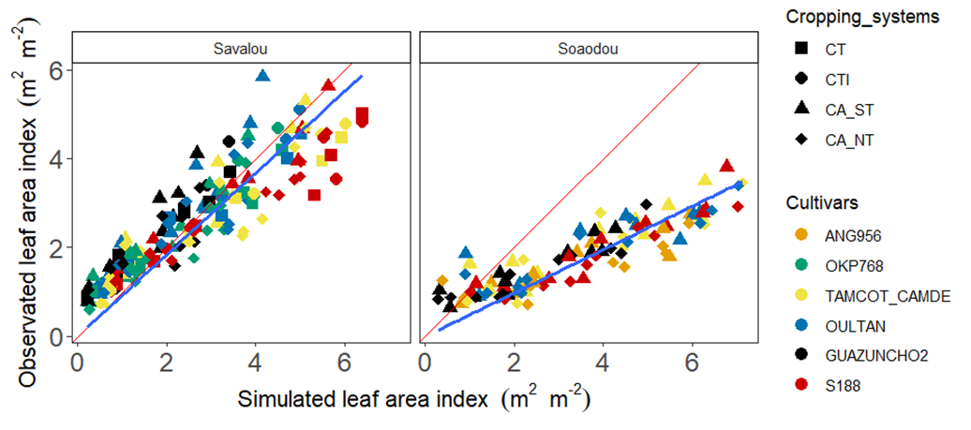


Introduction
Materials and Methods
Results and discussion
Conclusion
and prospects
Relationship of simulated leaf area index of cotton cultivars with the observed leaf area index (LAI) in 4 cropping systems across 2 sites of Benin in 2021, and 2023 for evaluation.
The overestimation of LAI by the model at Soaodou
This may be due high solar radiation which reduces SLA (Rawson et al., 1987).

Slide 11
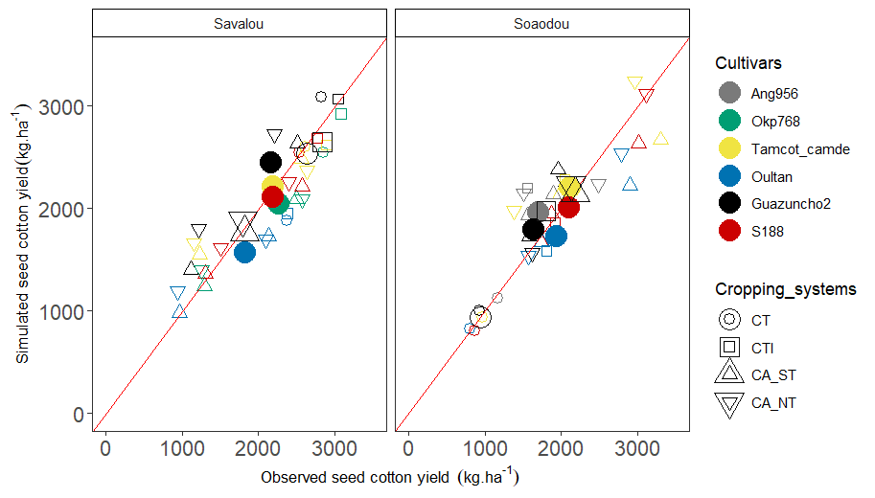
Introduction
Materials and Methods
Results and discussion
Conclusion
and prospects
Relationship of simulated seed cotton yield of cotton cultivars with the observed in 4 cropping systems across 2 sites of Benin in 2021, and 2023 for evaluation.
No interaction G x CS at Savalou
CTI better with OKP 768
y = 0.99x - 29
R² = 0.78, d=0.92
n=30, nRMSE=20%
y = 1.06x - 92
R² = 0.81, d=0.94
n=30, nRMSE= 14%
Significant interaction
G x CS at Soaodou
CA_NT, CA_NT better with TAMCOT-CAMDE

Slide 12
Introduction
Materials and Methods
Results and discussion
Conclusion
and prospects
Values of genetic parameters of cotton cultivars calibrated for the CSM-CROPGRO-Cotton in cropping systems in 2 sites of Benin.
Parameters | Description | TAMCOT_CAMDE | OKP768 | S188 | ANG956 | OULTAN | GUAZUNCHO2
Cultivars
EM-FL | Photothermal time between plant emergence and flower appearance | 42.5 | 45 | 45.5 | 44 | 42 | 43.5
SD-PM | Photothermal time between first seed and physiological maturity | 27 | 27.8 | 28.5 | 27.9 | 27.5 | 27
LFMAX | Maximum leaf photosynthesis rate (mgCO² m⁻² s⁻¹) | 2.56 | 2.14 | 2.48 | 2.31 | 1.4 | 1.84
FL-LF | Photothermal time between first flower and the end of leaf expansion | 61.83 | 65.93 | 58.51 | 45.33 | 50.18 | 51.75
SLAVR | Specific leaf area under standard conditions (cm² g⁻¹) | 170 | 172 | 170 | 168 | 198 | 174
SIZLF | Maximum size of full leaf (cm²) | 297.4 | 295.6 | 299.7 | 260.6 | 283.7 | 252.1
THRSH | Maximum ratio of seed cotton weight and boll weight | 71.6 | 74 | 71 | 72 | 70.7 | 71.3
WTSPD | Maximum weight per seed (g) | 0.203 | 0.185 | 0.225 | 0.160 | 0.228 | 0.178
Ecotypes
RWDTH | Relative width of this ecotype in comparison to the standard width per node | 0.8 | 0.95 | 0.65 | 0.95 | 0.5 | 0.95
RHGHT | Relative height of this ecotype in comparison to the standard height per node | 0.6 | 0.78 | 0.66 | 0.88 | 0.77 | 0.74
WTSPD +(LFMAX SLAVR)+ SIZLF+ FLFL

Slide 13
Introduction
Materials and Methods
Results and discussion
Conclusion
and prospects
High photosynthesis (Boote et al, 2001)
Leaf N increased (Iqbal et.al, 2020)
stay-green trait (Meena and Patil, 2021)
Photosynthetic capacity
Duration of leaf expansion (Delayed leaf senescence)
Thickness leaves (Wright et al., 1993; Gonias et al., 2011)
OKP 768, TAMCOT CAMDE, S188
Longer accumulation of reserves during seed filling (Wells et al., 1982)
Specific leaf area
ANG 956, OKP 768, Tamcot_camde, S188
Availability N in CTI, CA_ST and CA _NT
+
Seedling vigor (Chalise et al. (2023)
OKP 768, TAMCOT CAMDE, S188
increase of boll weight
High seed mass
Oultan, S188, Tamcot_camde, OKP 768,

Slide 14
Introduction
Materials and Methods
Results and discussion
Conclusion
and prospects
Agroecological cropping systems can improve seed cotton yields by cultivating varieties whose morpho-physiological traits optimize the edaphic and nutritional conditions of these systems
A combination of seedling vigor traits, thickness leaves, high photosynthesis, delayed leaf senescence of cotton cultivars is adapted to agroecological systems
These results provide useful traits and scientific evidence for breeders and cropping systems research programs focused

Slide 15
Acknowledgments
Benin Cotton Research Institute (IRC), Cotton Interprofessional Association (AIC), and the TAZCO2 project (Transition Agroécologique des Zones Cotonnières du Bénin), which is funded by the Republic of Benin and the French Development Agency (AFD) for financial support
CIRAD/AÏDA and INRAE for scientific and financial support

Slide 16
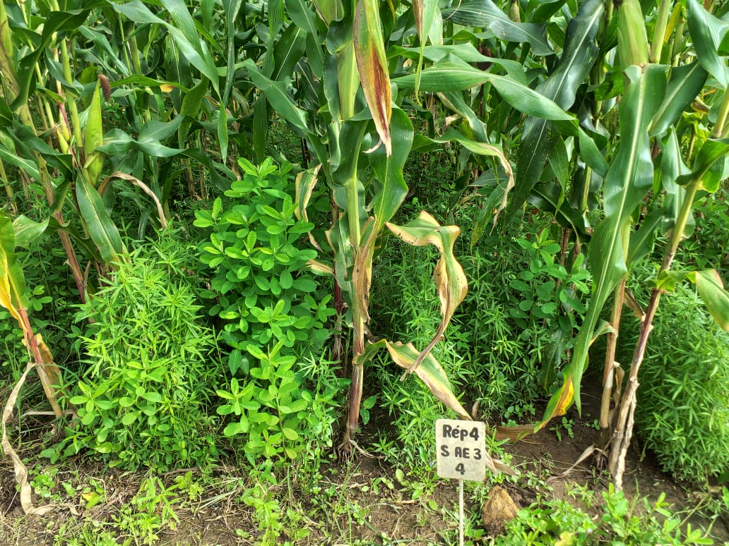
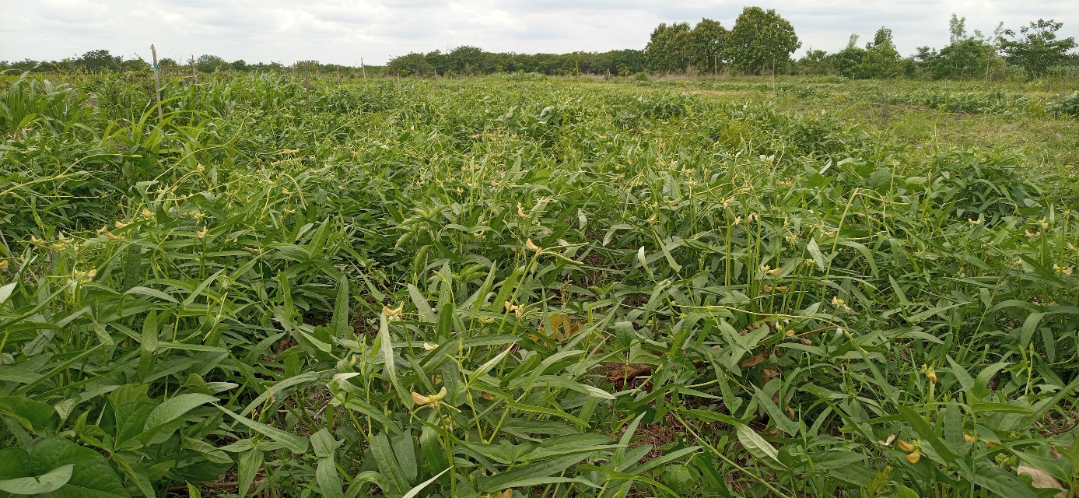
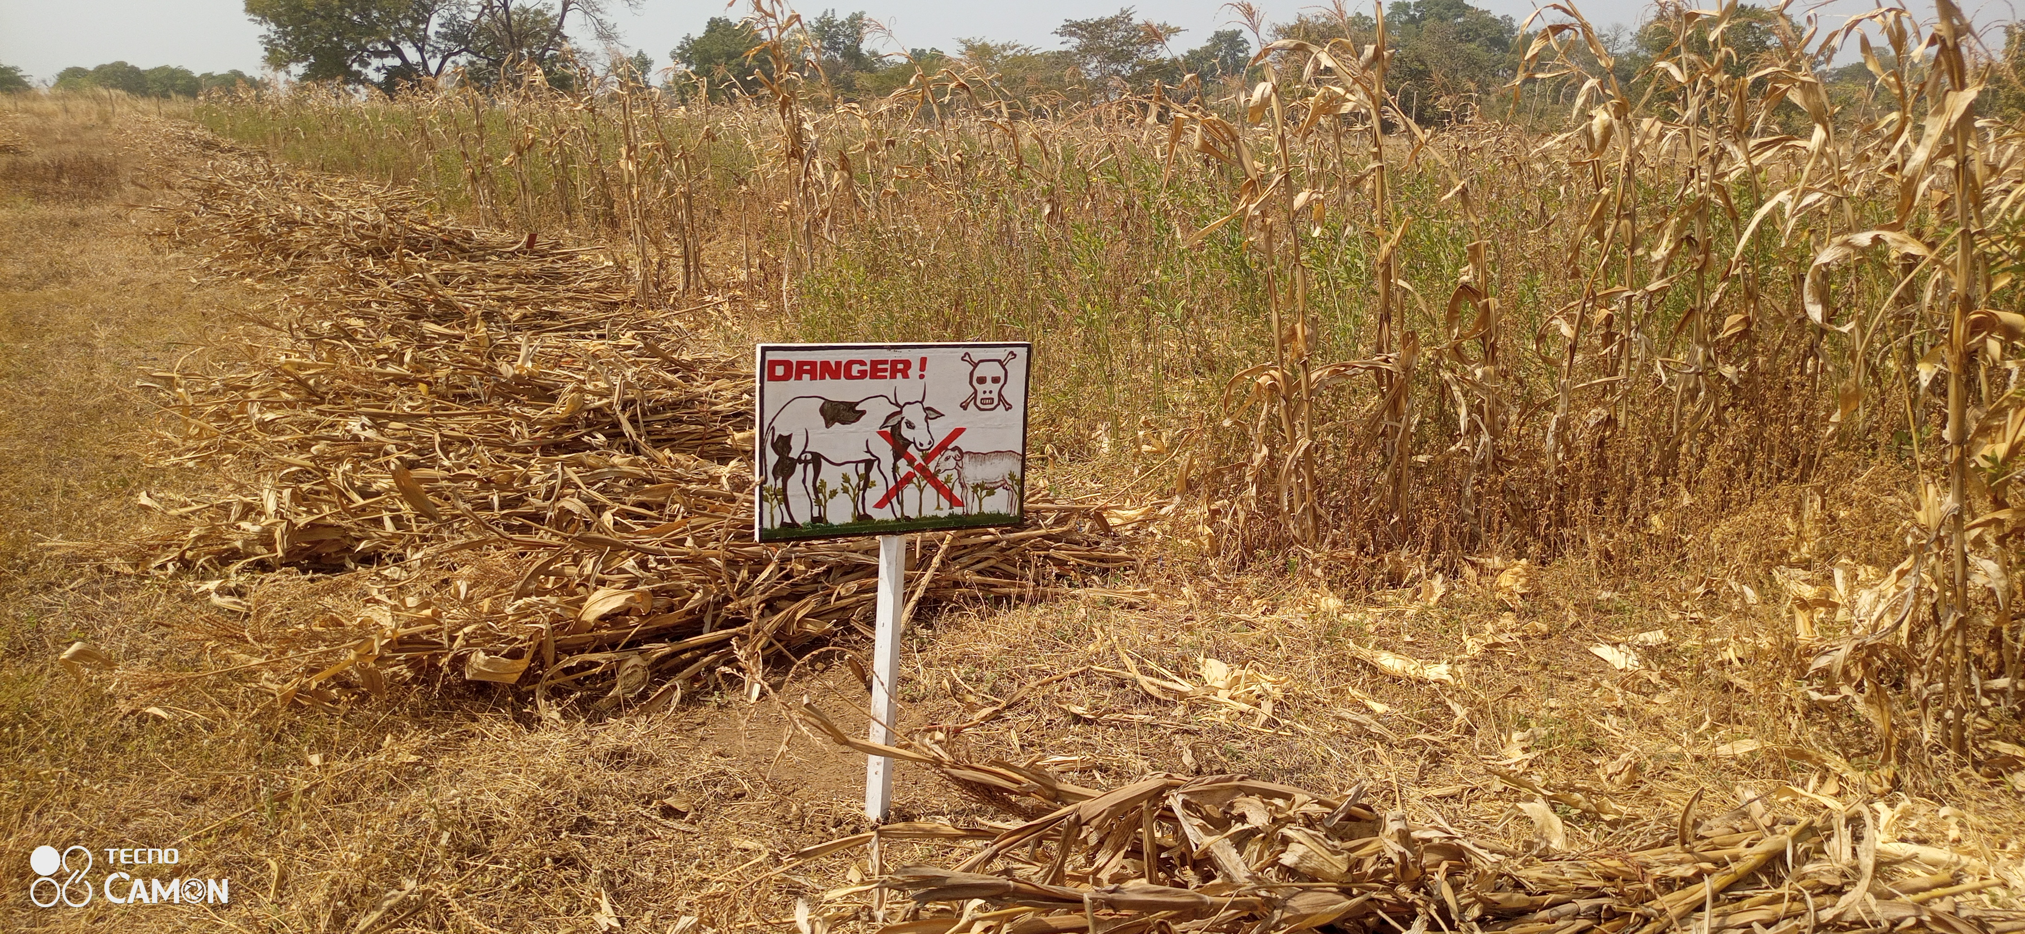
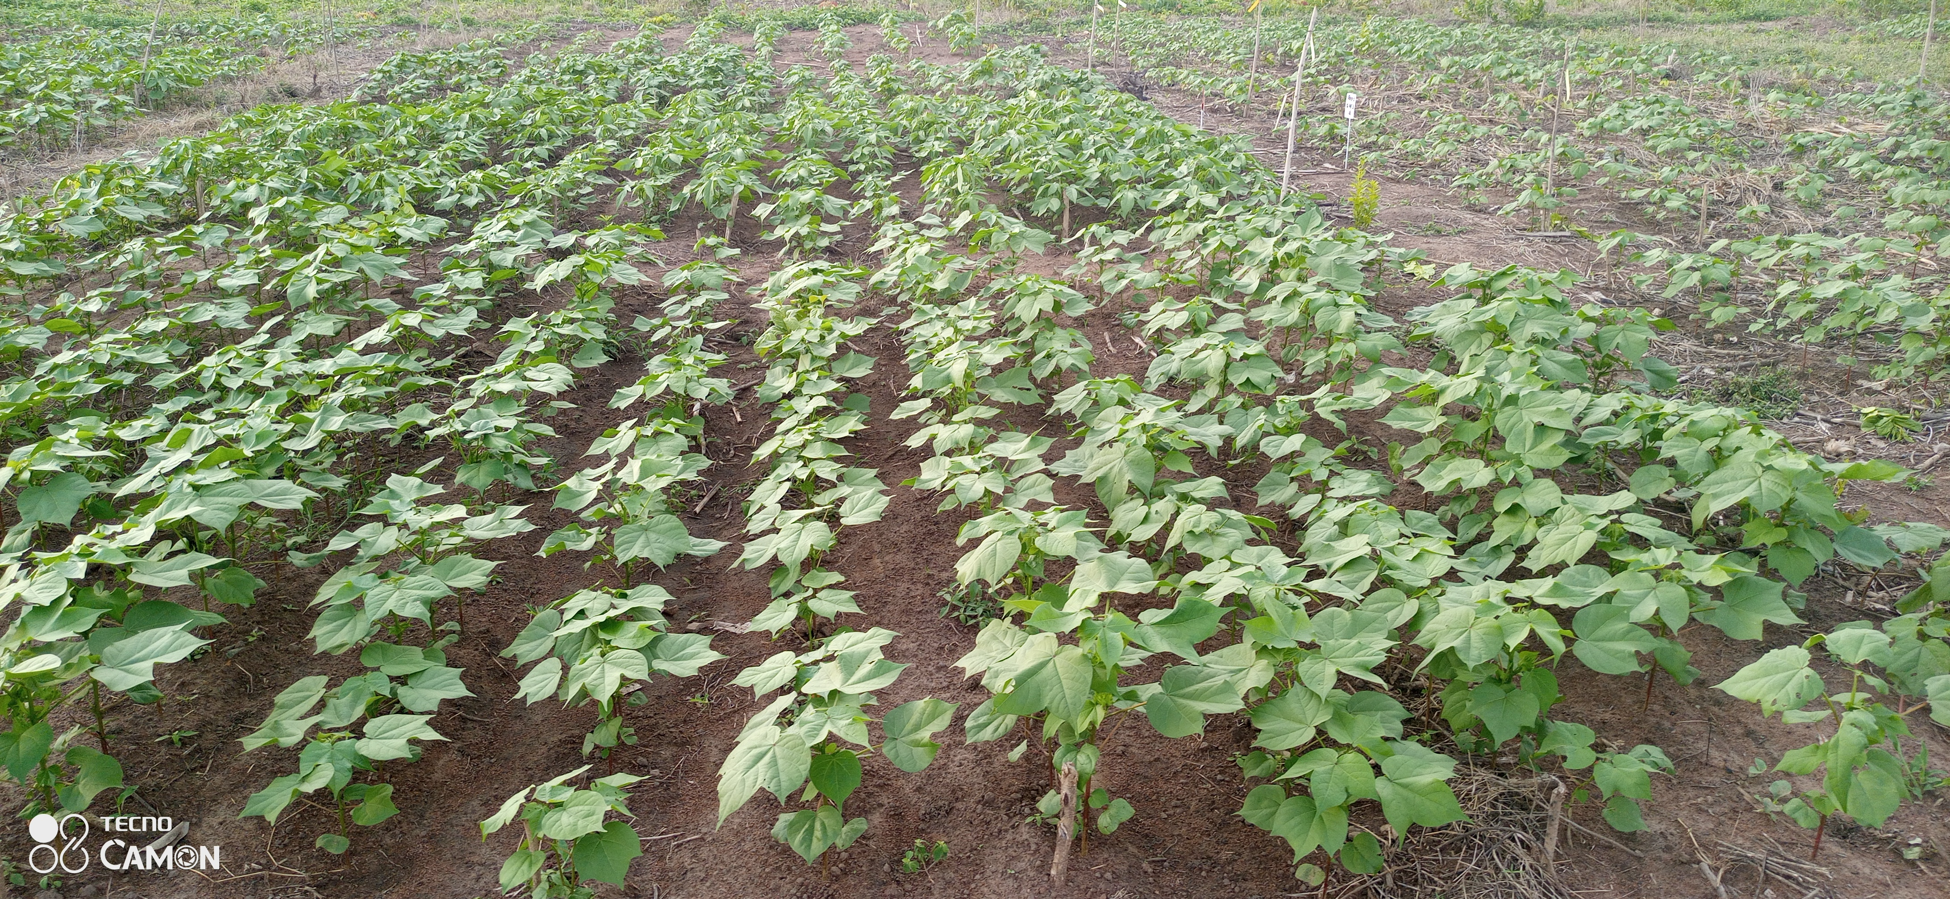
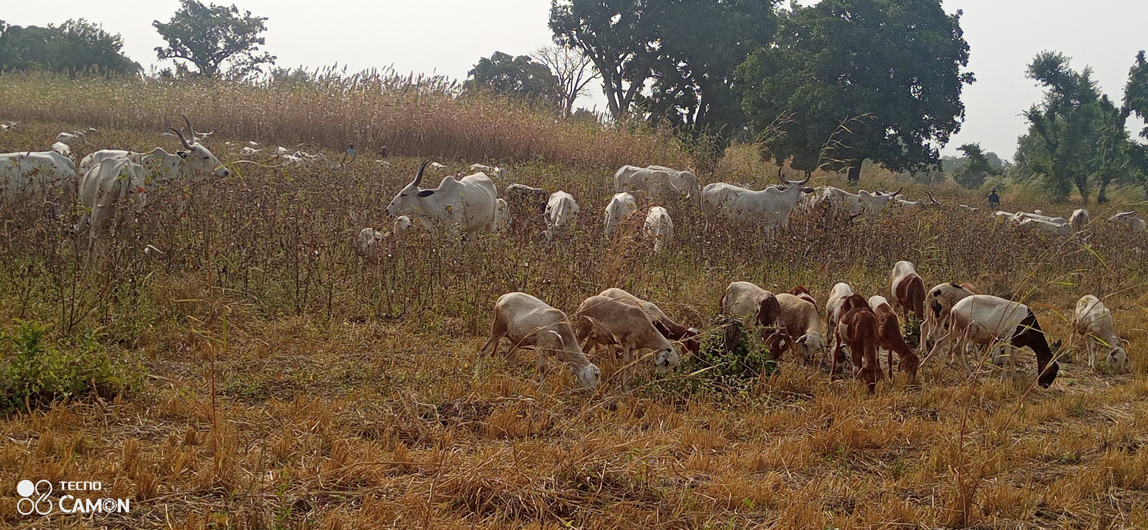

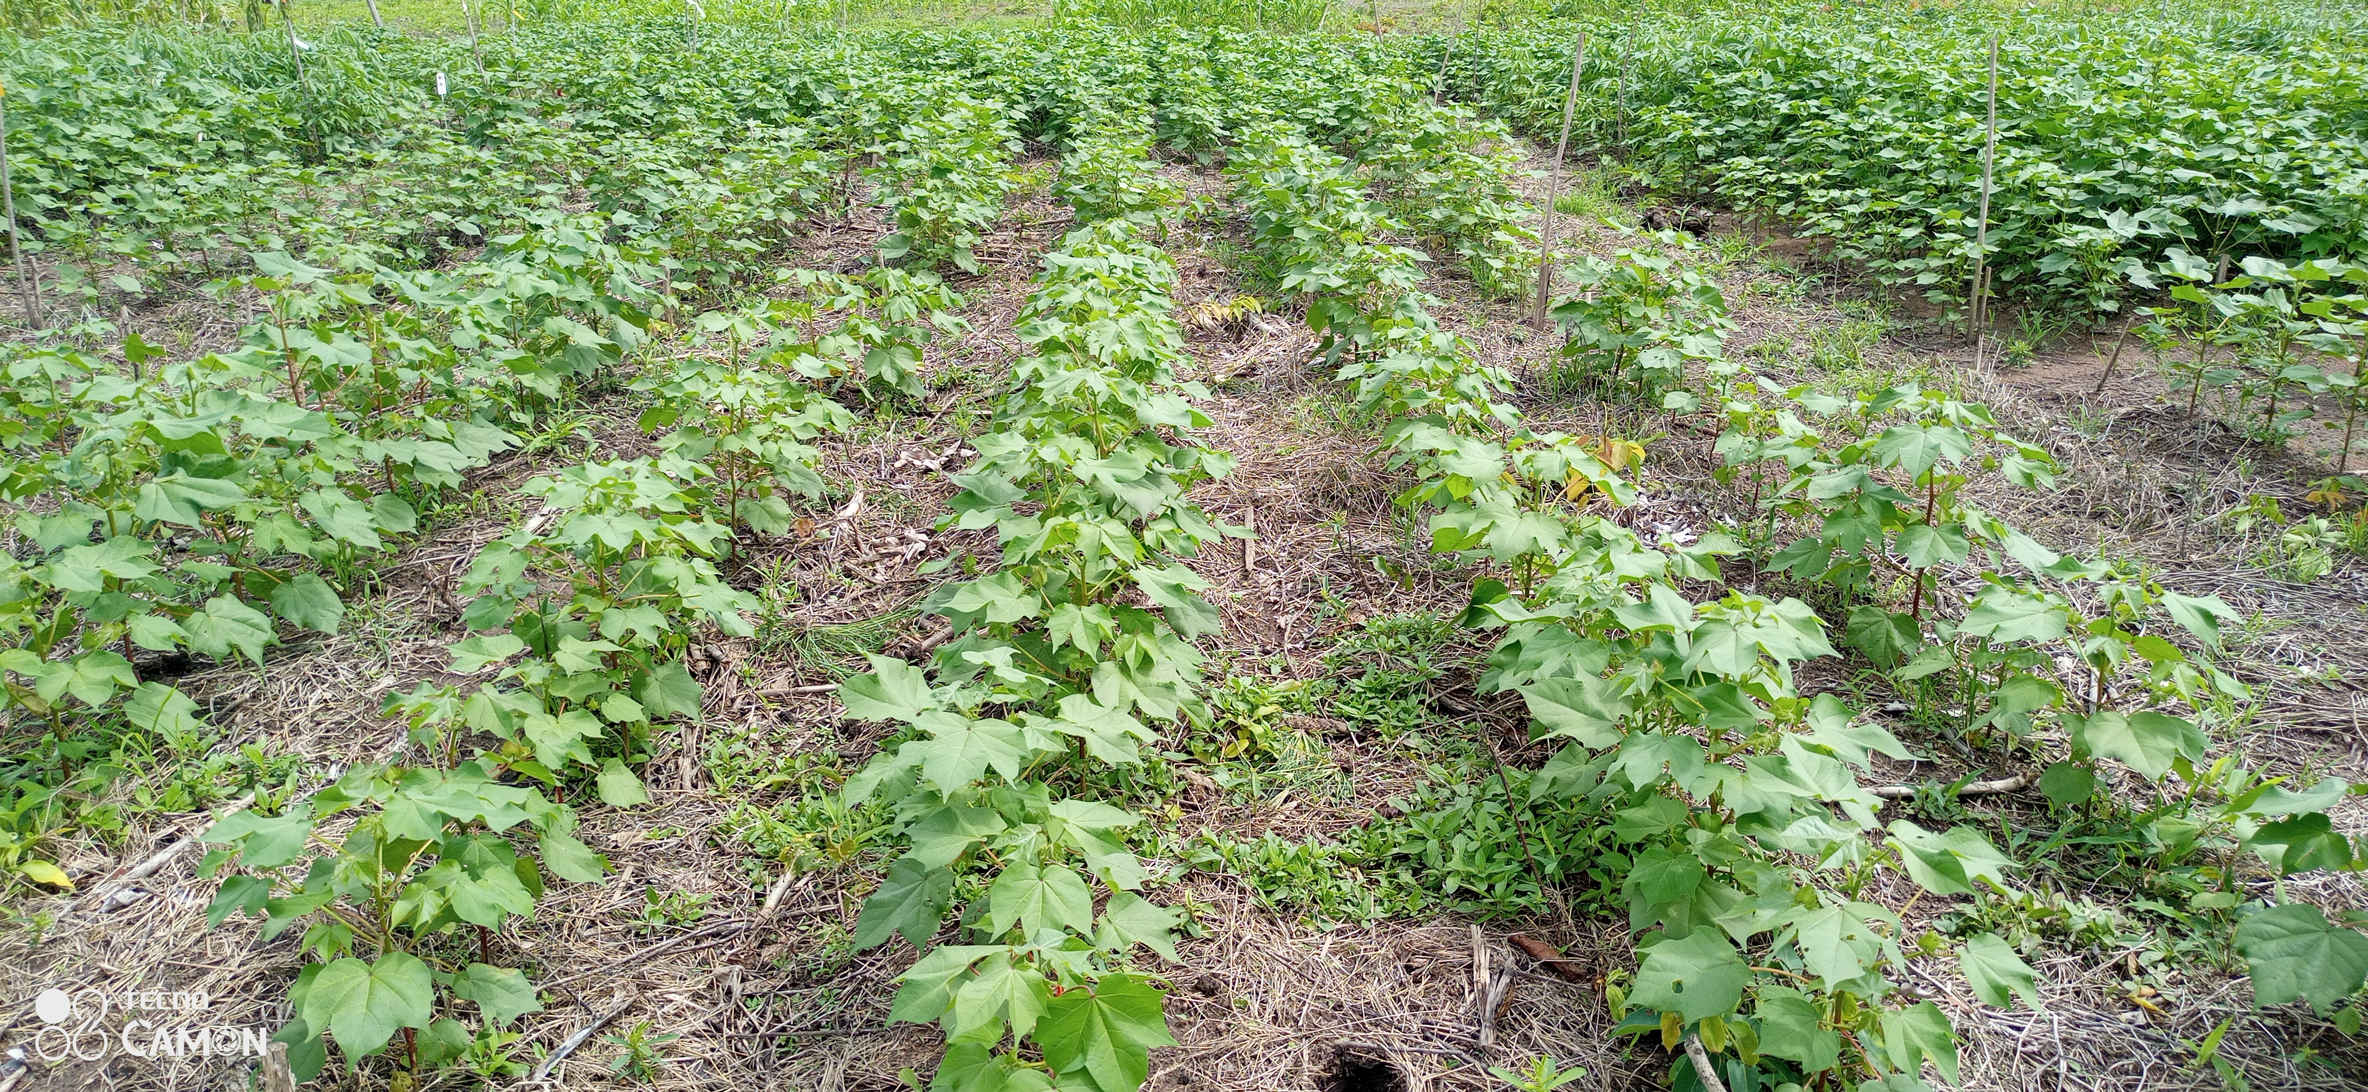
Thank you for you attention

