Slide 1
Trajectories of technical changes in pesticide reduction across French vineyards
Esther Fouillet; Bruno Rapidel; Anne Merot
INRAE, UMR ABSYS
Contact : esther.fouillet@inrae.fr

Slide 2
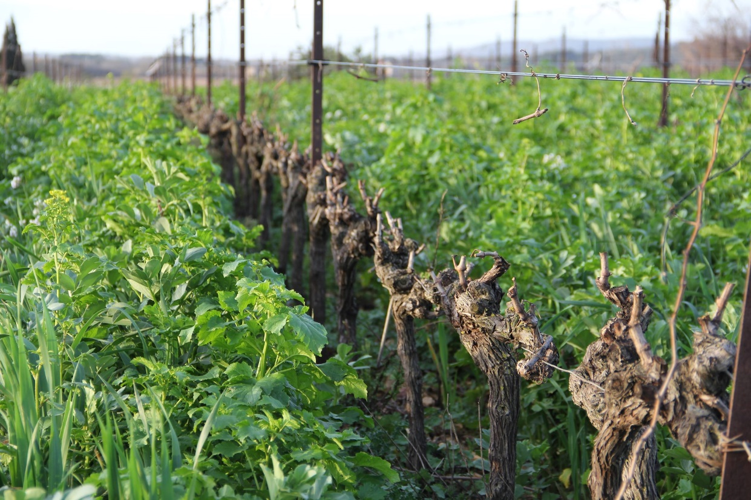
Scientific context
Vineyards : high pesticide use
Several technical levers
(Wezel et al., 2014)
Lockins in their implementation
(Mawois et al., 2019; Meynard et al., 2018; Vermunt et al., 2022)
Knowledge on the processes of change to better support farmers in their pesticide use reduction
(Dupré, Michels, et Le Gal 2017; Chantre, Cerf, et Le Bail 2015; Sutherland et al. 2012)
Service crops at Domaine du Chapitre / Photo : Yvan Bouisson
Notes:
Mainly fungicide, example of levers (dispo pour ajuster les doses et réduire les herbicides identifier par la recherche)

Slide 3
Aim of the study
Analyzing the transition toward low pesticide use vineyard systems through trajectories of technical changes

Slide 4
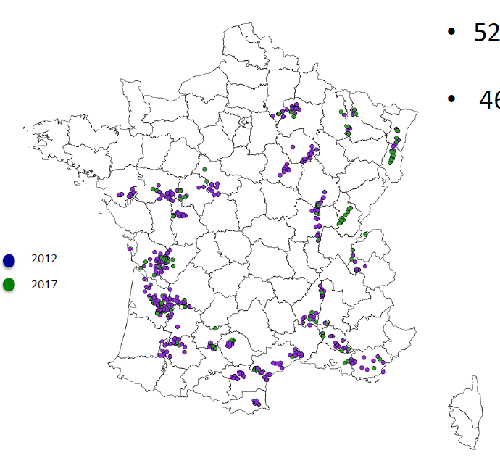
Case study
DEPHY Network
→ Cropping systems engaged in pesticide reduction
280 entered the Network between 2010 and 2012
AGROSYST Database
Cropping systems description (UAA, material… )
Data on practices (phytosanitary treatments)
Data on performances (yield, worktime… )

Slide 5
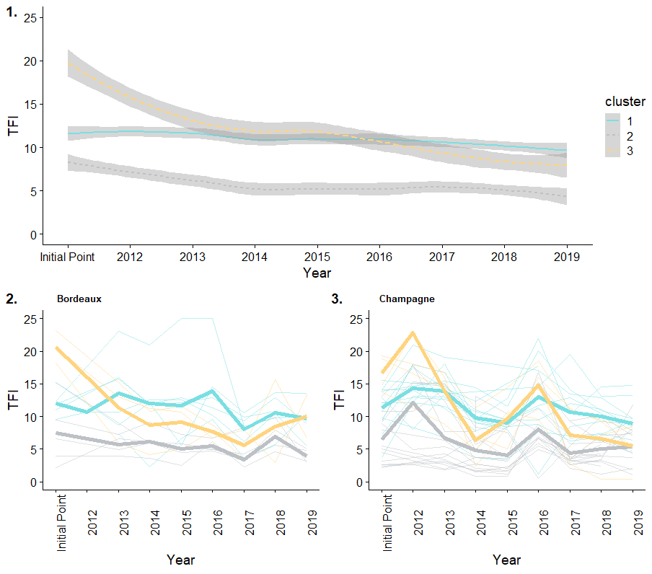
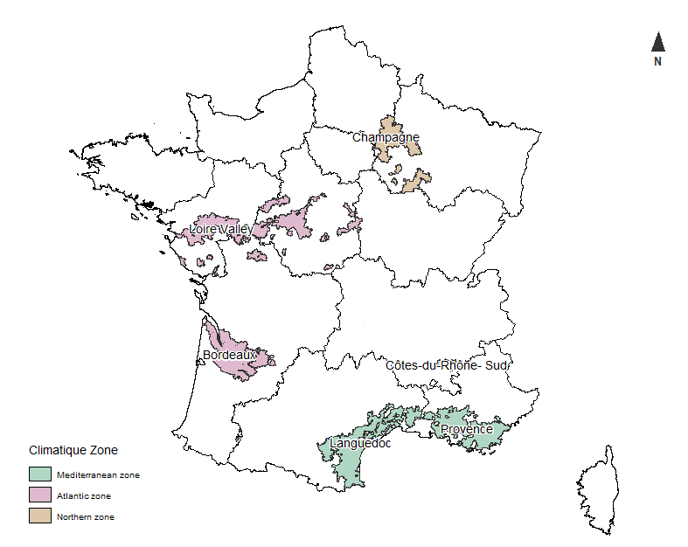
Methods – Identifying technical change trajectory
③
Fouillet et al. 2023
①
-16%
-63%
37 farms from the 3 different clusters were surveyed
Collect data on the context of the farm
Identified the changes implemented
②
-49%
Climatic Zone | 1 | 2 | 3 | Total
Atlantic Zone | 6 | 4 | 5 | 15
Organic Farming |  | 2 |  | 2
Conventional Farming | 6 | 2 | 3 | 12
Mediterranean Zone | 3 | 6 | 2 | 11
Organic Farming |  | 2 |  | 2
Conventional Farming | 3 | 4 | 3 | 10
Northern Zone | 4 | 4 | 3 | 11
Organic Farming
Conventional Farming | 3 | 5 | 3 | 11
Total | 13 | 14 | 9 | 37
Climatic Zone

Slide 6
Methods – Identifying the intensity of changes implemented
Use and adaptation of the Efficiency, Substitution, Redesign Framework (ESR, Hill and MacRae, 1996) to characterize each implemented changes
Stop of anti-botrytis product (with no replacement)
Dose reduction
Replacement of chemical product with biocontrol product
Mechanical weeding under the row to replace chemical weeding
STOP
EFFICIENCY
SUBSTITUTION
REDESIGN

Slide 7
Methods – Caracterizing the trajectory of changes implemented
Agronomic coherence phase
Time
Farm 1
Period during which the farm have the same coherence in the conduct of activities
Farm 2
Change of coherence phase
Adapted from Moulin et al. 2008
Gradual changes that do not affect coherence
Transformation : changes that lead to the implementation of a new coherence

Slide 8
Methods – Caracterizing the trajectory of changes implemented
Use of the ESR framework to split the trajectory into coherence phase
Time
Farm 1
E
S
R
R
Period during which the farm have the same coherence in the conduct of activities
Farm 2
R
Change of coherence phase
Adapted from Moulin et al. 2008
Gradual changes that do not affect coherence (A, E and S)
Transformation : changes that lead to the implementation of a new coherence (R)

Slide 9
Methods – Caracterizing the trajectory of changes implemented
Use of the ESR framework to cut trajectory into coherence phase
time

Slide 10
Type of products used
Mainly use of synthetic products
Use of copper/biocontrol supplemented by synthetic products
Use of copper and biocontrol only
Use of copper and biocontrol and PNPP (essential oil, purin...)
Cu
S
Cu
S
Notes:
CaraTCérisation des phases de cohérence

Slide 11
Weed management
Row
Inter-row
Covered
Mechanical
Chemical
Type of products used
Mainly use of synthetic products
Use of copper/biocontrol supplemented by synthetic products
Use of copper and biocontrol only
Use of copper and biocontrol and PNPP (essential oil, purin...)
Cu
S
Cu
S

Slide 12
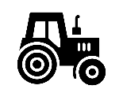
Weed management
Row
Inter-row
Covered
Covered
Bare soil
Mechanical
Covered
Bare soil
Chemical
Covered
Bare soil
Chemical
Chemical
Type of products used
Mainly use of synthetic products
Use of copper/biocontrol supplemented by synthetic products
Use of copper and biocontrol only
Use of copper and biocontrol and PNPP (essential oil, purin...)
Cu
S
Cu
S

Slide 13
Weed management
Row
Inter-row
TC8
TC14
Covered
Covered
Bare soil
TC5
TC7
TC11
TC13
Mechanical
Covered
TC4
TC12
Bare soil
TC3
TC6
TC9
TC10
Chemical
Covered
Bare soil
TC2
Chemical
Chemical
TC1
Type of products used
Mainly use of synthetic products
Use of copper/biocontrol supplemented by synthetic products
Use of copper and biocontrol only
Use of copper and biocontrol and PNPP (essential oil, purin...)
Cu
S
Cu
S

Slide 14
Weed management
Row
Inter-row
TC8
TC14
Covered
Covered
Bare soil
TC5
TC7
TC11
TC13
Mechanical
Covered
TC4
TC12
Bare soil
TC3
TC6
TC9
TC10
Chemical
Covered
Bare soil
TC2
Chemical
Chemical
TC1
Type of products used
Mainly use of synthetic products
Use of copper/biocontrol supplemented by synthetic products
Use of copper and biocontrol only
Use of copper and biocontrol and PNPP (essential oil, purin...)
Cu
S
Cu
S

Slide 15
Methods – Characterizing the coherence phase
Time

Slide 16
Methods – Characterizing the coherence phase
Time

Slide 17
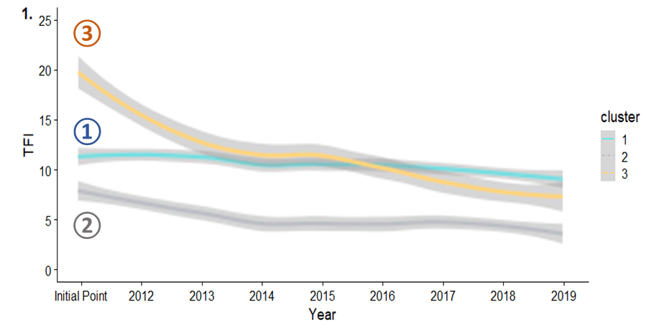
Weed management
Changes for winegrowers from Cluster 1 (-16 %) and 3 (-63%)
Row
Inter-row
TC8
TC14
Covered
Covered
Bare soil
TC5
TC7
TC11
TC13
Mechanical
Covered
TC4
TC12
Bare soil
TC3
TC6
TC9
TC10
Chemical
Covered
Bare soil
TC2
Efficiency/Substitution
Chemical
Chemical
TC1
Type of products used
Mainly use of synthetic products
Use of copper/biocontrol supplemented by synthetic products
Use of copper and biocontrol only
Use of copper and biocontrol and PNPP (essential oil, purin...)
Cu
S
Cu
S

Slide 18
Weed management
Changes for winegrowers from Cluster 2 – a reduction from 49% of the pesticide use
Row
Inter-row
TC8
TC14
Covered
Covered
Bare soil
Redesign
TC5
TC7
TC11
TC13
Mechanical
Covered
TC4
TC12
Bare soil
TC3
TC6
TC9
TC10
Chemical
Covered
Bare soil
TC2
Efficiency/Substitution
Chemical
Chemical
TC1
Type of products used
Mainly use of synthetic products
Use of copper/biocontrol supplemented by synthetic products
Use of copper and biocontrol only
Use of copper and biocontrol and PNPP (essential oil, purin...)
Cu
S
Cu
S

Slide 19
Levers implemented by farmers from cluster 2
③
Conversion toward Organic Farming
Prophylaxis
Reducing doses of copper and sulphur applied
Complex inter-row management (service crops, grazing with sheep…)
①
②
Fouillet et al. 2023

Slide 20
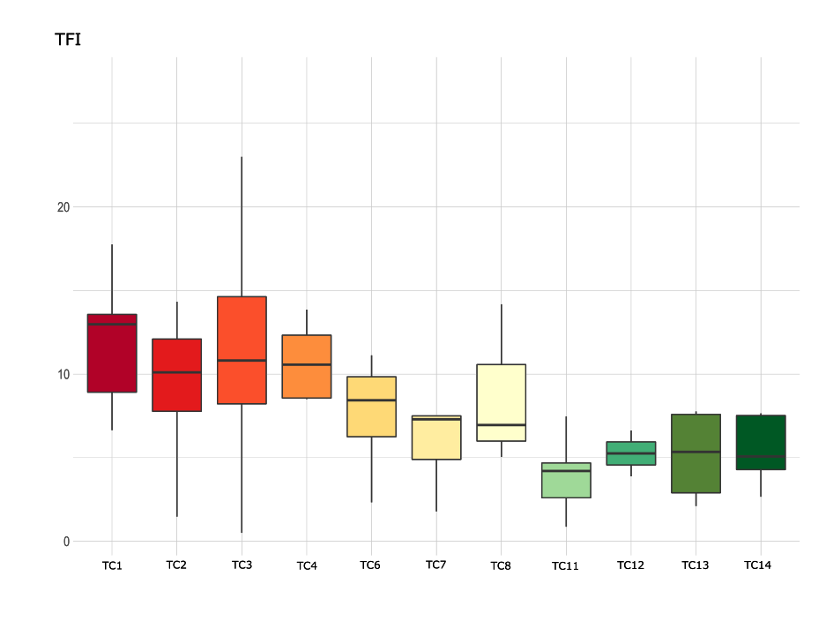
Discussion & Perspectives
Conclusion
Preferred trajectories for change of practices are observed mainly based on efficiency and substitution
Positive impact of the DEPHY network – Room for manoeuvre for the wine industry to reduce pesticide use from -20% with levers based on efficiency and substitution
Lock-ins are observed as some TCs appear as locking point
an in-depth analysis taking into account the farm context and logic of action is necessary
-20%
Perspectives

Slide 21
Thank you for your attention !
Conclusion
Preferred trajectories for change of practices are observed mainly based on efficiency and substitution
Positive impact of the DEPHY network – Room for manoeuvre for the wine industry to reduce pesticide use from -20% with levers based on efficiency and substitution
Lock-ins are observed as some TCs appear as locking point
an in-depth analysis taking into account the farm context is necessary (Liebert et al. 2022)
Perspectives

Slide 22
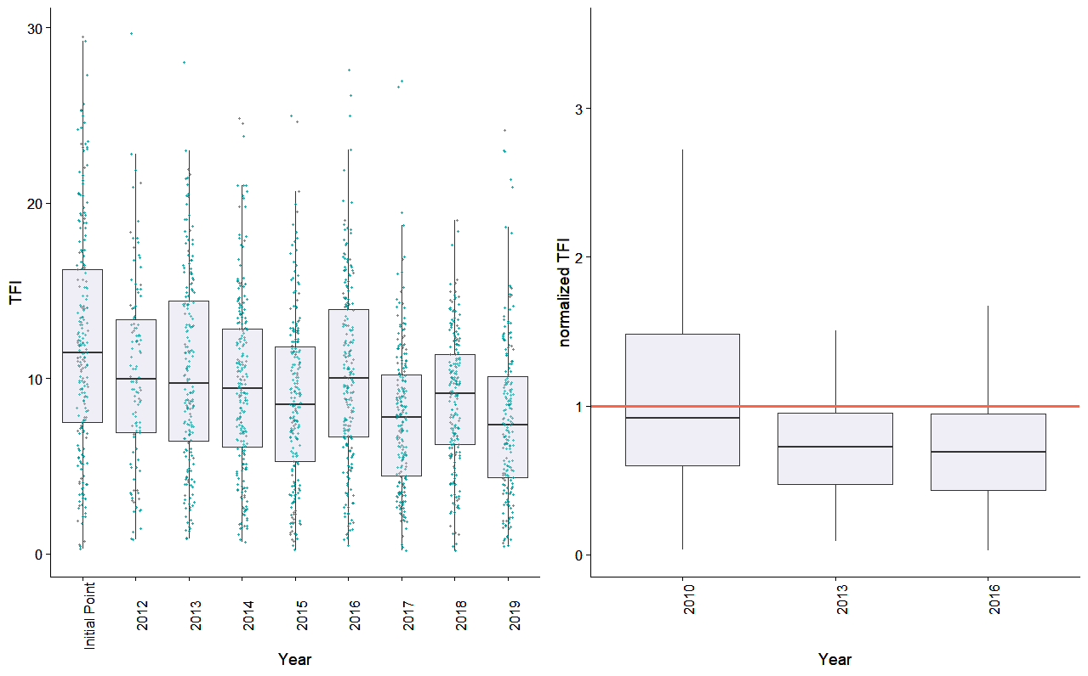
Knowledge produced on the DEPHY network with the AGROSYST Database
The pesticide use evolution within the DEPHY-Network was assessed
Use of the Treatment Frequency Index
→ A 32% pesticide use reduction
Fouillet et al. 2022
Notes:
Mainly regarding fungicide

Slide 23
Knowledge produced on the DEPHY network with the AGROSYST Database
A diversity of pesticide use trajectory was identified
③
→ Distribution of clusters in all winegrowing regions
①
Cluster 1 : medi Initial Point and small TFI decrease (-16%)
Cluster 2 : low Initial Point and high TFI decrease (-49%)
Cluster 3 : High Initial Point and high TFI decrease (-63%)
②
Fouillet et al. 2023

