Slide 1





Challenges and Opportunities For Increasing Organic Carbon in Vineyard Soils: Perspectives of Extension Specialists
Author(s) [M. Thiollet-Scholtus¹; Amélie C.M. Gaudin², Justine Vanden Heuvel³
INRAE – UMR Lae¹, UC-Davis², Cornell University³
Financial support : INRAE (Science for Action & Transition scientific division and International board of INRAE)
marie.thiollet-scholtus@inrae.fr

Slide 2
Aim Method Results-discussion Conclusion
Practices and Soil Organic Carbon (SOC) in vineyards
- Vineyards are often located on soils with low SOC
- Improving SOC can lead to improved soil health
- Improved SOC = improved resilience in challenging climates
- SOC is reduced in vineyards with use of herbicide or tillage
- Effective SOC sequestration is achieved through a combination of practices
- Barriers for winegrowers’ adoption of SOC-improved practices
(Raclot et al. 2009; Eldon & Gerhenson, 2015; Karl et al., 2016; Payen et al. 2021; Payen et al. 2023; )
(Muñoz-Rojas et al., 2012; Lal, 2016)
Perception of extension personnel regarding challenges and opportunities for improving SOC in vineyards
Notes:
The most effective SOC sequestration was achieved through a combination of organic amendments and no-till

Slide 3
Aim Method Results-discussion Conclusion
What is the perception of extension specialists regarding practices which are known to maintain and increase SOC in vineyard?
What barriers do extension specialists perceive for the wine industry to maintain or improve soil carbon ?

Slide 4
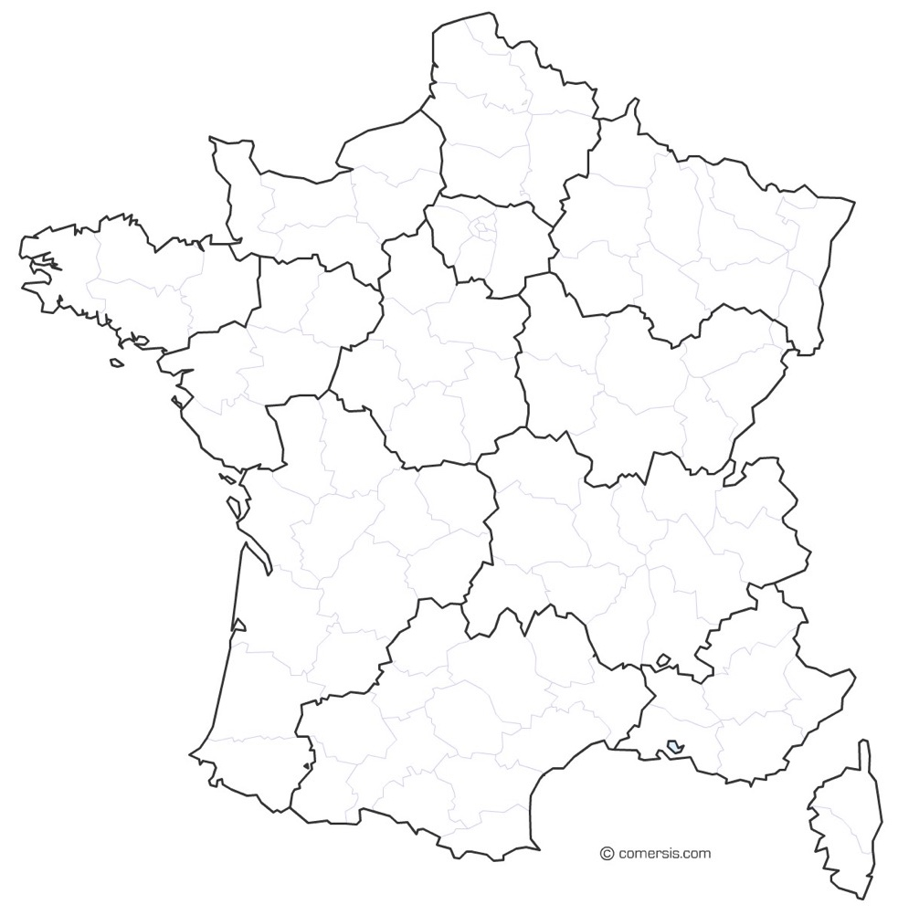
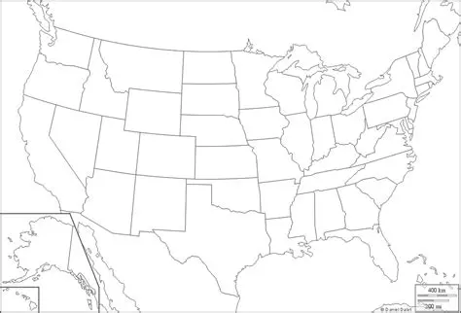
Aim Method Results-discussion Conclusion
Step1: 69 cases identified
France
8
Step 2: 32 interviews performed
warm and cool in USA + warm and cool in France
8
Step 3: practices to maintain or increase SOC identified
USA
8
Step 4: challenges and levers to apply SOC-friendly practices analyzed
8
Ryschawy et al., 2021; Warne et al., 2019
Step 5: challenges and opportunities identified
Study zones. Climate: red: warm; blue: cool
Notes:
Scheme of case study to keep interviees anonymous

Slide 5
Aim Method Results-discussion Conclusion
7 current practices identified to maintain or increase SOC
higher occurrences of answers are for organic fertilization, tillage and cover crop emphasized by extension:
Cover crop
Organic fertilization
Tillage reduction
Grazing
Agroforestry
Mulching
Herbicide use reduction

Slide 6
Aim Method Results-discussion Conclusion
Practices identified that could be adopted to improve SOC in their region
Cover crop
Organic fertilization
Tillage reduction
Grazing
Agroforestry
Mulching
Herbicide use reduction

Slide 7
Aim Method Results-discussion Conclusion
Diversity of barriers to adopt SOC-friendly practices in vineyard:
Differences in study areas
Notes:
Oral : detail main point for each practice with precision of the study area

Slide 8
Aim Method Results-discussion Conclusion
Diversity of barriers to adopt SOC-friendly practices in vineyard:
economic, agricultural, educational, conflict of interest, and structural
Economic & agricultural
69% of the extension specialists mentioned the cost of the SOC-friendly practice as the first barrier
the potential negative impact of the SOC-friendly practice on yield
The competition of cover crop with vine vigor
Education and training of winegrowers needed included knowledge to implement
the practices at the field scale
systems redesign at the farm scale
SOC-friendly practices
Sructural barriers
Climate of the location of the vineyard for competition for water and nitrogen
Planting density for agroforestry in Protected Designation vineyards
Availability of organic fertilizers close to the farm
Conflicts of interest
Potential food safety issues associated with livestock grazing, particularly in table grape production

Slide 9
Aim Method Results-discussion Conclusion
Discussion
Greater emphasis on addressing the challenges to adoption of SOC-favorable practices is urgently needed to inform national and regional agricultural policies in both countries
Couple extension specialists with winegrowers point of view because they work together in vineyard

Slide 10
Aim Method Results-discussion Conclusion
Take home message
Agronomic, educational, conflict of interest and structural challenges for SOC-favorable practices in vineyard
Need of agricultural policies at both national and regional scales
Acknowledgments: interviewees from California, Northern United States, Alsace, Burgundy, Champagne and Mediterranean French area
marie.thiollet-scholtus@inrae.fr
Notes:
Characterization of the weed and plant cover management logics of farmers with sloping or terraced vineyards who have eliminated the use of glyphosate.
Technical innovations were implemented by combining them with innovations in work organization.
Develop research on systemic levers to open up new possibilities and remove technical and socio-economic obstacles to the elimination of glyphosate use.
>>> Which could inspire those committed to redesigning their systems for the agro-ecological transition

