Slide 1
Intercropping chickpea with a mechanically controlled service plant: a promising way to manage weeds while mitigating interspecific competition
Margaux Guy, Mathieu Lorin, Xavier Bousselin & Guénaëlle Corre-Hellou
USC LEVA, Ecole Supérieure des Agricultures (ESA), INRAE
Angers (France)

Slide 2
Context
Among grain legumes, chickpea (Cicer arietinum) is a key species for the agroecological and dietary transitions
This crop has multiple advantages but its weak competitive ability againt weeds leads to high yield variability and low adoption by European farmers
Moreover, there is a lack of studies and references on this crop in Europe
Whish et al. (2002)
18th Congress of the European Society for Agronomy
2

Slide 3
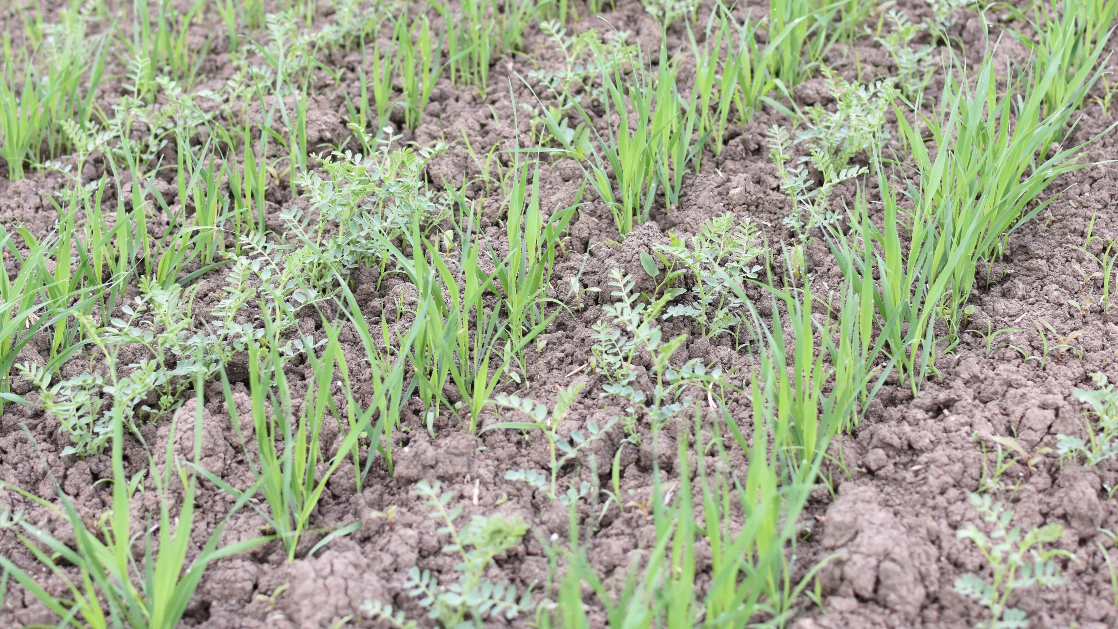
Agronomic levers for weed management
1st lever: intercropping chickpea with a service plant
Adding a species may induce high interspecific competition leading to yield loss
2nd lever: mowing the service plant to mitigate interspecific competition
Does intercropping chickpea with a service plant and mowing the inter-rows allow to improve weed control while mitigating interspecific competition?
Carton et al. (2017), Cheriere et al. (2020), Thorsted et al. (2006)
18th Congress of the European Society for Agronomy
3
Notes:
Intercropping, which is the simultaneous growth of two or more species in the same field for a significant period of time (Willey, 1979), has been shown by many studies to be effective for weed control
Intercropping with a service plant, which is a non harvested species grown for providing ecosystem services (Gardarin et al., 2022), allows to focus on the cash crop production only

Slide 4
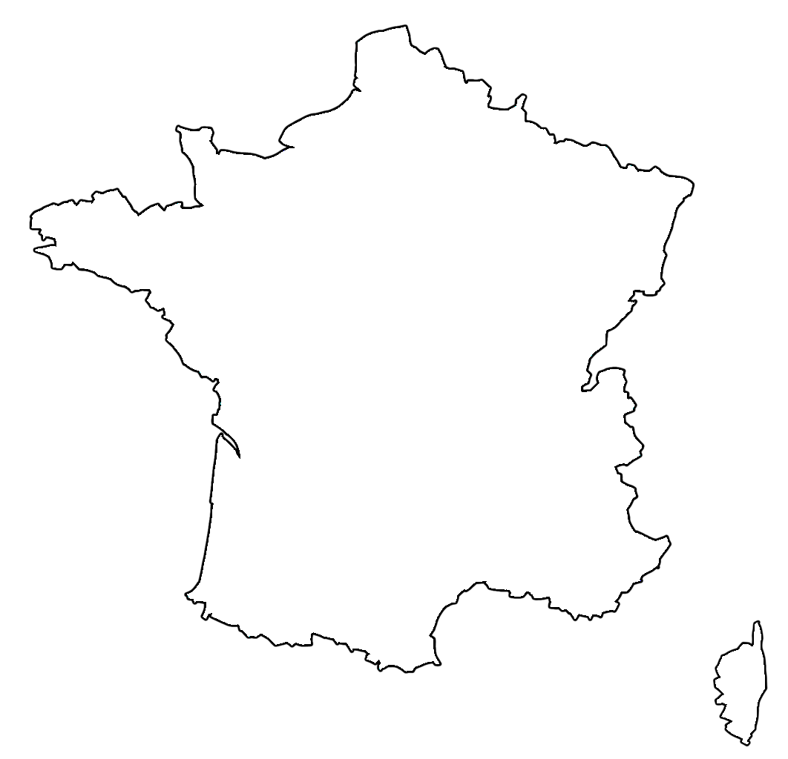
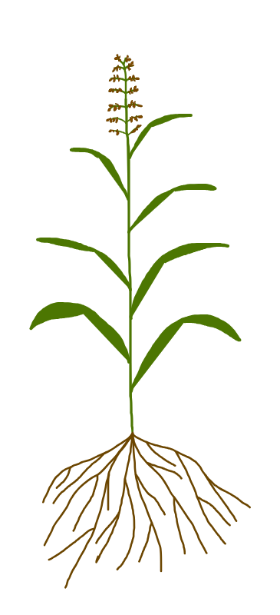
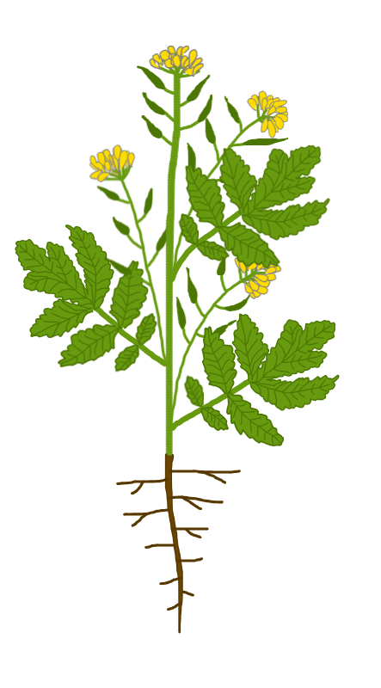
Experimental design
Angers
Field experiment in 2023 conducted near Angers (western France)
Oceanic climate, clay loam soil, low-input system, irrigation at crop emergence
Randomized complete block design (n=4)
Chickpea was intercropped with 5 contrasted species of service plants
Spring faba bean
Vicia faba
Egyptian clover
Trifolium alexandrinum
Spring oat
Avena sativa
Sudan grass
Sorghum x drumondii
White mustard
Sina alba
Fabaceae
Poaceae
Brassicaceae
18th Congress of the European Society for Agronomy
4
Notes:
Chickpea was grown as sole crop + in intercrops
Contrasts between species of service plants:
Growth habit
Root system
Ability to fix atmospheric nitrogen
Competitive ability for resource acquisition
Aim = creating different levels of interspecific competition with chickpea and weeds

Slide 5
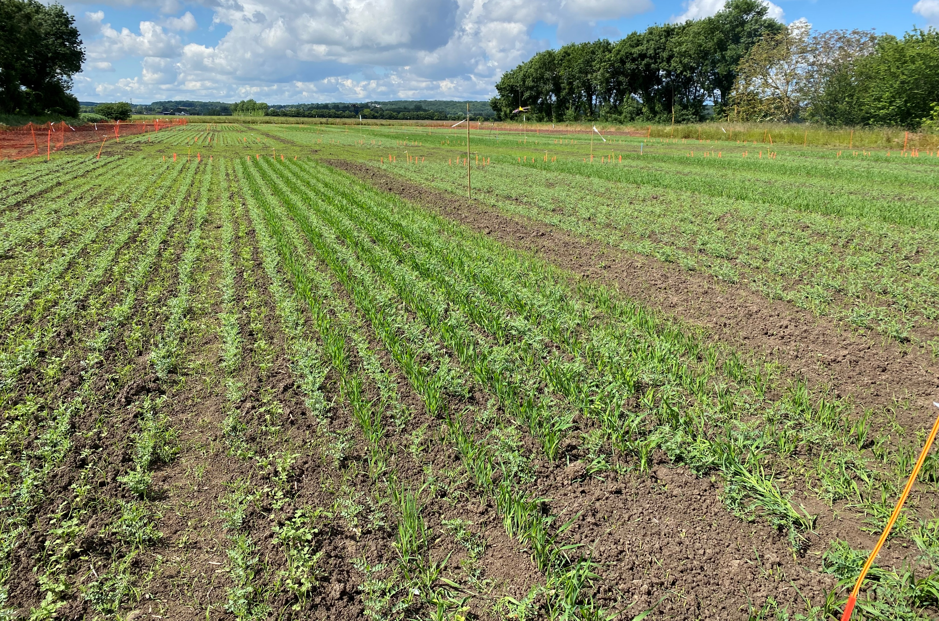
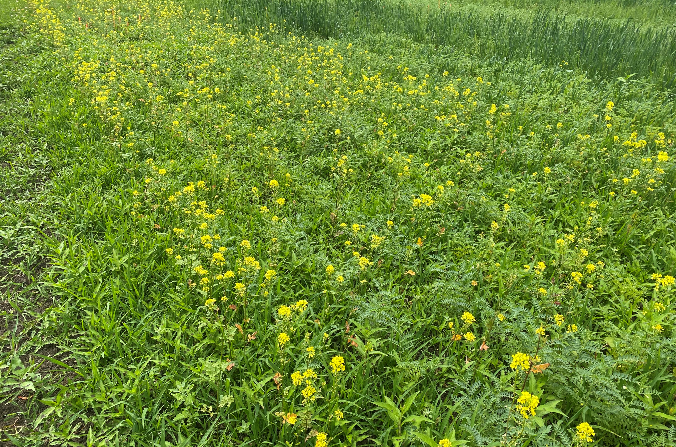
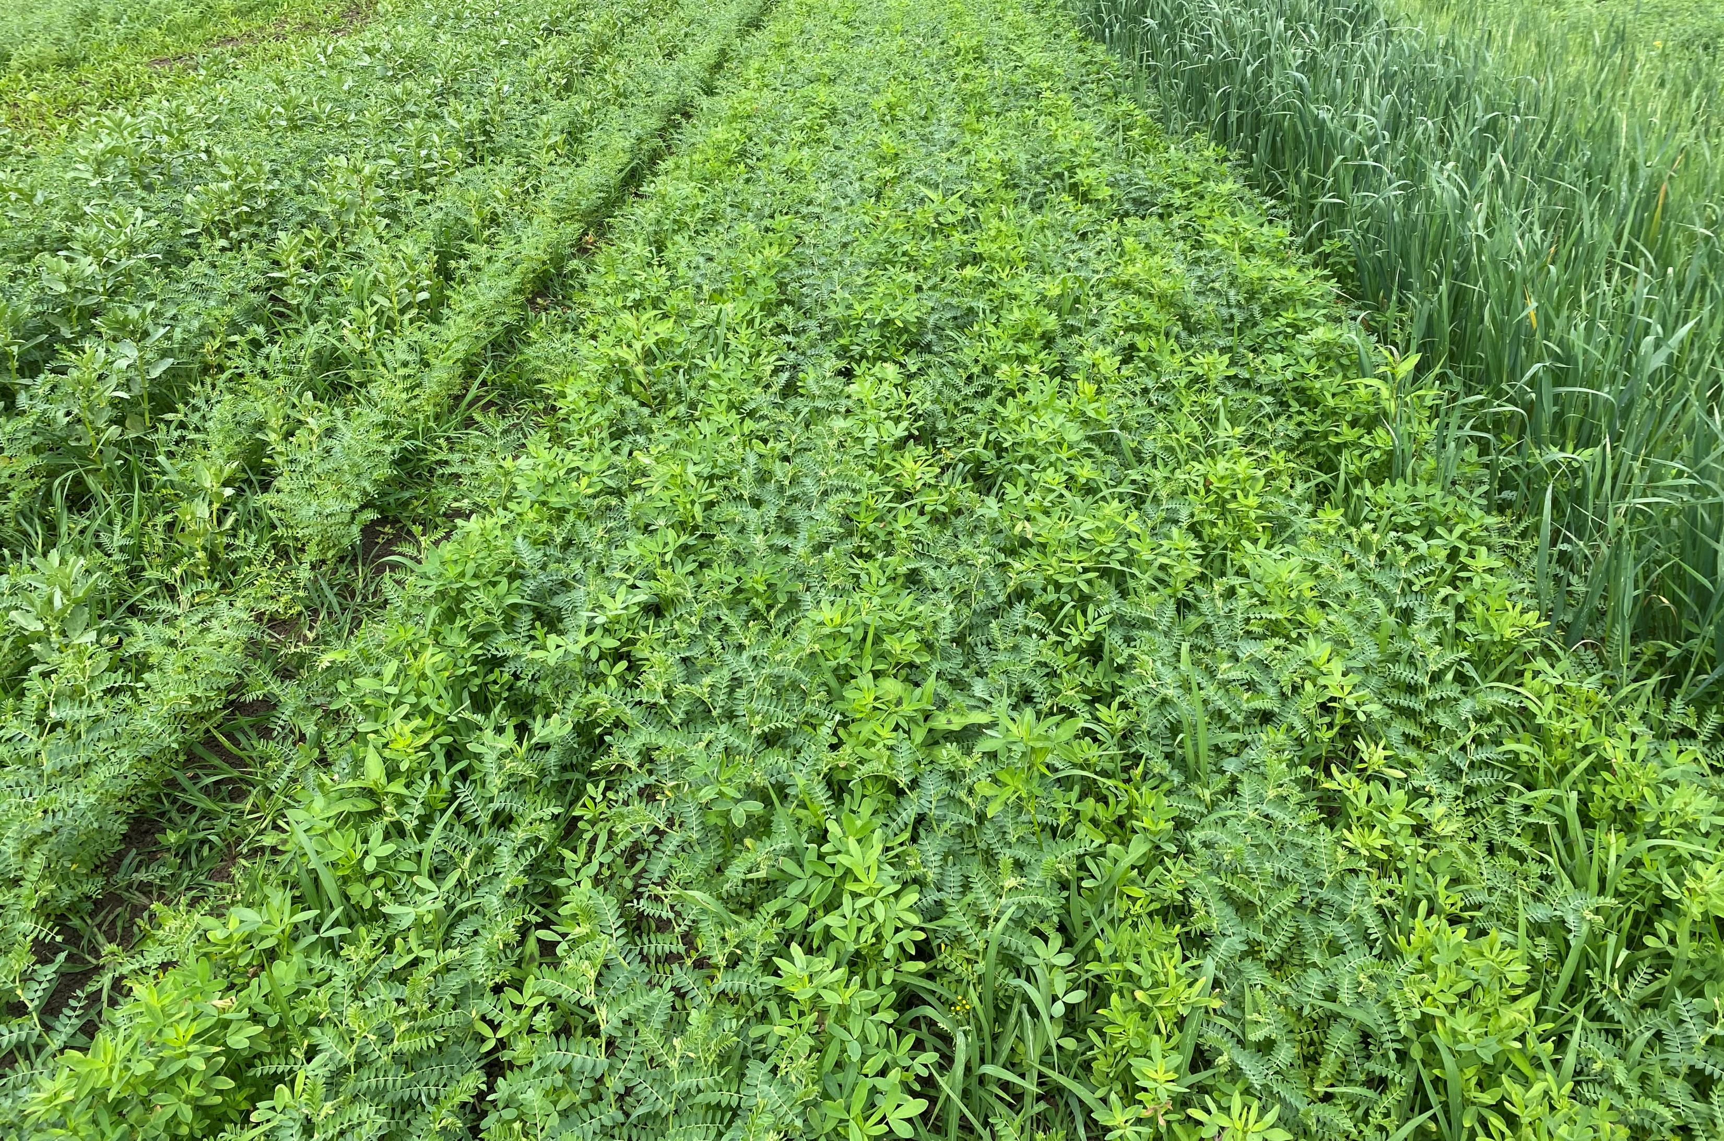
Experimental design
Angers
Field experiment in 2023 conducted near Angers (western France)
Oceanic climate, clay loam soil, low-input system, irrigation at crop emergence
Randomized complete block design (n=4)
Chickpea was intercropped with 5 contrasted species of service plants
The service plant was sown in chickpea’s inter-row
Additive design: 100% chickpea + 50% service plant recommended densities
18th Congress of the European Society for Agronomy
4

Slide 6
Experimental design
The inter-rows (service plant + weeds) were either mowed at the beginning of chickpea flowering or left without mechanical control
Chickpea/oat intercrop without mowing the inter-rows
Chickpea/oat intercrop after mowing the inter-rows
Measurements: dry matter accumulation (6 dates), soil N acquisition and %Ndfa (grain filling stage), chickpea grain yield
18th Congress of the European Society for Agronomy
5
Notes:
In order to study the effect of our treatments on competition for N we measured soil N acquisition and %Ndfa
Service plants also varied in their response to mowing: some of them grow back (clover, oat, sudan grass) and some don’t (faba bean, mustard)
2023:
Sowing date = 20th April
Mowing date = 15th June
2024:
Sowing date = 30th April
Mowing date = 28th June

Slide 7
Results: dry matter accumulation dynamics
Chickpea
Weeds
Service plant
No mowing
Inter-row mowed
Sole chickpea
Grain filling
Harvest
Egyptian clover
Faba bean
1000
1000
1000
750
End flowering
750
750
500
Beg. flowering
500
500
250
10 leaves
250
250
5 leaves
0
0
400
800
1200
1600
0
0
400
800
1200
1600
0
0
400
800
1200
1600
Mean dry weight (g/m²)
Sudan grass
Mustard
Oat
1000
1000
1000
750
750
750
500
500
Mowing
500
250
250
250
0
0
400
800
1200
1600
0
0
400
800
1200
1600
0
0
400
800
1200
1600
Cumulative growing degree days (°C, base 6)
18th Congress of the European Society for Agronomy
6
Notes:
Solid line = unmowed treatment and dashed line = inter-rows were mowed
From the 3rd date, chickpea biomass was the lowest when intercropped with oat (p < 0.001) but tended to increase when the inter-rows were mowed
In the absence of mowing, oat accumulated more biomass than the other species from the 2nd date (p < 0.001)
At the end of flowering, weed biomass was lower in the chickpea/oat intercrop (p < 0.01) and in the treatments with the inter-rows mowed (p < 0.05)

Slide 8
Results: N nutrition
No mowing
Chickpea
26%: %Ndfa
Grain filling: 1 month after mowing
Inter-row mowed
Weeds
14
Service plant
ns
12
a
***
ns
a
a
30%
ns
10
a
ns
39%
*
a
31%
30%
26%
30%
8
ab
32%
Soil N uptake (g/m²)
22%
33%
34%
6
ns
**
ns
ns
ns
44%
4
ns
b
b
46%
*
ns
ns
2
bc
c
bc
*
0
Sole chickpea
Clover
Faba bean
Mustard
Oat
Sudan grass
18th Congress of the European Society for Agronomy
ns: non-significant, * p < 0.05, ** p < 0.01, *** p < 0.001
7
Notes:
Ndfa other legumes around 80%
Chickpea:
Species effect: soil N uptake is lower in the intercrop with oat
Mowing effect: in the intercrops with oat and clover, chickpea soil N uptake was higher when the inter-rows were mowed
Service plants:
Species effect: unmowed oat had the highest soil N uptake and mustard accumulated more soil N than faba bean (p < 0.001)
Mowing effect: mowing the inter-row necessarily reduced soil N uptake for all species except Sudan grass
Weeds:
Species effect: seems to be lower in oat which doesn’t clearly appear in the statistical analysis (p-value = 0.05)
Mowing effect: none

Slide 9
Results: yield
No mowing
Inter-row mowed
6
a
a
a
5
a
4
a
Grain yield (t/ha)
3
2
b
1
0
Sole chickpea
Clover
Faba bean
Mustard
Oat
Sudan grass
18th Congress of the European Society for Agronomy
8
Notes:
High yields: in France chickpea’s yield potential is around 1 to 2.5 t/ha in organic farming and 1.5 to 3 t/ha in conventionnal farming (Lambert, 2023)
Sole chickpea without mowing: 3.6 ± 1.0 t/ha
Chickpea/oat without mowing: 1.0 ± 0.3 t/ha

Slide 10
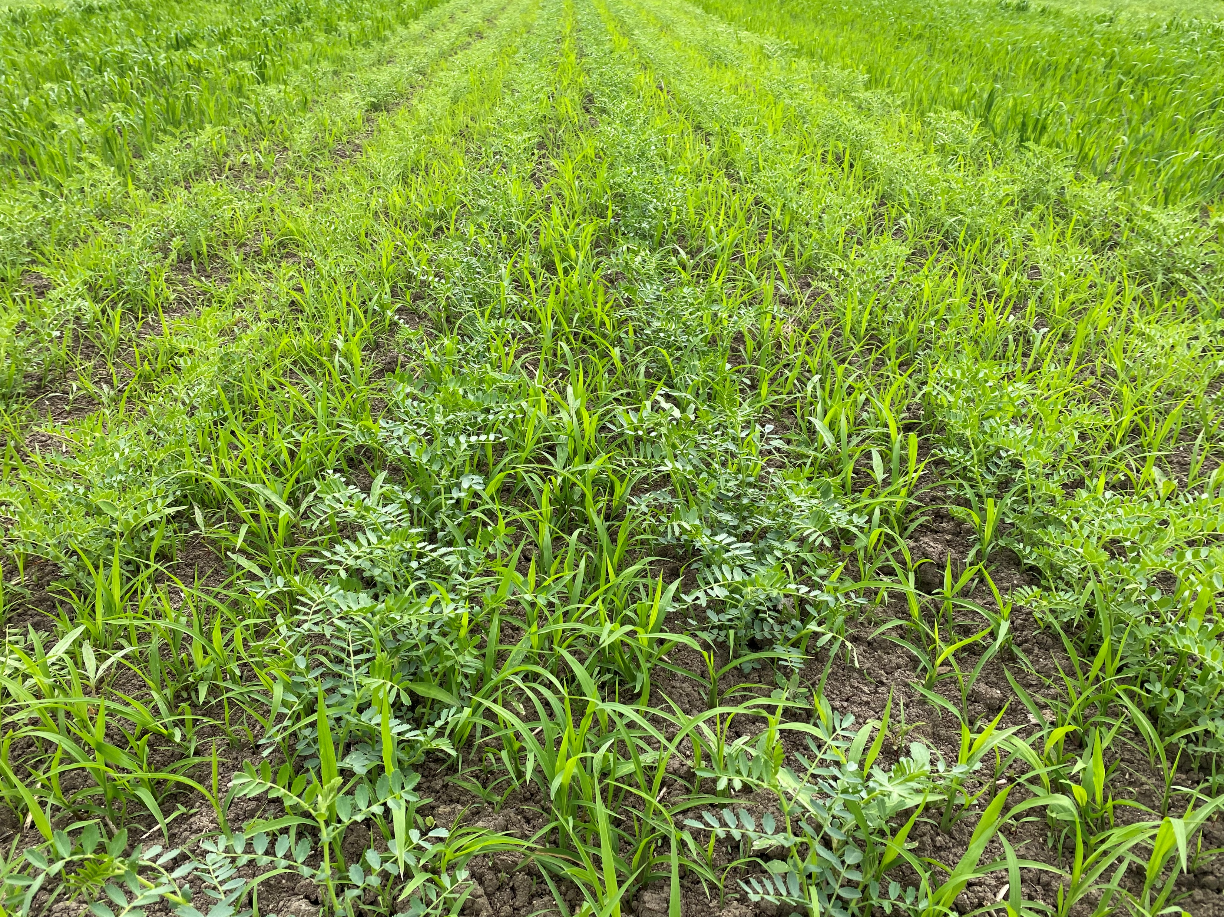
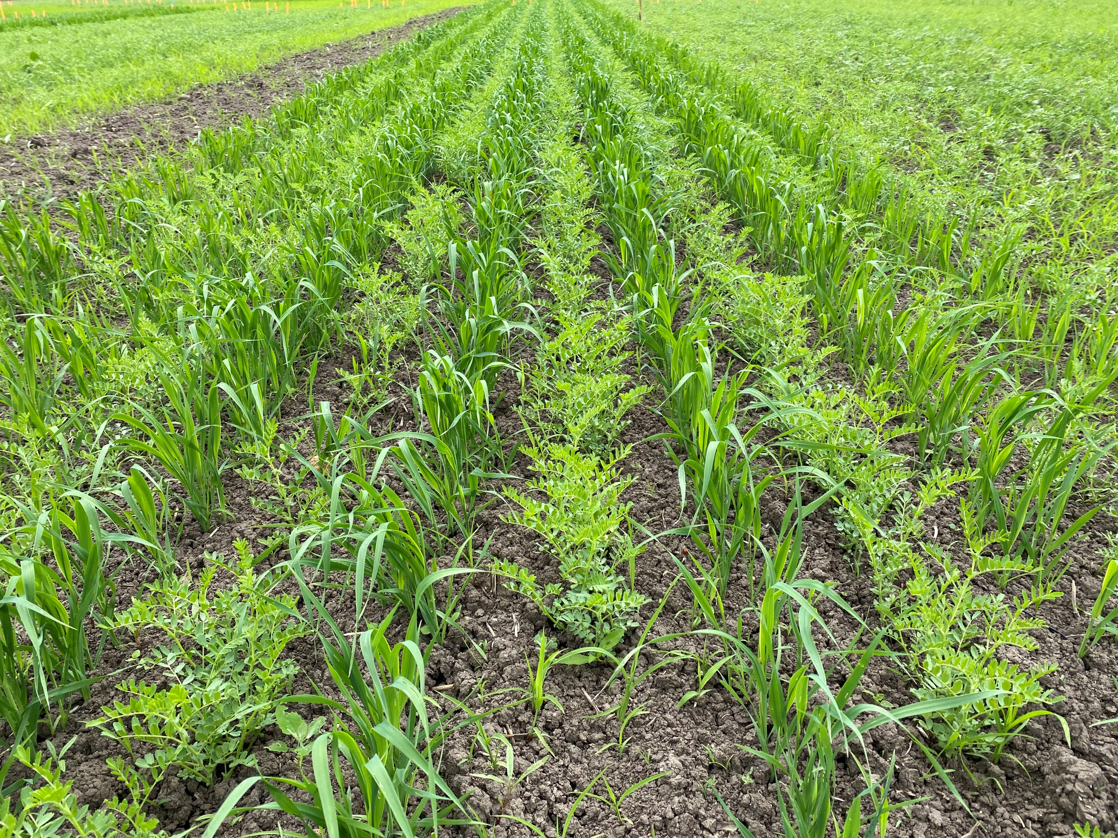
Discussion – conclusion: species effect
Intercropping chickpea with oat improved weed control in comparison with the sole crop (-51% weed biomass at harvest)
The other service plants did not improve weed control compared with the sole chickpea
Sole chickpea
Oat had the highest biomass production and soil nitrogen uptake among the service plants which suggest that these traits are necessary to ensure an effective weed control
Adding oat improved weed control but decreased chickpea’s grain yield (-72%)
Chickpea/oat
18th Congress of the European Society for Agronomy
9
Notes:
Mean % of weed biomass reduction = unmowed sole crop vs unmowed oat intercrop (same for yield)
High biomass prod + soil N uptake = in line with the results from other studies on intercrops
Improved weed control but lower yield = same results in the study of Banik et al. (2006) on chickpea/wheat intercrops

Slide 11
Discussion – conclusion: mowing effect
Mowing the inter-rows increased chickpea soil N uptake and tended to increase chickpea biomass and yield in the intercrop with oat
We managed to mitigate interspecific competition but not enough to prevent yield loss
Chickpea/oat without mowing
In a study on wheat/clover intercrops, Thorsted et al. (2006) had to brush clover in the inter-rows of wheat at least twice to reach a wheat yield close to or higher than the sole crop
In 2024, a treatment with an additional mowing date earlier in chickpea’s cycle was added for oat
Chickpea/oat with mowed inter-rows
18th Congress of the European Society for Agronomy
10
Notes:
Mowing the inter-rows did not have a lasting effect on weed biomass
Much higher weed pressure in 2024, we can expect a lower yield in the sole crop than last year
To be noted: some intercrops did not have the expected results, especially the one with mustard → the service plant did not have the level of competitive ability against weeds that we were searching for → sowing date too late for mustard

Slide 12
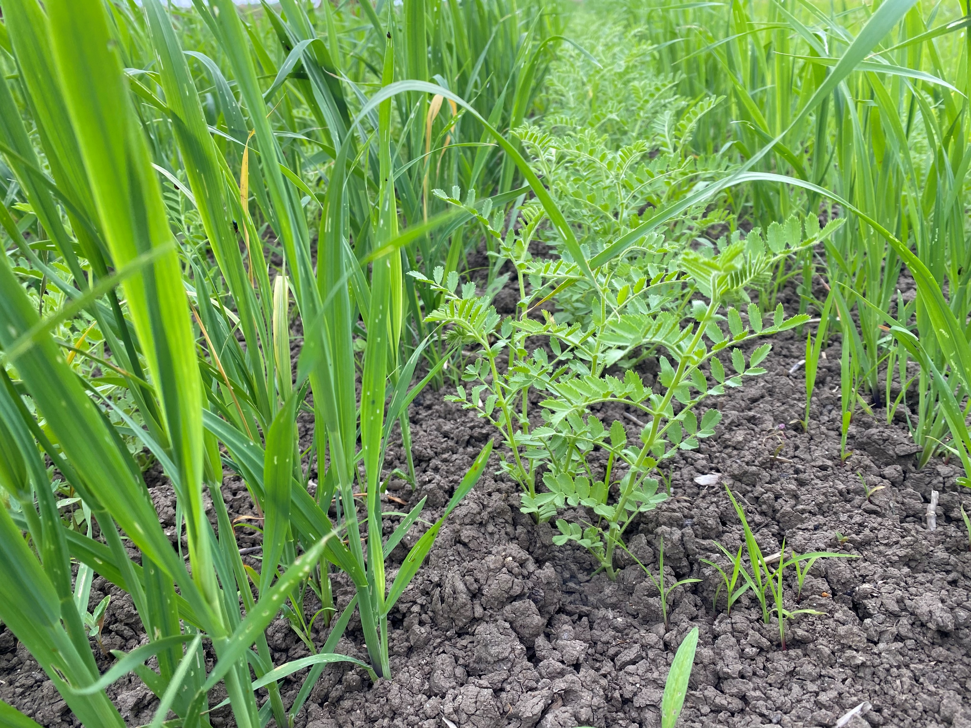
Thank you for your attention!
Many thanks to:
The LEVA staff:
Vincent Oury, Julien Poret, Sylvie Vincent
Our intern Chloé Gaudinat and all those who helped on the SPECIFICS project
m.guy@groupe-esa.com
The authors acknowledge financial support from the French “Priority Research Program Alternative Crop Production and Protection” and the ANR SPECIFICS project (ANR-20-PCPA-0008).
18th Congress of the European Society for Agronomy
11

Slide 13
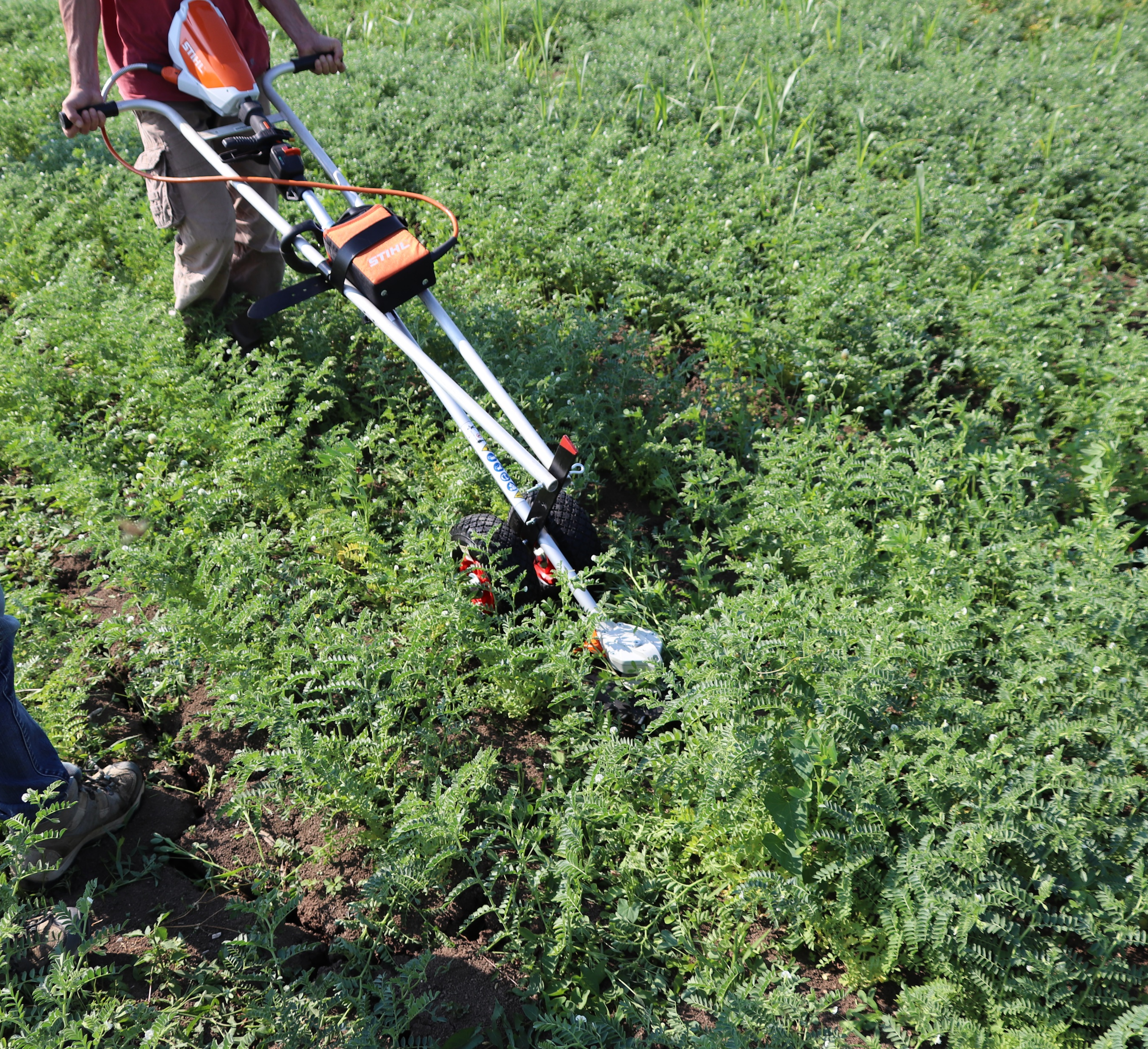
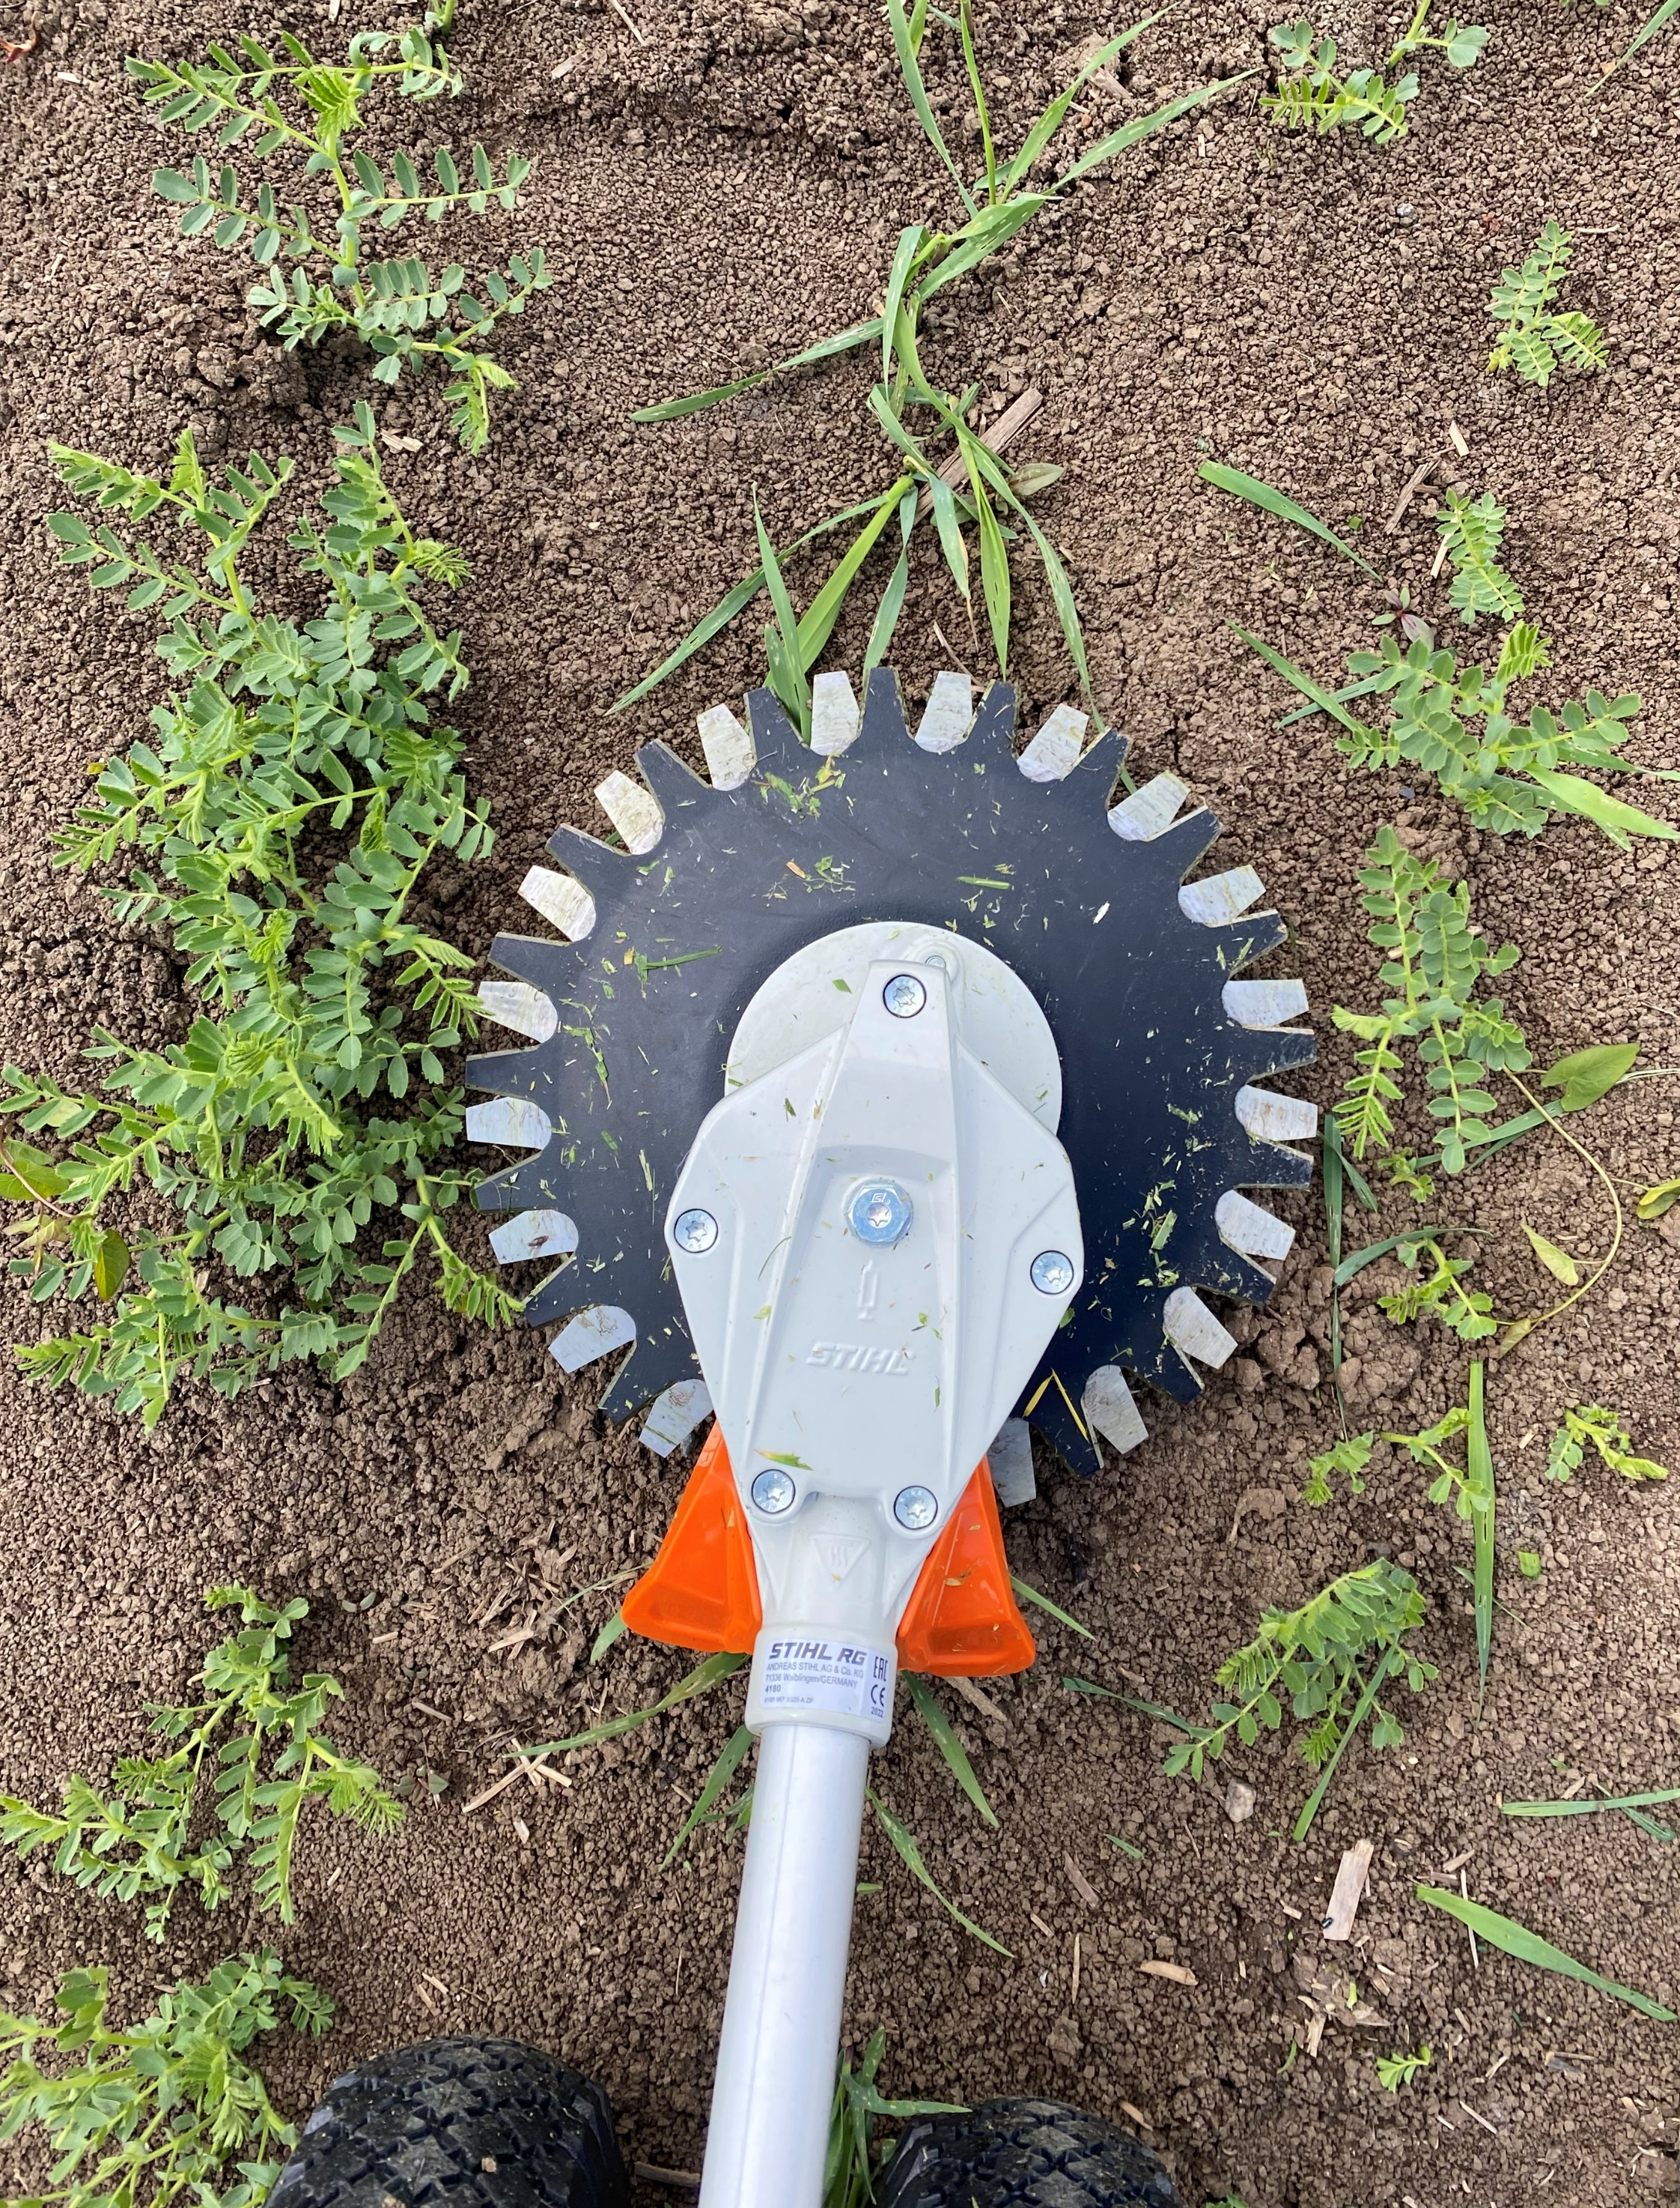
18th Congress of the European Society for Agronomy
12

