Slide 1
G x M interactions with solar radiation and temperature in the critical period to achieve high cereal and canola yields
Kenton Porker^{1,2}, Nick Poole¹, Darcy Warren¹, Julianne Lilley², Felicity Harris^{4,5}, John Kirkegaard²
CSIRO, FAR Australia, CSU

Slide 2
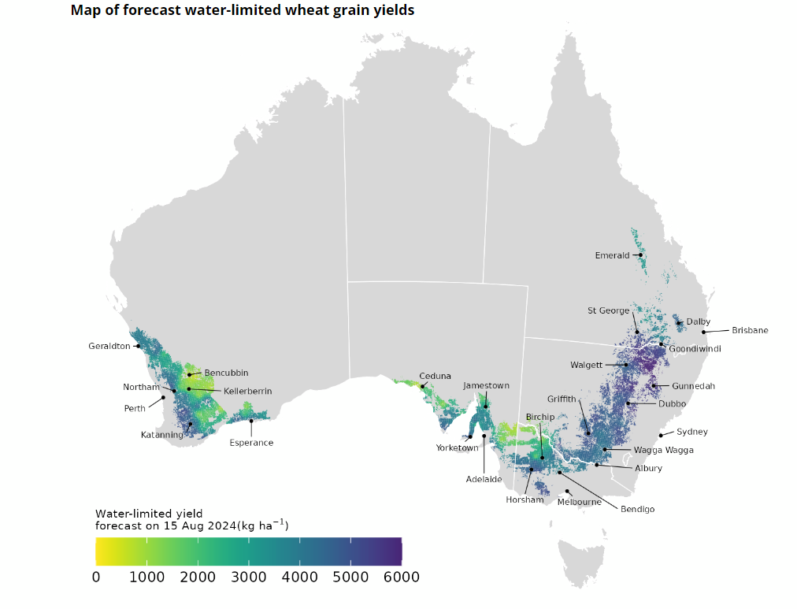
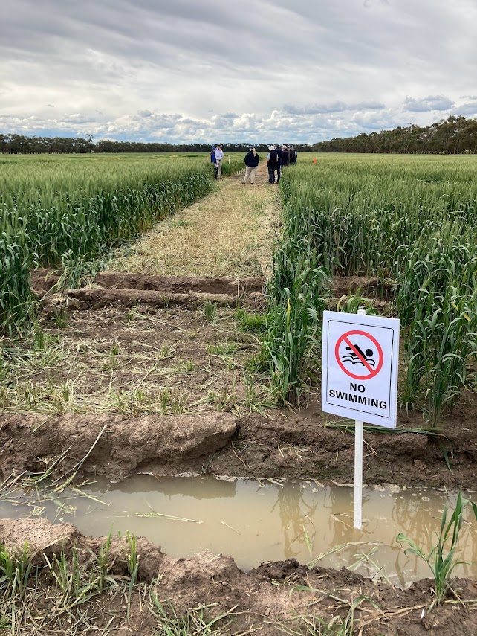
Benchmarking Potential Yield under best practice water and climate are the only factors limiting yield
Growers & researchers not routinely achieving rapeseed yields >5t/ha & Cereal yields > 8t/ha despite water supply exceeding >400mm in the higher rainfall zones
Aus High Rainfall Zone - ~11% annual cropping area (2.7m ha)

Slide 3
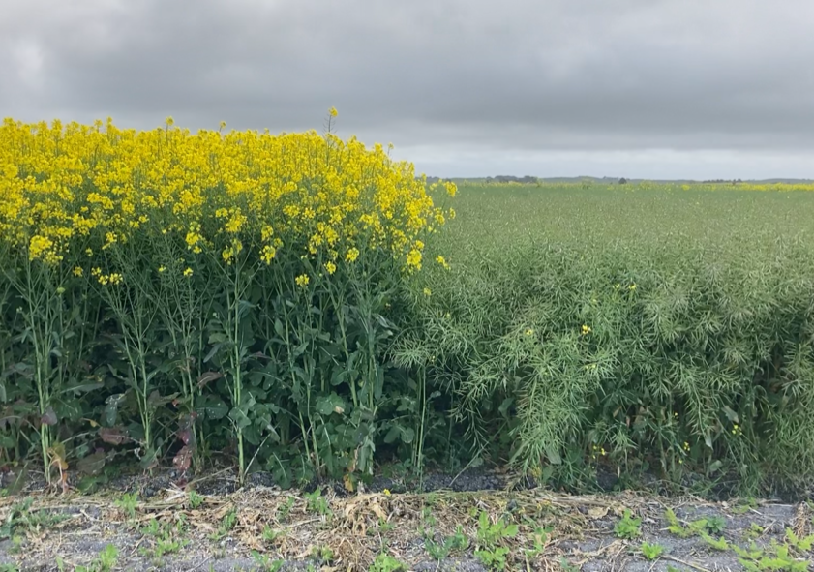
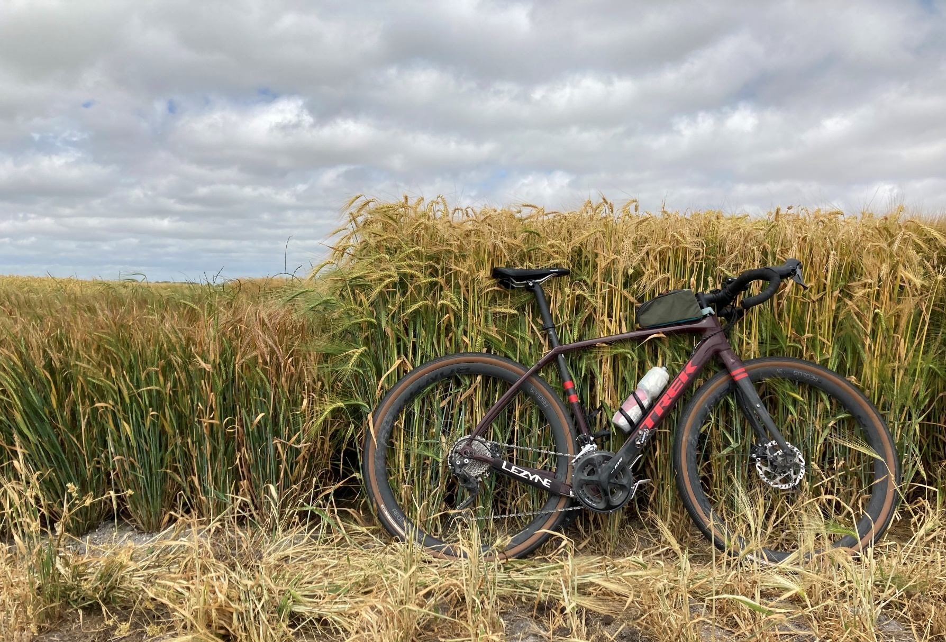
Let’s focus on crop conditions in the critical period
Dual focus on reducing stress (frost, heat, moisture) ie Optimal flowering Periods (Lilley et al 2019) and maximising growth in the critical period (*Slafer et al 2023)

Slide 4
Grain number (yield potential) is defined in a species-specific critical period and is proportional to;
the rate of growth in the critical period;
the duration of the critical period,
reproductive allocation
(Slafer et al 2023)
Yield
Relative to unstressed control
Wheat (Fischer 1985),
Barley (Arisnabarreta & Miralles 2008))
Canola (Kirkegaard et al 2018)
-500 | -400 | -300 | -200 | -100 | 0 | 100 | 200 | 300 | 400 | 500 | 600 | 700 | 800
Thermal time before and after the start of flowering (⁰C. day)

Slide 5
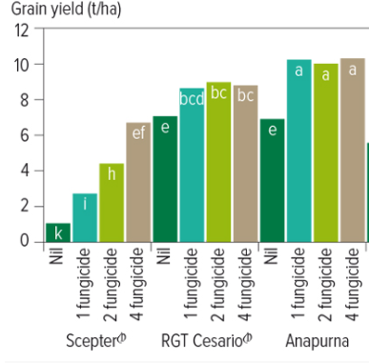
The shift to slower developing (European) genetics in the Australia HRZ coincided with later flowering (later critical period), improved disease resistance, and lodging control
Scepter – Broadly adapted
Released 2015
Introduction of new European genetics
RGT Accroc (red winter) – 2016
RGT Planet (Spring barley) – 2016

Slide 6
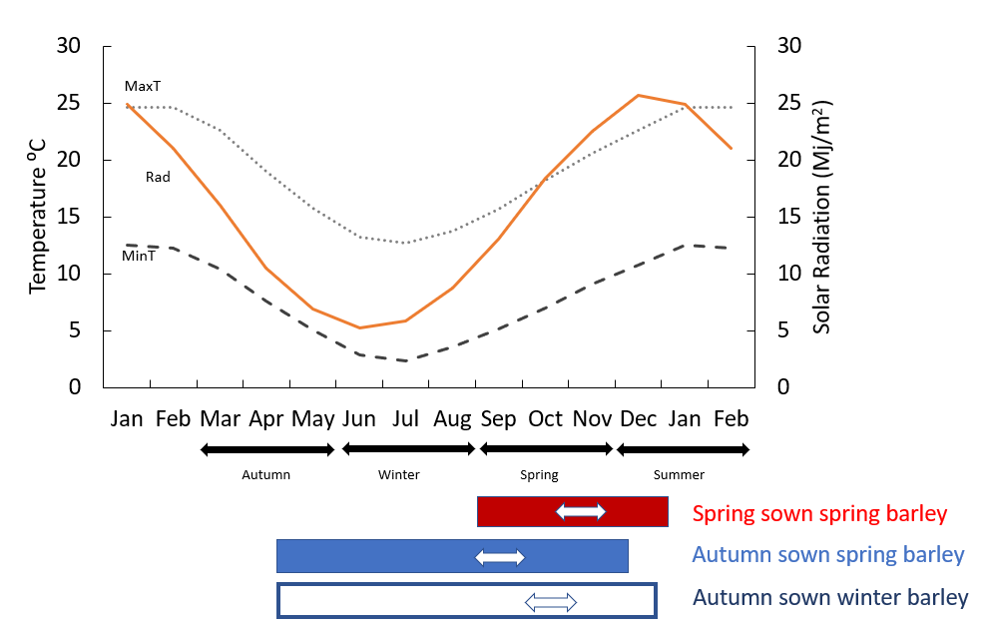
Winter genetics enabled early sowing but later flowering and conditions of higher radiation and cooler temperatures in the critical period
High light energy maximises photosynthesis
Cool temperatures slow development and increases phase length
/Wheat
/Wheat

Slide 7
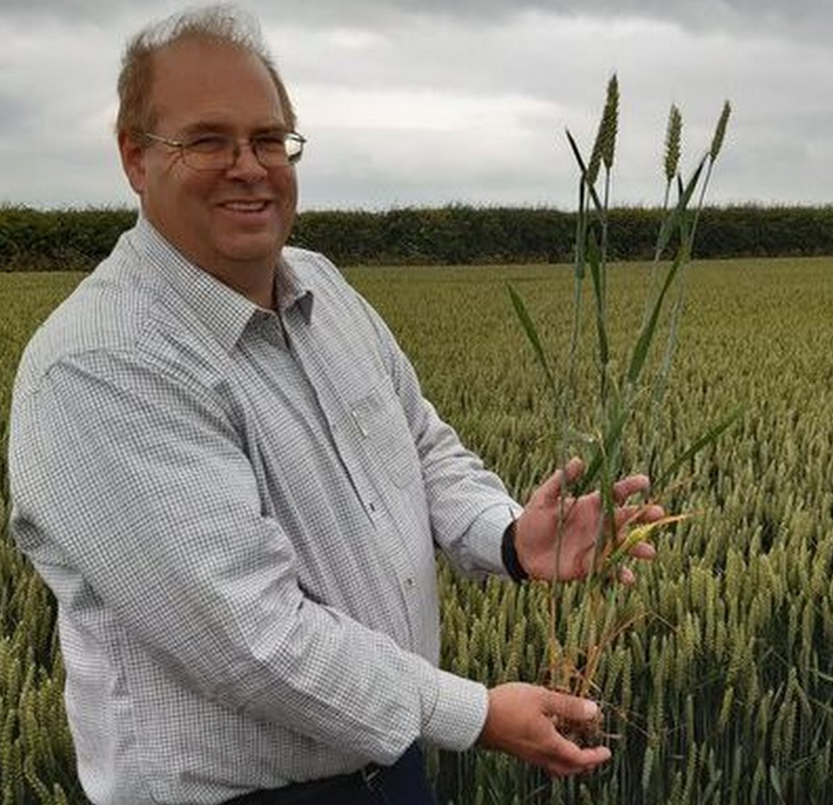
Benchmarking: Temperature and solar radiation (Photothermal Quotient) in the critical period sets yield potential in wheat when water isn’t limiting
Tim Lamyman Lincolnshire, Louth UK ~ 17.95 t/ha (10 month growing cycle)
Angus and Peake 2008
Wakanui, New Zealand
Yanco, NSW
Gatton, Queensland
Not a new concept (Rawson 1988),
Kernel number (Fischer 1985
For the 30 days before anthesis

Slide 8
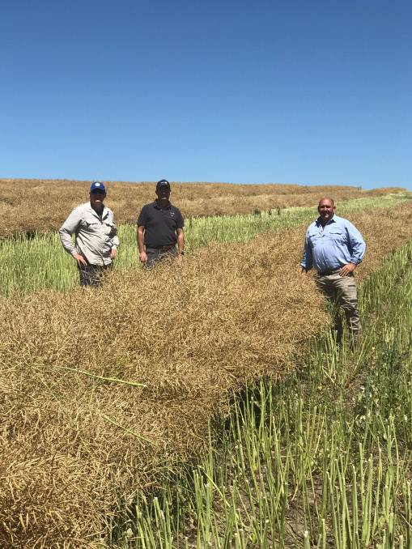
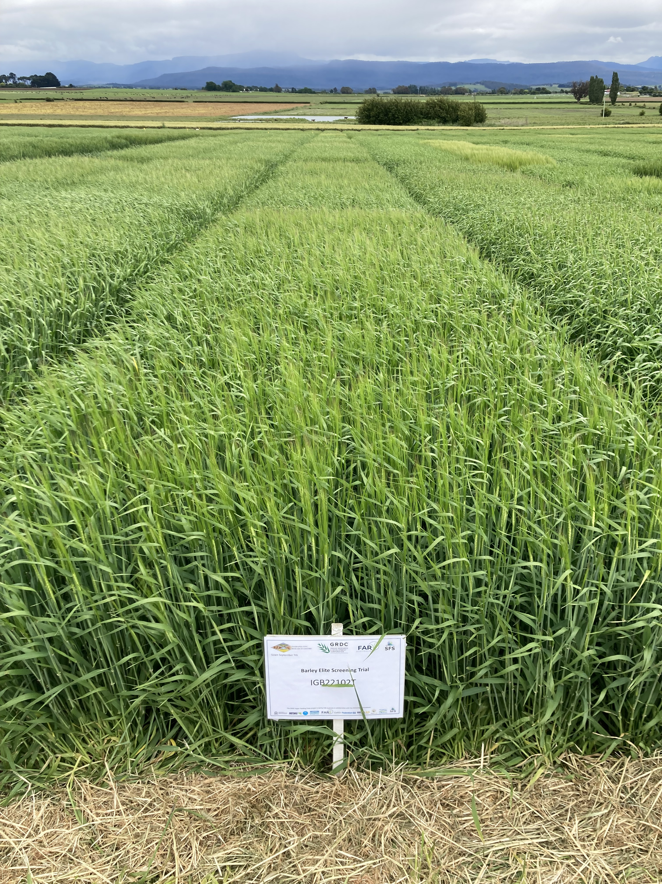
- Is there evidence the potential yield line needs updating for wheat? - Can we use the same approach for barley and rapeseed?
Hagley Tasmania ~ 4.5 month life cycle
Awn-peep 23rd Nov 2022 =
12.38t/ha actual yield
Peter Brooks, Princess Pastoral Co.
Oberon NSW
7.16t/ha

Slide 9
PTQ is a robust estimation of potential yield from high yielding Australian experiments (Wheat n= 90, Barley n = 63, 25 environments)
Evidence to suggest a new yield frontier in wheat
The relationship for barley is different
Porker et al (in review 2024)

Slide 10
The critical period for barley is slightly different to wheat? No. Sensitivity to timing and duration? No
Same method can be used for wheat and barley – however the slope differs
Barley
Wheat
The critical period for both barley and wheat is the period from 20 days prior to flower and 10days post
Porker et al (in Review )

Slide 11
The proposed relationship between potential yield and PTQ in the critical period for canola based on 60% of wheat.
Glucose equivalents
(Penning de Vries et al., 1974)
(Hocking et al., 1997)
Comparative yields
60% (Holland et al., 1999)
WUE equations
50% of wheat in non-water limited environments (GRDC Hyper-yielding 2020 – 22)
Kirkegaard 2020 (GRDC HYC Report)

Slide 12
Its slightly more complicated in Rapeseed - Higher yields were being achieved in the southern high rainfall zones despite low PTQ

Slide 13
Canola can compensate for low grain number (from low PTQ in the critical period) in favourable grain filling environments
Shading experiments that reduced grain number had a - 3%, 29%, or 61% increase in seed weight
Zhang and Flottmann (2015), Kirkegaard et al. (2018) and Labra et al. (2017),
44% increase in seed weight
Cool grain fill (5.4mg)
Warm grain fill (3.8mg)
Vs.

Slide 14
Key highlights:
Australian grain yields >15 Mg ha⁻¹ in wheat, >12 Mg ha⁻¹ in barley, and Canola >5t/ha are possible – new benchmarks, and grain number models need to be updated
Photothermal quotient in the critical period is applicable to all crops but require species specific adjustments
Yield more constrained by solar radiation and temperature where water supply >400mm - This is not a new concept!
Renewed focused on breeding and agronomy in the critical period.

Slide 15
Thank you

Slide 16
Acknowledgements
FAR2004-002SAX, FAR0003 GRDC Hyper-yielding crops
Stewart Coventry (AGT), Jason Eglinton (SRA), Tim March, Neil Fettell,
Matthew Tucker
HYC Collaborating Partners

Slide 17
Tasmania spring barley ~ 4.5 month crop life cycle
Long term avg
2022
CROP LIFE CYCLE – SOW to MATURITY
Awn-peep 23rd Nov 2022 =
12.38t/ha actual yield
Hagley Tas, 2022

