Slide 1
Winter wheat-soy strip intercropping supports natural enemy abundance and pest control in an intensive farming system
J.B. Thompson, T.F. Döring, S. Bellingrath-Kimura, K. Grahmann, M. Glemnitz, M. Reckling
​​​​​​​​​​​​​​​​​​​​Leibniz Centre for Agricultural Landscape Research (ZALF)

Slide 2
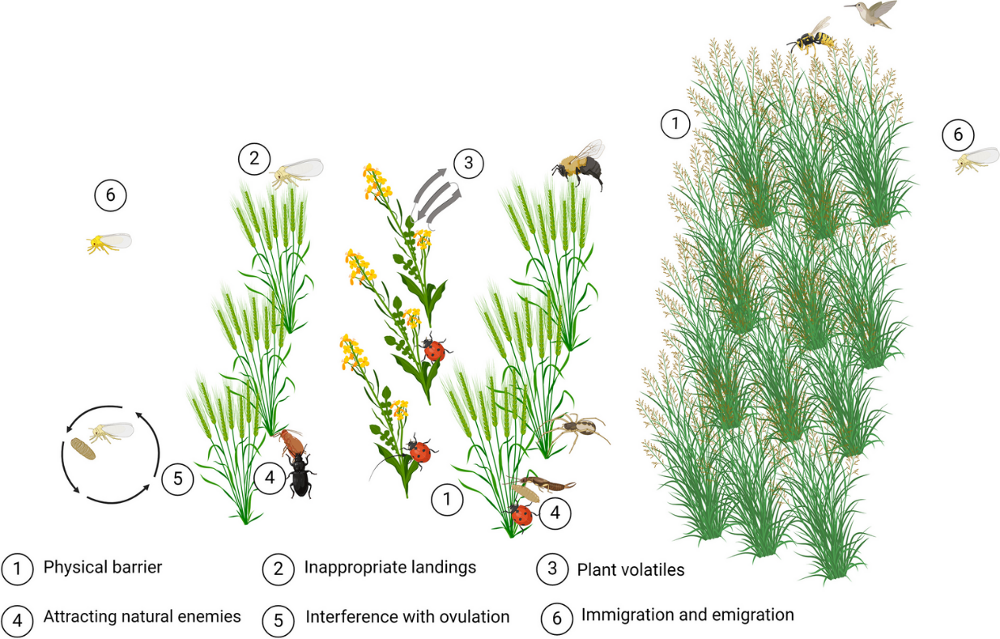
Introduction
EU Farm to Fork and Biodiversity Strategies :
Decrease pesticide usage
Increase biodiversity
Increased spatial diversity supports pest control (Letourneau et al., 2011)
Different intercropping arrangements have different benefits (Lopes et al. 2016)
From Yousefi et al. 2024
Notes:
Plant diversity creates new habitats and resources which can support higher natural enemy abundance or diversity (Ju et al., 2019; Rakotomalala et al., 2023; Sunderland & Samu, 2000)
Different arrangements and crop combinations can have different effects

Slide 3
Research questions
1. Which intercropping system can reduce pests or increase pest predation?
2. Which intercropping system supports natural enemy diversity or abundance?
3. Can any of the intercropping systems yield as high as sole crops?

Slide 4
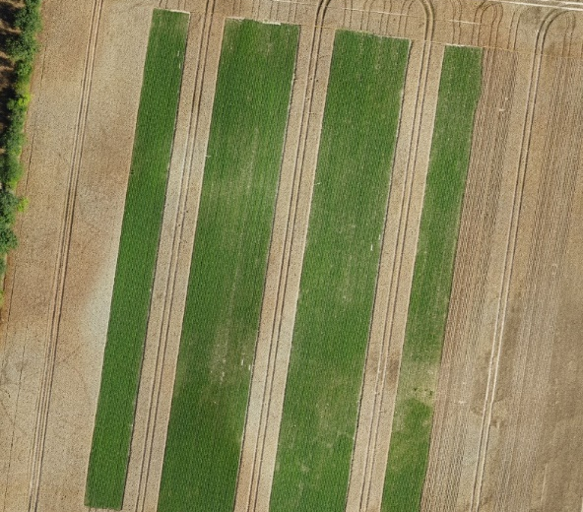
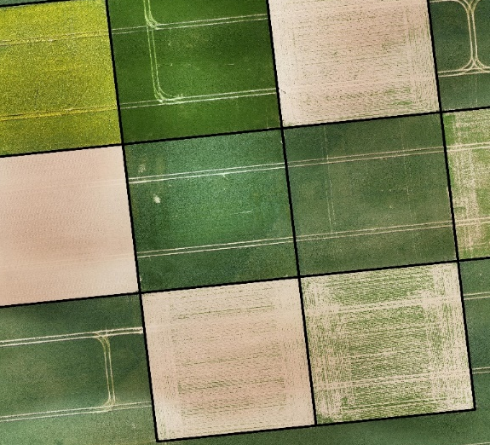
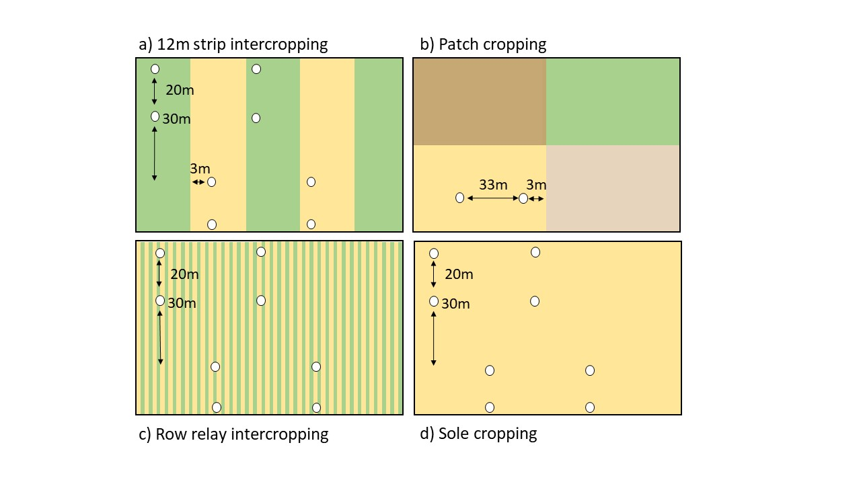
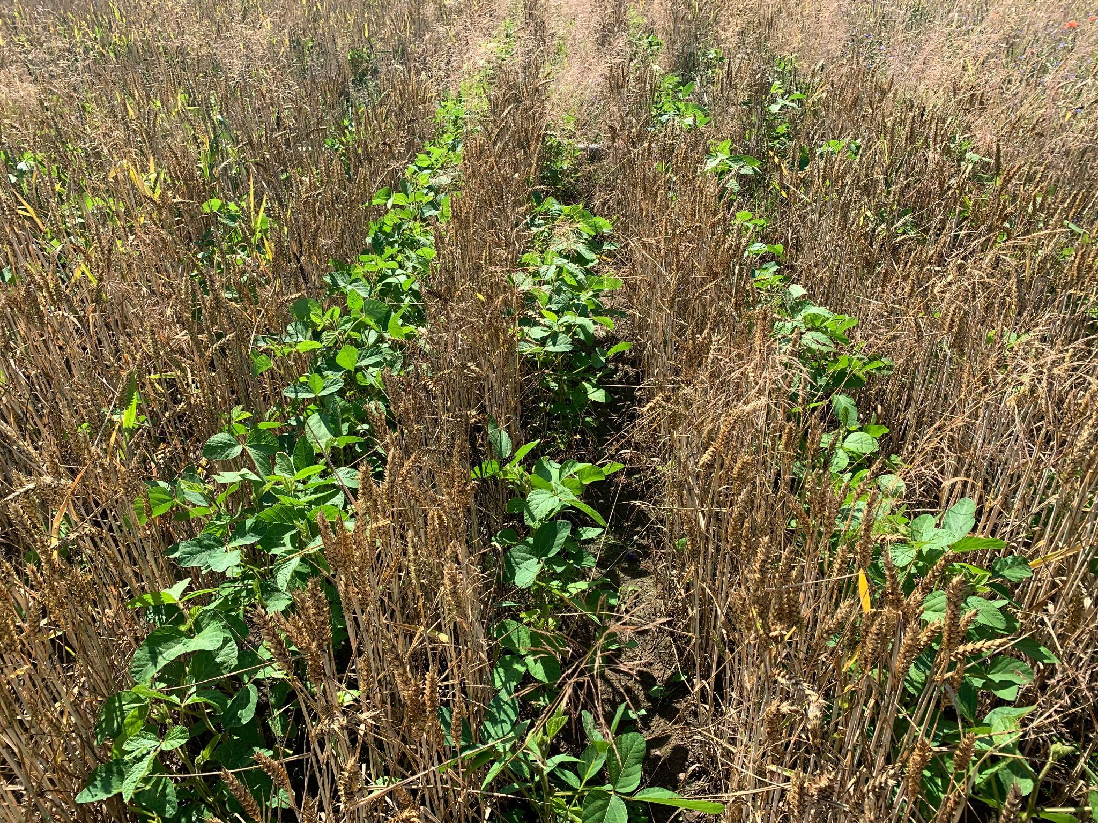
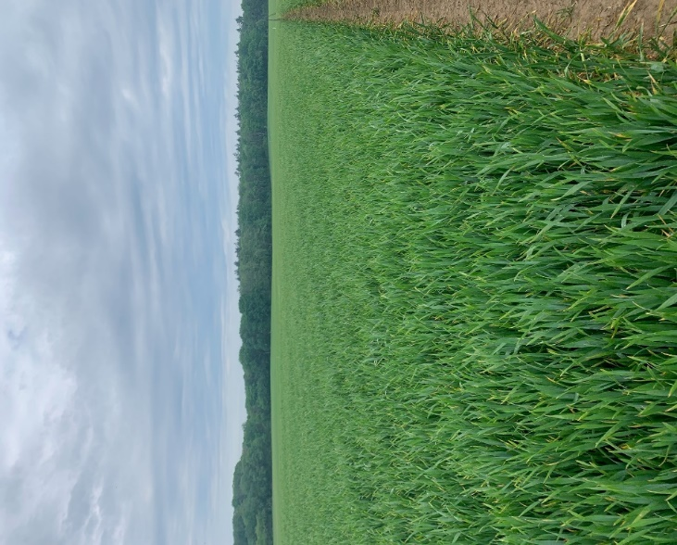
Cropping systems and sampling
Wide strip
Patch
Two year, on-farm trial in Germany
Large, conventionally managed farm
Co-designed with farmers
One field per system per year, three sampling replicates per system
Row-relay
Sole cropping
Notes:
Mention field size

Slide 5
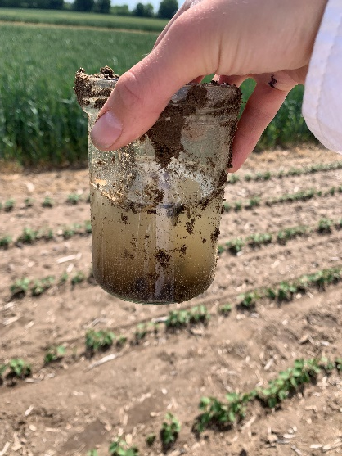
Methods
Natural enemies
Traps open 2 weeks in May and June
Pests
Pest predation
Yield
300 plants per treatment
May- July
15, 10m harvest cuts per treatment
Similar soil ratings
6 pitfall traps per treatment per month
12 aphid predation cards per treatment * month
Visual monitoring of aphids in June
Notes:
Mention that we counted abundance abut also ID’d to speicies

Slide 6
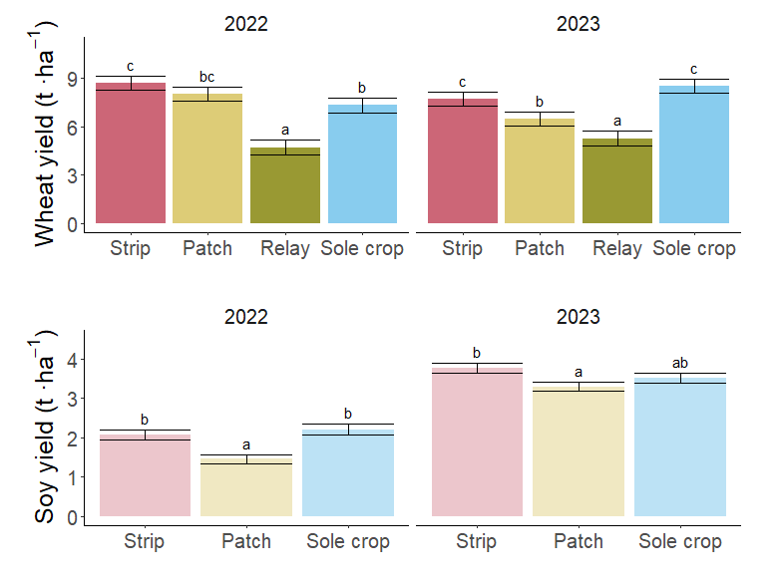
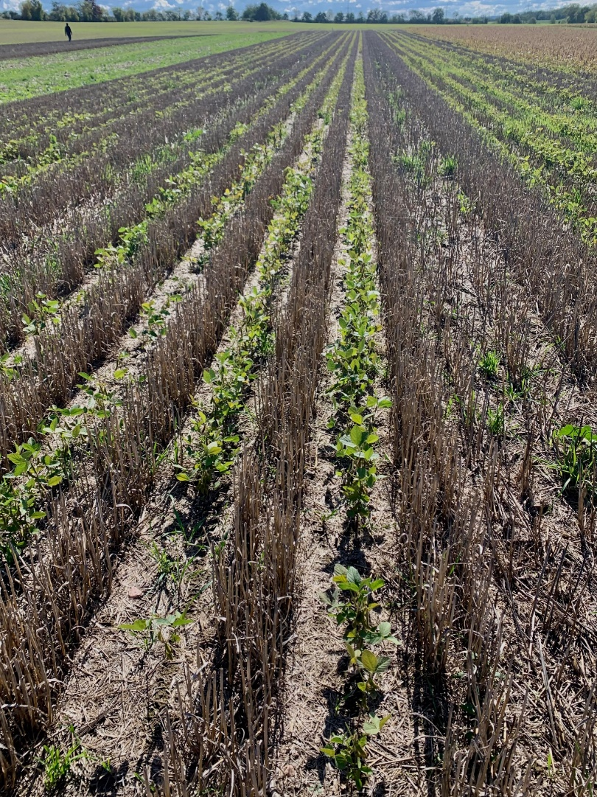
Results - Yields
Relay soy crop failed both years
Strips had equivalent or higher yields than sole crops
Patches yielded the same or lower than sole crops
Notes:
Yield was measured in similar soil quality ratings

Slide 7
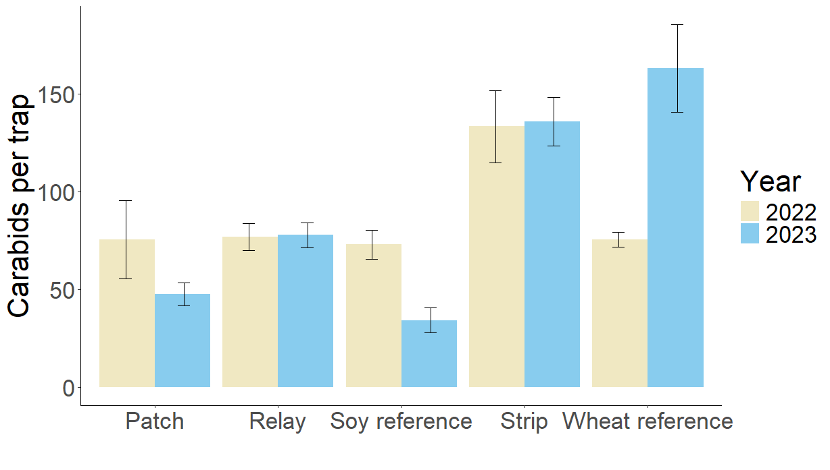
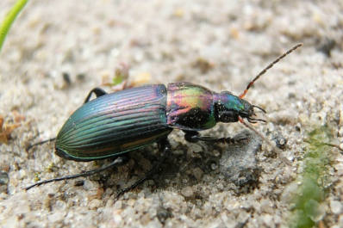
Results – Carabid abundance
Strip cropping supported some of the highest carabid abundances
Strips have highest edge:area ratio of all treatments, preferred by carabids (Zhao et al., 2013)
Poecilus cupreus
D
b
CD
ab
a
BC
a
a
a
A
AB
A
Notes:
When comparing wheat cropping treatments, the wheat strip had higher beetle abundance than the wheat patches both years (p=0.049 and p=0.0015) as well as the relay in 2022 (p=0.0064). In 2022, there was higher beetle abundance in the wheat patches (p=0.0487) than the wheat reference. In 2023, the wheat reference had significantly more beetles than the patches (p<0.0001) and relay (p=0.003) but not the wheat strip. Soy strips had significantly more beetles than the soy patches both years (p=0.0078 and p<0.0001) and the soy reference in 2023 (p<0.0001).

Slide 8
Results – Species composition
No clear effects on species richness or diversity
Significant clustering of species composition
Wheat and soy patches and strips supported different species despite being adjacent
Notes:
Adjacent crops can provide spatio-temporal diversification of resources

Slide 9
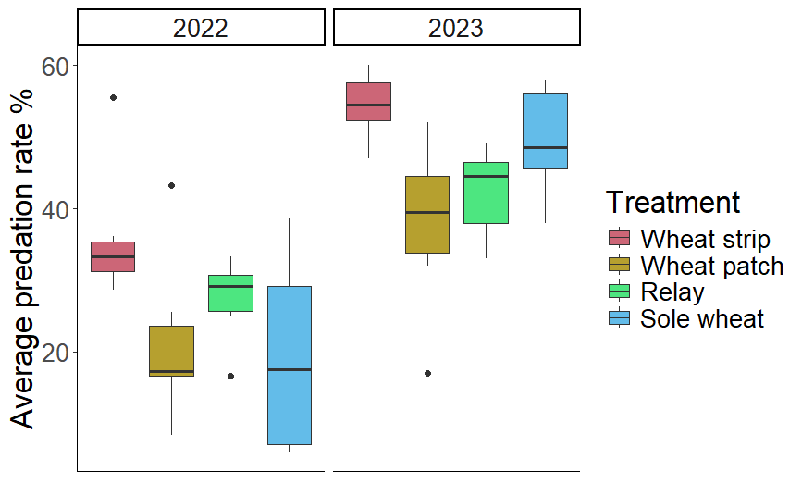
Results – Pests & pest predation
Pests No treatment effects on aphids Predation
No difference between soy treatments
Wheat strips had higher predation than wheat patches (p=0.002) and sole wheat (p=0.044)

Slide 10
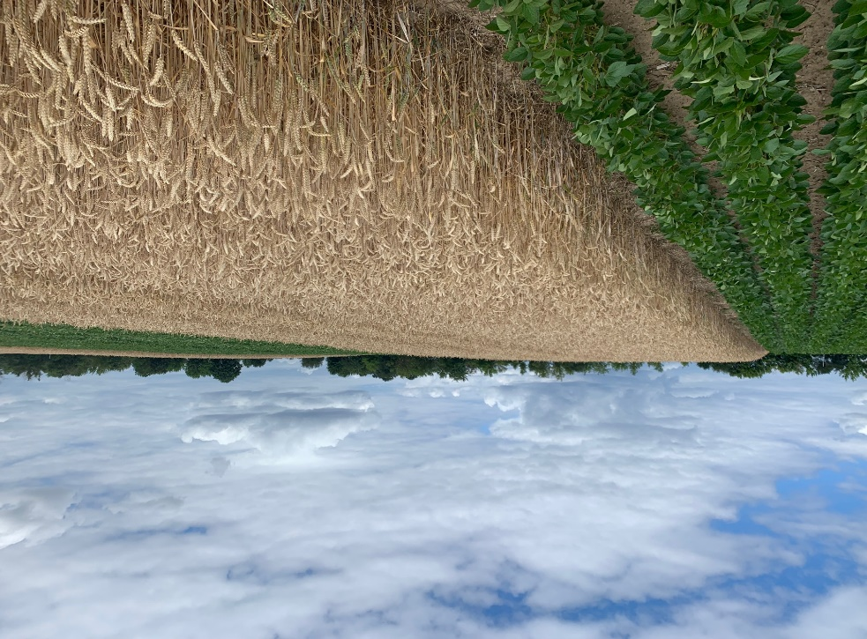
Conclusions
Row relay intercropping may not be viable in our sandy continental region with low precipitation
Strip intercropping supported high carabid abundance and aphid predation rates in wheat
Strip cropping has no yield penalties and no need for additional machinery
Notes:
We found that spatial arrangement of intercropping impacted predator activity densities, predation rates and the community assemblage of carabids and epigeic spiders.. This study was one of the first of its kind to compare yields and ecological benefits of wide strip, relay, and patch intercropping with sole cropping in a commercial farming context in central Europe.
Constraints on strip cropping (labor cost, can just say)+further studies replicated across farms would be useful

Slide 11
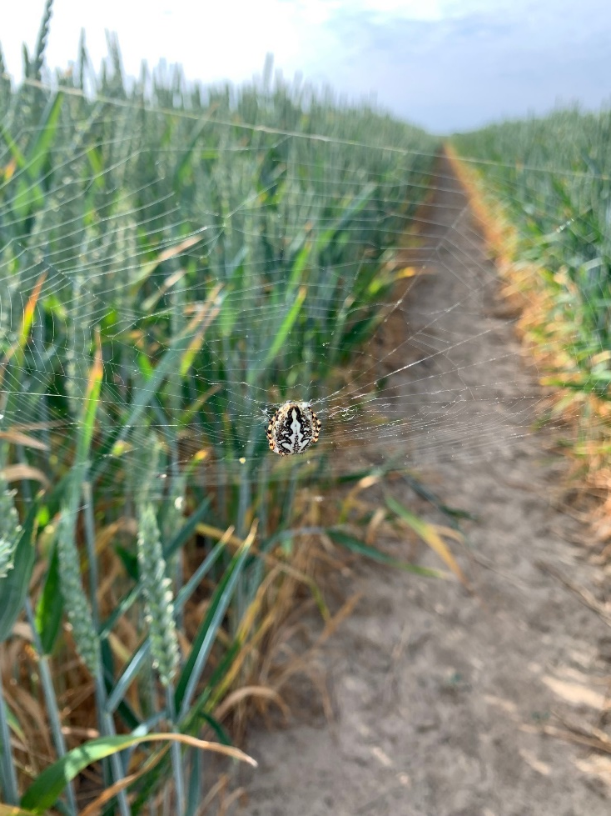
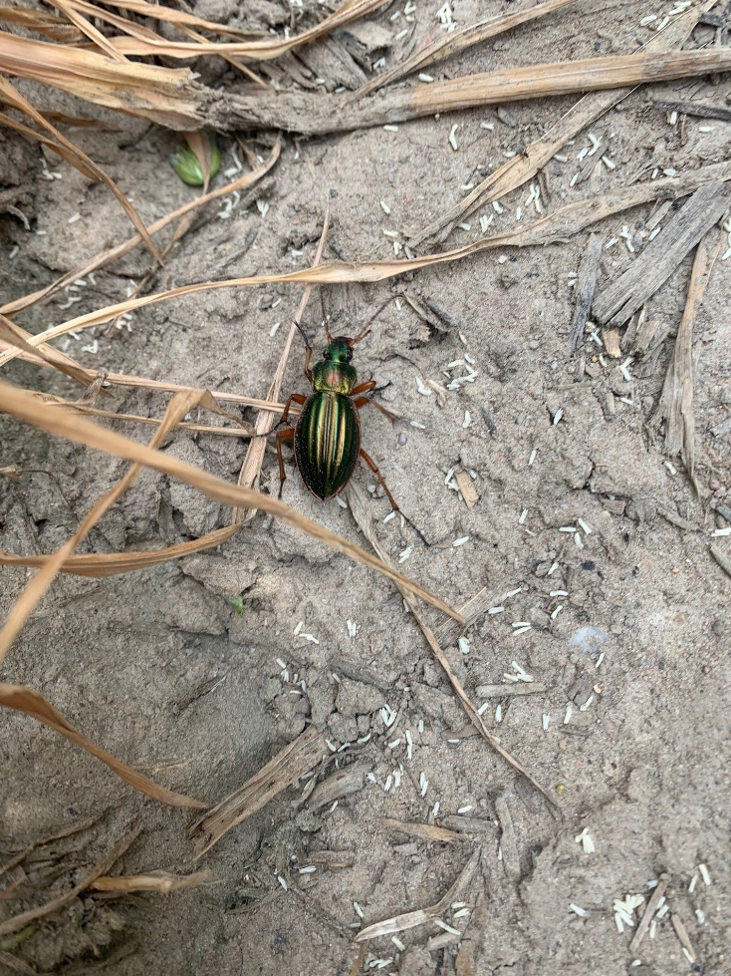
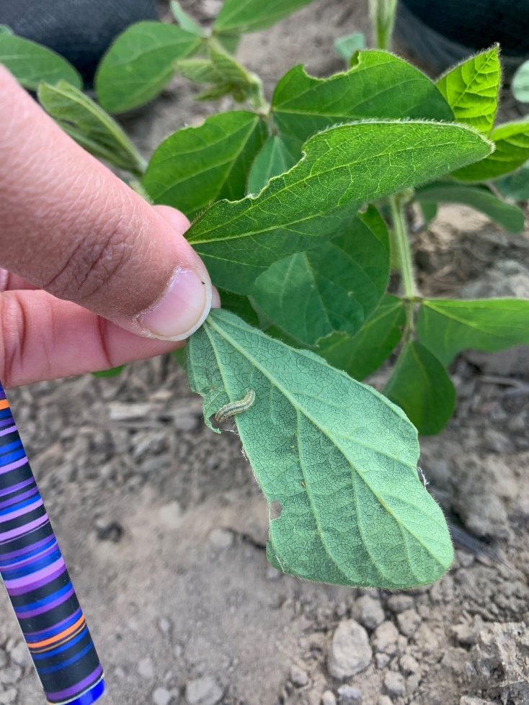
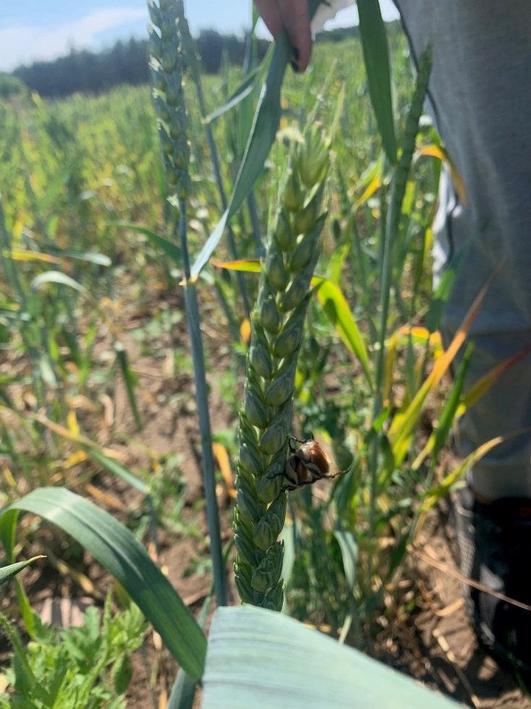
Thank you for your attention!
Jennifer B Thompson – Jennifer.Thompson@zalf.de

Slide 12
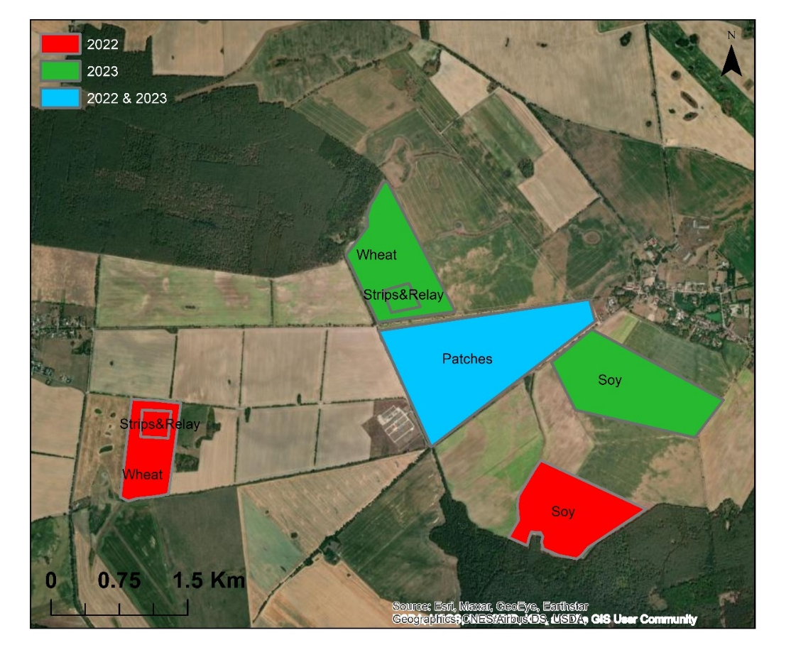
Study system

Slide 13
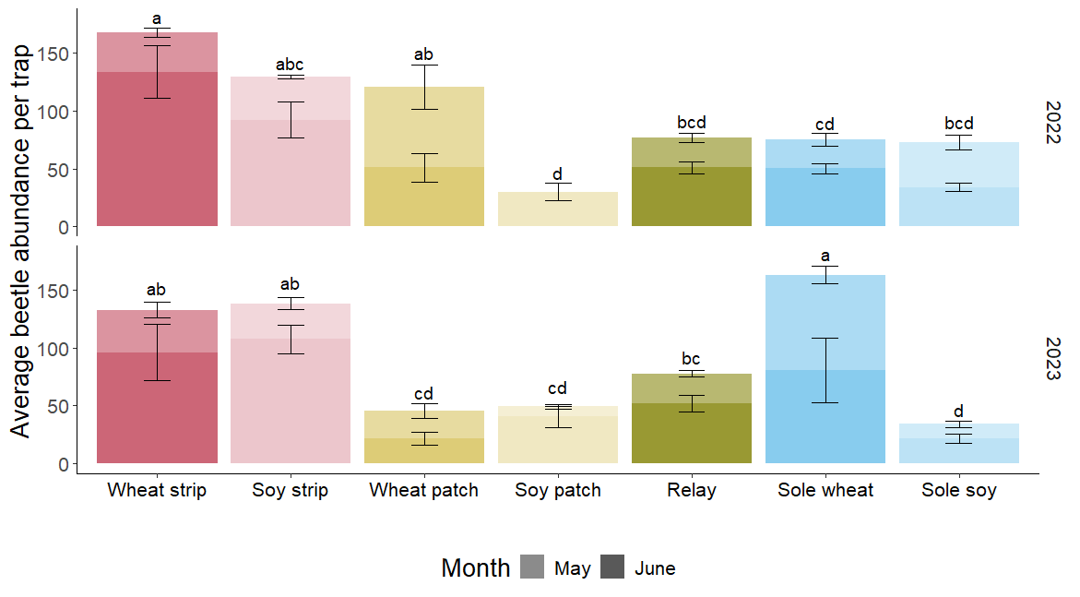
Results – carabid abundance

Slide 14
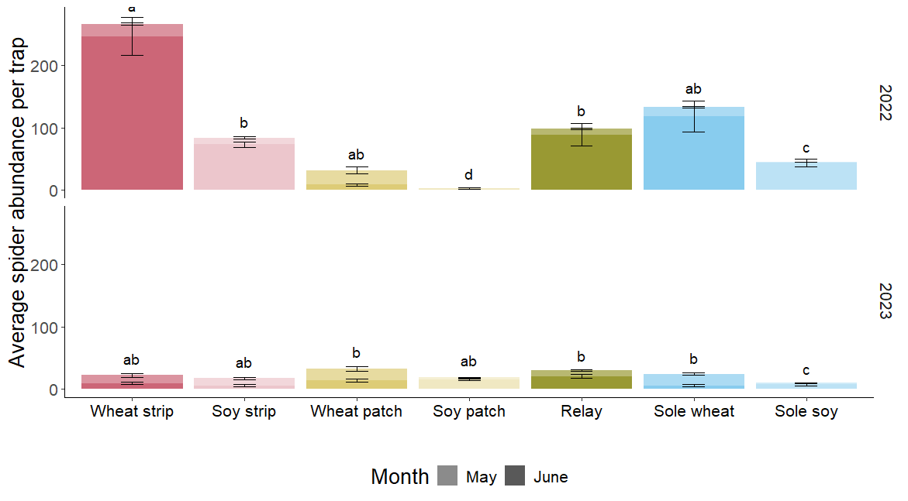
Results – Spider abundance
Notes:
When looking at individual cropping treatments, in 2022, there were significant effects of treatment both years (p<0.0001 both years) and month in 2023 (p<0.0001) on spider abundance. In 2022, significantly more spiders were collected in the wheat strips than the wheat patches (p=0.0005) and relay (p=0.0226). The soy strips had more spiders than the soy reference (p=0.0386) and soy patches (p<0.0001). In 2023, there was a significant effect of treatment (p<0.0001) on spider abundance but treatment differences were primarily between crops rather than differences in arrangement.
Pitfall trap catches from 2022 show that spider activity densities were much higher in wheat compared to soy treatments and in strips compared to respective patch or reference treatments

