Slide 1
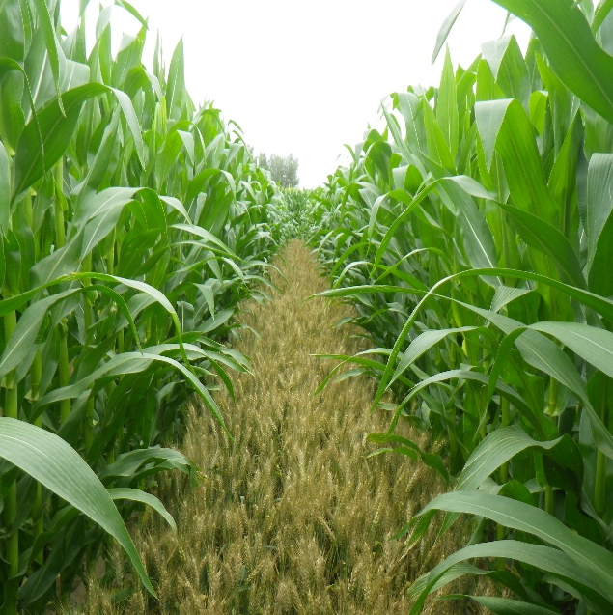
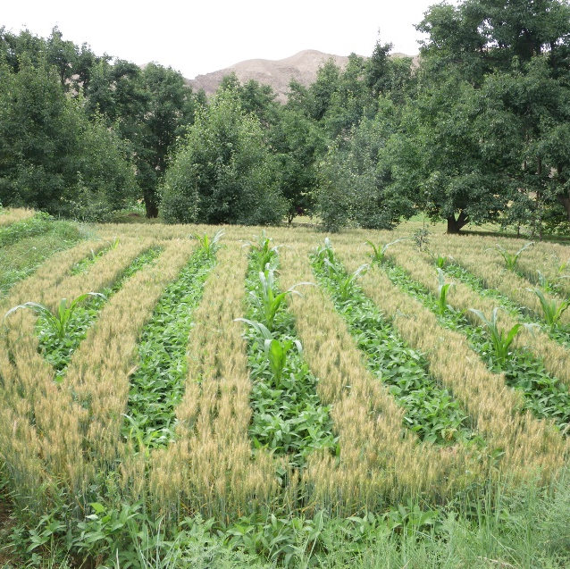
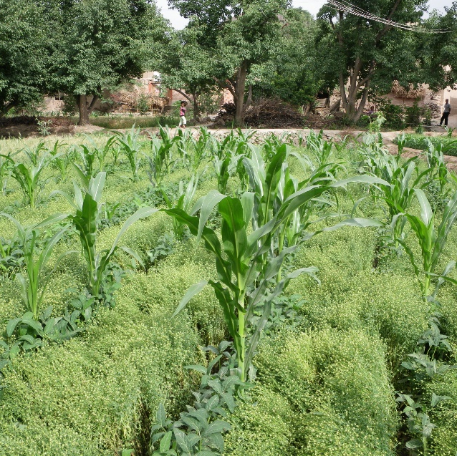
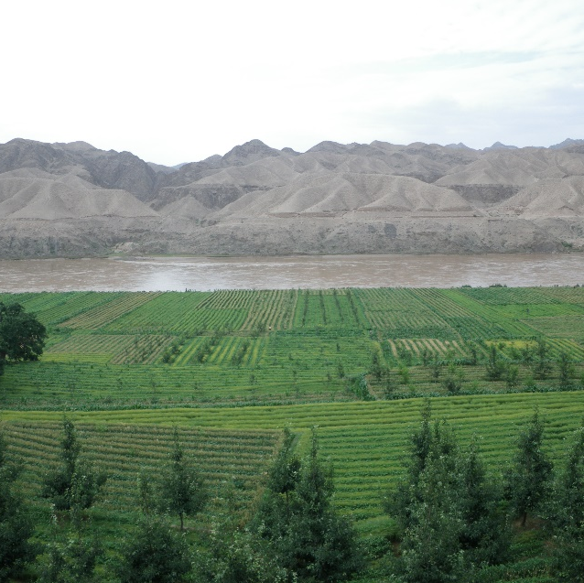
The productive performance of intercropping; new insights from existing data through meta-analysis
Wopke van der Werf, Wageningen University, the Netherlands

Slide 2
What is intercropping?
Growing species together on a plot of land to benefit from species complementarity
Simultaneous intercropping: cultivation of (usually) two crop species in a field with the same sowing and harvesting dates
Species 1
Species 2
Relay intercropping: cultivation of two crop species with a difference in sowing and/or harvesting dates
Species 1
Species 2
More profitable because more productive
More sustainable because more resource-use efficient

Slide 3
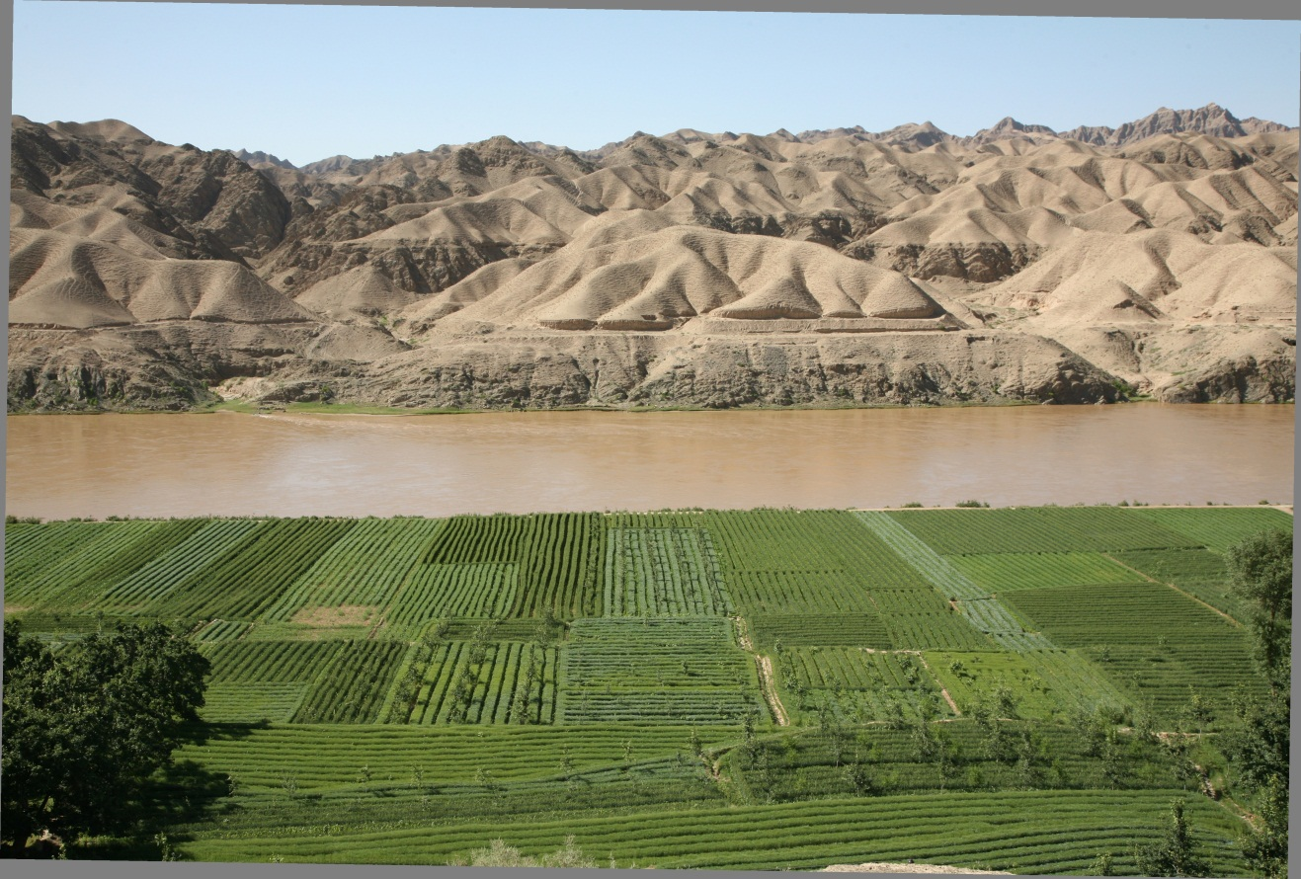
Intercropping and crop/tree mixture along the Yellow River in Gansu, China (photo: Li Long)

Slide 4
Ecological processes in agro-ecosystems and landscapes – importance for and of family farms

Slide 5
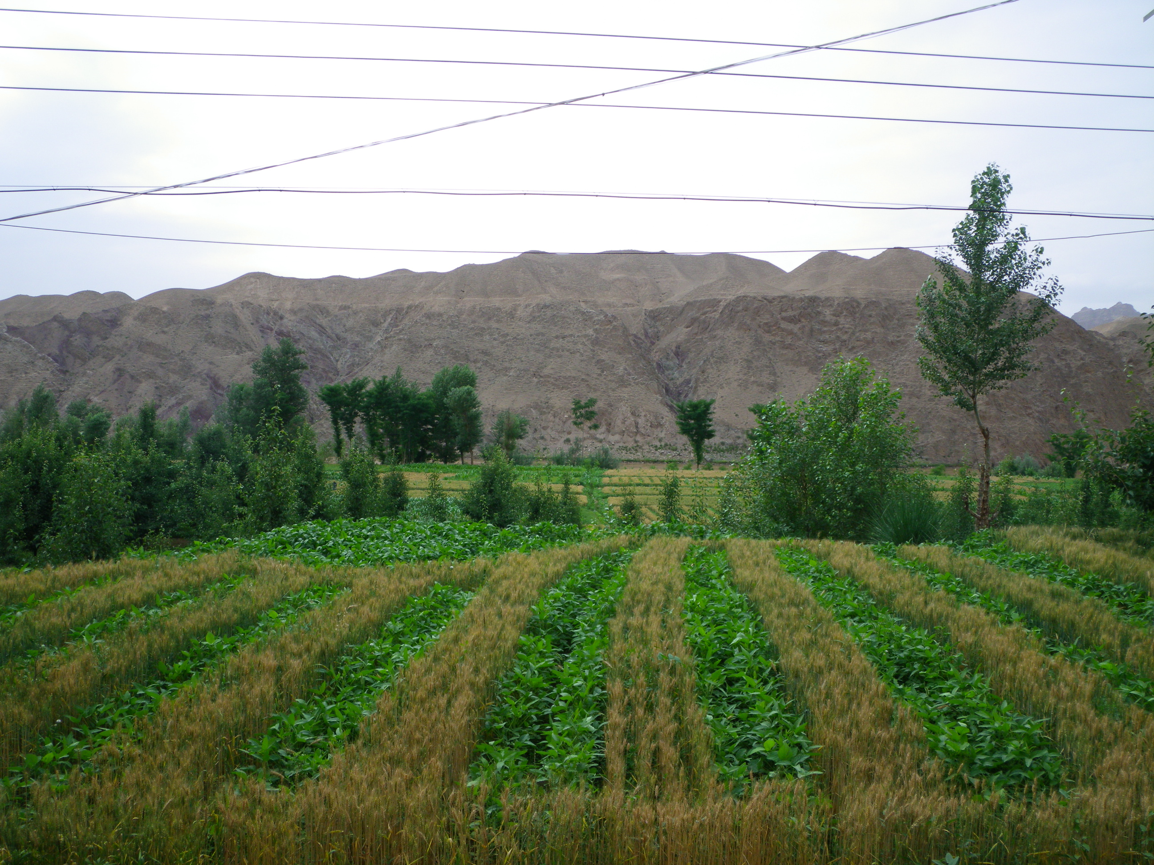

Slide 6
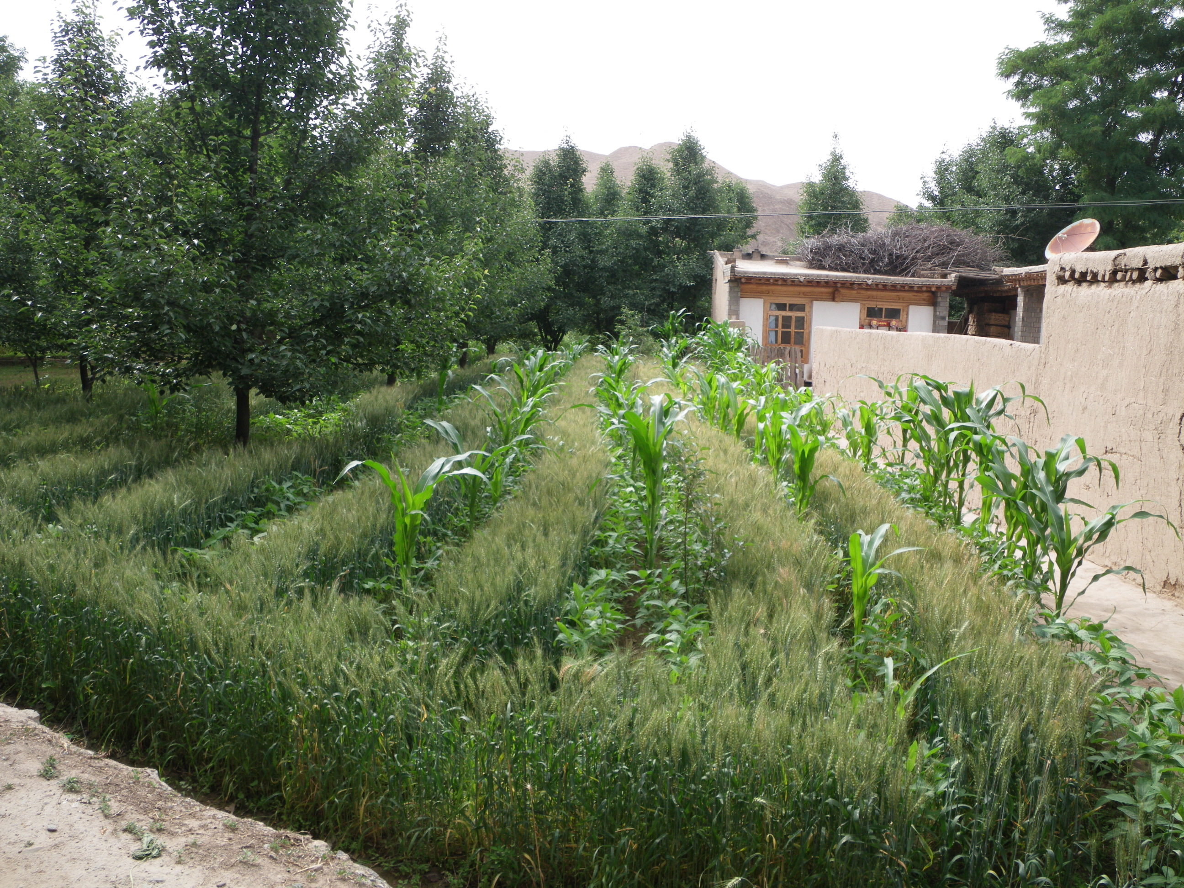

Slide 7
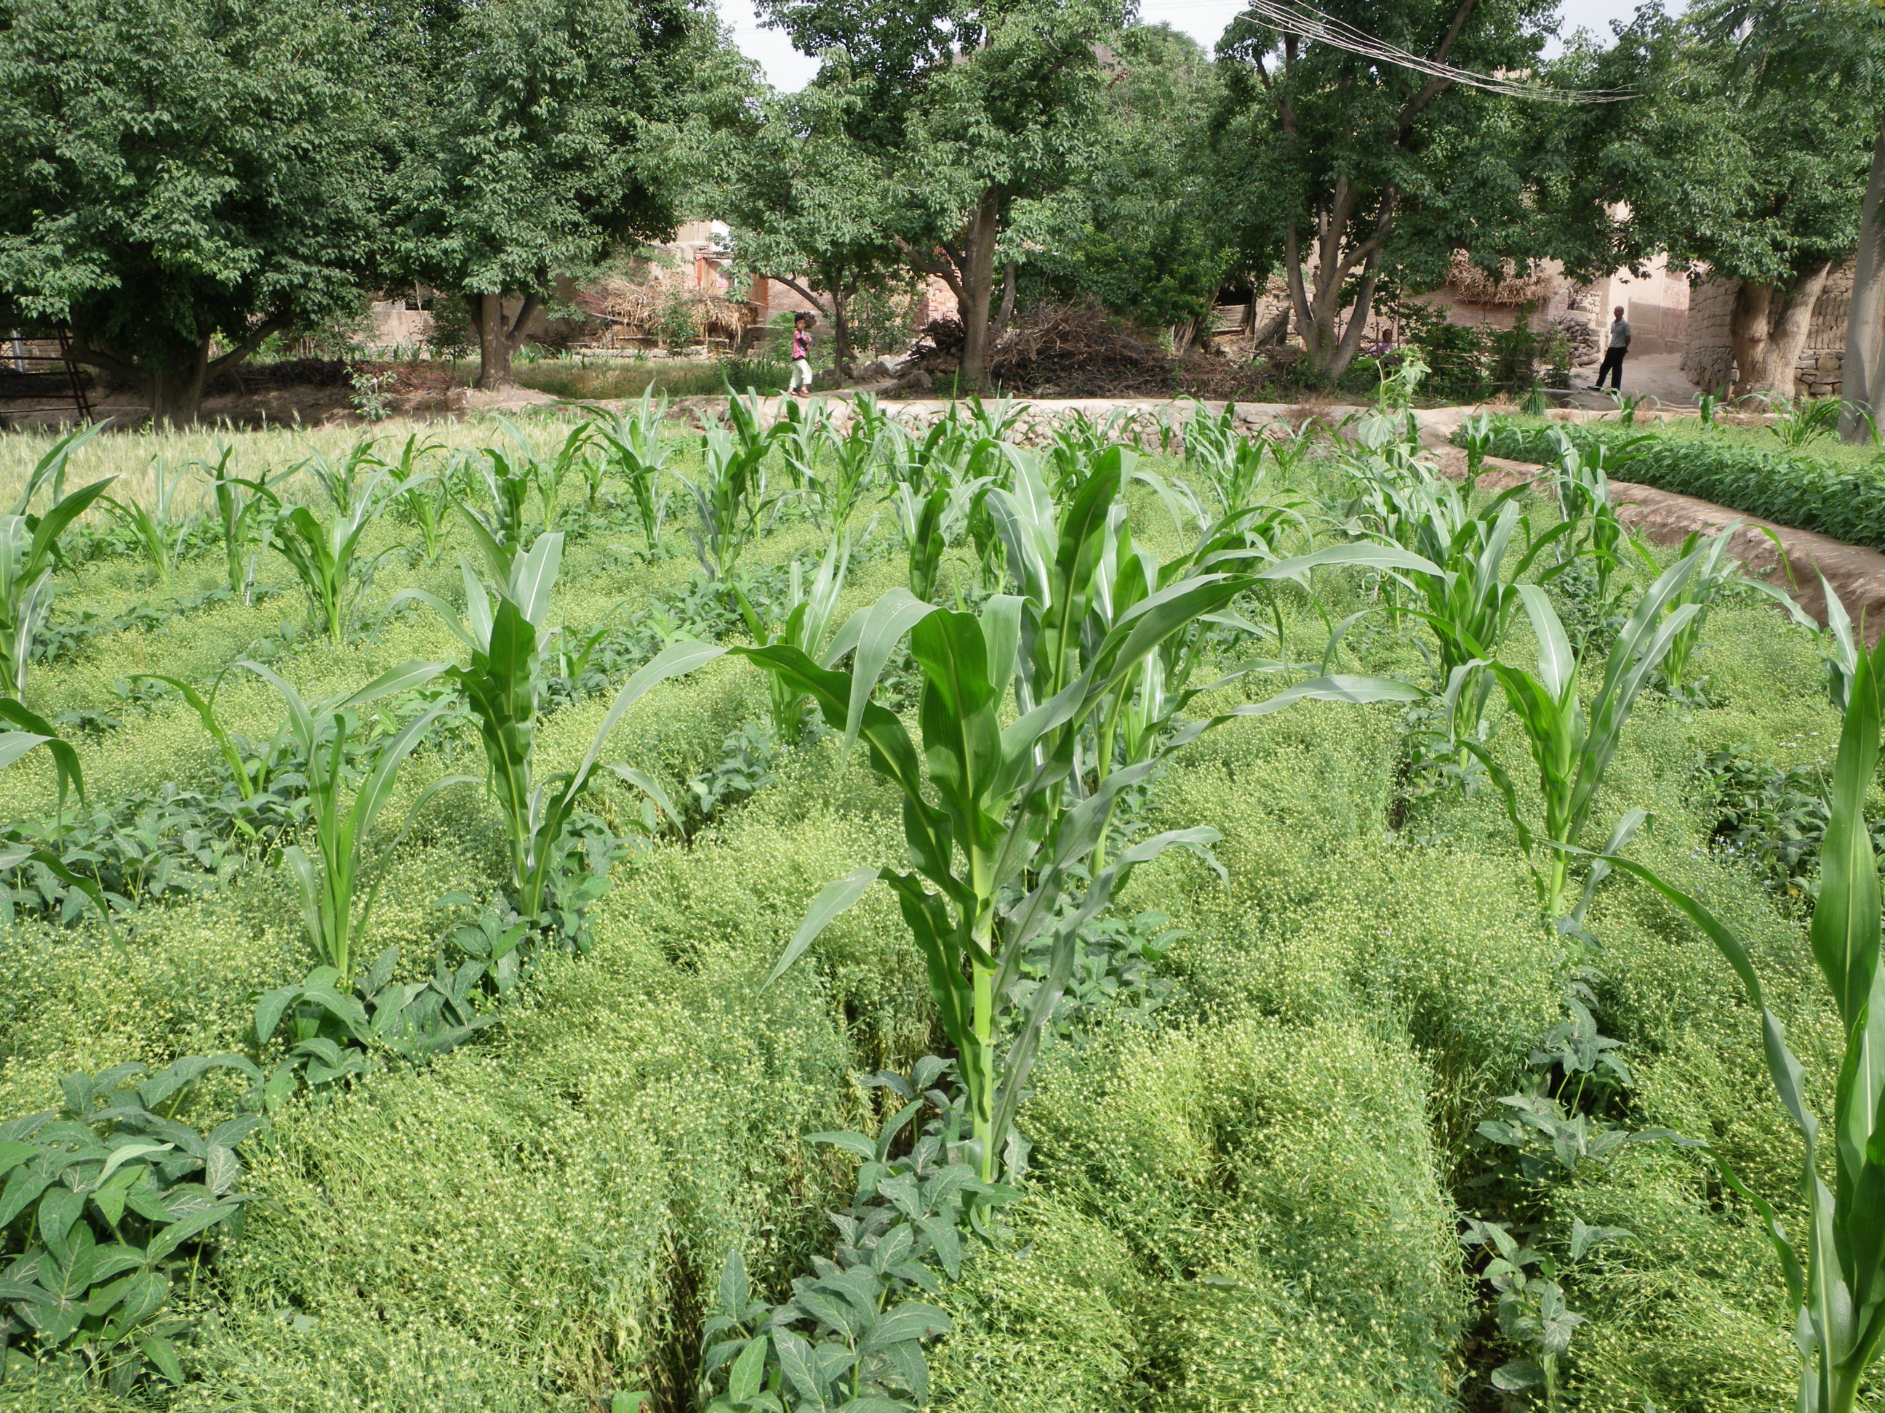

Slide 8
There is an incredible diversity of systems
Wheat - maize
Photo: Zhang Fusuo

Slide 9
There is an incredible diversity of systems
Wheat - Soybean

Slide 10
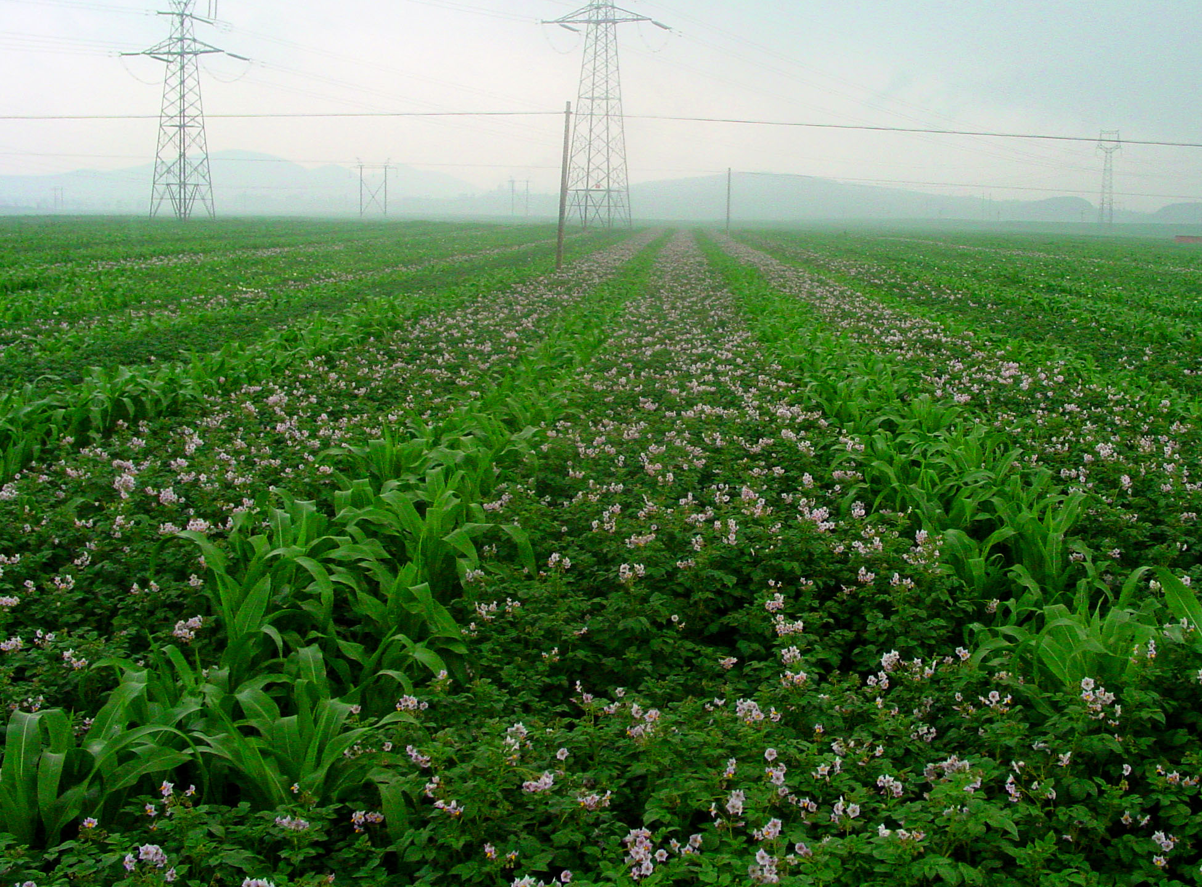
There is an incredible diversity of systems
Maize - potato

Slide 11
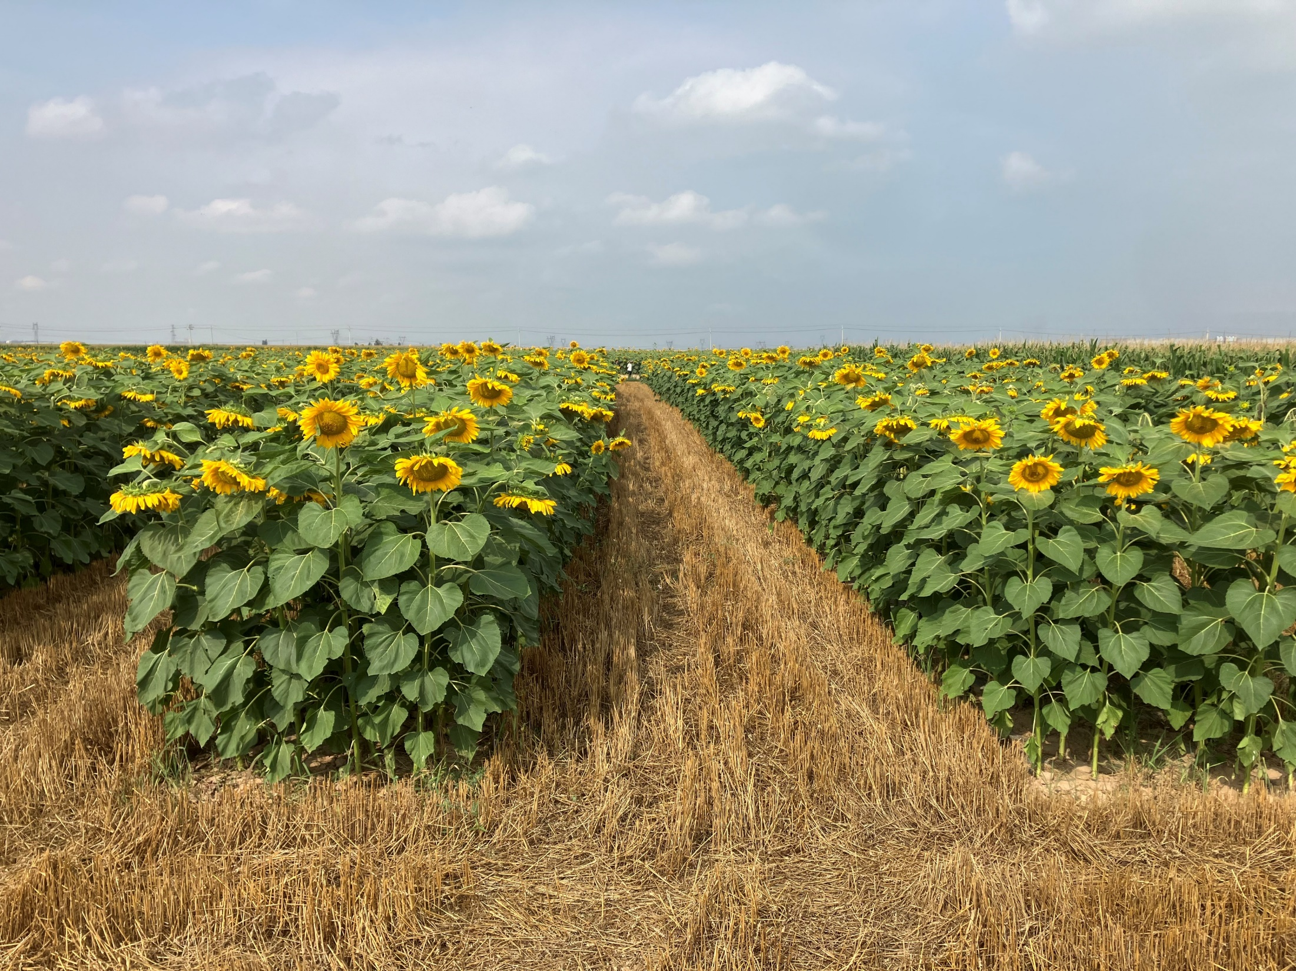
There is an incredible diversity of systems
Wheat-sunflower (Hanging Houqi)

Slide 12
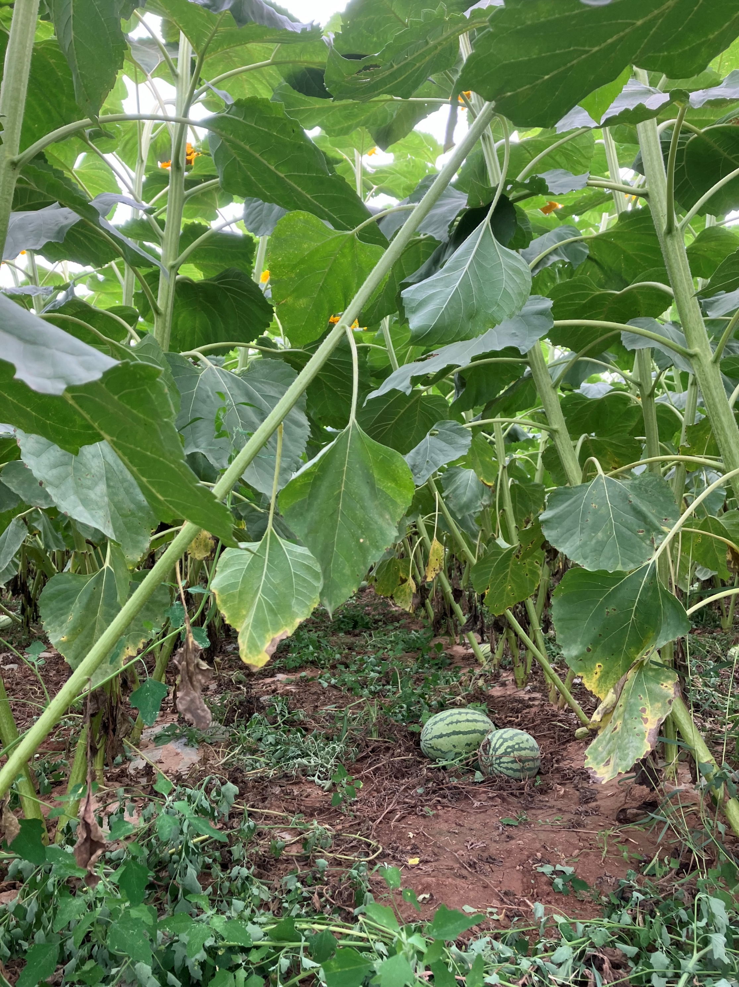
There is an incredible diversity of systems
Watermelon-sunflower (Hanging Houqi)

Slide 13
Adoption of intercropping
Not widespread in modern agriculture
More prevalent in smallholder agriculture in the global south
Smallholder farmers use intercropping to fully utilize their land, and increase food production (LER) and income
But many types of intercrop are difficult to mechanize (key challenge) or market (supply chain)
Survey in China indicated 2% intercropping, 3% agroforestry (Hong et al., 2017)
Why study intercropping?: potential contribution to making agriculture more sustainable
Agriculture, Ecosystems and Environment 244 (2017) 52–61

Slide 14
Intercropping has high land use efficiency (LER)
It can improve the capture of resources (N) and it can suppress pests, diseases and weeds
It improves N cycling in agricultural systems
But is it more productive than the most productive sole crop in the mixture (e.g. maize)?
In other words: does intercropping show transgressive overyielding?

Slide 15
Metrics for comparing the productivity of intercrops and sole crops
Land equivalent ratio (Mead & Willey, 1980)
Net Effect Ratio (Cardinale et al. 2007)
Transgressive overyielding index (Cardinale et al. 2007)

Slide 16
The three metrics measure different things
Land equivalent ratio (LER): How much land do sole crops and intercrops require for the same product output? This metric recognizes that we may require to have the product of a less productive species
Net effect ratio (NER): What is the total production in a mixture (e.g. total grain, total energy, total protein) in comparison to the expected total production in that mixture? Expected is a weighted average of the sole crops. This metric compares the total aggregate output of the intercrop and the average of the two sole crops (bulk)
Transgressive overyielding index (TOI): does the intercrop have greater total production than the most productive sole crop? This metric compares the total aggregate output of the intercrop and the best of the sole crops (bulk)

Slide 17
Land equivalent ratio (LER)
How much land do sole crops and an intercrop require for the same product output?
$$LER=pLER_{1}+pLER_{2}=\frac{Y_{1}}{M_{1}}+\frac{Y_{2}}{M_{2}}=RY_{1}+RY_{2}$$
Y₁: yield of species 1 in the intercrop
M₁: yield of species 1 in the sole crop
Y₂: yield of species 2 in the intercrop
M₂: yield of species 2 in the sole crop
$RY_{1}=Y_{1}/M_{1}$ is the relative yield of species 1
${RY_{2}=Y}_{2}/M_{2}$ is the relative yield of species 2
The relative yields are also the partial land equivalent ratios; these represent the relative areas of monocrop required to give the intercrop production of a species

Slide 18
Net effect ratio (NER)
What is the total production in a mixture (e.g. total grain, total energy, total protein) in comparison to the expected total production in that mixture? Expected is a weighted average of the sole crops.
$$NER=\frac{Y_{1}+Y_{2}}{{p_{1}M}_{1}+p_{2}M_{2}}$$
$Y_{1}+Y_{2}$ is the total yield in the intercrop
$p_{1}M_{1}+p_{2}M_{2}$ is the expected total yield in the intercrop
$p_{1}$ and $p_{2}$ are the species shares in the intercrop
Species shares are well defined in replacement intercrops but not well defined in additive intercrops
The NER compares actual yield to an expectation (a weighted average of sole crops yields)

Slide 19
Transgressive overyielding index (TOI)
Does the intercrop have greater total production than the most productive sole crop?
$$TOI=\frac{Y_{1}+Y_{2}}{max⁡(M_{1},M_{2})}$$
The TOI compares actual total intercrop yield to the yield of the most productive sole crop
Note that calculation of the NER and TOI requires that the species yields are expressed in the same unit, e.g. kg grain/ha, Joules/ha or kg protein per ha. Calculation of the LER does not require this.

Slide 20
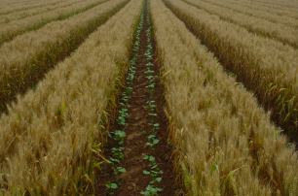
Example of the land equivalent ratio
6000 kg/ha
60%-70%
Lizhen Zhang
Wheat
$$M_{1}$$
1125 kg/ha
60%-80%
Productivity and resource use in cotton and wheat relay intercropping
Wheat
$$Y_{1}$$
Lint
$$M_{2}$$
Lint
$$Y_{2}$$
Lizhen Zhang
Sole wheat
Sole cotton
Intercrop

Slide 21
Land equivalent ratio
Land equivalent ratio: relative area of land required when using sole crops to obtain the yield that is obtained in a unit area that is intercropped
$$LER=pLER_{1}+pLER_{2}=\frac{Y_{1}}{M_{1}}+\frac{Y_{2}}{M_{2}}$$
~ 0.7 ha of sole wheat
1 ha of wheat-cotton Intercrop
=
~ 0.7 ha of sole cotton

Slide 22
Graphical illustration of the calculation of the land equivalent ratio (LER), net effect ratio (NER) and transgressive overyielding index (TOI) from the yields per ha of maize (yellow) and soybean (green) in an intercrop and in the sole crops.
https://doi.org/10.1073/pnas.2201886120

Slide 23
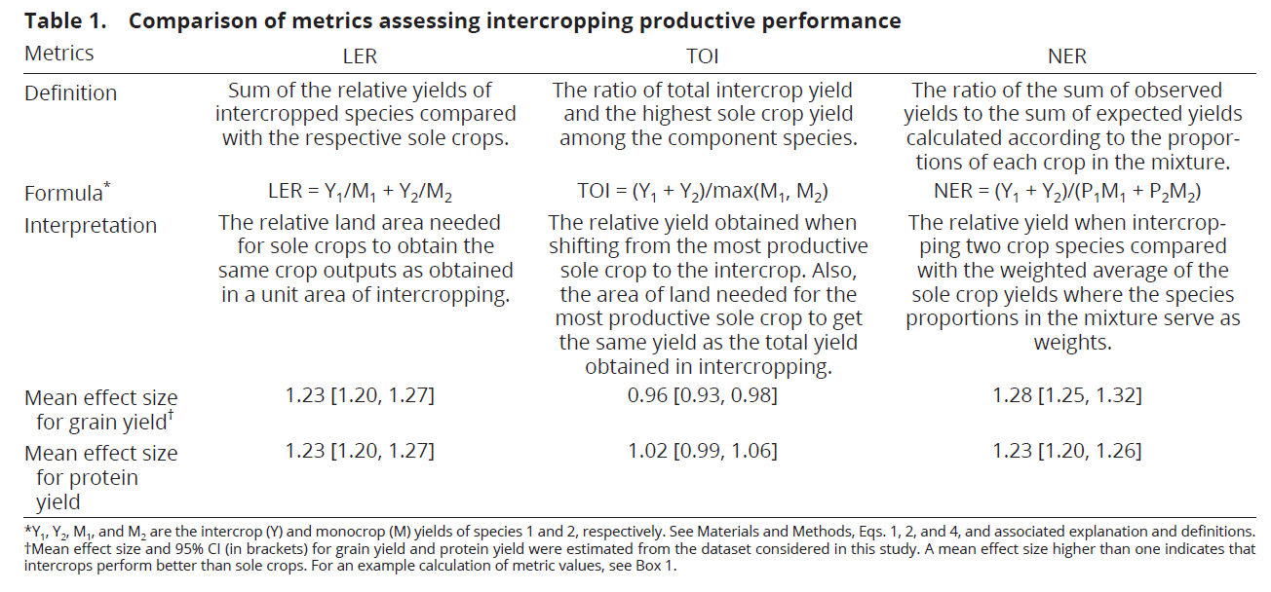
Results of meta-analysis

Slide 24
Key findings (1)
The average LER was 1.23 [1.20-1.27]. It means that intercropping saves 100*(1.23-1)/1.23 = 19% land compared to sole crops for equal product output.
The average NER was 1.28 [1.25-1.32]. It means that intercrops had 28% higher productivity than would be expected if the intercrop would yield a simple weighted average of the sole crops. Intercrops produce more, often because the more productive species exceeds expectation or because of temporal complementarity and because the less productive species does not fully exploit the resources.
The average TOI was 0.96 [0.93-0.98]. It means that the intercrop produces almost as much as the most productive sole crop in the same experiment.

Slide 25
Key findings (2)
The average TOI for grain or energy production per unit N fertilizer was 1.11 [1.02-1.20]. It means that intercrops had greater N use efficiency than the most N-use efficient sole crop.
The average TOI for protein production per unit N fertilizer was 1.06 [0.97-1.15]. It means that the intercrop produced as much protein per unit N fertilizer as the most N-use efficient sole crop, with a tendency (not significant) to produce more per unit N fertilizer.

Slide 26
Overall conclusion
Intercropping is a superior land use to produce a diversity of products on a farm because it can concentrate the production on less land
But intercrops are not clearly superior in productivity to the most productive sole crop
For instance, growing sole maize may be the most productive way to obtain animal feed. But it will not be the most sustainable way.
However, using species mixtures is superior to using sole crops if we want to grow less productive sole crops anyhow to have a diversity of food and feed, and because we want to benefit more from biological N fixation
These conclusions were obtained by meta-analysis of literature data (226 experiments)

Slide 27
wopke.vanderwerf@wur.nl

Slide 28
Benefits of intercropping
Better resource capture and more efficient use of land
Almost as good as the most productive and most efficient sole crop (TOI almost one)
Thus: increases yield at the farm level, even if the yield at the crop level is diversified but not necessarily increased
Often: combine species with partially overlapping growing periods in relay intercrops
Allows reducing inputs if desired
Provides other ecosystem services: disease and pest control, soil formation (organic matter)

Slide 29
Principles for productive and resource use efficient intercropping (speculation)
Potential growing conditions: difference in growing period (temporal complementarity) allows increased light and nutrient capture compared to sole crops
N-limited growing conditions: cereal/legume intercropping
Micro-nutrient shortages: facilitation mechanisms, e.g. maize/peanut for peanut on Fe-deficient soils
Water-limited growing conditions: one species can access water that another species cannot or does not, or not at the same time (perennial/annual mixtures) or when the available water meets the average demand of the species but not the demand of the species with the highest demand.
https://doi.org/10.1016/bs.agron.2019.10.002

Slide 30
Challenges
Need to learn what intercropping system is good for each place, production situation and type of farmer (full time/part time, small farm/large farm, market or non-market). Need to optimize species combination and management: G*G*E*M.
For strip intercropping: mechanization for narrow strips. Consider the labour use efficiency (not high)
Robots?
For full mixtures: consider the separation of grains or the use of mixed product (e.g. maize/legume silage for animal feed)
Varieties that are suitable for intercropping, e.g. more shade tolerant soybean and peanut

Slide 31
Challenges
With decreasing rural populations and farm scale enlargement, the farmer’s time to do intercropping will diminish. Mechanisation is key.
Smallholder farmers are very interested in intercropping but farmers on larger farms are only interested if intercropping can be done quickly and efficiently.
Key challenges in sowing, harvesting, processing, weeding

Slide 32
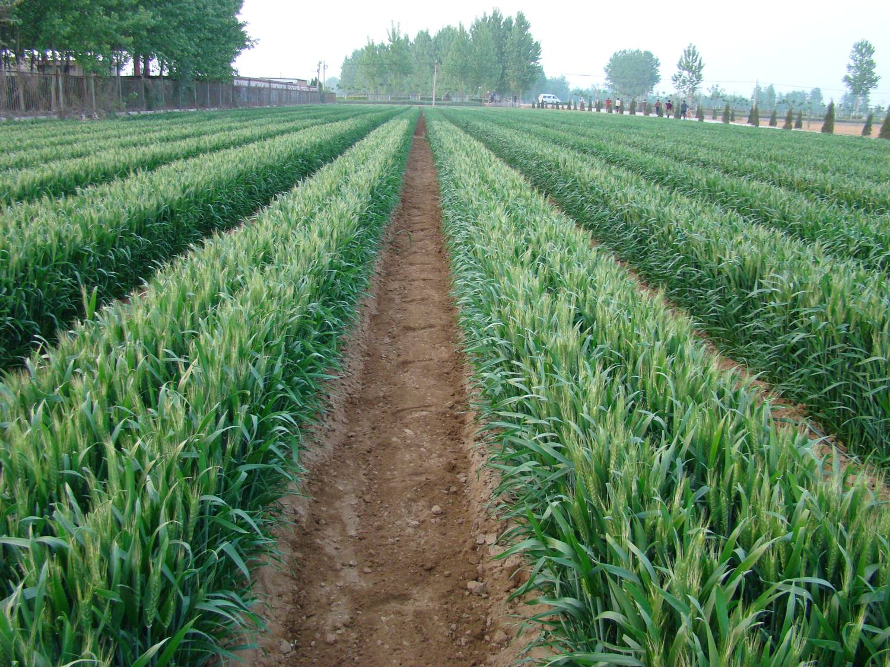
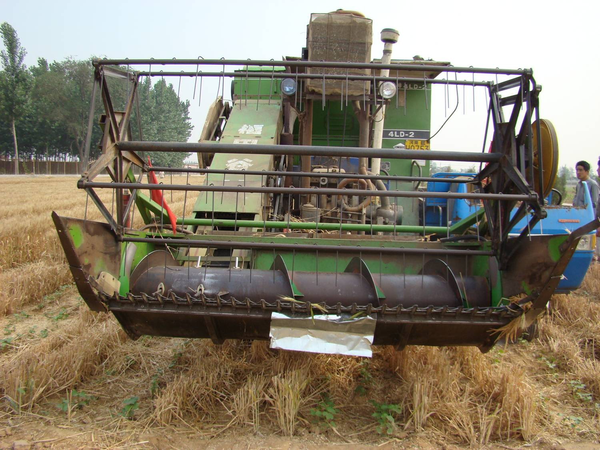
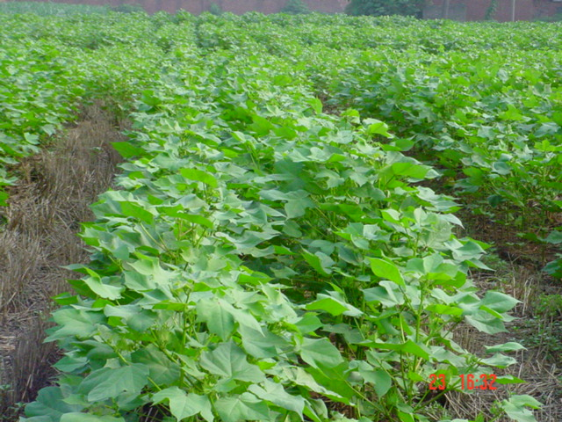

Slide 33
Strip cropping in the Netherlands

Slide 34
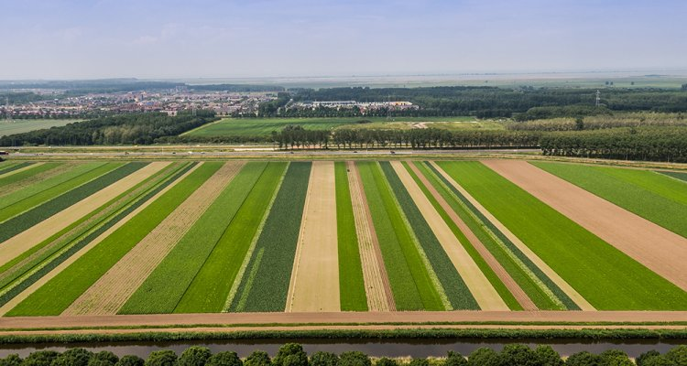

Slide 35
Cited references (chronological)
Yu Y, Stomph TJ, Makowski D, van der Werf W (2015) Temporal niche differentiation increases the land equivalent ratio of annual intercrops: a meta-analysis. Field Crops Research 184, 133–144. http://dx.doi.org/10.1016/j.fcr.2015.09.010
Yu Y, Stomph TJ, Makowski D, Zhang L, van der Werf W (2016) A meta-analysis of relative crop yields in cereal/legume mixtures suggests options for management. Field Crops Research 198: 269-279. http://dx.doi.org/10.1016/j.fcr.2016.08.001
Yu Y, Makowski D, Stomph TJ, van der Werf W (2016) Robust increases of land equivalent ratio with temporal niche differentiation: a meta-quantile regression. Agronomy Journal 108 (6): 2269-2279. http://dx.doi.org/10.2134/agronj2016.03.0170
Xu Z, Li CJ, Zhang CC, Yang Y, van der Werf W, Zhang FS (2019) Intercropping maize and soybean increases efficiency of land and fertilizer nitrogen use; A meta-analysis. Field Crops Research 246 (2020) 107661. http://dx.doi.org/10.1016/j.fcr.2019.107661
Feng C, Sun ZX, Zhang L, Feng LS, Zheng JM, Bai W, Gu CF, Wang Q, Xu Z, van der Werf W (2021) Maize/peanut intercropping increases land productivity: A meta-analysis. Field Crops Research ###: 108308 http://dx.doi.org/10.1016/j.fcr.2021.108208
Li CJ, Hoffland E, Kuyper ThW, Yu Y, Li HG, Zhang CC, Zhang FS, van der Werf W (2020) Yield gain, complementarity and competitive dominance in intercropping in China: A meta-analysis of drivers of yield gain using additive partitioning. European Journal of Agronomy 113: 125987. http://dx.doi.org/10.1016/j.eja.2019.125987
Li CJ, Hoffland E, Kuyper Th W, Yu Y, Zhang CC, Li HG, Zhang FS, van der Werf W (2020) Syndromes of production impact yield gains in intercropping. Nature Plants 6, 653–660. http://dx/doi.org/10.1038/s41477-020-0680-9
Makowski D, Piraux F, Brun F (2019) From Experimental Network to Meta-analysis. Springer. Edition Quae, 155 pp. https://www.springer.com/gp/book/9789402416954
Tang XY, Zhang CC, Yu Y, Shen JB, Zhang FS, van der Werf W (2021) Intercropping legumes and cereals increases phosphorus use efficiency; a meta-analysis. Plant and Soil 460: 89–104 http://dx.doi.org/10.1007/s11104-020-04768-x

