Slide 1
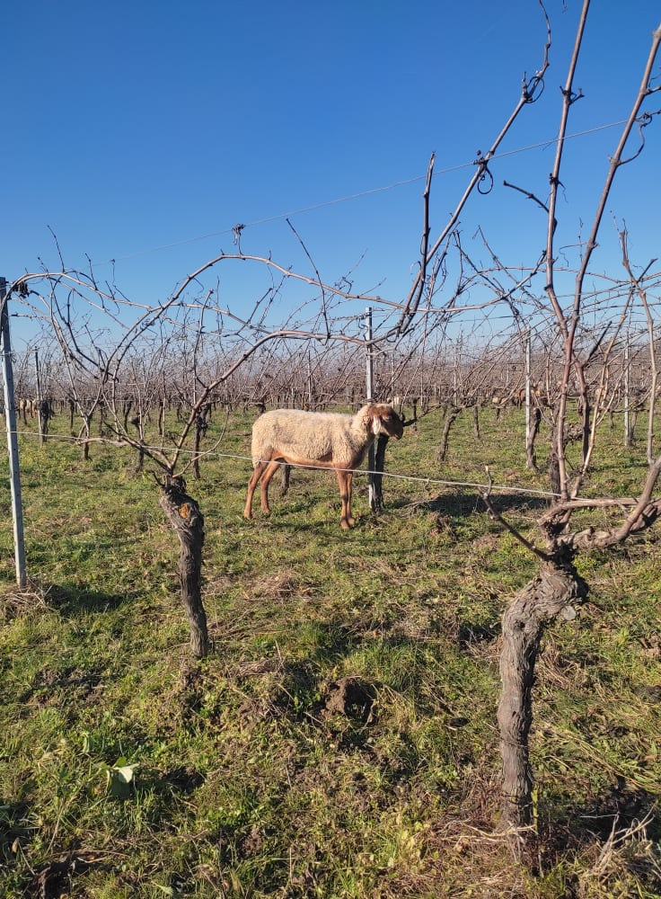
1
Reintegrating livestock onto crop farms
A step towards sustainability?
Clémentine Meunier
Guillaume Martin, Julie Ryschawy
28/08/2024

Slide 2
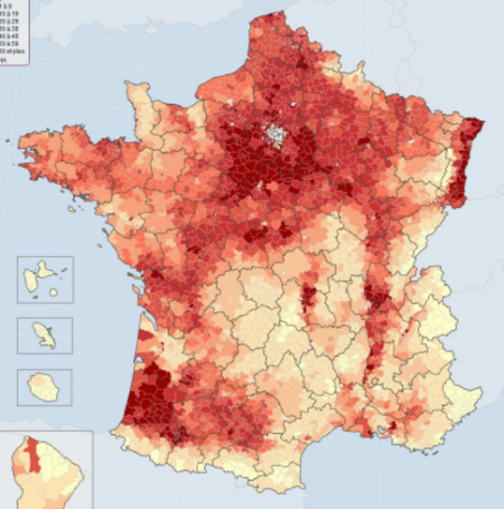
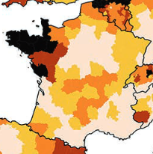
An ongoing disconnection between crop and livestock production
2
At the farm level
At the regional level
Grain crops (% UAA)
LU / ha
Mixed farms
Specialized crop or livestock farms
(MAAF – 2012 – IGN Géo Fla 2010 – Agreste – Recensement agricole 2010 / Traitement INRA SMART – LERECO)
(Eurostat 2010 - Traitement RMT Economie des filières animales)
Farms (% of french Farms) | 1988 | 2020
Mixed | 19 % | 12 %
Crops | 37 % | 52 %
Livestock | 44 % | 36 %
(AGRESTE, 2020 ; Garrett, 2020 ; Lemaire, 2014 ; Martin, 2016 ; Veysset, 2014 )

Slide 3
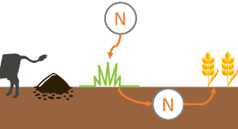
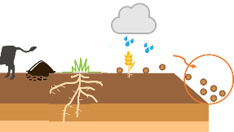
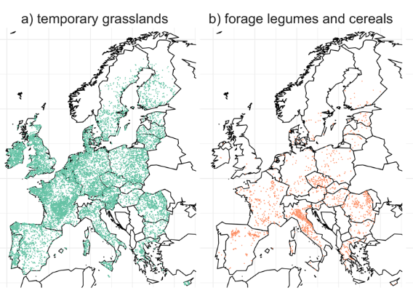
A specialization coming with high environmental impacts
3
A decrease of fodder legumes in crop rotations
Depriving specialized crop farms from the ecosystem services provided by fodder legumes and animals
Nitrogen fixation and supply
Soil quality improvement
Biodiversity and improved pest and weed control
Increased reliance on direct and indirect energy and nutrients
Increased reliance on feed inputs
Excessive amount of manure
Contributing to disturbance of biogeochemical flows, water pollution, biodiversity loss, climate change
(Ballot, 2023 ; Lassaletta, 2014 ; Peterson, 2020)

Slide 4
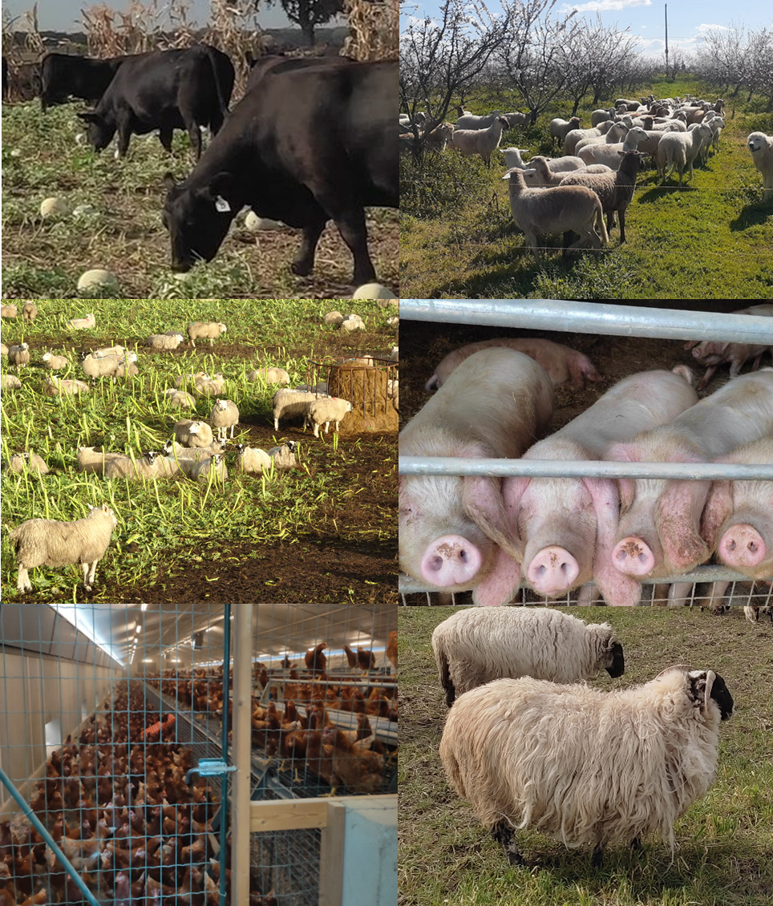
Bucking the trends of specialization and livestock regression, some crop farmers are … Reintegrating Livestock
4

Slide 5
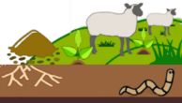
Sustainable or not sustainable, that is the question
5
Systems integrating crop and livestock enterprises are often thought to be sustainable
Farms having reintegrated livestock have been understudied by research to date
Livestock production is highly criticized for its environmental impacts
One of crop farmers’ main motivation for reintegrating livestock is the provision of ecosystem services
Need to determine the extent to which reintegrating livestock can improve the agroenvironmental dimension of crop farm sustainability
Characterizing changes in farming practices related to reintegrating livestock on crop farms and estimating their agroenvironmental impacts
(Meunier, 2024 ; Ryschawy, 2021 ; Torpman, 2024)

Slide 6
15 farmers having reintegrated livestock in various farming systems identified through innovation tracking
6
Mostly organic farming
4 crop types
2 livestock types
10 certified (+1)
Grain crops (10), orchards (3), vineyards (2), vegetables (1)
Free-range poultry : laying hens (4), broilers (1)
Sheep : for meat (9), for wool (1)
Always in fully outdoor systems except fattening lambs
Reintegration at several levels
With a wide range of farm size and number of animals reintegrated
And different duration since reintegration
Farm UAA : From 5 to 2000 ha
Farm level (5 poultry, 5 sheep)
2 to 25 years ; M = 6.6 years, med = 5 years
Regional level (4 sheep)
Reintegrating 200 laying hens ;
15 000 fattening lambs ;
850 hosted ewes
Both (1 sheep)
Interviews with 15 farmers
Characterize changes in farming practices and estimate the related agroenvironmental impacts
(Salembier, 2021)

Slide 7
Estimating the agroenvironmental impacts of change in farming practices beyond reintegrating livesotck
7
Reasons for choosing these indicators
3 agroenvironmental indicators
Sensitive to changes in farming practices related to reintegrating livestock
Aligned with the main advantages of integrated crop-livestock systems and farmers’ motivations to reintegrate livestock
Easy data collection and explanation to farmers
Nitrogen surplus
Nitrogen input, output, storage
Choices made for calculations
Energy consumption
Direct and indirect
Focus on changes before / after reintegrating livestock
Greenhouse gas emission
and carbon storage
Emissions from mechanization, electricity, inputs, animal presence, mechanized fertilizer spreading
Storage through conversion of cropland into pasture, planting trees
Farm reintegrating livestock
at the farm or regional level
Specialized crop farm
Calculations at farm gates on a yearly basis
Equations and coefficients from IDEA4
(Zahm, 2019, 2023)

Slide 8
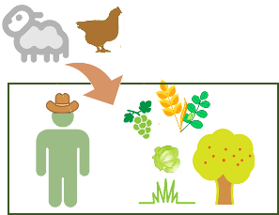
Reintegrating livestock may generate high environmental impacts…
8
Nitrogen surplus changes
Energy consumption changes
Greenhouse gas emission changes
+ 16 ± 27
+ 6 837 ± 14 430
+ 0.83 ± 1.7
Impacts on farms in the sample
(All livestock, n=15)
… According to the main features of livestock reintegration
Means for reference specialized crop farms
35
13 425 ; 21 480
2.25 ; 0.75

Slide 9
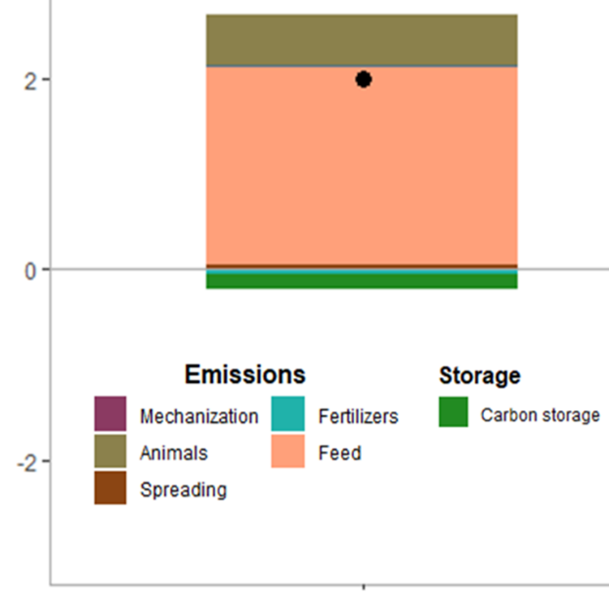
High environmental impacts for poultry reintegration in highly integrated value chains
9
Main motivation
Greenhouse gas emission changes
Nitrogen surplus changes
+ 43 kgN/ha
Increasing economic sustainability
Energy consumption changes
+ 21 047 MJ/ha
Specialized crop farm reintegrating poultry
Highly integrated value chains
Low adaptations
Greenhouse gas emission changes
+2.46 t CO₂ eq /ha
High reliance on feed input
Fear, lack of knowledge and equipment
No fertilization strategy change
Limited introduction of pastures

Slide 10
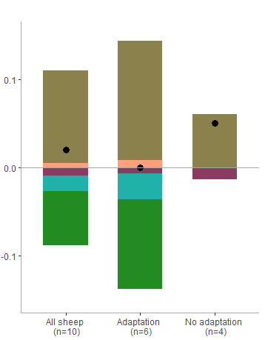
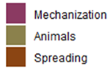
Lower environmental impacts for sheep reintegration, depending on the adaptations made
10
Subsequent adaptations (n=6)
Low adaptations (n=4)
Greenhouse gas emission changes
+ 0.01 ± 0.08
Nitrogen surplus changes
+ 2 kgN/ha
+ 0.02 ± 0.08
Specialized crop farm reintegrating sheep
+ 0.05 ± 0.08
Main motivation
+ technical challenge
Ecosystem service promotion
Energy consumption changes
-268 MJ/ha
Sheep as part of the system
Sheep as mowers
Reduction of mechanization
Reduction of mechanization
Conversion of cropland into pastureland and increased legume share in cover crops
Greenhouse gas emission changes
+0.02 t CO₂ eq /ha
Reduction of fertilizer inputs

Slide 11
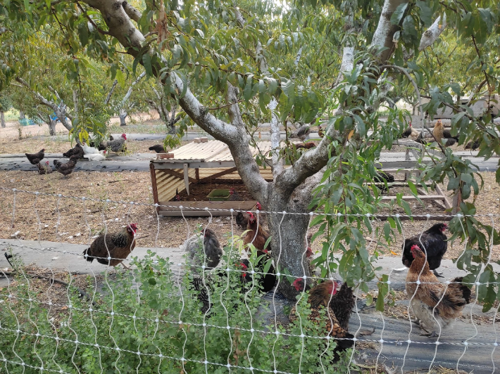
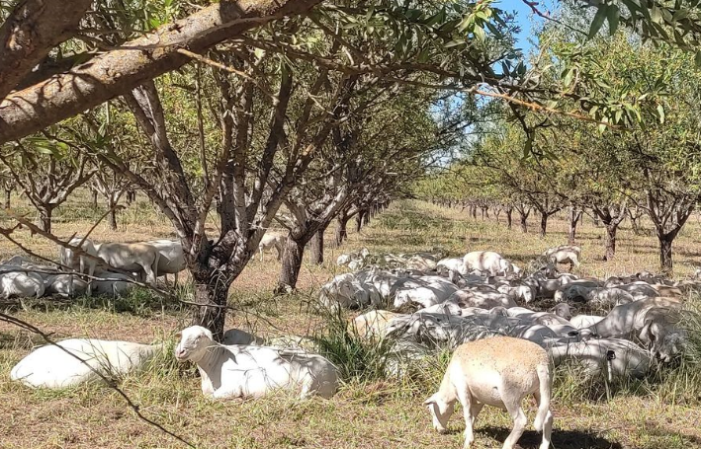
Key take home messages
11
The question of the sustainability of livestock reintegration is not straight to answer
It depends on the changes made in farming practices, themselves conditioned by farmers’ motivations, sociotechnical contexts and emerging opportunities
If subsequent adaptations of the cropping system are made to promote synergistic interactions between crop and livestock enterprises, reintegrating livestock onto specialized crop farms can be a sustainable option for livestock farming in the future
Further quantification of the impacts of reintegrating livestock on farm sustainability is needed to support their scaling up

Slide 12
12
Thank you for your attention
Clémentine Meunier
clementine.meunier@inrae.fr
28/08/2024

Slide 13
A few references (1/2)
13
AGRESTE, 2020. Recensement Général Agricole.
Ballot, R., Guilpart, N., Jeuffroy, M., 2022. The first map of dominant crop sequences in the European Union over 2012-2018. Earth Syst. Sci. Data 1–26.
Garrett, R.D., Ryschawy, J., Bell, L.W., Cortner, O., Ferreira, J., Garik, A.V.N., Gil, J.D.B., Klerkx, L., Moraine, M., Peterson, C.A., Dos Reis, J.C., Valentim, J.F., 2020. Drivers of decoupling and recoupling of crop and livestock systems at farm and territorial scales. Ecol. Soc. 25. https://doi.org/10.5751/ES-11412-250124
Lassaletta, L., García-Gómez, H., Gimeno, B.S., Rovira, J. V., 2009. Agriculture-induced increase in nitrate concentrations in stream waters of a large Mediterranean catchment over 25 years (1981-2005). Sci. Total Environ. 407, 6034–6043. https://doi.org/10.1016/j.scitotenv.2009.08.002
Lemaire, G., Franzluebbers, A., Carvalho, P.C. de F., Dedieu, B., 2014. Integrated crop-livestock systems: Strategies to achieve synergy between agricultural production and environmental quality. Agric. Ecosyst. Environ. 190, 4–8. https://doi.org/10.1016/j.agee.2013.08.009
Martin, G., Moraine, M., Ryschawy, J., Magne, M.A., Asai, M., Sarthou, J.P., Duru, M., Therond, O., 2016. Crop–livestock integration beyond the farm level: a review. Agron. Sustain. Dev. 36. https://doi.org/10.1007/s13593-016-0390-x
Meunier, C., Martin, G., Barnaud, C., Ryschawy, J., 2024. Bucking the trend : Crop farmers ’ motivations for reintegrating livestock. Agric. Syst. 214. https://doi.org/10.1016/j.agsy.2023.103820

Slide 14
A few references (2/2)
14
Peterson, C.A., Deiss, L., Gaudin, A.C.M., 2020. Commercial integrated crop-livestock systems achieve comparable crop yields to specialized production systems: A meta-analysis. PLoS One 15, 1–25. https://doi.org/10.1371/journal.pone.0231840
Ryschawy, J., Tiffany, S., Gaudin, A., Niles, M.T., Garrett, R.D., 2021. Moving niche agroecological initiatives to the mainstream: A case-study of sheep-vineyard integration in California. Land use policy 109. https://doi.org/10.1016/j.landusepol.2021.105680
Salembier, C., Segrestin, B., Weil, B., Jeuffroy, M., Cadoux, S., 2021. A theoretical framework for tracking farmers ’ innovations to support farming system design. Agron. Sustain. Dev. 41:61. https://doi.org/10.1007/s13593-021-00713-z
Torpman, O., Röös, E., 2024. Are Animals Needed for Food Supply, Efficient Resource Use, and Sustainable Cropping Systems? An Argumentation Analysis Regarding Livestock Farming. Food Ethics 9, 1–24. https://doi.org/10.1007/s41055-024-00147-9
Veysset, P., Lherm, M., Bébin, D., Roulenc, M., 2014. Mixed crop-livestock farming systems: A sustainable way to produce beef? Commercial farms results, questions and perspectives. Animal 8, 1218–1228. https://doi.org/10.1017/S1751731114000378
Zahm, F., Barbier, J.M., Cohen, S., Boureau, H., Girard, S., Carayon, D., Alonso Ugaglia, A., Del’homme, B., Gafsi, M., Gasseli, P., Guichard, L., Loyce, C., Manneville, V., Redlingshöfer, B., 2019. IDEA4 : une méthode de diagnosticpour une évaluation clinique de ladurabilité en agriculture 39–51.
Zahm, F., Girard, S., Alonso Ugaglia, A., Barbier, J.M., Boureau, H., Carayon, D., Cohen, S., Del’homme, B., Gafsi, M., Gasselin, P., Gestin, C., Guichard, L., Loyce, C., Manneville, V., Redlingshöfer, B., Rodrigues, I., 2023. La Méthode IDEA4 – Indicateurs de durabilité des exploitations agricoles. Principes & guide d’utilisation. Évaluer la durabilité de l’exploitation agricole, Éducagri é. ed.

