Slide 1
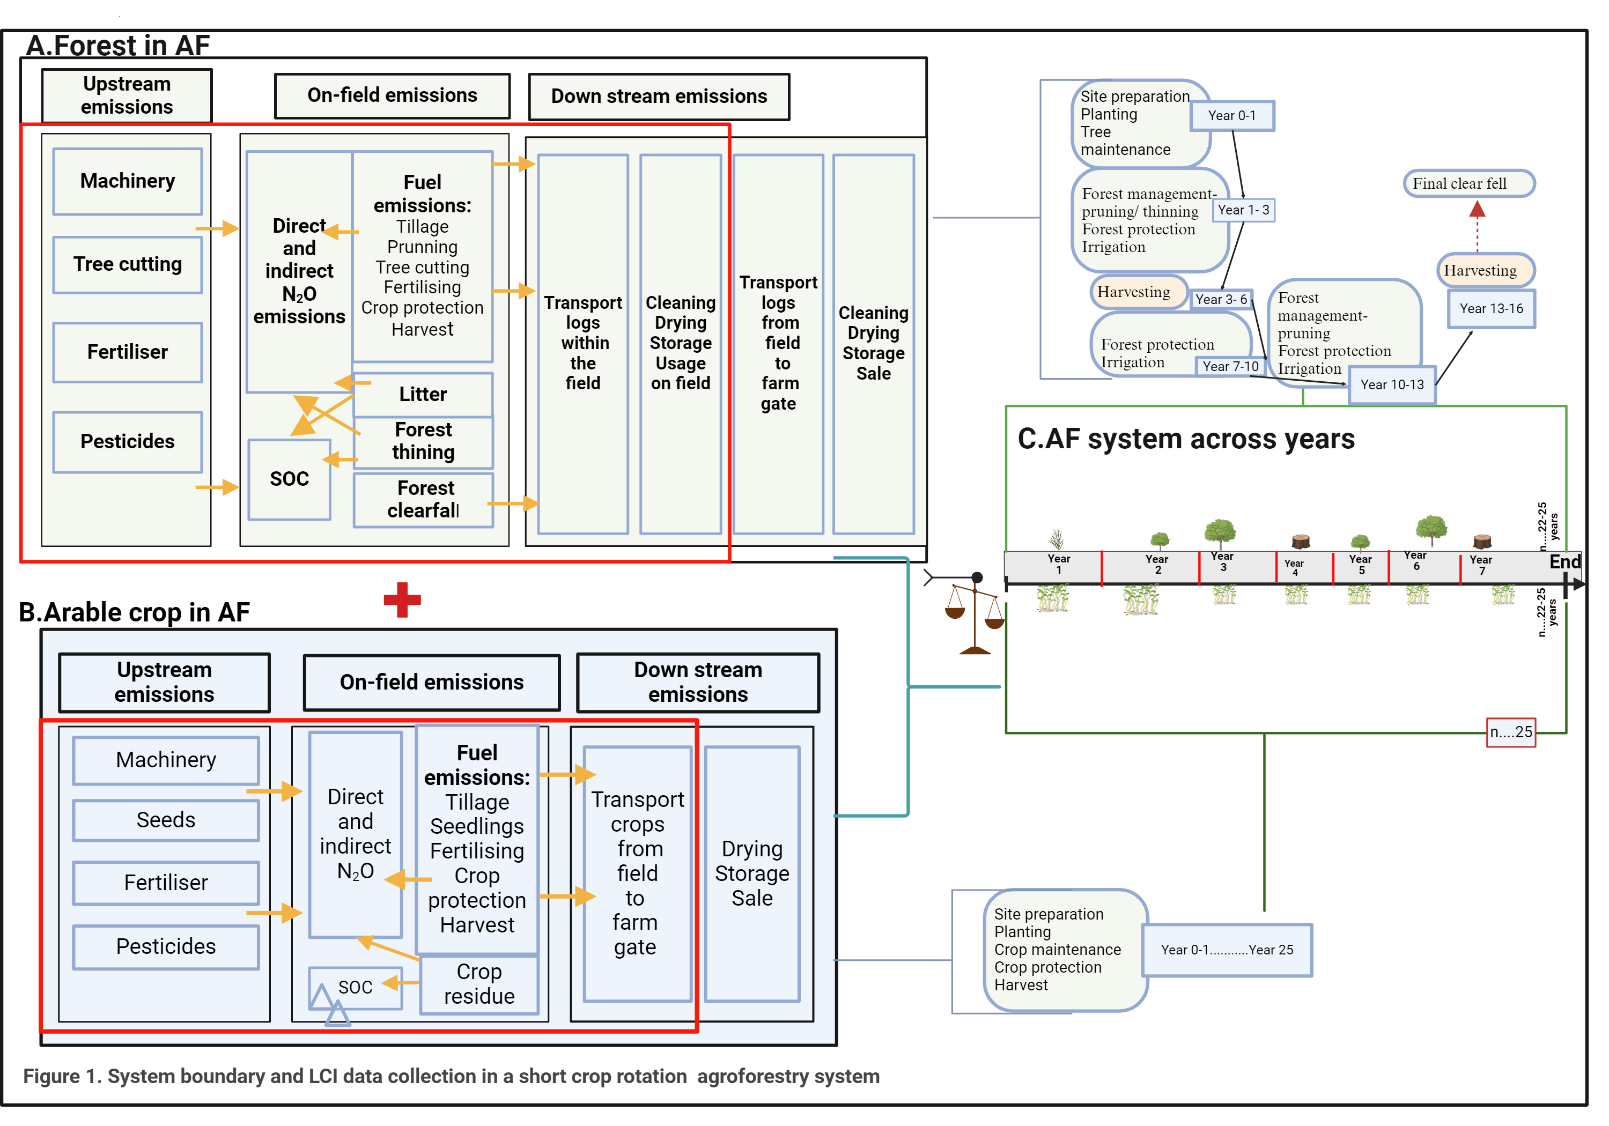
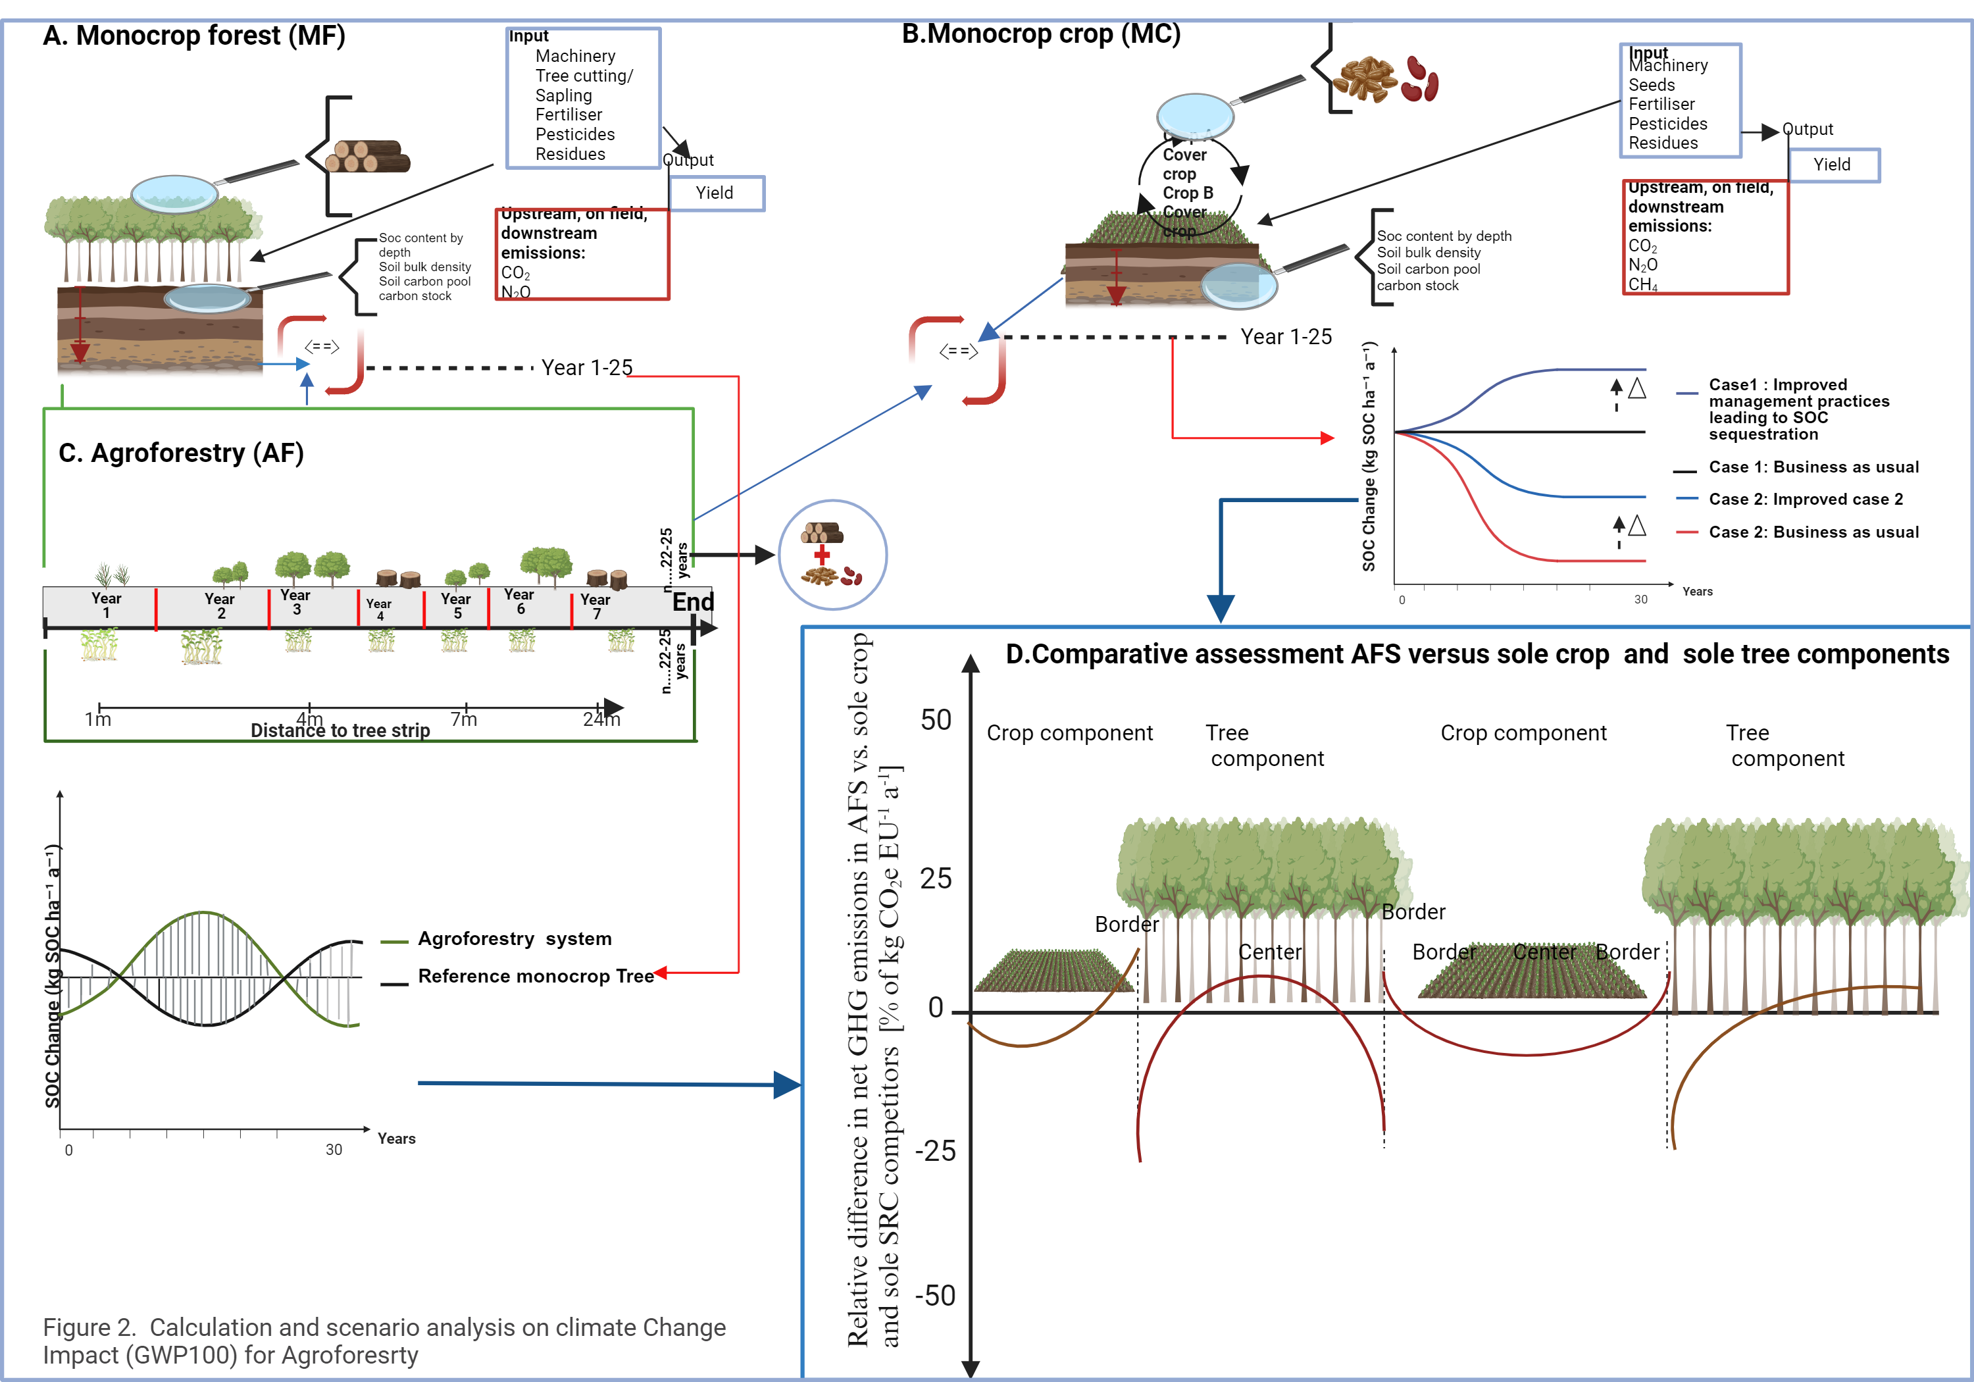
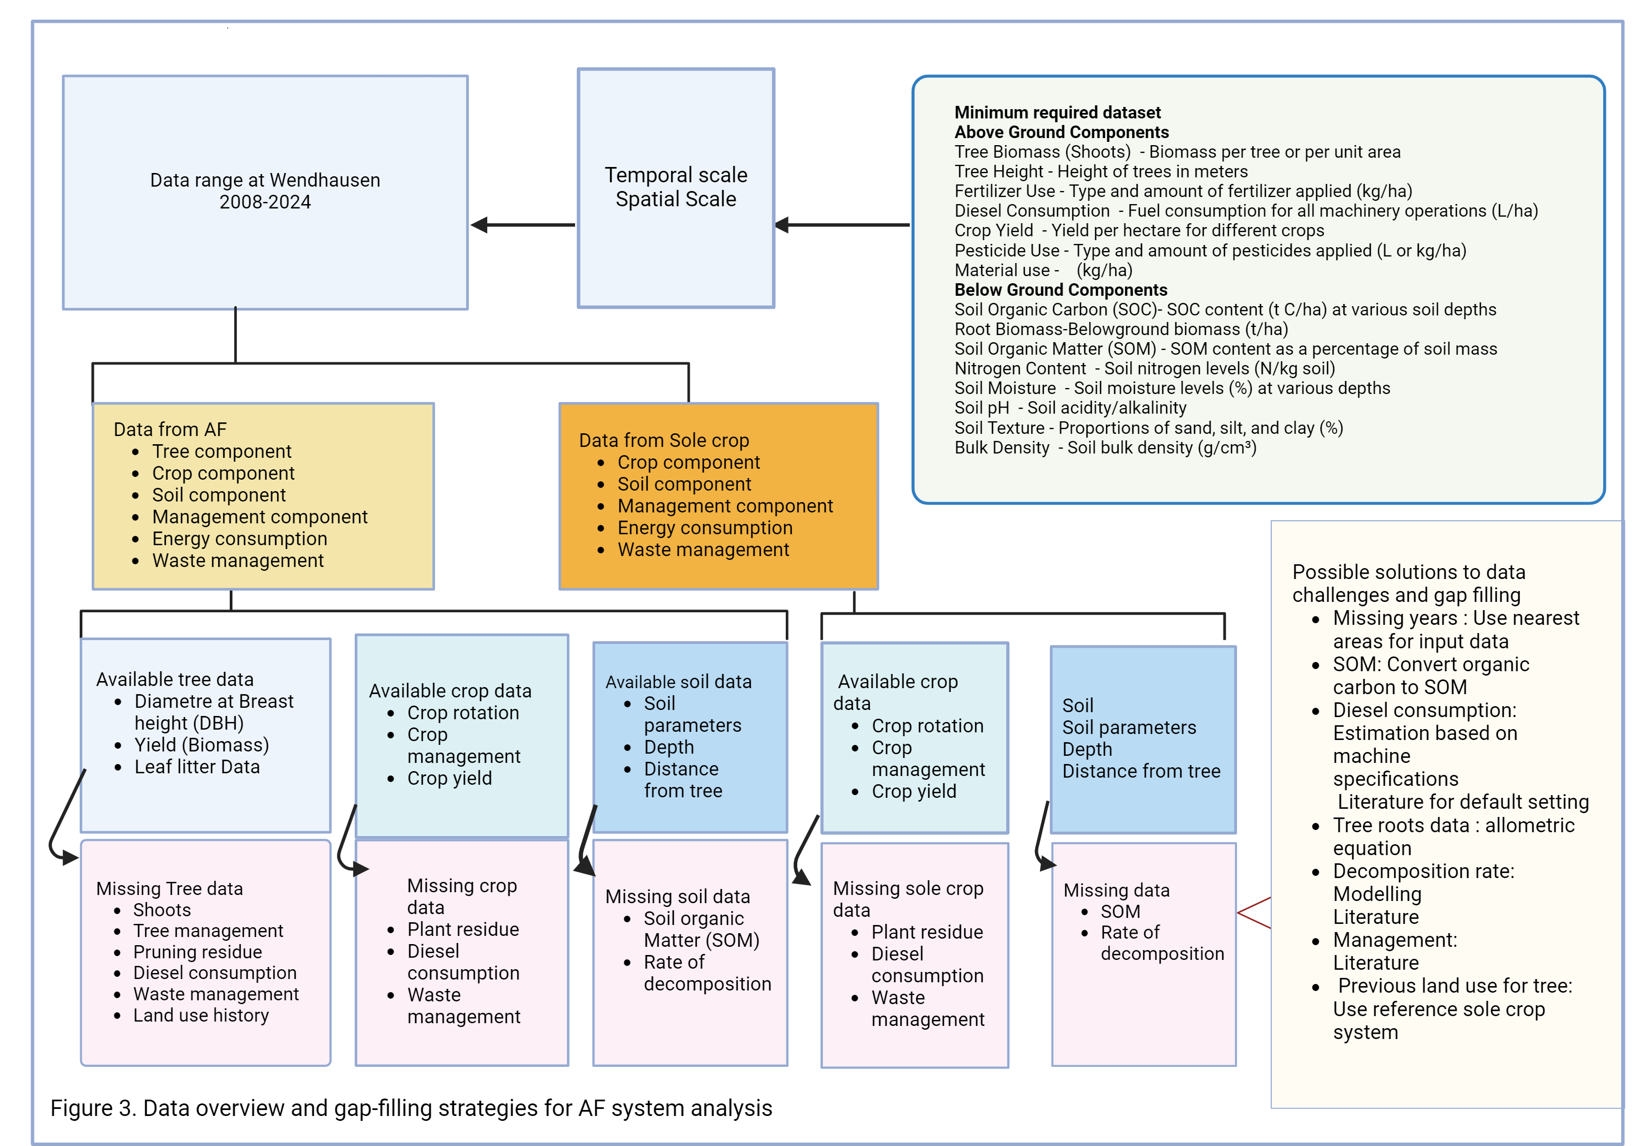
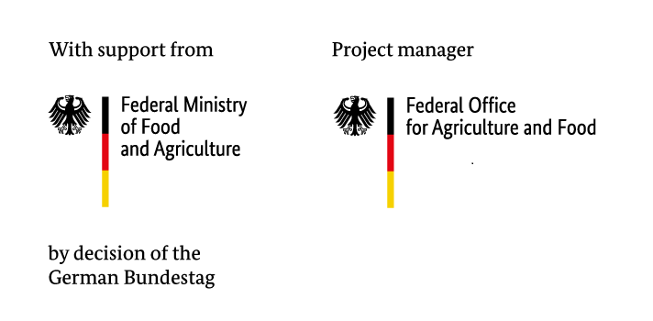
Contribution of agroforestry to climate change mitigation: a case study from Wendhausen, Germany
Priscilla N. Kephe¹, Juvenal Assou², Maren Langhof², Ahmed Kheir¹, Navid Bakhtiary^{1,} Jörn Strassemeyer¹ , Til Feike¹
¹Julius Kühn Institute, Institute for Strategies and Technology Assessment, Kleinmachnow, Germany
²Julius Kühn Institute, Institute for Crop and Soil Science, Brunswick, Germany
E-Mail: Priscilla.Kephe@julius-kuehn.de
Introduction
Knowledge about SRC's role in climate change mitigation within agroforestry is limited.
This study quantify the net GHG emissions per hectare and per unit product in the AFS in Wendhausen.
Compares these emissions with those from sole cropping and sole SRC system
Materials and methods
The study site is in Wendhaussen, Northern Germany.
The study compares an AFS with nine tree strips to a 3-hectare control field
Two functional units (FU) (Figure 2) are used :
1.Total GHG emissions per hectare (GHGL):
Total GHGL (kg CO₂e ha⁻¹) = Upstream emissions (kg CO₂e ha⁻¹) + On-field emissions (kg CO₂e ha⁻¹) + Downstream emissions (kg CO₂e ha⁻¹)………………………….(1)
2. Carbon footprint per unit product (CFP): CFP (kg CO2e kg−1)=
Total CFP (kg CO₂e ha⁻¹ ) = $\frac{Total GHGL}{Yield}\left(\frac{{kg CO2e ha}^{−1}}{MT {ha}^{−1}}\right)$……………………....(2)
Net GHG emissions quantified per ha and unit product (i.e., per grain unit (GU) and energy unit (EU))
Outlook
Comparative assessment of (AFS) versus sole crops on annual basis(Figure 2)
Agroforestry yields a more sustainable SOC trajectory over 30 years compared to monocrop systems.
Agroforestry boosts carbon sequestration
Challenges
Data Limitations (Figure.3):
Limited spatial and temporal coverage
Inadequate Data Formats
Missing Data
Data accessibility
Change of scope in data collection in long term experiments
Conclusion
Measure all measurable component of the system
Use intergrated approaches for complete assessment
References
DIN, E. (2009). 14040: Umweltmanagement–Ökobilanz–Grundsätze und Rahmenbedingungen. DIN: Berlin, Germany.
Swieter, A., Langhof, M., Lamerre, J., & Greef, J. M. (2019). Long-term yields of oilseed rape and winter wheat in a short rotation alley cropping agroforestry system. Agroforestry Systems, 93, 1853-1864.
Acknowledgement : This research is funded by the German Federal Ministry of Food and Agriculture (BMEL) in the frame of the KlimAF project (FKZ 2822KLI006)
Poster ID #359

