Slide 1
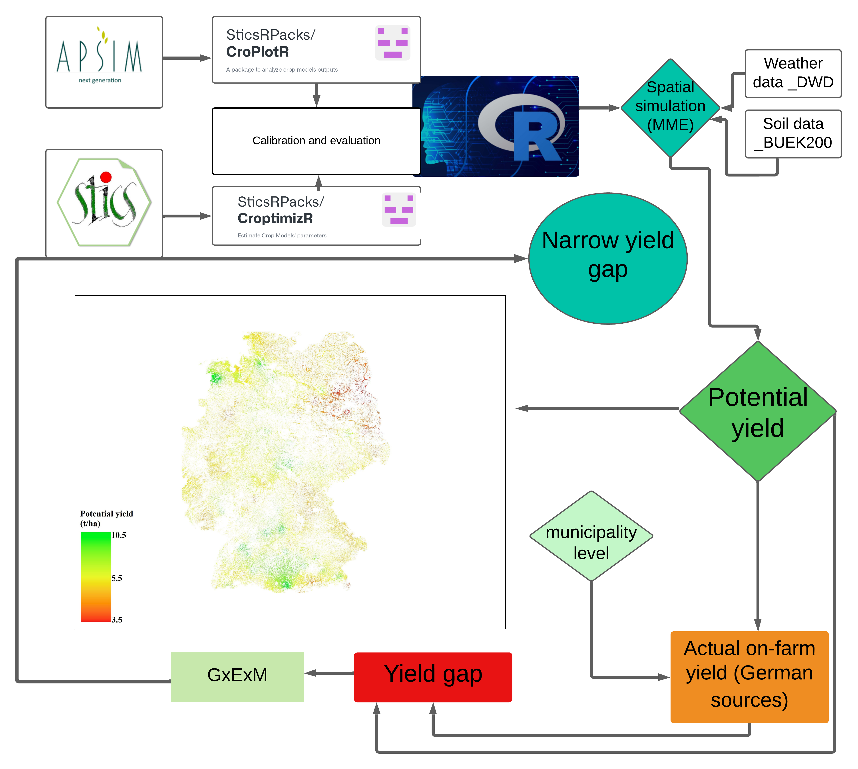
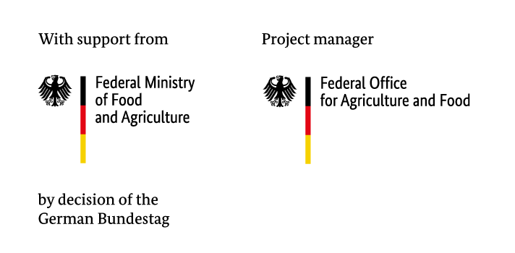
Yield gap assessment of spring barley over Germany using STICS and APSIM Multi-Model Ensemble
Ahmed M.S. Kheir, Asmae Meziane, Ashifur Rahman Shawon, Til Feike
Julius Kühn Institute, Institute for Strategies and Technology Assessment, Kleinmachnow, Germany
E-Mail: ahmed.kheir@julius-kuehn.de
Background
Barley (Hordeum vulgare L.) ranks as one of the primary cereal crops globally, second only to bread wheat in Europe
Spring barely is especially important due to its value in crop rotations as a spring crop and due to its value for the brewing industry
Site- and climate-optimized production of spring barley is required to minimize trade-offs between productivity and sustainability in crop production
Exploring yield gaps on national scale can help to device improved production and support food security
This study presents an approach of advanced multi-model techniques to assess yield gaps in spring barley across Germany
Objectives
Precisely calibrate and validate APSIM Next Generation, STICS and DSSAT crop models for four spring barley cultivars across various regions in Germany to ensure accurate simulation of phenology, growth and grain yield
Utilize the calibrated models to simulate yield potential and phenological stages of spring barley in a spatially explicit manner, providing detailed insights across different agro-climatic regions
Quantify and explain spatial and temporal development of yield gaps by comparing actual on-farm yields with simulated potential yields
Assess reasons for yields gaps and differences between crop models
Explore strategies to narrow yield gaps by optimizing management practices, including adjusted sowing dates and cultivar selection
Preliminary Conclusions
The envisaged findings may guide targeted interventions and agronomic practices to narrow yield gaps, contributing to the sustainable intensification of barley production in Germany
Multi-model ensemble improved the accuracy of spatial simulations and reduced uncertainty rather than single model
Materials and Methods
Genotype-specific model calibration and evaluation of APSIM Next Generation and STICS for four wide-spread spring barley cultivars (Avalon, Brake, Quench, RGT Planet) using R packages CroptimizR and CroPlotR
Building on genotype-specific multi-environment (~30 locations) long-term data covering all agro-climatic regions of Germany of the “Value for cultivation and use” trials (VCU) data provided by the federal variety office.(e.g., Laidig et al., 2024)
Plus detailed phenotyping data of two year field experiments (cultivar × sowing × irrigation) in 2021 & 2022
Evaluated models are to assess yield potentials over all agro-climatic regions of Germany during 2000-2018
Test the effect of shifted sowing dates (March to April) and cultivar selection
Determine absolute and relative yield gaps considering detailed nation-wide municipality-level on-farm yield data from the Farm Accountancy Data Network (BMEL, 2023)
First Results
Calibration showed robust agreement between observed and simulated yield (80 < d) and phenology (70 <d)
APSIM and STICS effectively simulated environmental interactions, crop management practices, and cultivar differences
Potential yield ranged between 3.5-10.5 t/ha (Fig. 1) with spatial differences
Significant differences were found in potential yields among cultivars and locations
Impact of Sowing Dates: March sowing generally exhibited higher yield potential compared to April sowing, with notable variations depending on the cultivar and location.
Figure 1. Sketch of the conceptual approach for spatial simulation to potential yields and yield gap assessment over Germany using a multi-model ensemble
Next Steps
Conduct spatio-temporal analysis of potential yields, plus absolute and relative yield gaps.
Explore reasons of spatio-temporal differences in yield gaps and explore options to narrow yield gaps.
Develop a web-based decision support tool to assist farmers in making informed decisions. This tool will integrate model outputs and adaptation strategies, offering guidance on optimal management practices and genotype selection to maximize yield and minimize risks in the face of climate change.
Acknowledgements
This research is funded by the German Federal Ministry of Food and Agriculture (BMEL) in the frame of the KlmAF project (FKZ 2822KLI006); we further express our gratitude to the Plant Variety Office (Bundessortenamt) for granting access to the variety trial data.
References
Brisson et al. (2003). An overview of the crop model STICS. European Journal of Agronomy, 18, 309-332.
Buis et al. (2023). CroptimizR: A Package to Estimate Parameters of Crop Models. Zenodo.
Guilpart et al. (2017). Estimating yield gaps at the cropping system level. Field Crops Research, 206, 21-32.
Laidig et al. (2024). Breeding progress of nitrogen use efficiency of cereal crops, winter oilseed rape and peas in long-term variety trials. Theor Appl Genet 137, 45.
Holzworth et al. (2018). APSIM Next Generation: Overcoming challenges in modernising a farming systems model. Environmental Modelling & Software, 103, 43-51.
Van Ittersum et al. (2016). Can sub-Saharan Africa feed itself? PNAS, 113, 14964-14969.
Vezy et al. (2023). CroPlotR: A Package to Analyse Crop Model Simulations Outputs with Plots and Statistics. Zenodo.
BMEL, Federal Ministry of Food and Agriculture (2023). Buchführung der Testbetriebe: Grundlagen zur BMEL-Testbetriebsbuchführung: https://www.bmel-statistik.de/fileadmin/daten/BFB-0114001-2018.pdf

